Slide 1
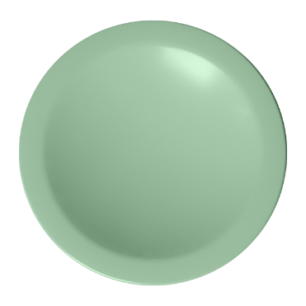
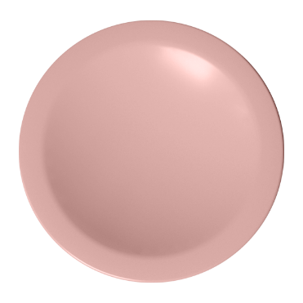
, ZED !
Workplace that inspires

Slide 2
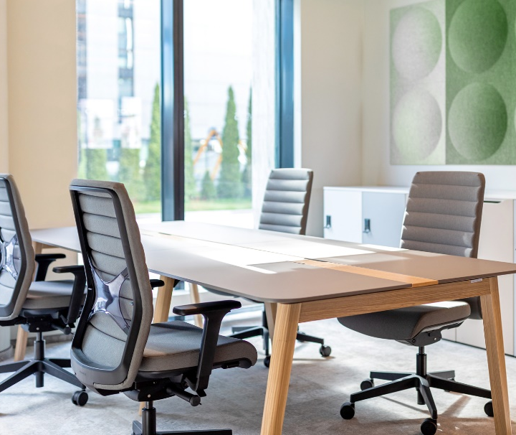
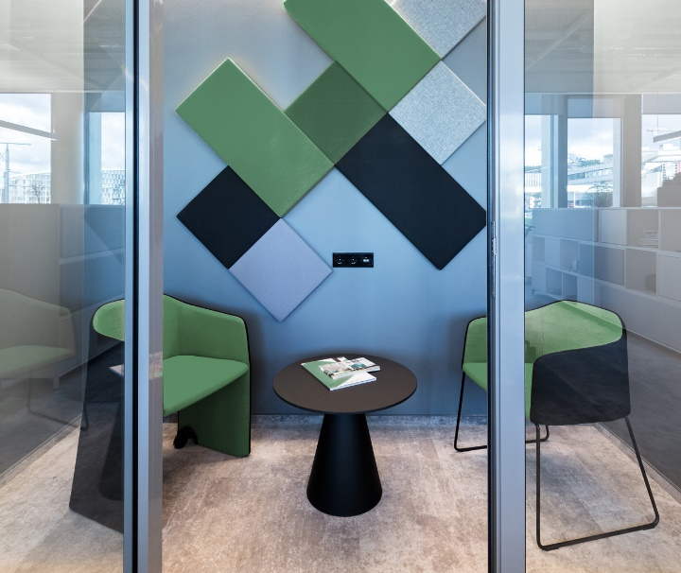
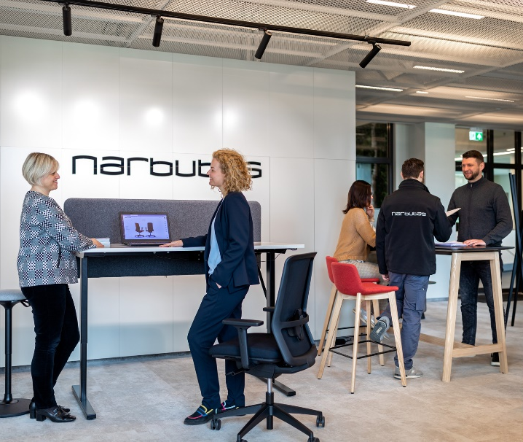
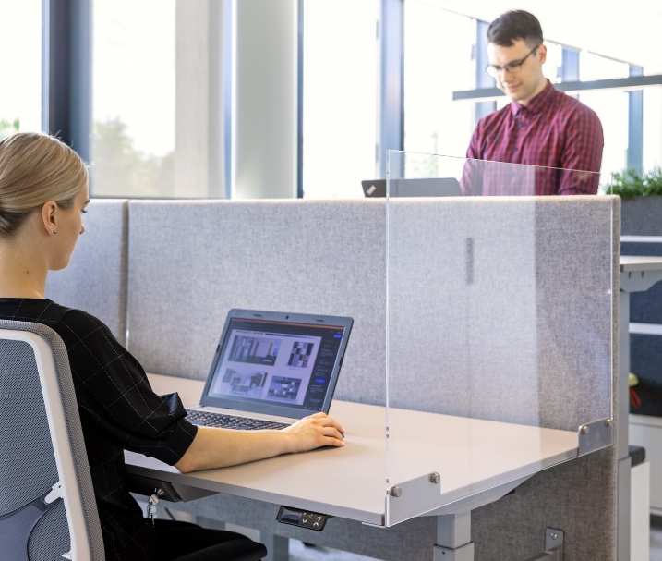
ZEDO
A modern office is a place where it is nice to be and comfortable to work
Notes:
A modern office is a place where it is nice to be and comfortable to work. But that is not enough anymore. It is important not only to offer an ergonomic workstation that meets the physiological and technological needs of employees, but also inspire them to work, change and improve every day.

Slide 3
ZEDO
And a place that inspires
Notes:
A work environment with an original character makes employees more engaged and helps them to build and maintain a closer relationship with a company.

Slide 4
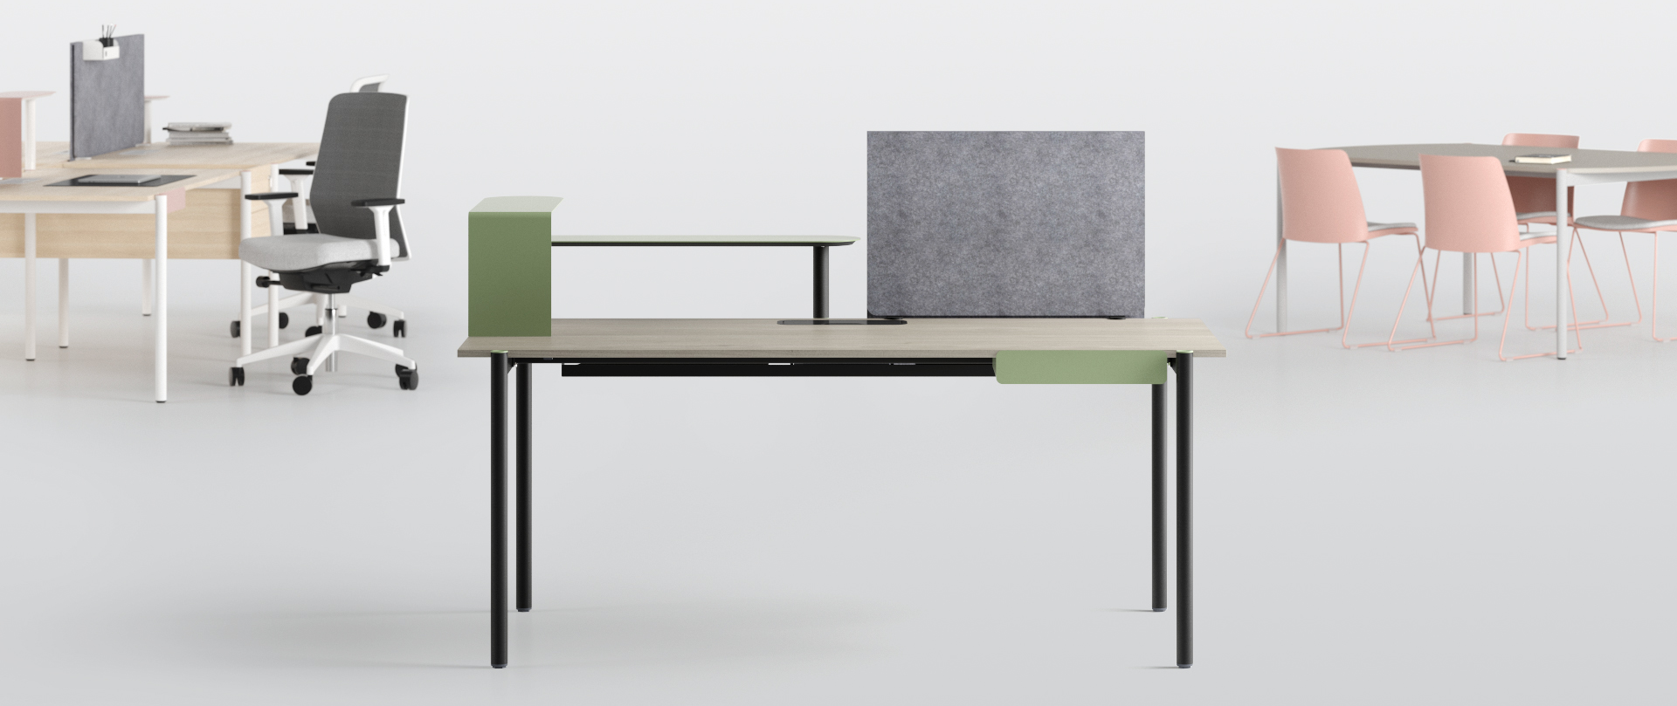
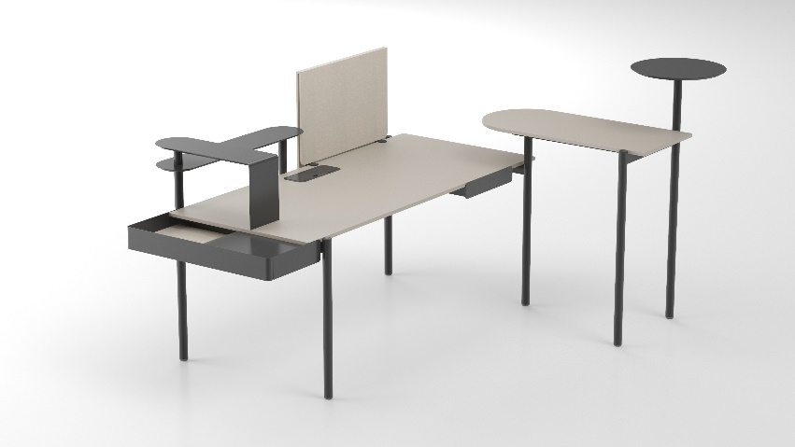
ZEDO
ZEDO is an inspiring and flexible desk system featuring distinctive design
Notes:
ZEDO is an inspiring and flexible desk system featuring distinctive design with carefully selected and colourful accessories that will help you create workplaces with a unique character.

Slide 5
ZEDO
”
I want to discover new forms and bring more colors to a modern office.“
Paolo Pampanoni

Slide 6
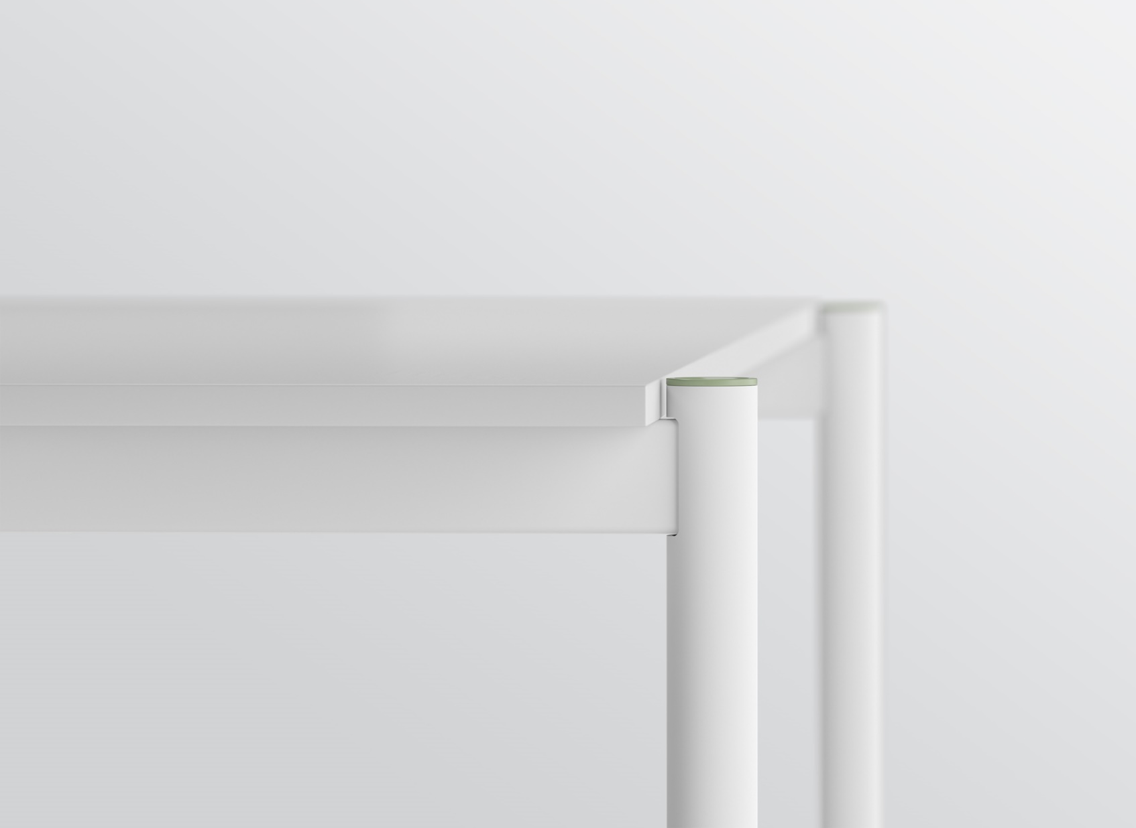
ZEDO
Original design and unique combinations
Notes:
The main element of the ZEDO design is a round metal leg on the outer part of the table, with a playful coloured plug as the final touch. This leg is also a link that allows you to add different accessories. Paolo Pampanoni, the author of the ZEDO design, emphasizes that even a small detail can make a big difference to the character of a piece of furniture, and thus of an office. The original design of the desks offers a very wide range of options for combining the colours of legs, plugs and accessories to create a unique workplace atmosphere.

Slide 7
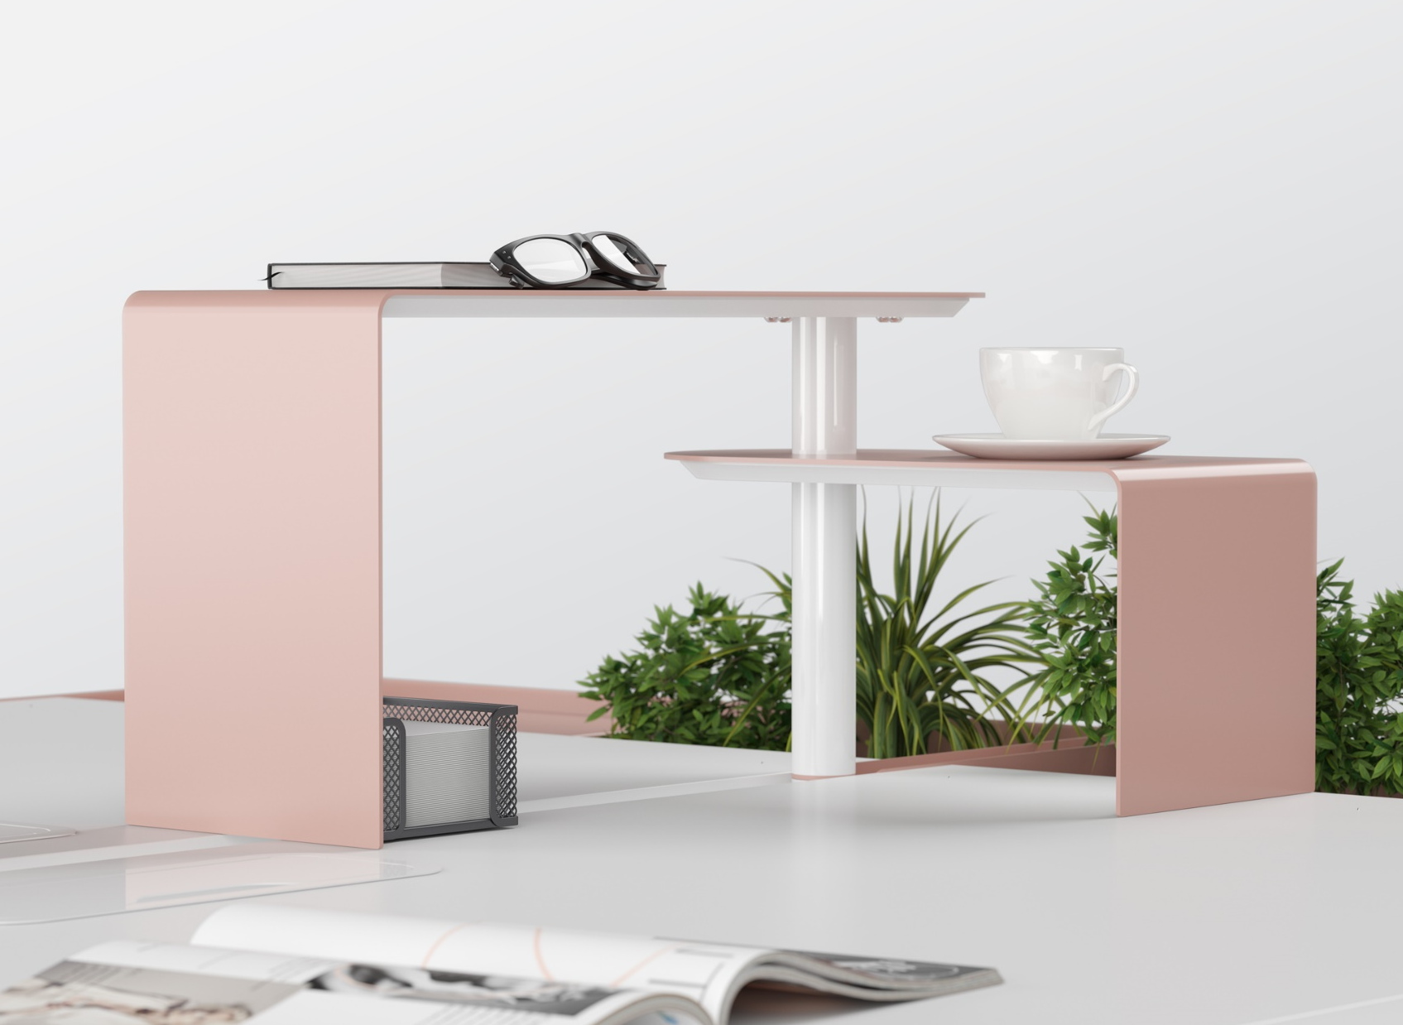
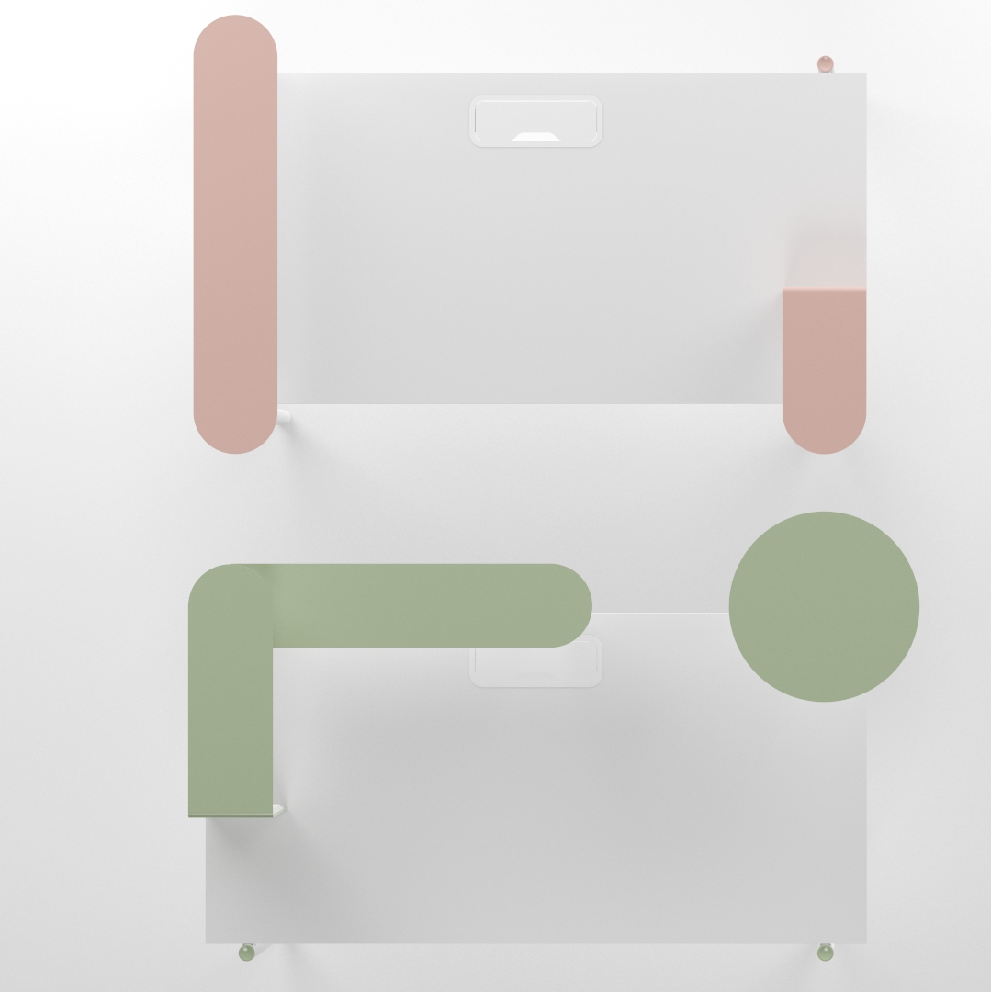
ZEDO
Colourful shelves – stylish and practical
Notes:
Bicoloured metal shelves create a distinctive and stylish look. Shelves of varying forms can be combined with each other and into higher compositions. That way you will also clear your desk of small items and be able to clean it easily as well as disinfect.

Slide 8
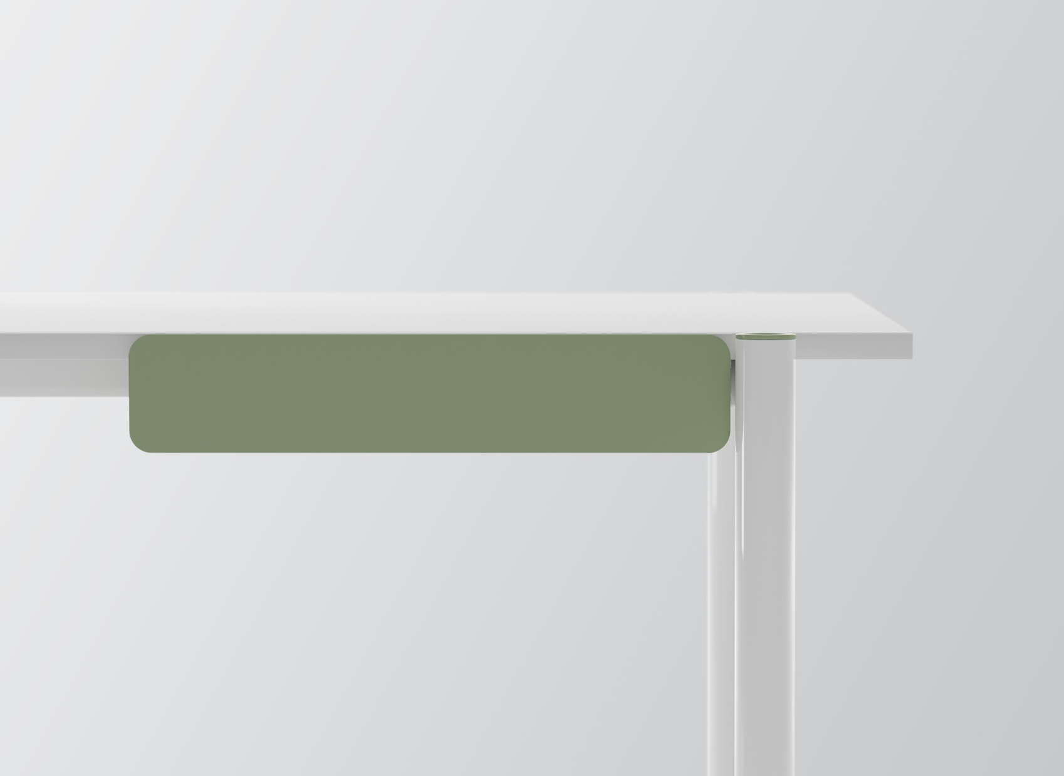
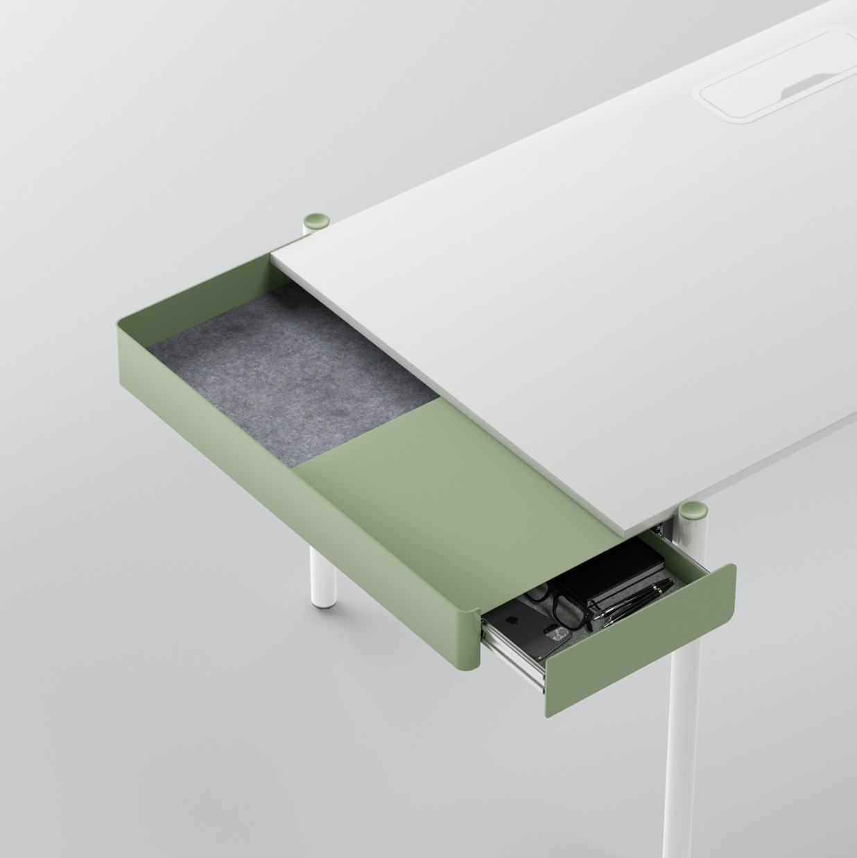
ZEDO
For storing items in a minimalist workplace
Notes:
Thanks to digital technology, a modern workplace is becoming less cluttered and no longer requires many cabinets. Minimalist drawers and open niches with a PET felt lining are perfect for such a case. All the accessories of ZEDO desk collection – drawers, shelves and power units – maintain the continuity of metal colour combinations and functionality.

Slide 9
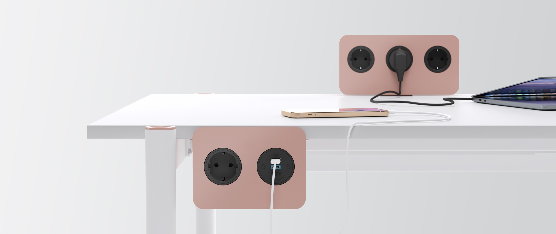
ZEDO
Design continuation in convenient power solutions
Notes:
Exceptional power units blend in the whole design concept perfectly due to the choice of metal colour and rounded forms.
The power unit can be mounted on or under the desk for convenient and quick access to electricity.

Slide 10
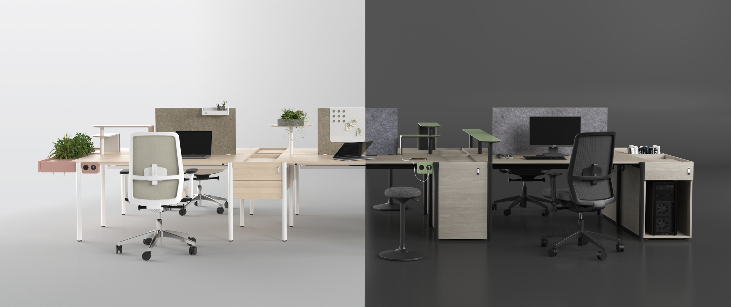
ZEDO
ZEDO changes together with the user
Notes:
All the design elements can be combined according to the personal user’s needs. And as these change, ZEDO will adapt easily. The desk can be really simple or in a complex combination, official or playful, without accessories or with a lot of them – just what is right for you.

Slide 11
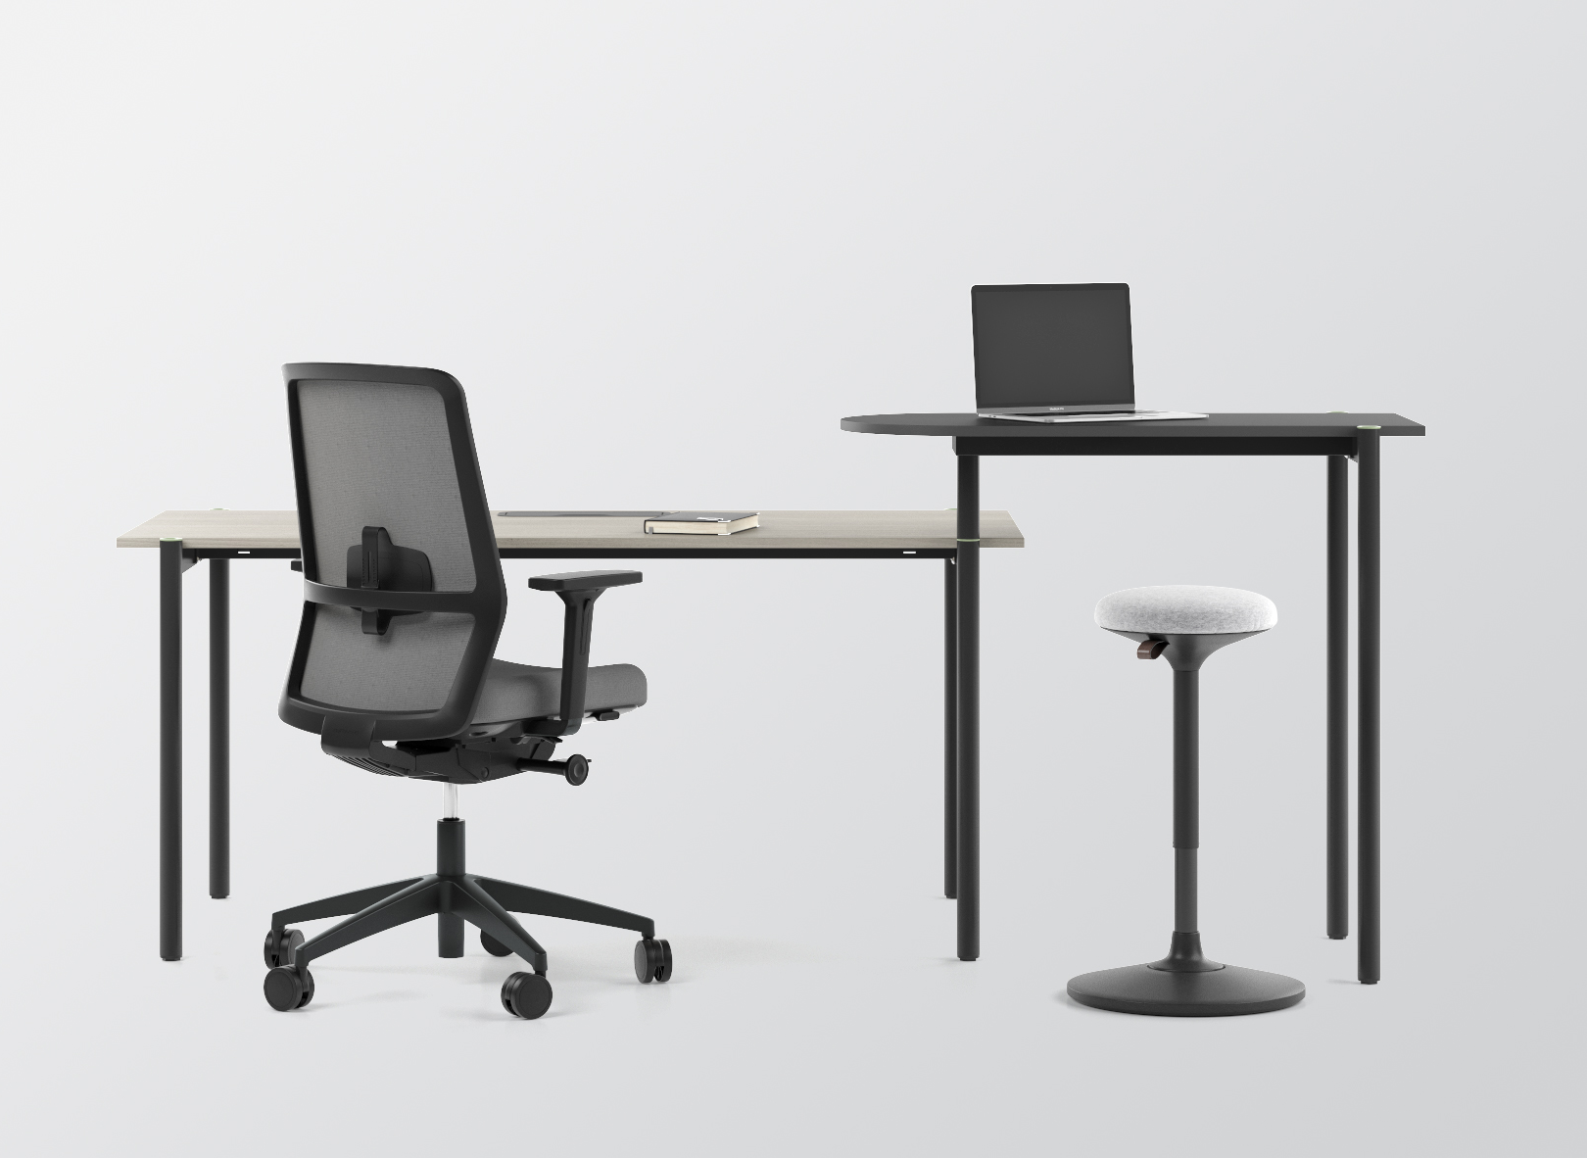
ZEDO
An easily adaptable extension table
Notes:
Extend your desk possibilities with a rotatable extension table that can be used for both temporary work while standing and short meetings due to its larger height.

Slide 12
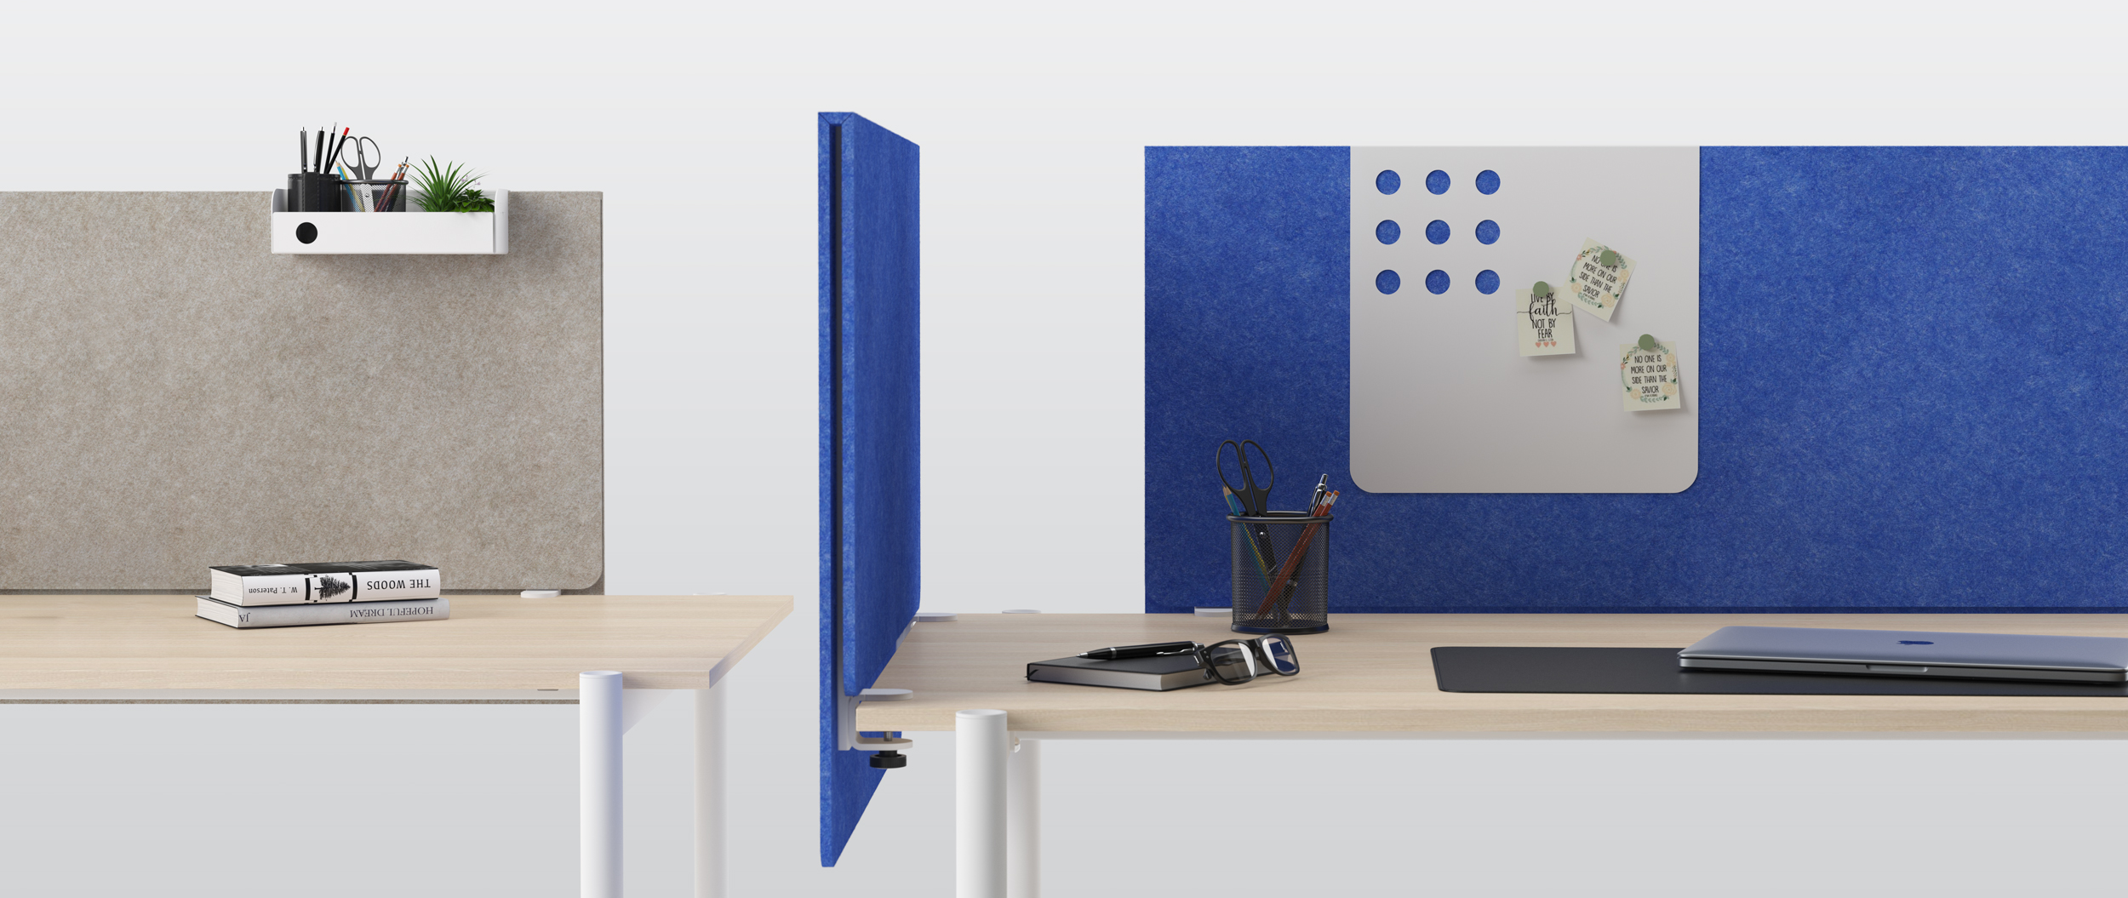
ZEDO
A screen made from PET felt
Notes:
ZEDO stands out not only for its colourful metal accessories, but also for the special PET felt screen. Non-typical felt sheet bending totally hides its supporting structure, while the extended edge covers the cable tray and wires. You can enliven the screen with playful and functional accessories – a magnetic board and a shelf for small items.

Slide 13
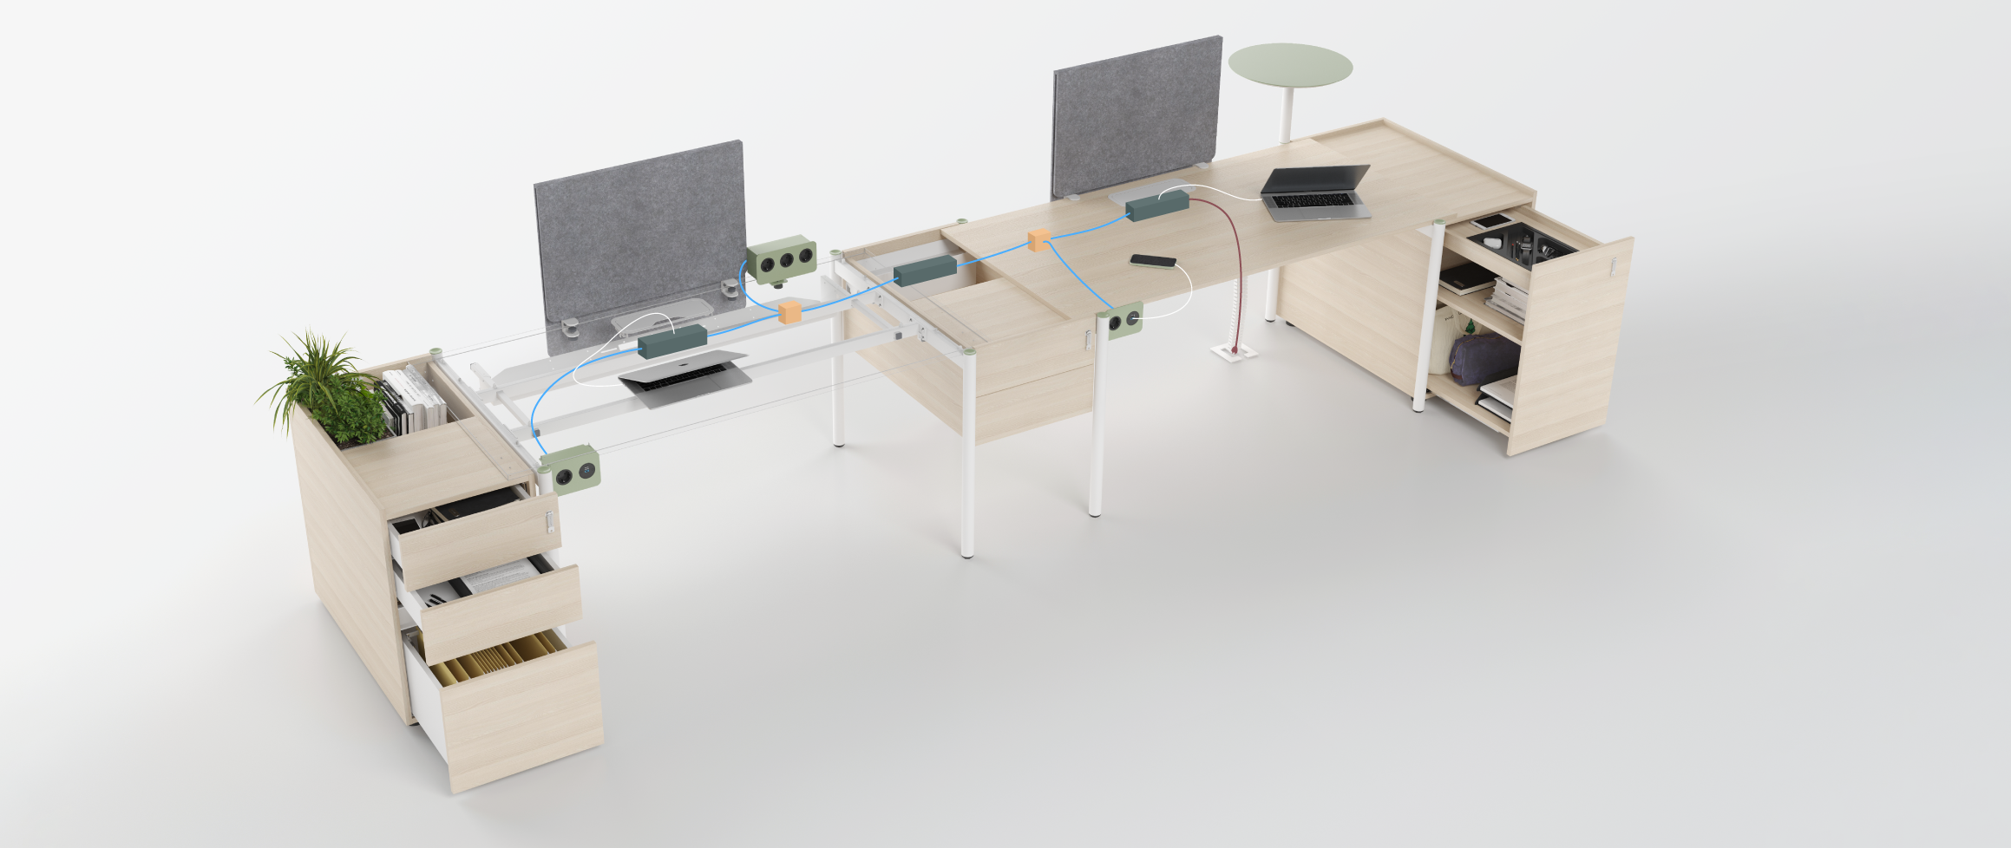
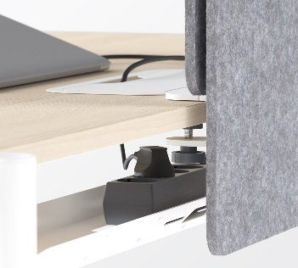
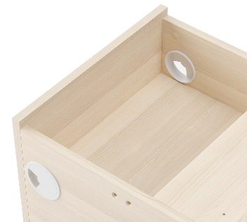
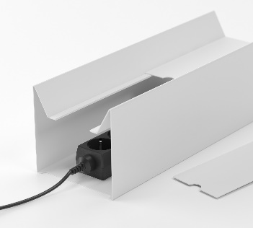
ZEDO
Thought out to the smallest detail
Notes:
A wide range of pedestals and storage towers allow you to store your personal items conveniently as well as hide cables. The holes in the frames allow you to easily combine several workplaces into a single power circuit, while the elegant metal box with opening grommet provides easy access to the sockets.

Slide 14
ZEDO
”
We create the first design. The final one is created by the client.“
Paolo Pampanoni

Slide 15
Create your workplace
the way that is right for you

Slide 16
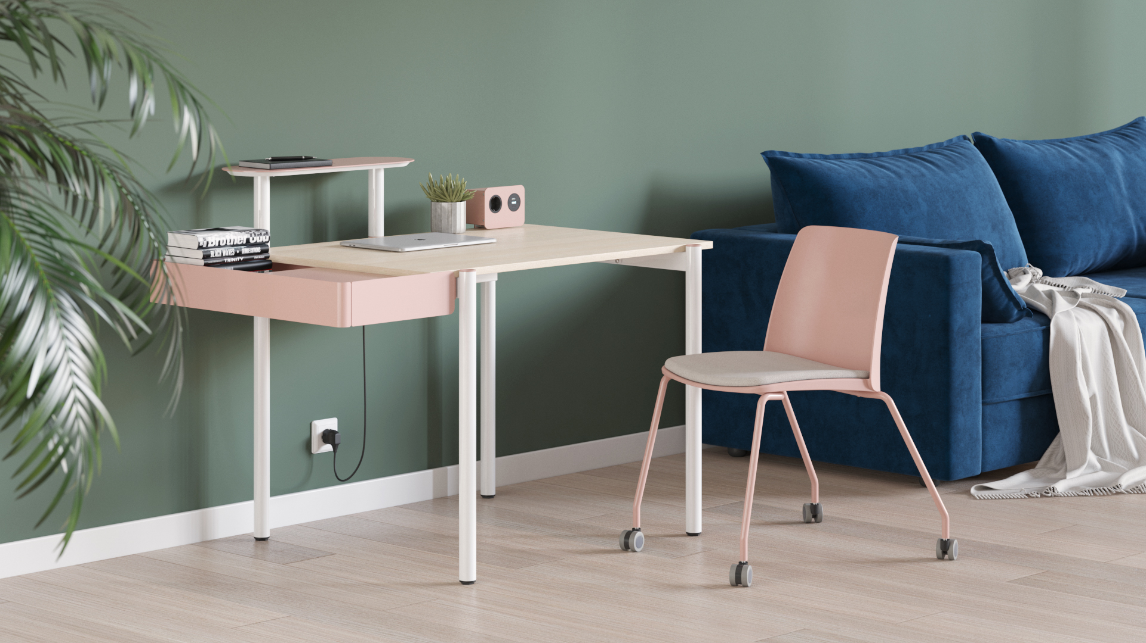
ZEDO
Notes:
A cosy home office
A small-scale desk (1000x700mm) will easily find a place in a small office or home and the abudance of accessories will enliven the interior and create warm and cosy atmosphere.

Slide 17
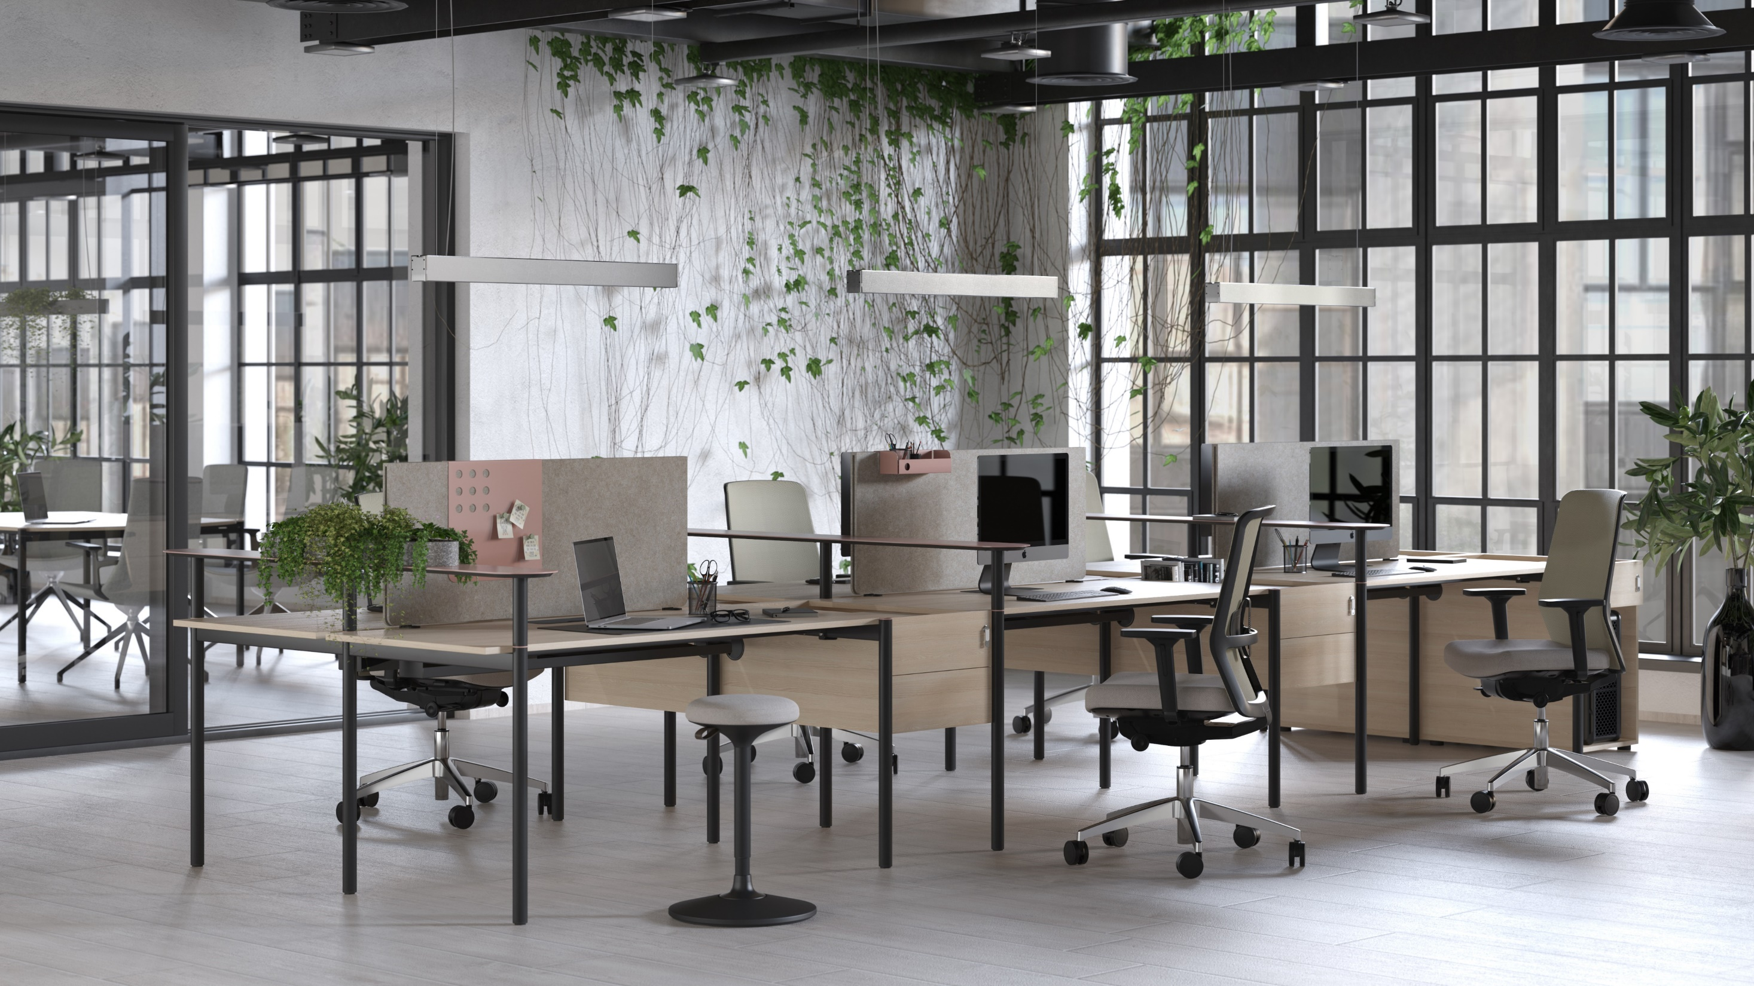
ZEDO
Notes:
Open and flexible
Large bench desks with PET felt screens and pedestals with hidden cables will ensure a comfortable workplace for a big team. Meeting tables in a range of various sizes will extend the functionality of workspaces – you will be able to have meetings or work with the whole team while staying close to your workplace.

Slide 18
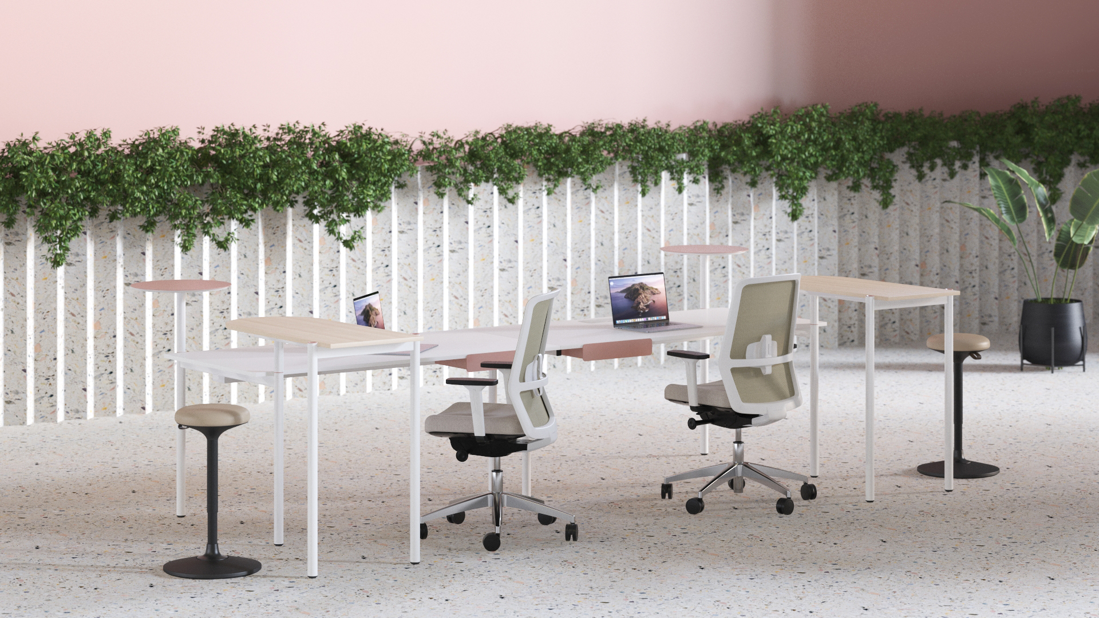
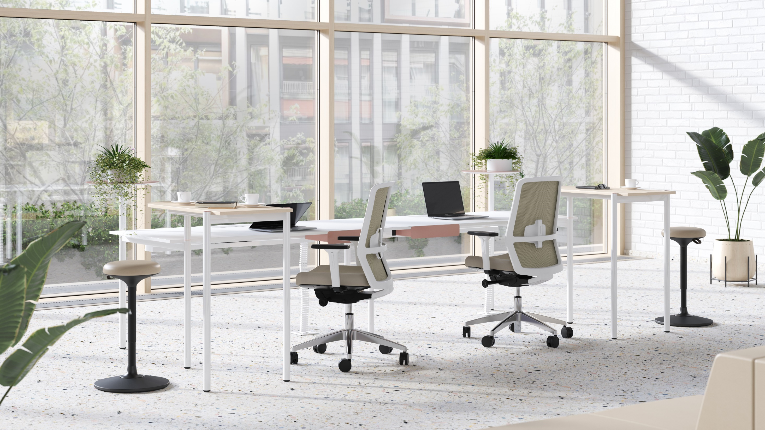
ZEDO
Notes:
Bright and minimalist
Dominant white color creates an especially minimalist image of ZEDO and the subtle colourful details – plugs and shelves – give the system a touch of uniqueness and elegance.

Slide 19
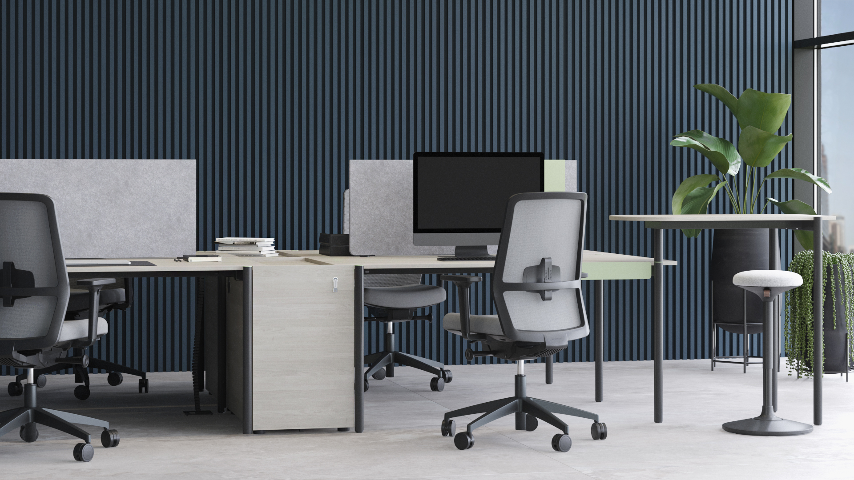
ZEDO
Notes:
Subtly luxurious
Black legs and dark tones of melamine reveal an unexpected side of ZEDO character. Constrasting colours and bright accossories create a special work environment style.

Slide 20
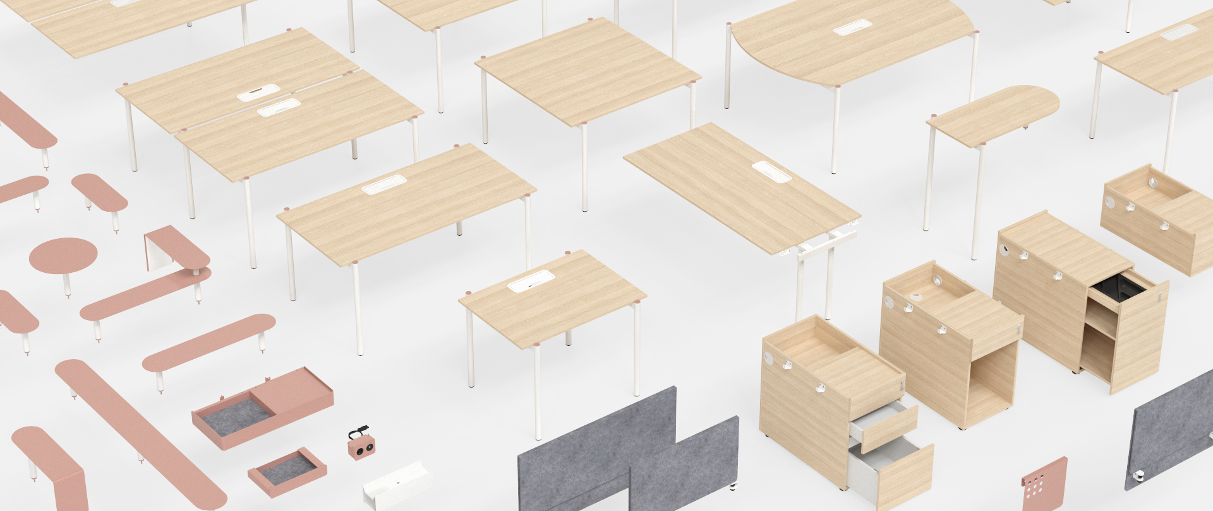
ZEDO
A flexible and functional system that fulfils all the needs of a modern office
Notes:
Whatever atmosphere you want to create, ZEDO is a flexible and functional system that fulfils all the needs of a modern office.
You can combine linear- and classical-plan bench desks, desks and meeting tables, side and central pedestals, screens and extension tables.

Slide 21
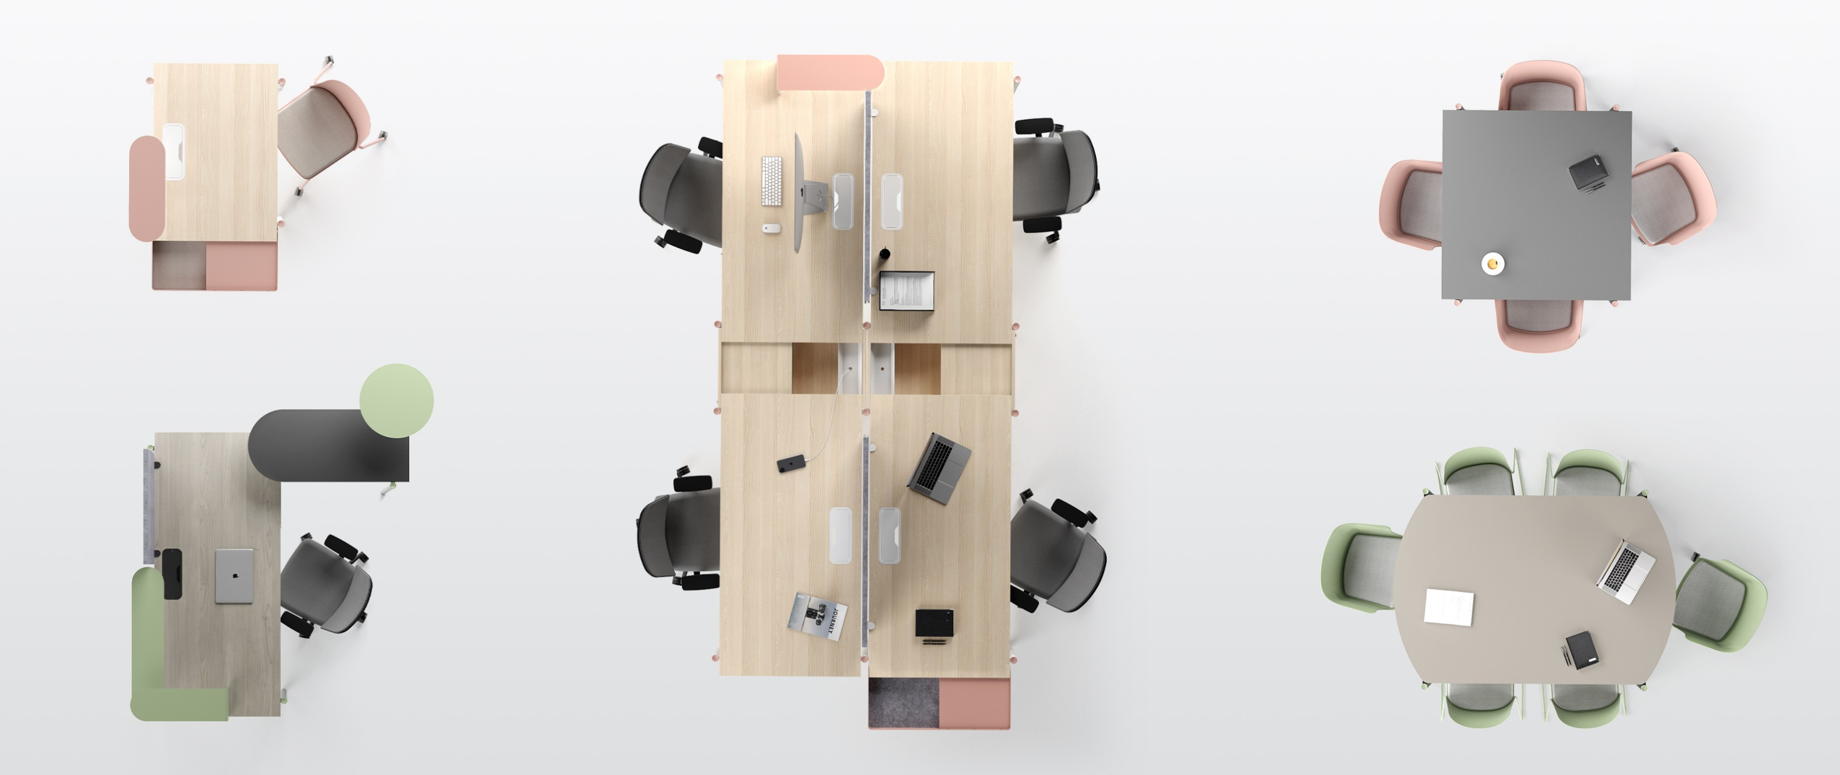
ZEDO
Create a practical and unique office
Notes:
A wide range of desks and the abudance of original accessories will make every office not only practical, but also unique.

Slide 22
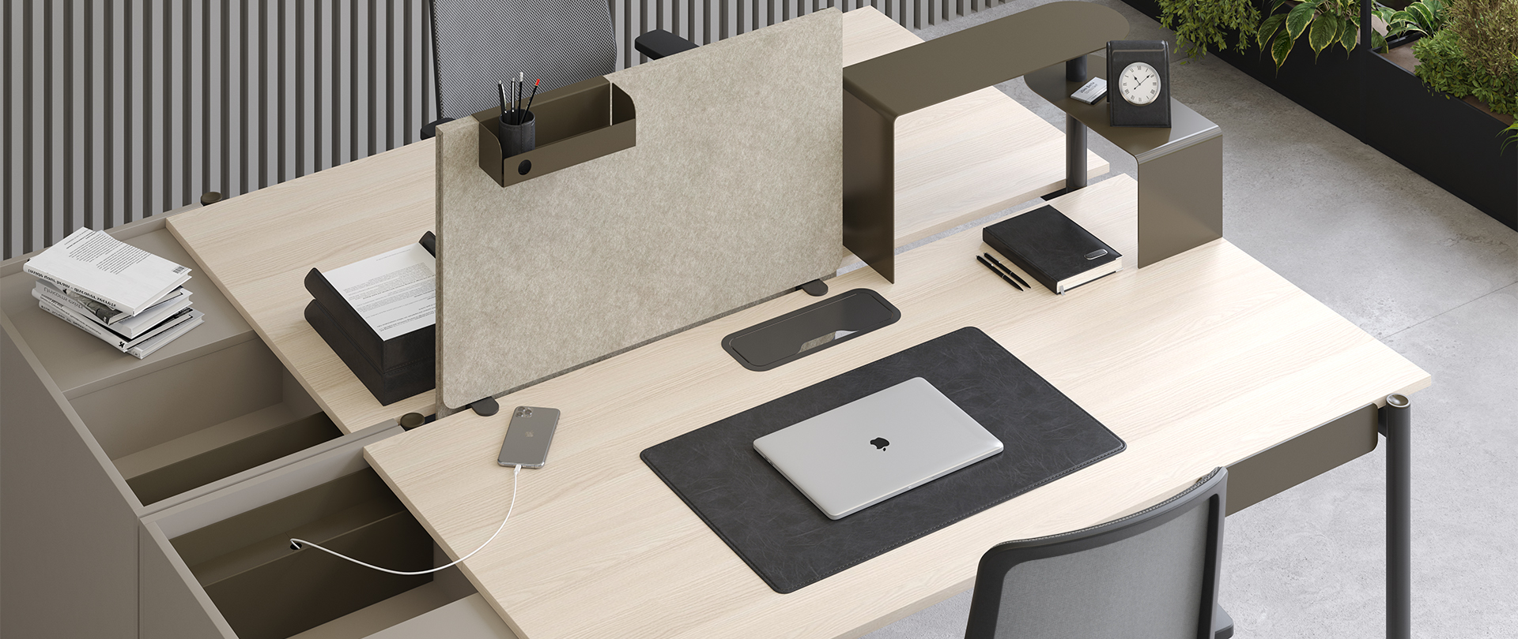
ZEDO
ZEDO – an inspiring workplace with an original character

Slide 23
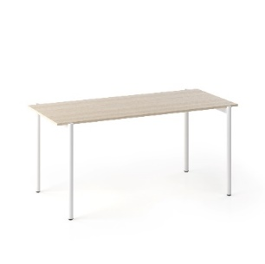
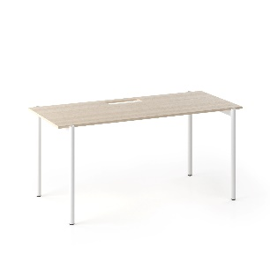
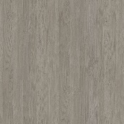
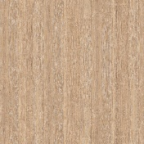
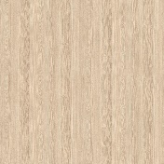
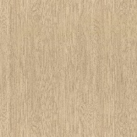
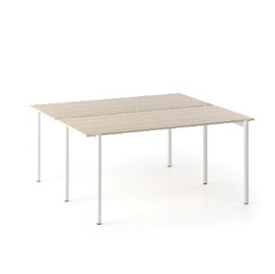
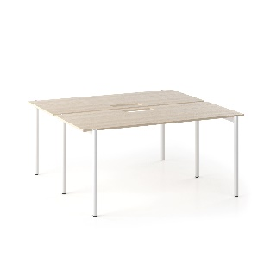
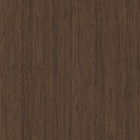
ZEDO desks
Desks | Dimensions | Legs | Plug | Desktop
 | Width: 1000 (only 785 in depth), 1200, 1400, 1600, 1800 Depth: 785 (700) 885 (800) Height: 740 | Metal | Metal | Melamine
 | Width: 1200, 1400, 1600, 1800 Depth: 1530 (1445) 1730 (1645) Height: 740
1 category
2 category

Slide 24
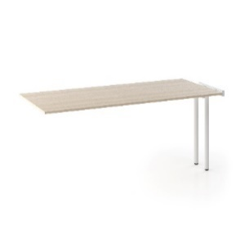
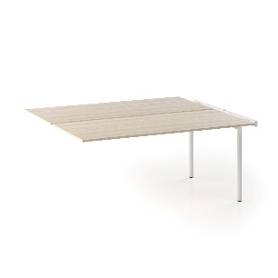
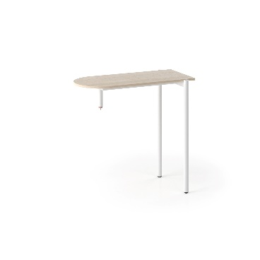
ZEDO desks
Supplementary units / Extension table | Dimensions | Legs | Plug / Fittings | Desktop
 | Width: 1200, 1400, 1600, 1800 Depth: 785 (700), 885 (800) Height: 740 | Metal | Metal | Melamine
 | Width: 1200, 1400, 1600, 1800 Depth: 1530 (1445), 1730 (1645) Height: 740
 | Width: 1000, 1400 Depth: 535 (450) Height: 950
1 category
2 category

Slide 25
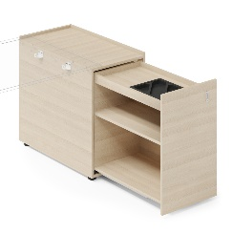
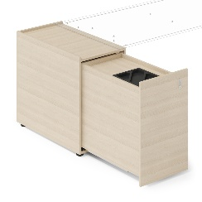
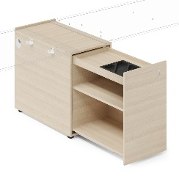
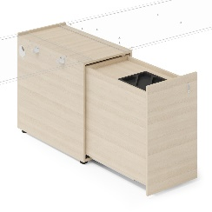
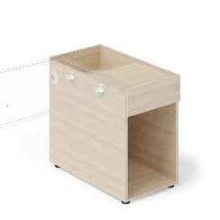
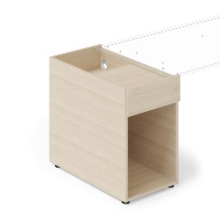
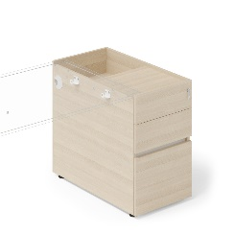
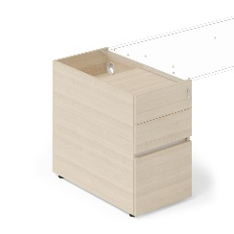
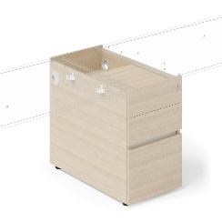
ZEDO towers & pedestals
Towers / Pedestals | Dimensions | Drawers / Carcass | Fittings
 | Width: 450 Depth: 739, 839 Height: 741 | Melamine | Metal
 | Width: 450 Depth: 739, 839 Height: 346
1 category
2 category

Slide 26
ZEDO accessories
Drawer / Side drawer | Dimensions | Carcass | Lining | Insert
 | Width: 400 Depth: 250 Height: 79 | Metal | Fabric | -
 | Width: 365 Depth: 700, 800 Height: 100 |  |  | PET felt
Era
Synergy, Velito Presto

Slide 27
ZEDO accessories
Shelves | Dimensions | Upper part | Bottom part | Legs | Fittings
 | Width: 590 Depth: 200 Height: 200 | Metal | MDF | Metal | Metal
 | Width: 945, 1045 Depth: 200 Height: 200
 | Width: 1690, 1890 Depth: 200 Height: 200
 | Width: 945, 1045 Depth: 600 Height: 200/300 | Plotis: 450 Gyliai: 739, 839 Aukštis: 346

Slide 28
ZEDO accessories
Shelves | Dimensions | Upper part | Bottom part | Legs | Fittings
 | Width x Depth x Height 400x200x200 600x200x300 | Metal | MDF | Metal | Metal
 | Width: 600 Depth: 400 Height: 200/300
 | Width: 450 Depth: 450 Height: 300

Slide 29
ZEDO accessories
Power socket blocks | Dimensions | Types | Standards | Carcass
 | Width: 150 Depth: 88 Height: 110 | 2 x AC or 1 x AC, 1 x USB (A+C) | EU UK FR CH | Metal
 | Width: 220 Depth: 88 Height: 110 | 3 x AC or 2 x AC, 1 x USB (A+C)
 | Width: 150 Depth: 88 Height: 110 | 2 x AC or 1 x AC, 1 x USB (A+C)

Slide 30
ZEDO PET acoustic desk screens
Desk screens | Dimensions | Screen colour | Fittings | Accessories (optional) | Accessories colour
 | Width: 700, 800 Depth: 28 Height: 600 (470) | PET felt | Metal |  | Metal
 | Width: 700, 800 Depth: 28 Height: 470
 | Width: 750, 950, 1150, 1350, 1550 Depth: 28 Height: 600 (470)
 | Width: 750, 950, 1150, 1350, 1550 Depth: 28 Height: 470 | Plotis: 450 Gyliai: 739, 839 Aukštis: 346

Slide 31
ZEDO conference & meeting tables
Tables / Supplementary units | Dimensions | Legs | Plug | Desktop
 | 4 seats 1000x1085x740 1200x1285x740 6 seats 1400x1485x740 | Metal | Metal | Melamine
 | + 4 seats 1000x1000x740 1200x1200x740 + 6 seats 1400x1400x740
 | 6 seats 1800x1085x740 1800x1285x740
1 category
2 category

Slide 32
narbutas.com

