Slide 1
PARTHOS
Architectural design that sparks collaboration

Slide 2
PARTHOS
The PARTHOS table collection brings people together and becomes an eye-catching interior accent
Notes:
The PARTHOS table collection is characterised by its stylish, elegant design, with well-thought-out shapes that spark collaboration. When we can see and hear each other well, we can actively share information and ideas as well as engage in conversation or discussion. Whether in meeting rooms, collaboration spaces or relaxation areas, the PARTHOS tables will become a stylish interior accent in both formal and informal environments.

Slide 3
PARTHOS
The PARTHOS table collection consists of:
Meeting tables
High tables
Coffee tables
Notes:
The PARTHOS collection consists of meeting tables, high tables and coffee tables. The wide selection of tables gives you plenty of creative options for setting up different functional spaces and maintaining a consistent style throughout the interior.

Slide 4
PARTHOS
PARTHOS distinctive qualities
Elegant architectural design.
Thoughtful functional solutions.
Many stylish combination options.
Developed according to the sustainability principles.
Notes:
What makes the PARTHOS tables so distinctive? Its elegant architectural design will complement any style of interior and make it the main accent of the space. Functional solutions have been well thought out to ensure that the tables are comfortable and pleasant to use. Mixing and matching different materials, sizes and colours opens up a wide range of options to create various stylish combinations in different spaces. And, of course, NARBUTAS consistently applies the key principles of sustainability in the design and manufacture of its furniture.

Slide 5
PARTHOS
Elegant architectural design
Notes:
NARBUTAS pays a great deal of attention to the design of its products. One of the distinctive qualities of the PARTHOS table collection is its elegant architectural design.

Slide 6
PARTHOS
“
When designing the PARTHOS tables, we paid particular attention to the search for shape and proportion, with the aim of maintaining a coherent, uncluttered style and revealing the architectural nature of this furniture.
NARBUTAS Designer
Rytė Milišiūnaitė

Slide 7
PARTHOS
A sculptural cylindrical column is the main design element
Notes:
The main design element of the furniture from this collection is a sculptural cylindrical column, which has historically symbolised strength and stability in architecture. With a modern interpretation, this element of classical architecture becomes the unifying and distinctive design accent of the PARTHOS table collection.

Slide 8
PARTHOS
The vertical pattern emphasizes the architectural nature of the piece of furniture
Notes:
The cylindrical column is covered with PET felt. This material’s textural pattern of vertical lines further emphasises the allusion to the column, an element of classical architecture.

Slide 9
PARTHOS
Round, cosy furniture shapes
Notes:
To maintain the thoughtful, visually uncluttered design of the PARTHOS tables, a great deal of attention was paid to the search for shape. The round lines are echoed in the tabletop and cylindrical column. When designing the PARTHOS tables, it was important to find a balance of sizes and proportions between the different parts of the furniture. The elegant and cosy shapes of the piece of furniture reflect a great end result.

Slide 10
PARTHOS
Solutions that create aesthetic design
Notes:
You will not see any protruding cables on the PARTHOS tables, as they are hidden under the tabletop in a PET felt cable tray and column. This gives the piece of furniture a clean and aesthetically pleasing appearance.

Slide 11
PARTHOS
Thoughtful functional solutions
Notes:
When designing furniture, we think not only about aesthetic but also functional solutions for comfortable and enjoyable meetings, down to the smallest detail. The PARTHOS tables are no exception.

Slide 12
PARTHOS
Round tables for enjoyable conversations
Notes:
Round tables are ideal for enjoyable conversations and effective collaboration. Tables like these allow us to see and hear each other well, actively share ideas and information, engage in conversation and find solutions.

Slide 13
PARTHOS
Functional and convenient power solutions
Notes:
Modern technology is essential for a smooth and efficient meeting. Round power units with different types of sockets can be integrated into the PARTHOS tables for easy charging of devices. For wire management, you can also choose a rectangular metal grommet that opens on both sides of the table, providing a convenient solution for meeting participants sitting on different sides.

Slide 14
PARTHOS
Improving the acoustic environment with the PARTHOS columns
Notes:
​PET felt features acoustic properties. The porous surface absorbs sound, while the vertical cut-outs disperse some of the sound waves. We recommend combining these tables with the PARTHOS acoustic columns. They will not only ensure a better acoustic environment but will also create stylistically harmonious interiors for meeting, relaxation and other spaces.

Slide 15
PARTHOS
Stylish combinations and a wide range of applications in interiors
Notes:
The PARTHOS tables offer a wide range of possibilities in interiors.

Slide 16
PARTHOS
Various options in height, size, colour and material
Notes:
You can choose the height, tabletop size, finish and number of columns for the PARTHOS tables. The wide range of PET felt colours is another important distinctive quality of the collection. Such a comprehensive selection will allow architects and designers to take into account the different functional and aesthetic requirements of a space and adapt the furniture accordingly.

Slide 17
PARTHOS
Notes:
The PARTHOS tables are perfect for a variety of interior styles: presentable and elegant classic...

Slide 18
PARTHOS
Notes:
...industrial interior style...

Slide 19
PARTHOS
Notes:
...stylish and playful interior...

Slide 20
PARTHOS
Developed according to the sustainability principles
Notes:
NARBUTAS consistently applies the key principles of sustainability. When creating a new piece of furniture, we carefully think not only about its design and functional solutions but also about the entire cycle of its production and use: how will it be made and what materials will it be made from? Will it be durable and long lasting? Will it be possible to disassemble the piece of furniture that is no longer used and recycle its individual parts?

Slide 21
PARTHOS
Manufactured using green energy
Made from recycled materials
Reliable and long-lasting
Disassembled materials are easy to recycle
Easy to disassemble and recycle individual parts
Notes:
The PARTHOS tables reflect a consistent chain of sustainability: the tables are made from recyclable materials (metal, chipboard, PET felt) using renewable energy, the furniture is durable and the design is well thought out. The tables that are no longer in use can be easily disassembled and their parts can then be recycled.

Slide 22
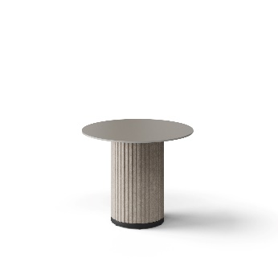
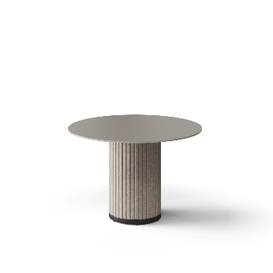
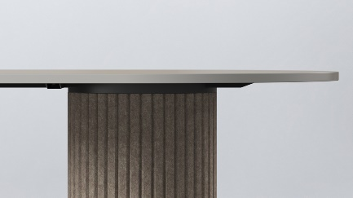
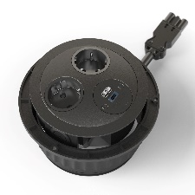
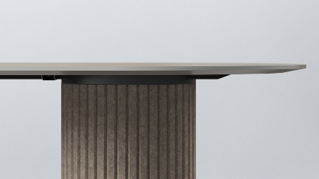
PARTHOS meeting tables
1 column | 8 seats | Tabletop | Column | Power solutions
4 seats Ø900 mm Height: 740 mm | 5 seats Ø1100 mm Height: 740 mm | Melamine | PET felt | -
4 seats Ø900 mm Height: 740 mm | 5 seats Ø1100 mm Height: 740 mm
Type of edge
HPL / HPL Fenix
2 x AC power sockets, USB fast charger
3 x AC power sockets
Type of edge
2 x AC power sockets, 1 x USB fast charger, wireless charger
3 x AC power sockets, wireless charger

Slide 23
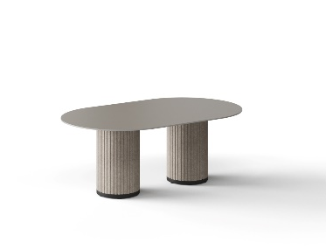
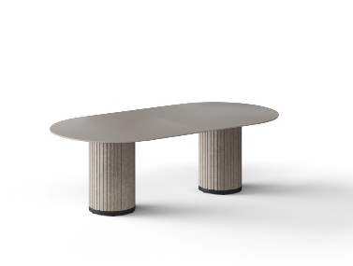
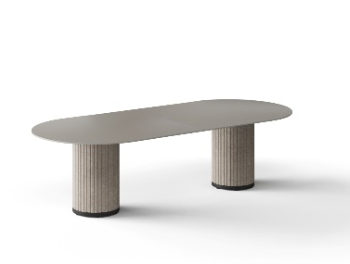
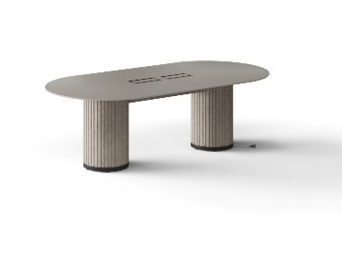
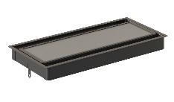
PARTHOS meeting tables
2 columns | 8 seats |  | Tabletop | Column | Power solutions
6 seats Width: 2000 mm Depth: 1200 mm Height: 757 mm | 8 seats Width: 2400 mm Depth: 1200 mm Height: 757 mm | 8 seats Width: 2800 mm Depth: 1200 mm Height: 757 mm | Melamine | PET felt | -
6 seats Width: 2000 mm Depth: 1200 mm Height: 758 mm | 8 seats Width: 2400 mm Depth: 1200 mm Height: 758 mm | 8 seats Width: 2800 mm Depth: 1200 mm Height: 758 mm |  |  | Wide selection of power units
Type of edge
HPL / HPL Fenix
Grommet for wire management
Type of edge

Slide 24
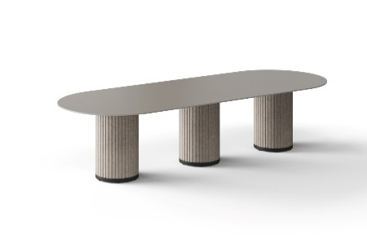
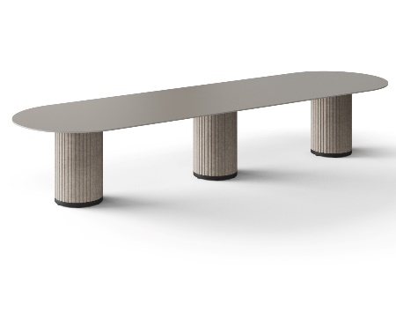
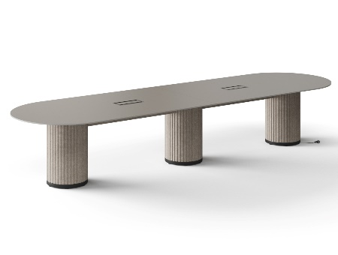
PARTHOS meeting tables
3 columns | 8 seats | Tabletop | Column | Power solutions
10 seats Width: 3200 mm Depth: 1200 mm Height: 757 mm | 12 seats Width: 4200 mm Depth: 1200 mm Height: 757 mm | Melamine | PET felt | -
10 seats Width: 3200 mm Depth: 1200 mm Height: 758 mm | 12 seats Width: 4200 mm Depth: 1200 mm Height: 758 mm |  |  | Wide selection of power units
Type of edge
HPL / HPL Fenix
Grommet for wire management
Type of edge

Slide 25
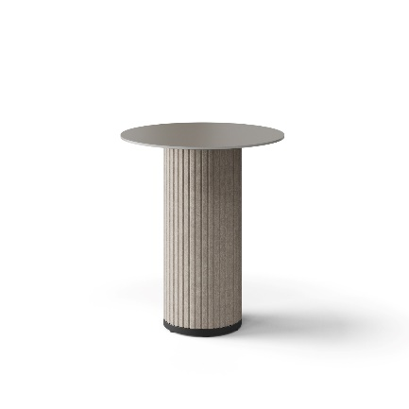
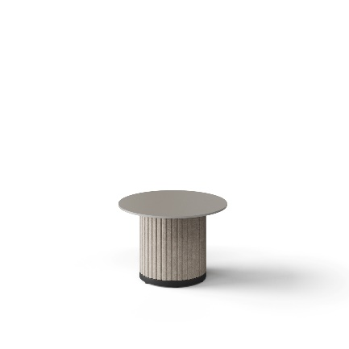
PARTHOS coffee tables and high tables
1 column | 8 seats | Tabletop | Column | Power solutions
4 seat high table Ø900 mm Height: 1050 mm | Coffee table Ø700 mm Height: 480 mm | Melamine | PET felt | -
4 seat high table Ø900 mm Height: 1050 mm
Type of edge
HPL / HPL Fenix
2 x AC power sockets, USB fast charger
3 x AC power sockets
Type of edge
2 x AC power sockets, 1 x USB fast charger, wireless charger
3 x AC power sockets, wireless charger

Slide 26
narbutas.com

