Slide 1
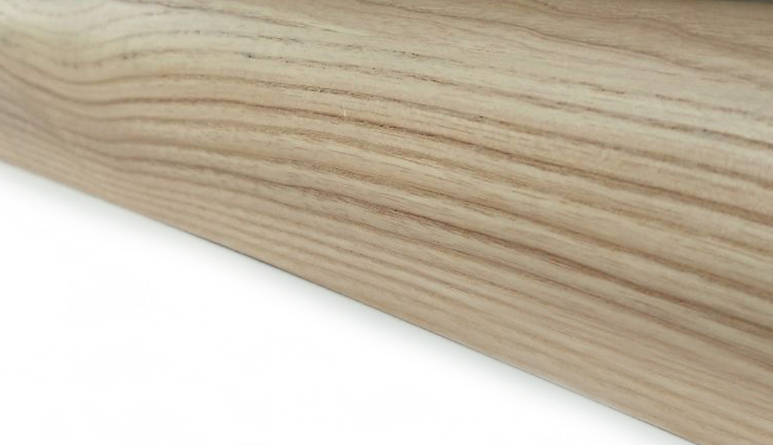

NOVA Wood
DESKING SYSTEM

Slide 2
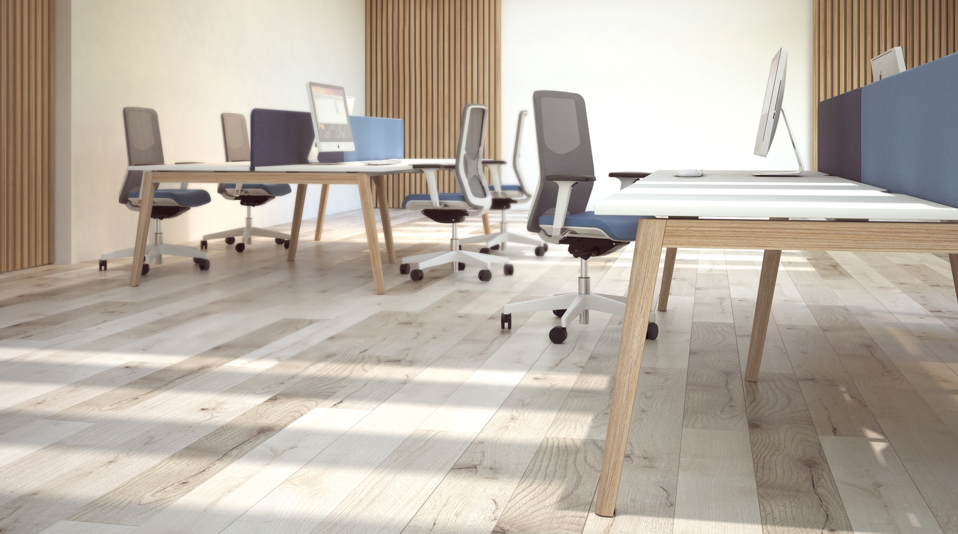
NOVA Wood
Nature’s touch in your office!

Slide 3
Desking system that gives your office a delicate sense of luxury and brings you closer to nature and home atmosphere!

Slide 4
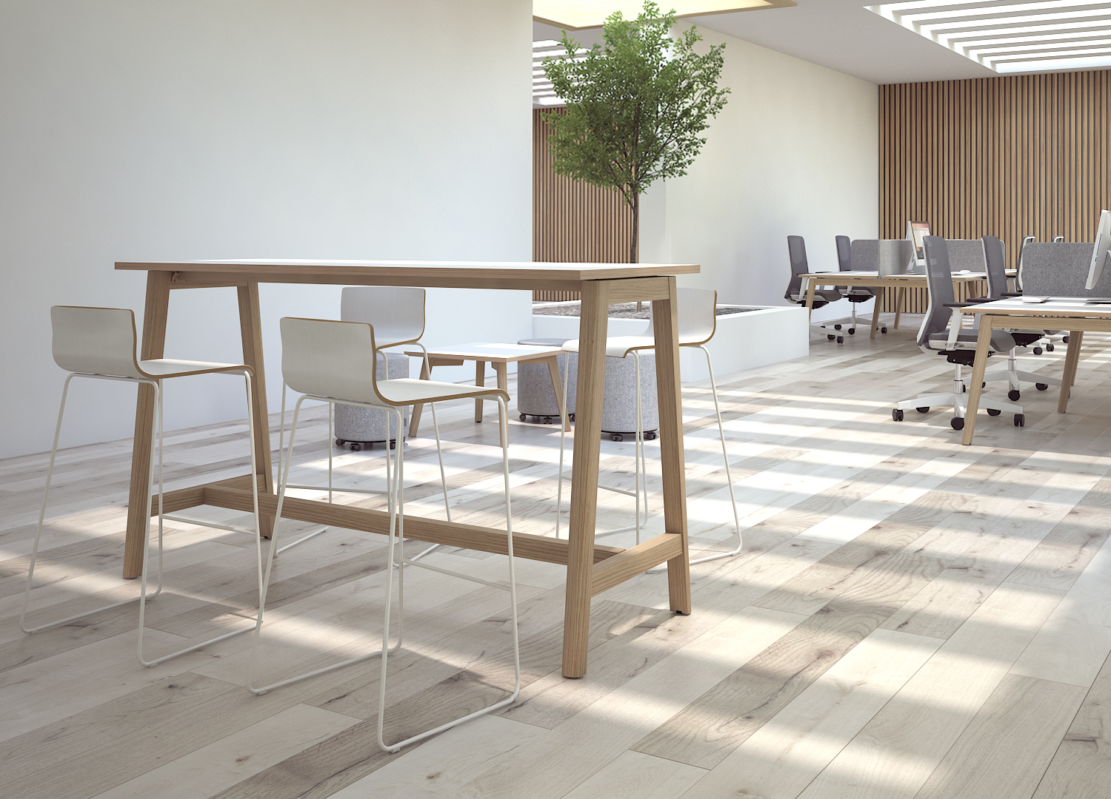
NOVA Wood
is suitable for arranging offices based on the open space concept including different zones for individual work, teamwork, meetings and leisure activities.

Slide 5
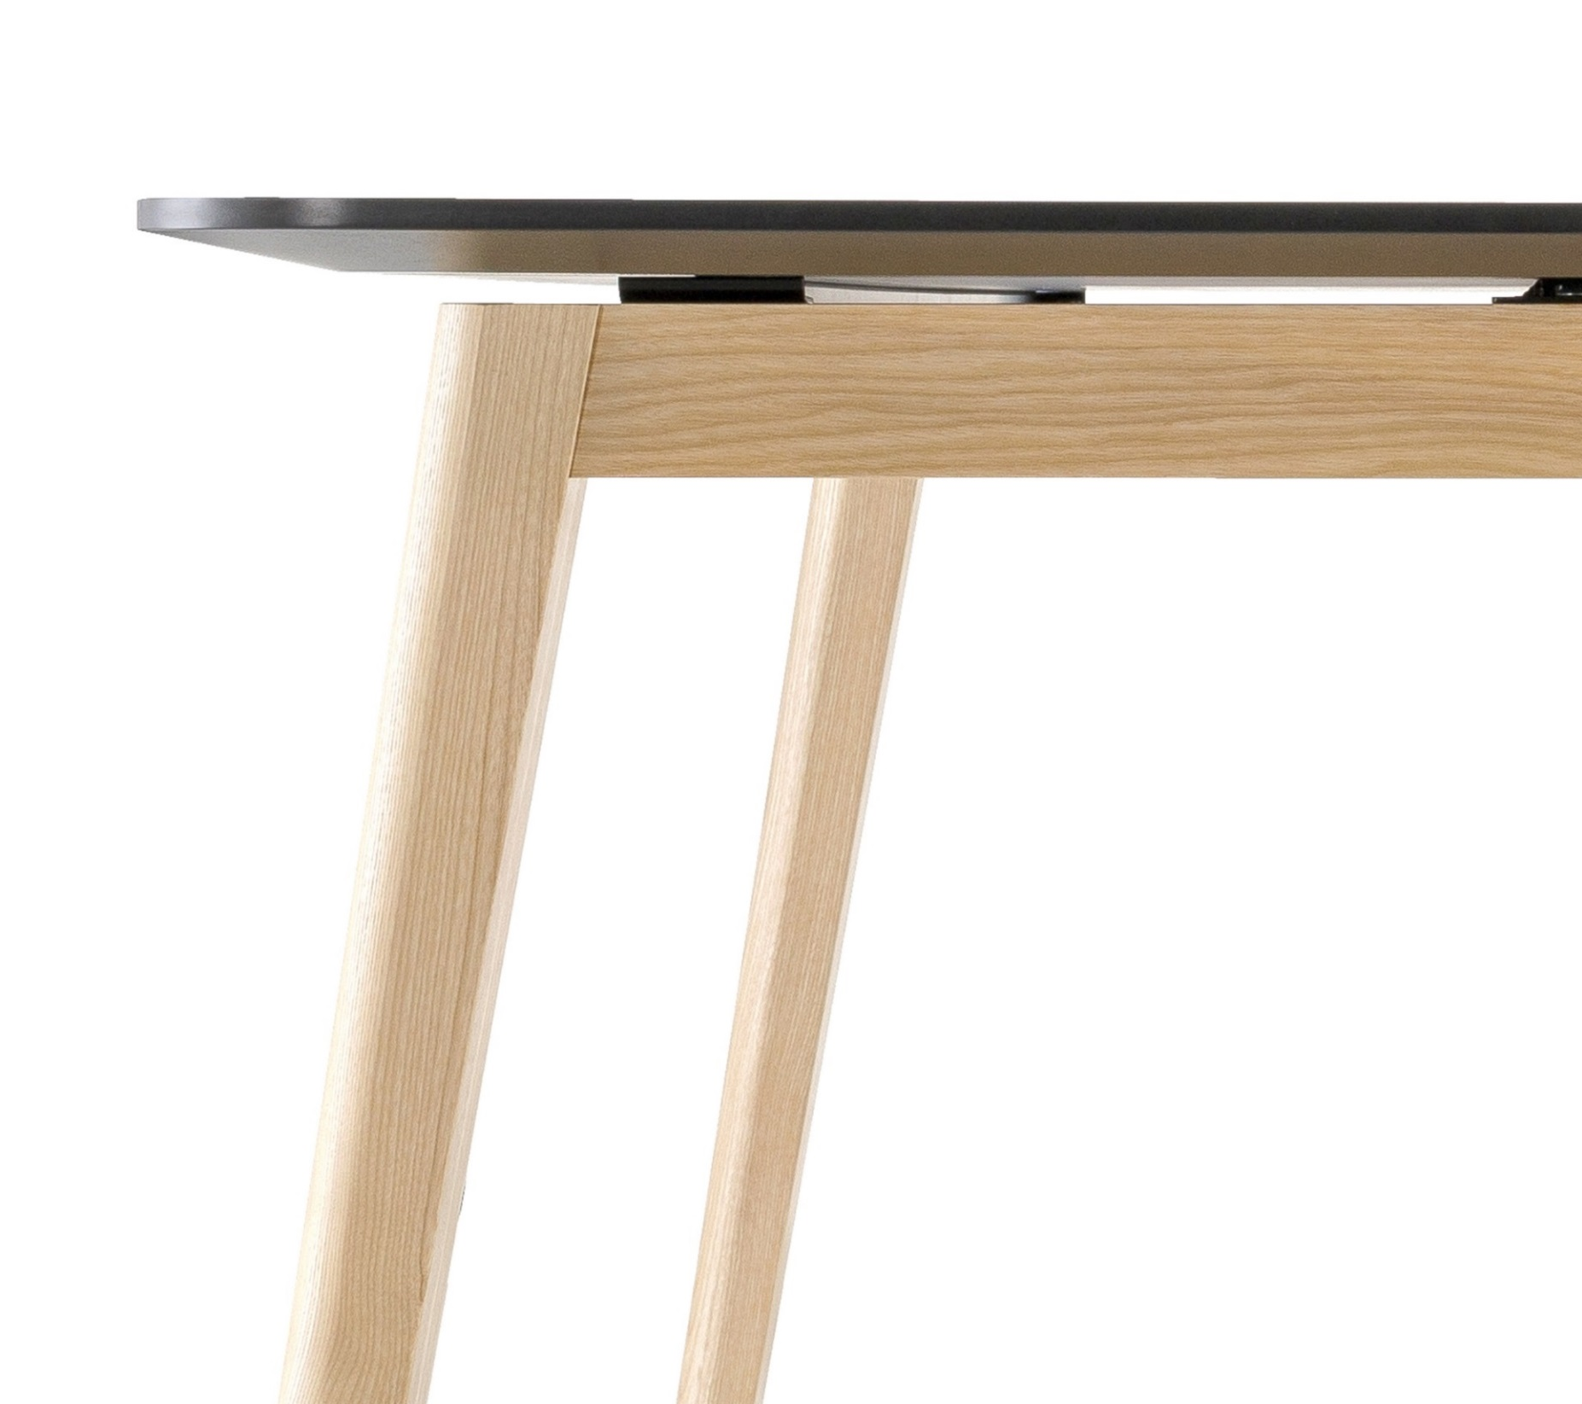

NOVA Wood meeting table is a winner of the Red Dot Award: Product Design.
Notes:
It is one of the world’s largest design competitions, started in 1955. International Red Dot jury gives this prestigious award only to products that feature an outstanding design, innovation, functionality, formal quality, longevity and ergonomics.

Slide 6
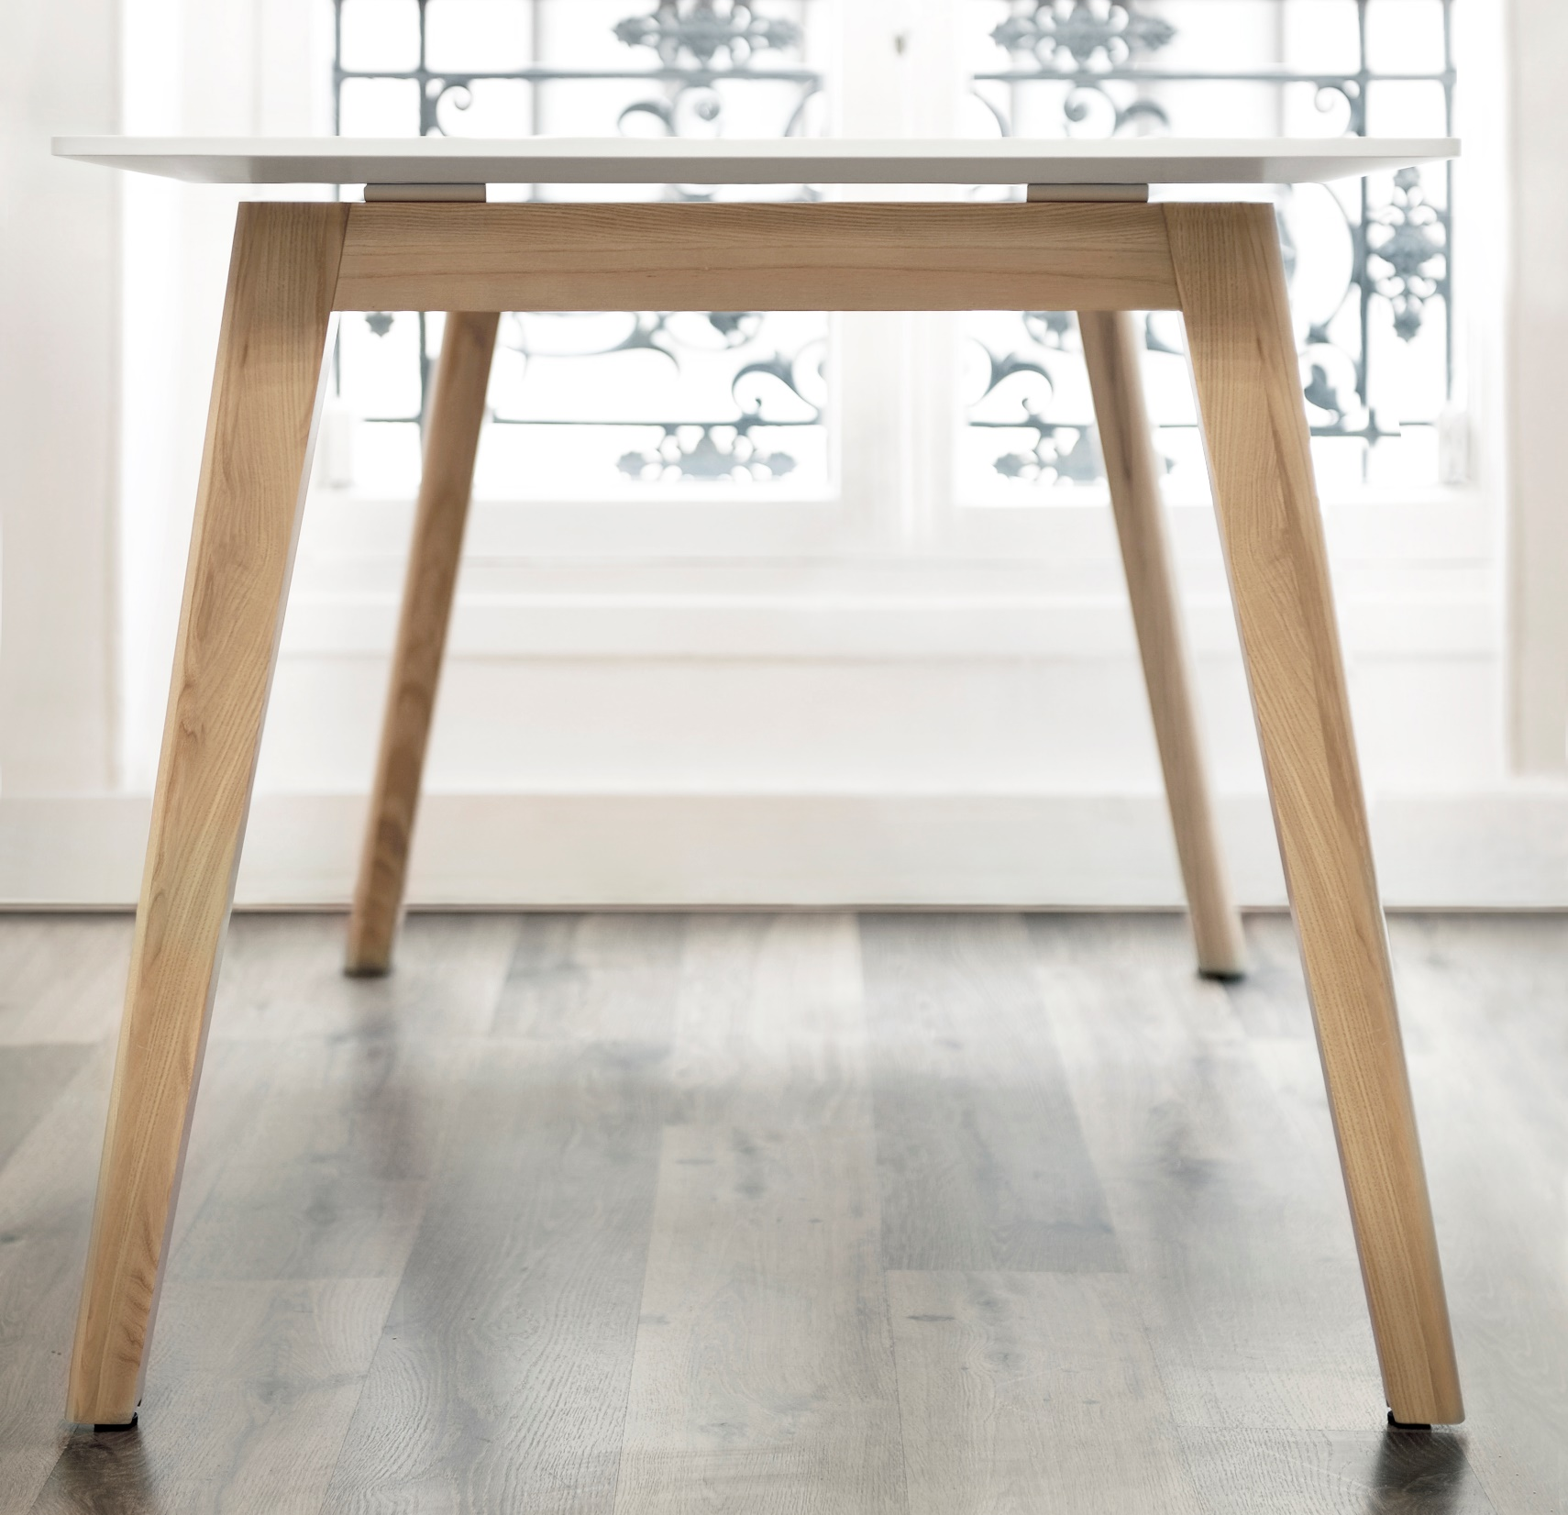
Solid ash wood legs make every desk unique

Slide 7
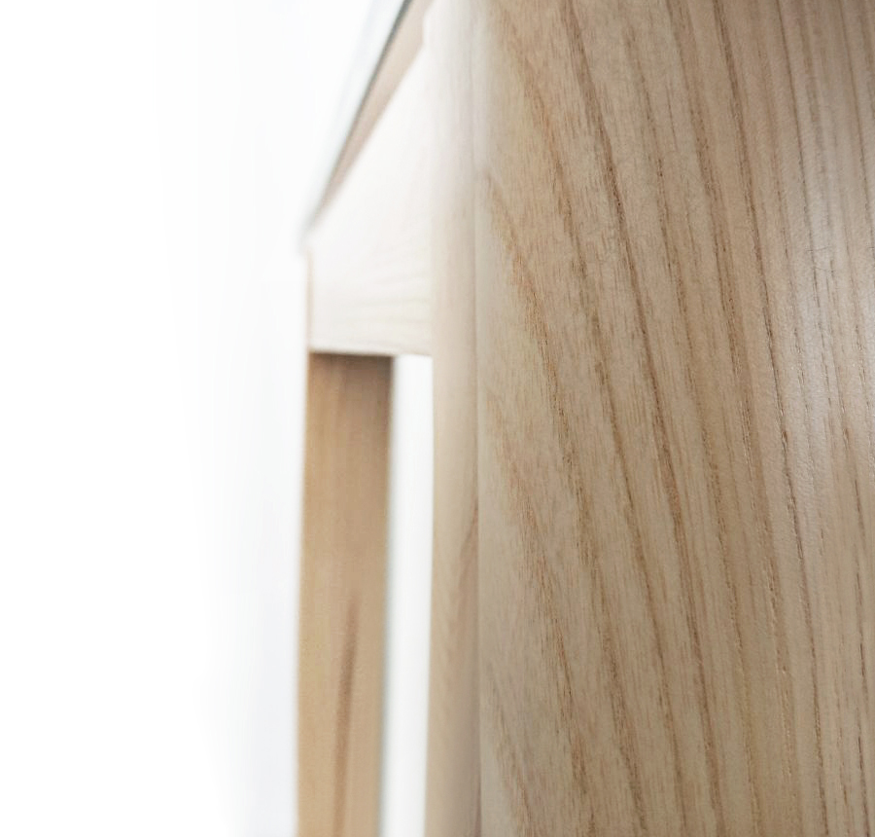
Tree’s texture and wide growth rings create a distinctive pattern.
Stained and lacquered wood reveals the pattern even more.
Natural wood tends to change colour over time.
Note: wood is sensitive to sunlight and temperature changes.

Slide 8
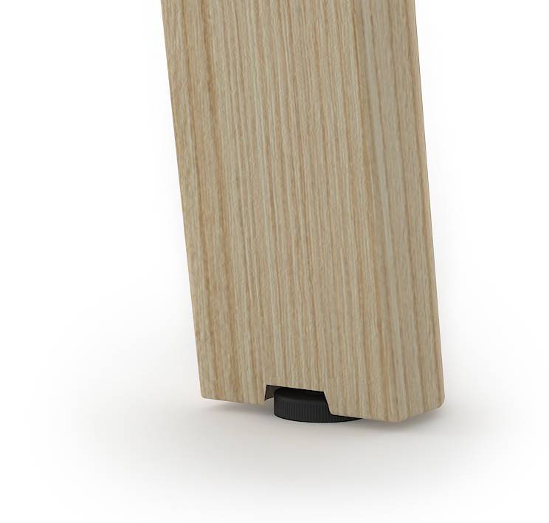
Adjustable legs height
All tables have plastic adjustable gliders you won‘t even notice. It enables you to adjust the height in the range of 10 mm. Useful especially on uneven surfaces.

Slide 9
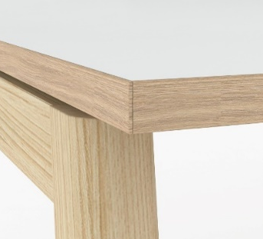
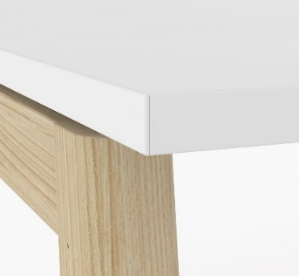
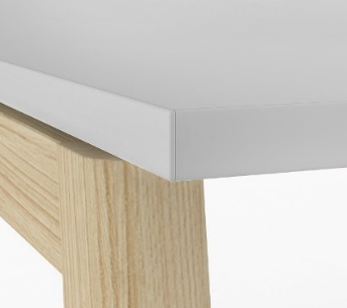
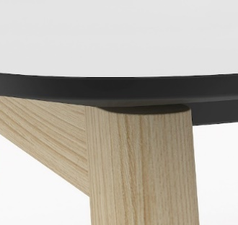
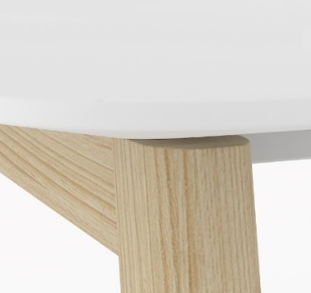
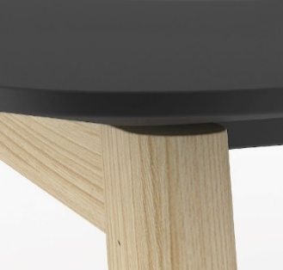
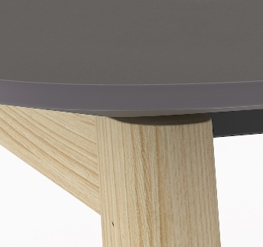
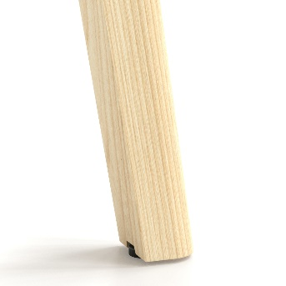
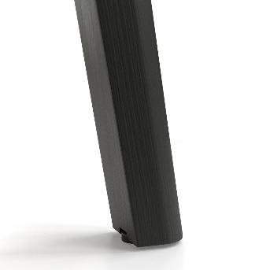
Various desktop types and textures for subtle combinations
Melamine with ABS edging:
M1D2
M1
N
HPL / HPL Fenix* with sloping edges:
H70B01
H70B02
H16B01*
H17B03*
Solid wood legs:
W2
W3

Slide 10
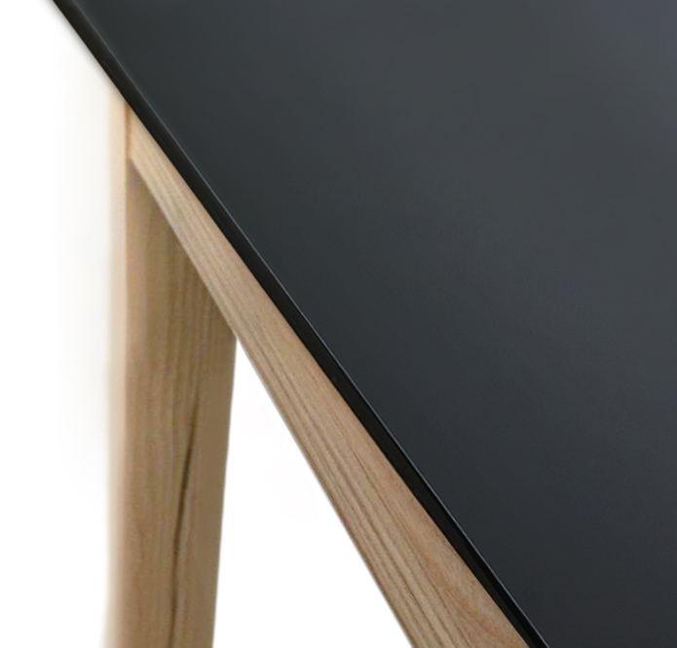
PerfectSense Matt laminate
High-quality finish stands out with its unusual look and surface feel.
Advantages:
super-matt surface;
resistant and dense;
anti-fingerprint property;
minimal cleaning effort.

Slide 11
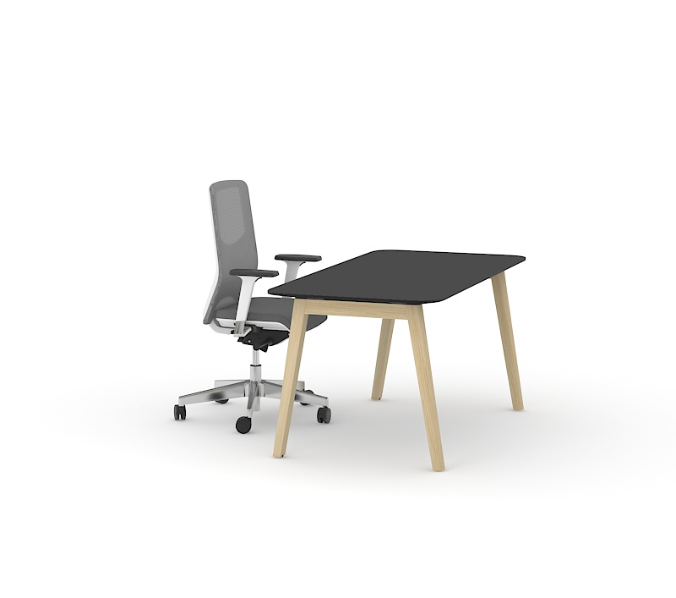
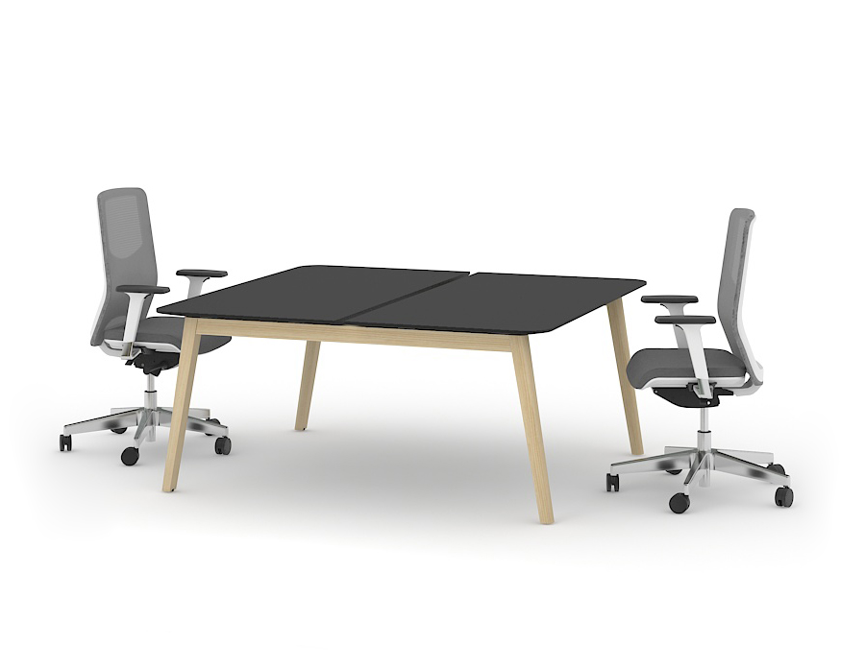
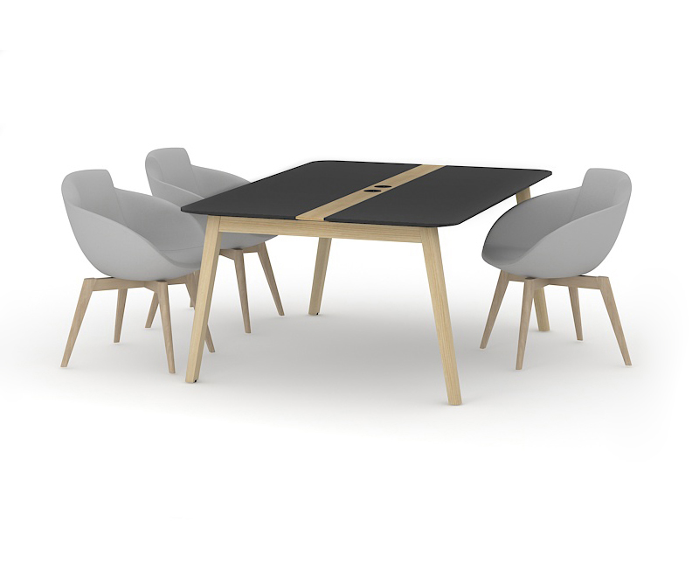
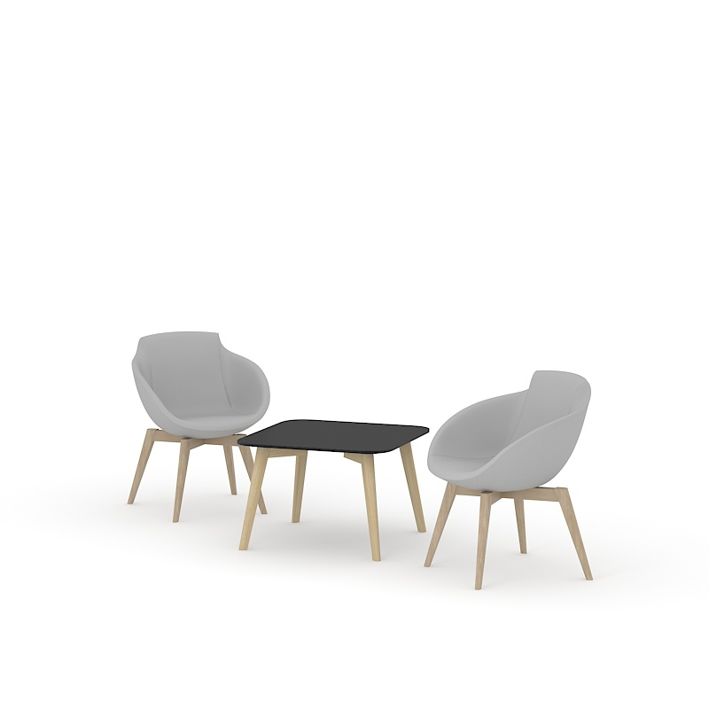
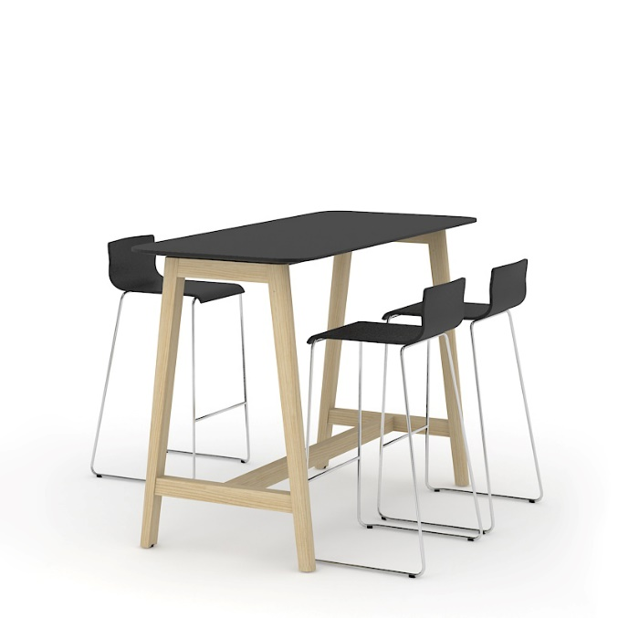
Categories
Single desks
Bench desks
Meeting tables
High tables
Coffee tables

Slide 12
Single desks

Slide 13
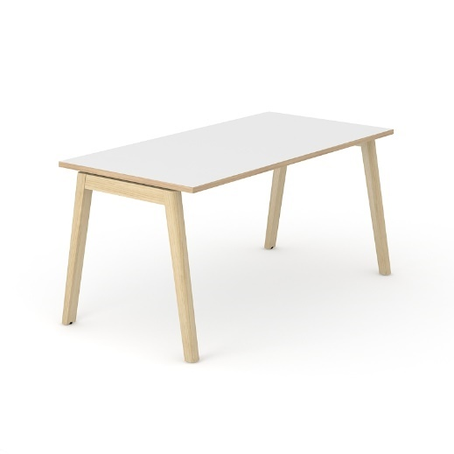
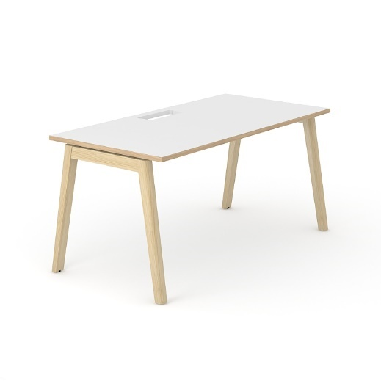
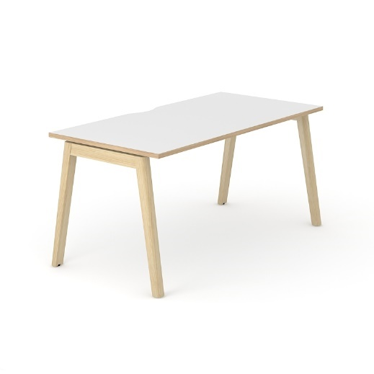
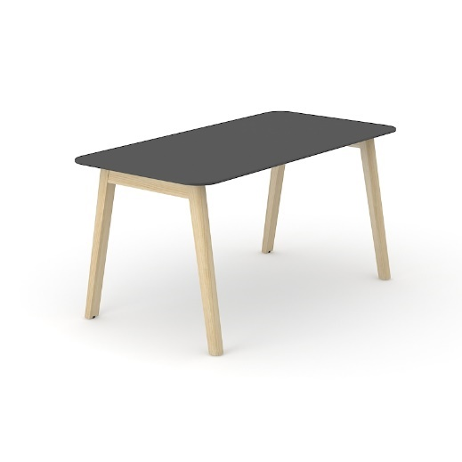
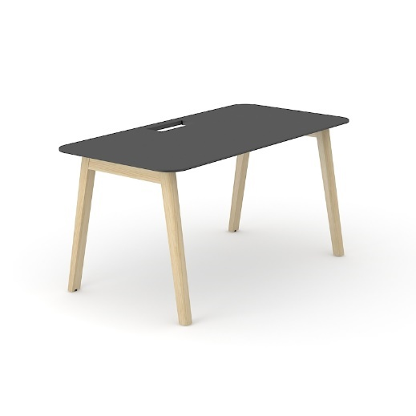

Range
Plain
Desktop with cut-out for grommet
Desktop with cut-out (scallop) for wire management
Melamine
1200 / 1400 / 1600x700 mm
1200 / 1400 / 1600 / 1800x800 mm
H=740 mm
HPL/HPL Fenix
1400 / 1600x700 mm
1400 / 1600 / 1800x800 mm
H=740 mm

Slide 14
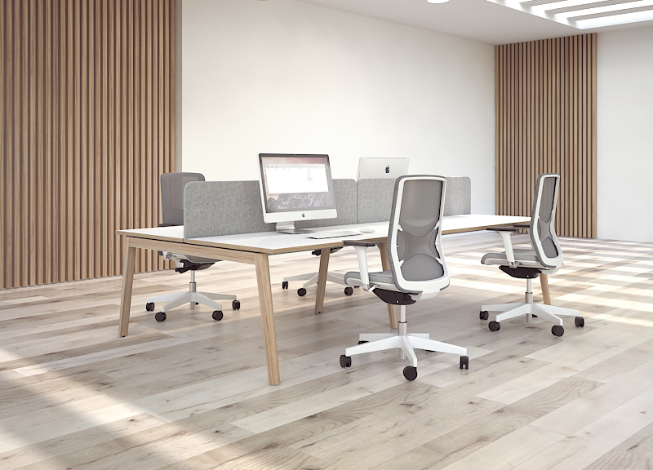
Bench desks

Slide 16
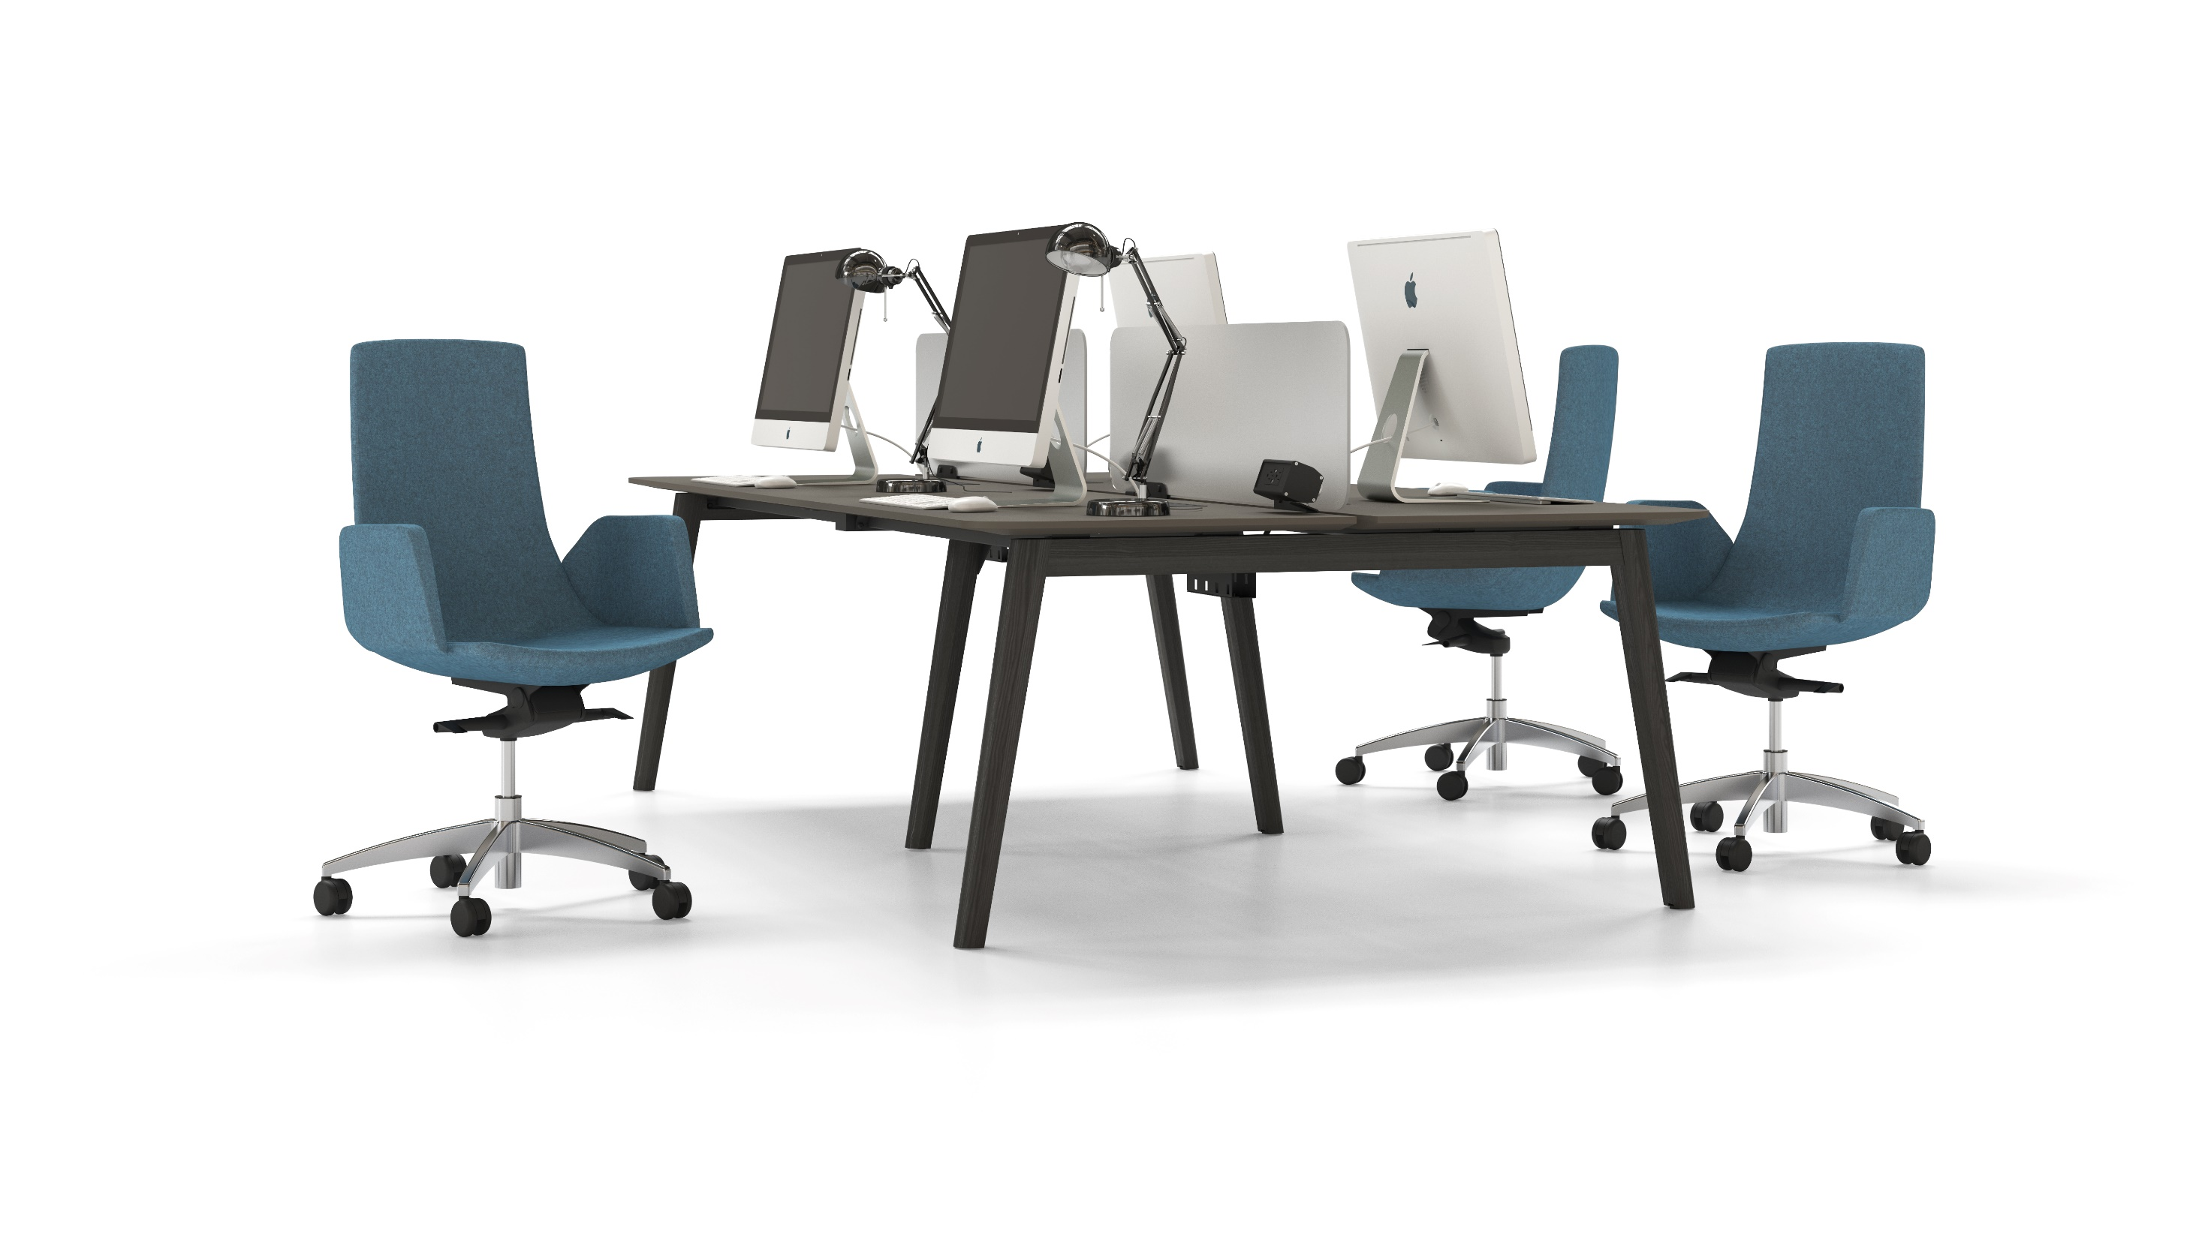

Slide 17
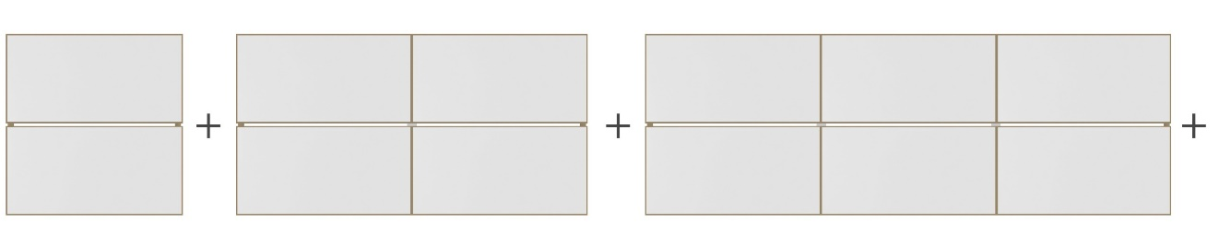
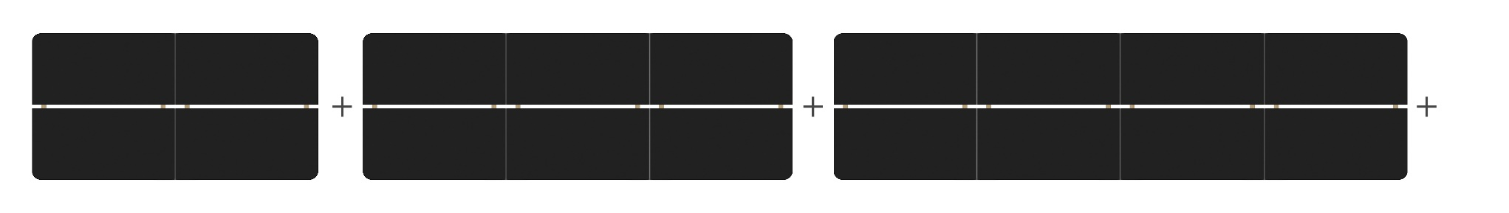
Bench desks
Can be easily adapted to the office dynamics by using supplementary units to increase the number of workplaces.
2-desk bench with melamine desktops
4-desk bench with HPL desktops

Slide 18
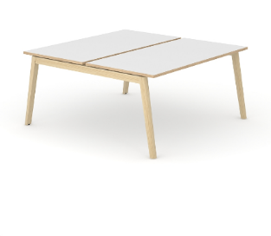
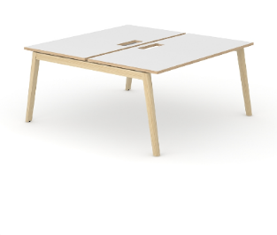
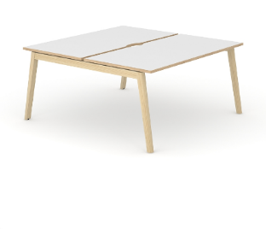
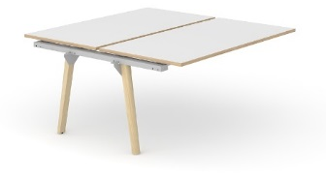
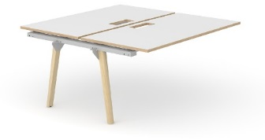

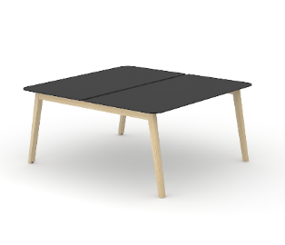

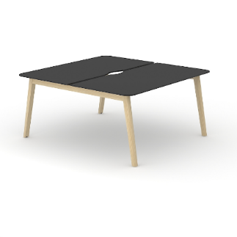
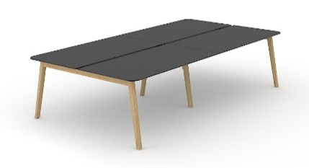
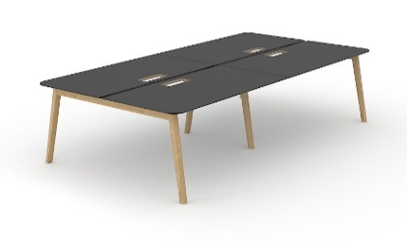
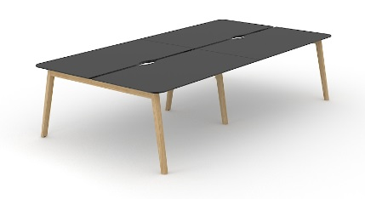
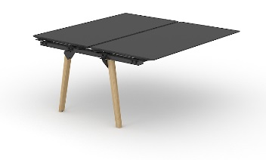
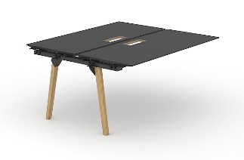
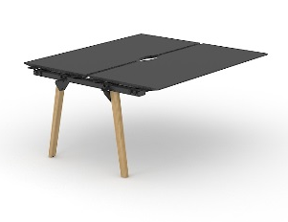
Range
Plain
Desktop with
cut-out for grommet
Desktop with cut-out (scallop) for wire management
Melamine
1200 / 1400 / 1600x1440 mm
1200 / 1400 / 1600 / 1800x1640 mm
H=740 mm
HPL/HPL Fenix
1400 / 1600x1440 mm
1400 / 1600 / 1800x1640 mm
H=740 mm
2800 / 3200x1440 mm
2800 / 3200 / 3600x1640 mm
H=740 mm
1400 / 1600x1440 mm
1400 / 1600 / 1800x1640 mm
H=740 mm

Slide 19
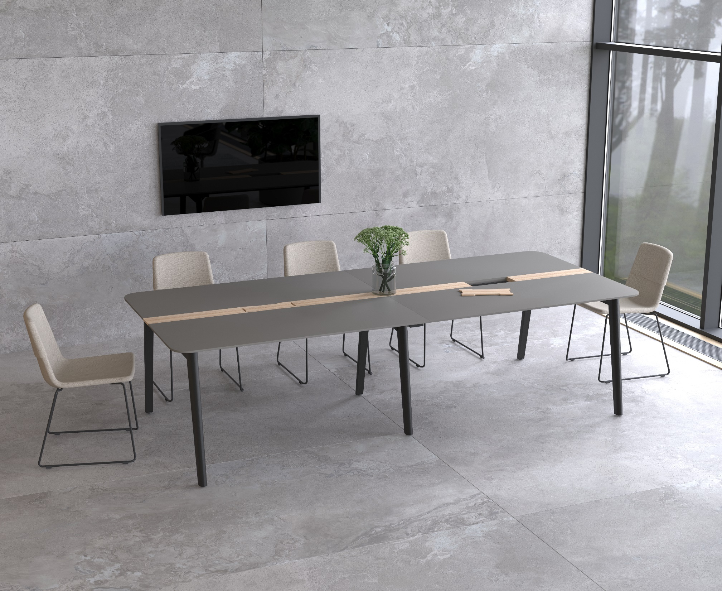
Meeting tables

Slide 20
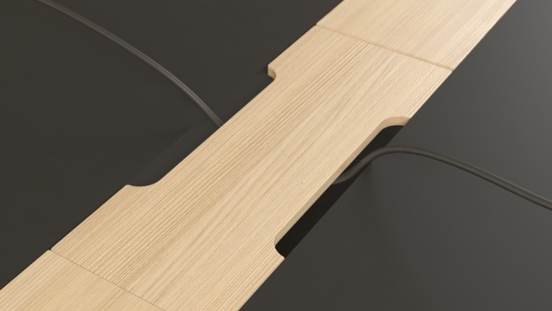
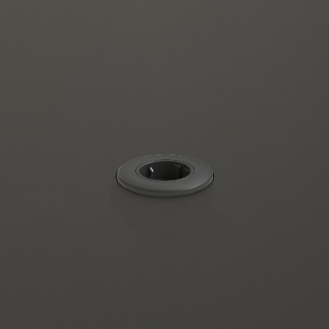
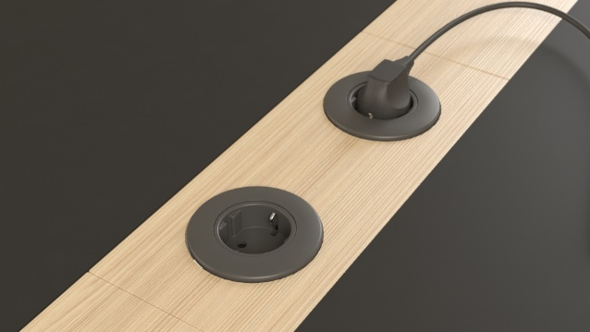
Ash wood veneer insert is not only an eye-catching element, but also a convenient electrical and cable management solution for the meeting area.
One or two grommets for wire management and metal cable trays
One or two power sockets* and metal cable trays
*Meet the EU / UK / FR / US standards.

Slide 21
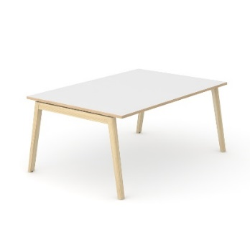

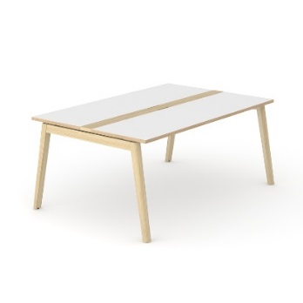













Range
Plain
With power sockets and cable tray
With wood insert and grommets
With wood insert and power sockets
Melamine
HPL/HPL
Fenix
1200 / 1600 / 1800 / 2400 / 2800x1200 mm
1400 / 1600x1400 mm
2400x1000 mm*
H=740 mm
*plain desktop, desktop with power sockets and cable tray

Slide 22
High and coffee tables

Slide 23






Range
High tables
Coffee tables (round)
Coffee tables (square)
Melamine
HPL/HPL Fenix
1200 / 1400 / 1600 / 1800x700 mm
H=1050 mm
Ø700 mm
H=480 mm
700x700 mm
H=480 mm

Slide 24



Screens
Plexiglas (Perspex) screens and modesty panels
Fabric screens
Fabric screens with metal frame

Slide 25






Accessories
Power socket blocks
Cable clips
Metal grommet
Cable ducts
Cable trays
Vertical cable tray (suitable only for central wood leg)

Slide 26

NOVA Wood
Nature’s touch!

