Slide 1
MYAMI
Home in your office

Slide 2
MYAMI
MYAMI – soft furniture collection with exceptional comfort
Notes:
MYAMI is a soft furniture collection that blends exceptional comfort with a home-like cosiness, creating a pleasant experience in the office—whether for relaxation, informal conversations, or collaboration.

Slide 3
MYAMI
MUCNYC design studio
Stefanie Kubanek and Michael Geldmacher—a dynamic design duo bridging Munich and New York—blend global expertise with creative mastery to craft thoughtful, impactful solutions across products, systems, and experiences.
Notes:
The designers behind the MYAMI collection are Stefanie Kubanek and Michael Geldmacher, who together form the design studio MUCNYC. This dynamic duo has extensive experience in furniture design, bridging Munich and New York while combining global expertise with creative excellence.

Slide 4
MYAMI
“
The MYAMI collection is inspired by the elegance of Art Deco, featuring curved, architectural details that evoke a sense of timeless sophistication. The name captures this spirit while also reflecting a sense of personal connection. MYAMI is designed to make you instantly feel at home.
Stefanie Kubanek and Michael Geldmacher
Notes:
The soft furniture collection is inspired by the architecture of Miami's South Beach district, featuring the elegant elements of classic Art Deco design with curved forms and a bold aesthetic.
The name also resonates with the French phrase "mon ami" or the Spanish "mi amigo," both meaning "my friend." This symbolically emphasises the collection's friendliness and the sense of cosiness it creates.

Slide 5
MYAMI
The MYAMI collection includes:
Lounge chair
Three-seater sofa
Two-seater sofa
Notes:
The MYAMI collection includes three types of soft furniture: a two-seater sofa, a three-seater sofa and a lounge chair.

Slide 6
MYAMI
Key features of the collection:
Exceptional comfort.
Timeless, elegant design.
Effortless adaptability to diverse needs and interior settings.
Notes:
The MYAMI collection features an exceptional sense of comfort and a timeless, elegant design that can be effortlessly adapted to diverse needs and interior settings.

Slide 7
Exceptional comfort
Notes:
The MYAMI collection is the softest compared to the other upholstered furniture in the NARBUTAS product portfolio.

Slide 8
MYAMI
Well-thought-out solutions for a pleasant relaxation experience
Cushions and seat adapt naturally to body weight.
Well-balanced softness.
The proportions of the seat and backrest provide additional stability and comfort.
Notes:
High-quality MYAMI collection furniture is suited for different people. The cushions and seat, made of layers with varying firmness, adapt to the user's body, ensuring even weight distribution and balanced softness. Carefully selected seat and backrest proportions provide additional stability and comfort.

Slide 9
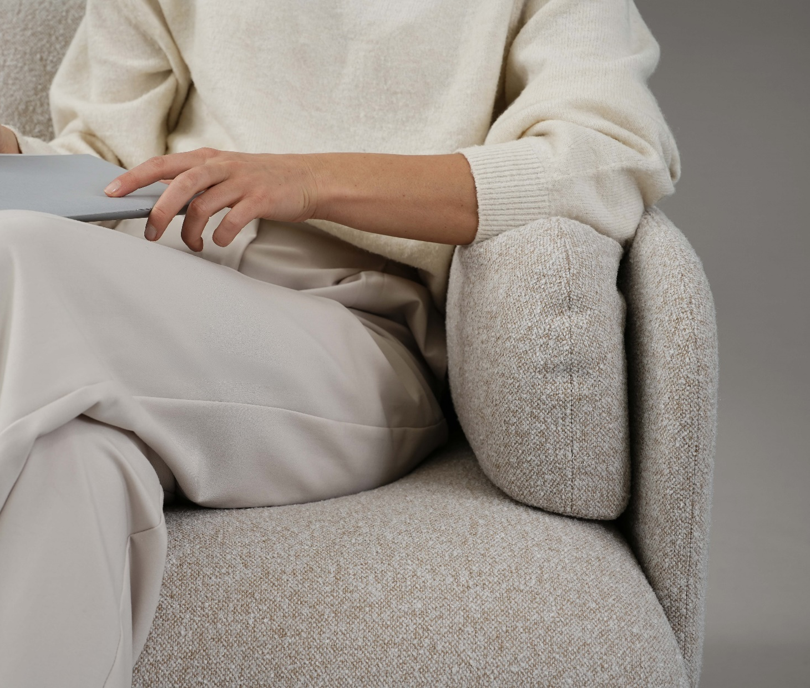
MYAMI
Soft cushions for ultimate relaxation
Notes:
Large, soft backrest cushions and smaller side cushions gently embrace the seated person, providing exceptional comfort for relaxation and rest. The side cushions are also highly convenient for resting the arms.

Slide 10
MYAMI
Dream fabric collection with bouclé effect to enhance cosiness
Notes:
The cosy feel of MYAMI soft furniture is further enhanced by the Dream collection fabric with a bouclé effect. Its distinctive texture resembles home textiles, adding even more warmth to the furniture not only visually but also through its exceptionally soft feel when seated.

Slide 11
Timeless, elegant design
Notes:
According to the product designers, the MYAMI collection features curved, architectural details that evoke a sense of timeless sophistication.

Slide 12
MYAMI
Inspired by the architectural elegance of Art Deco
The standout feature is a seamless, curved backrest that gently embraces the seating area, offering both style and comfort.
Notes:
The modern architecture characteristic of Miami’s South Beach district, which evolved from the Art Deco style, is distinguished by clean geometric lines with decorative accents and rounded or curved edges. This aesthetic served as the inspiration for this soft furniture collection.
The MYAMI sofas and lounge chair stand out with a seamless, curved backrest that subtly embraces the seating area. Art Deco buildings are often visible from any angle. Instead of appearing two-dimensional—the way many buildings look when placed directly next to each other—Art Deco buildings consistently appear three-dimensional.
The same applies to MYAMI soft furniture—no matter where you place it, its aesthetic appeal remains visible from both the front and back. The furniture subtly embraces the user from a 360-degree angle, providing unparalleled comfort.

Slide 13
“
MYAMI
The shapes and forms are designed to capture the play of light and shadow, combining crisp lines with soft contours to create a warm and inviting atmosphere.
Stefanie Kubanek and Michael Geldmacher
Notes:
The product designers emphasise that MYAMI shapes and forms are designed to capture the play of light and shadow, combining crisp lines with soft contours to create a warm and inviting atmosphere.

Slide 14
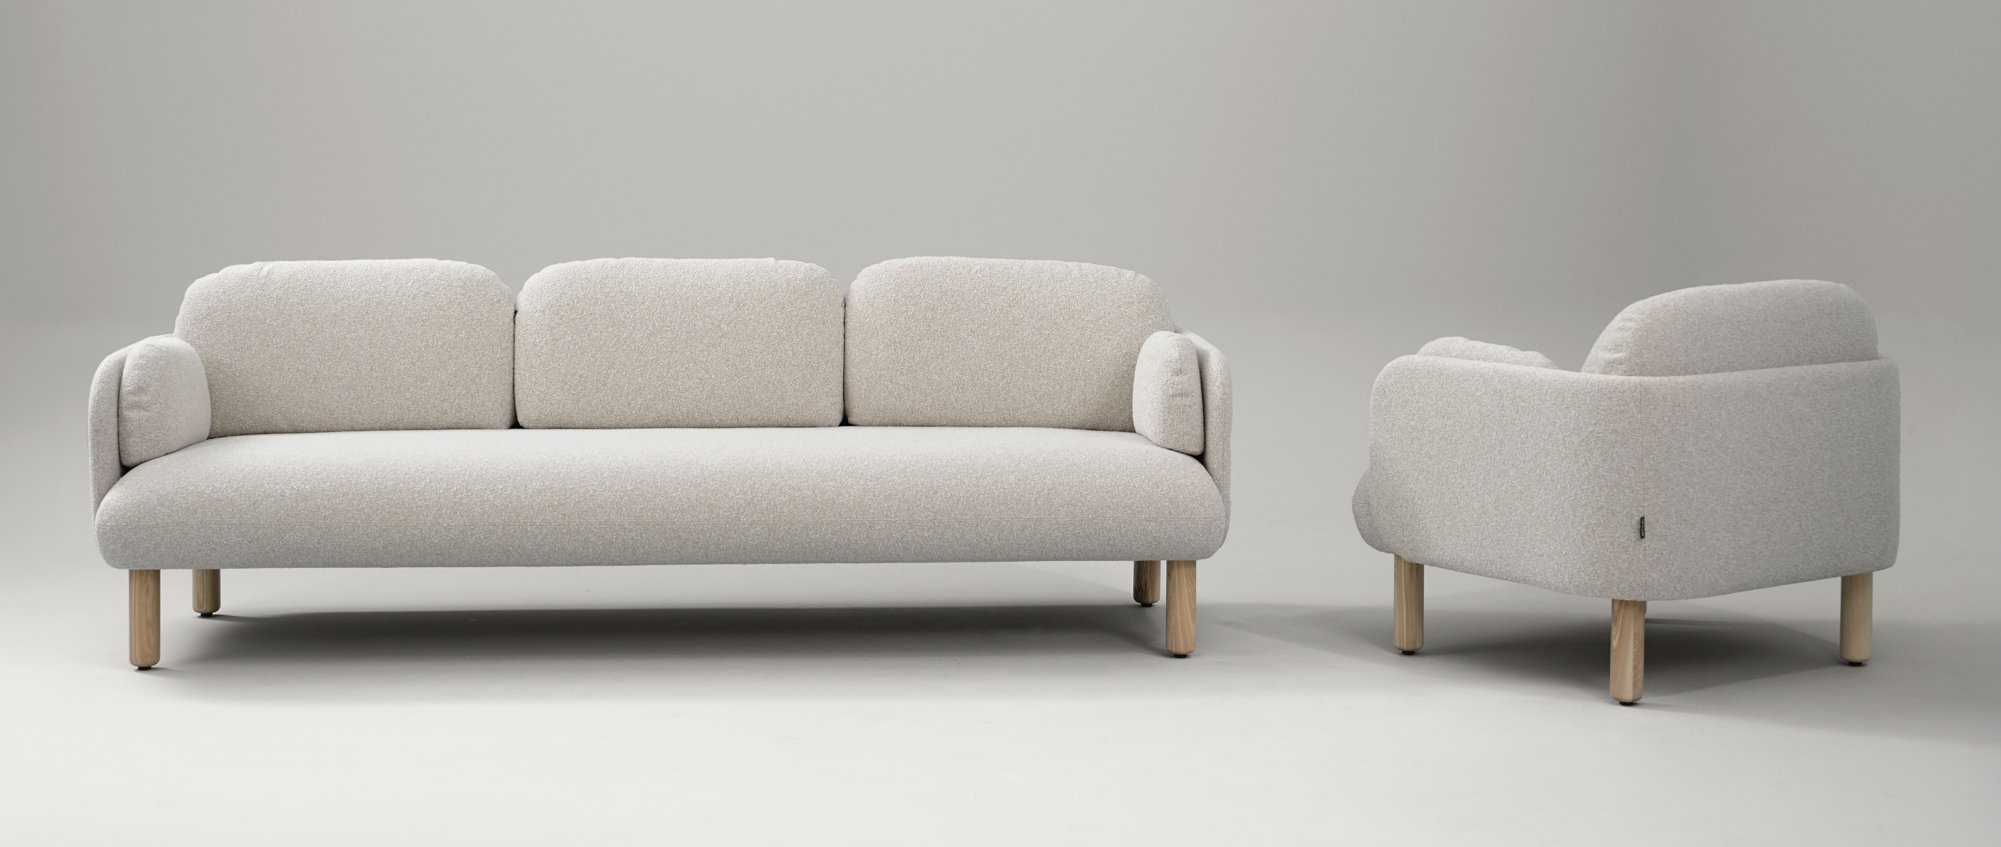
MYAMI
Subtle rounded shapes
Notes:
MYAMI soft furniture has been designed with great attention to detail and craftsmanship. Its sleek, seamless design, characterised by subtly rounded shapes and lines echoed in the cushions, armrests, seat, and wooden legs, creates a sense of cosiness and naturally draws you in to sit down.

Slide 15
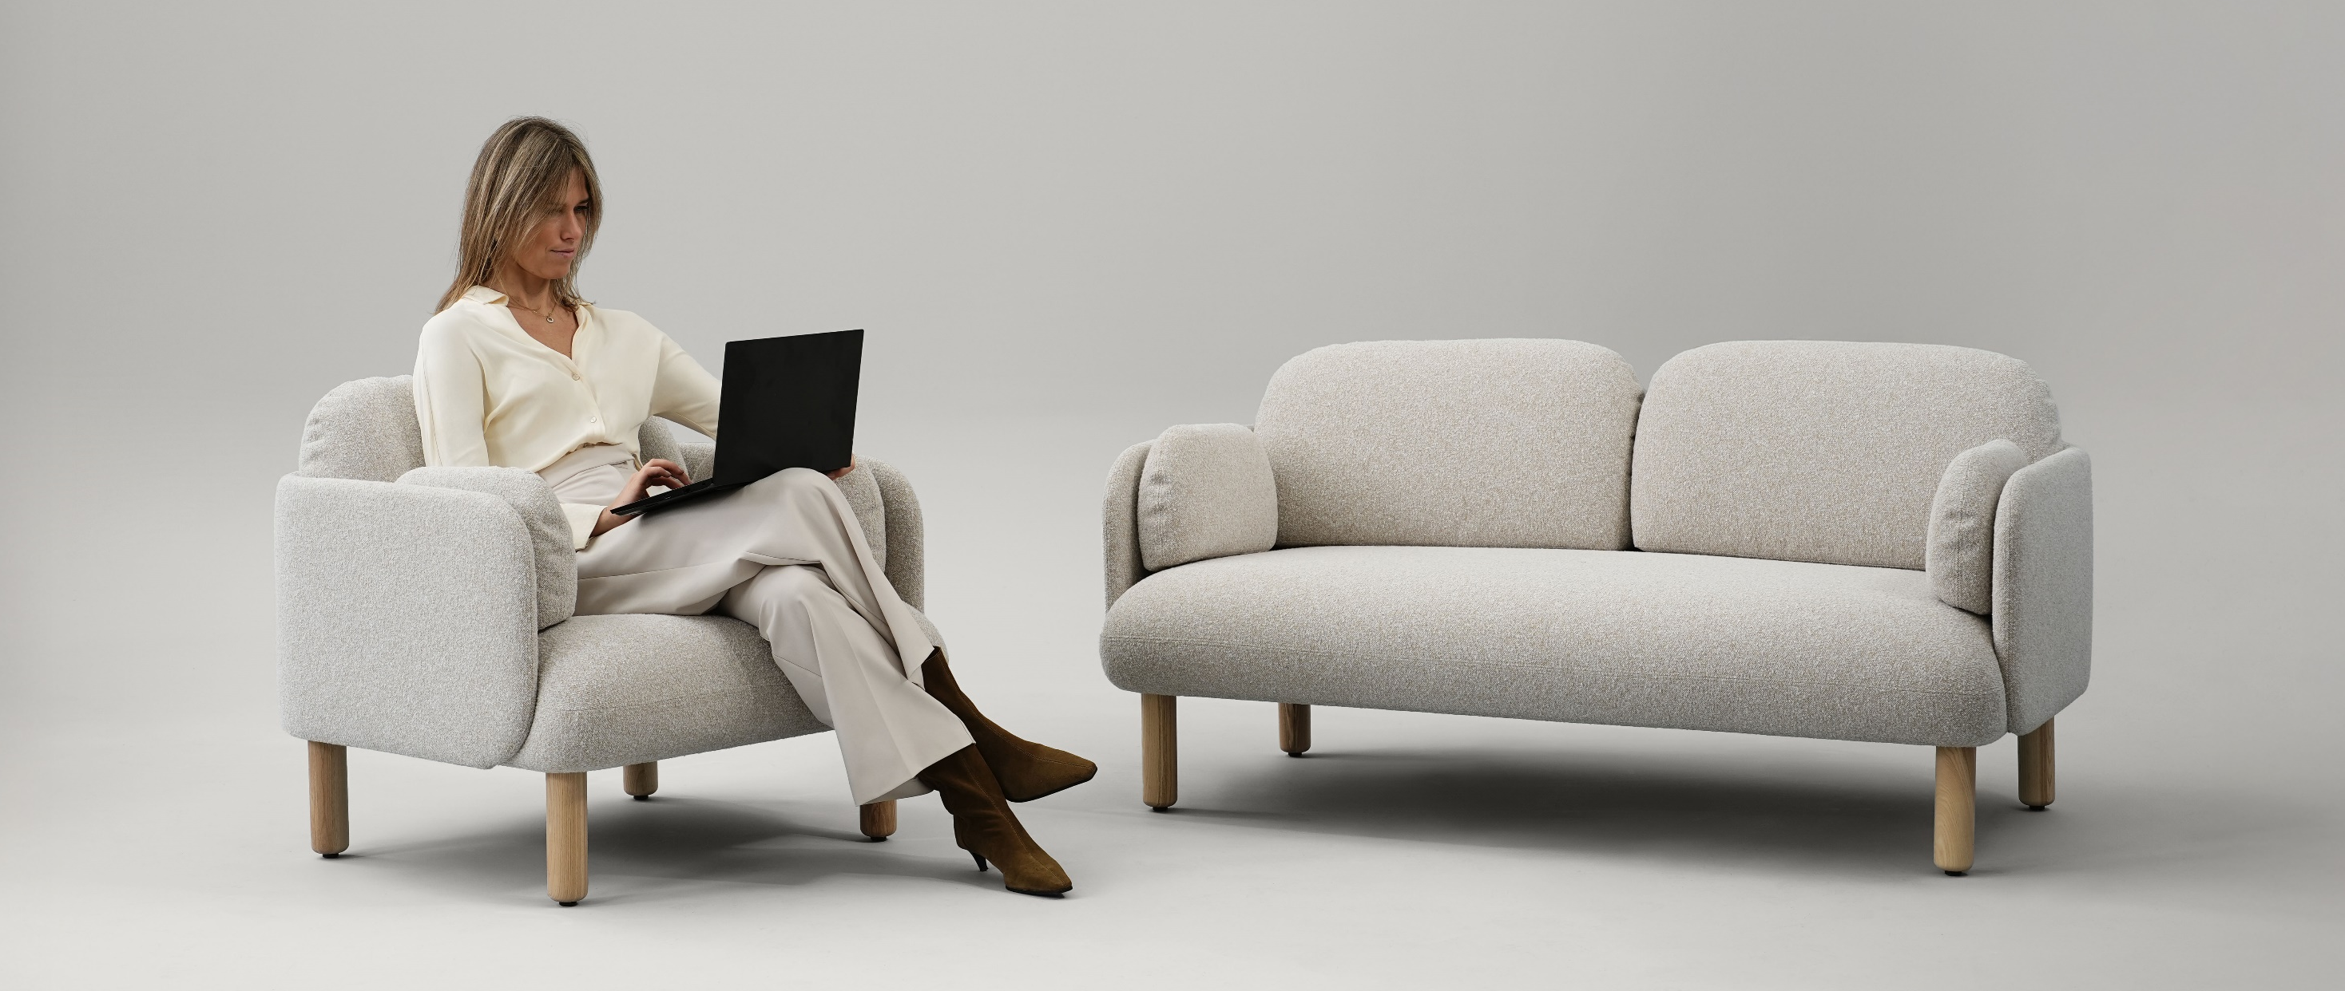
MYAMI
Simplicity, centered on what truly matters—the human experience
Notes:
The design aims for clarity, balance, and visual harmony. Human-centered design puts people first, which is why the solutions are practical, meaningful, and impactful, focusing on the most enjoyable experience. Simplicity and elegance make this soft furniture collection timeless.

Slide 16
Effortless adaptability to diverse needs and interior settings
Notes:
Thanks to their versatility, both sofas and lounge chairs can be easily adapted to diverse needs and interior settings.

Slide 17
MYAMI
From optimal to solid solutions
The MYAMI soft seating collection offers a wide selection of fabrics and bases, allowing you to create both an optimal version and one with gravitas.
Notes:
A wide selection of fabrics and bases offers various possibilities to create different soft furniture combinations—both optimal and solid.

Slide 18
MYAMI
Four bases to create different characters
Notes:
We offer four different bases: two in metal and two in wood, so you can choose according to the interior style you are creating.
Metal legs are an economical, versatile choice for many modern office interiors.
Metal sled legs - perfect for achieving a formal, refined look.
Soft furniture with solid ash wood legs combines modernity and cosiness and will appeal to those who appreciate a less formal look.
Solid ash wood frame with legs – the most home-like option, particularly well-suited for classic interiors.

Slide 19
MYAMI
Notes:
This is what a cosy, stylish relaxation area looks like in a small office with MYAMI soft furniture.

Slide 20
MYAMI
Notes:
A solid image is created in the office waiting area, which would also be suitable for an executive's workspace.

Slide 21
MYAMI
Notes:
MYAMI is well suited not only for reception lounge areas but also for larger public spaces, such as hotels.

Slide 22
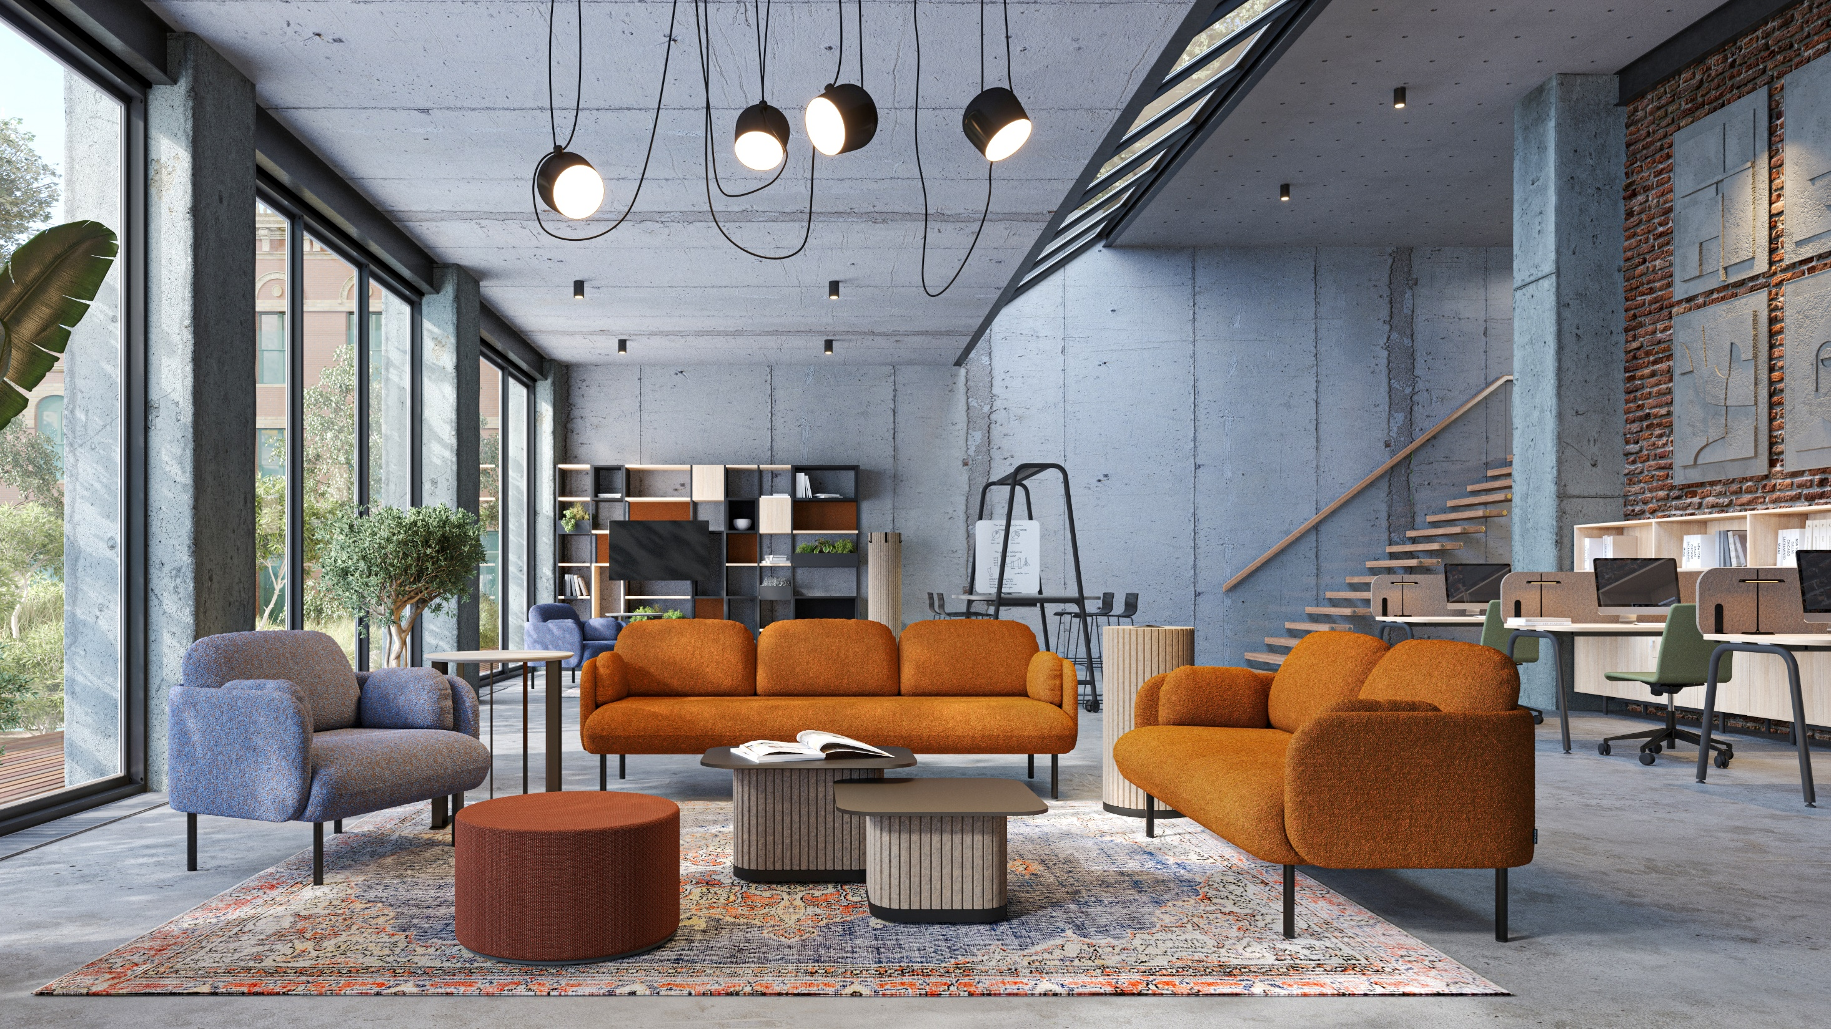
MYAMI
Notes:
Finally, we see MYAMI applied to a multifunctional mobile workspace or training area.

Slide 23
Range

Slide 24
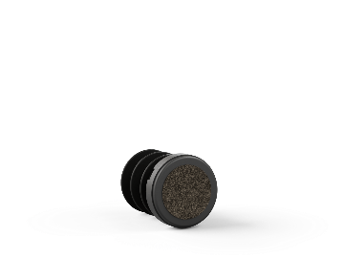
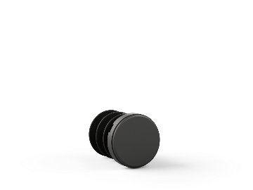
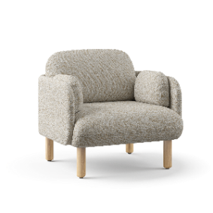
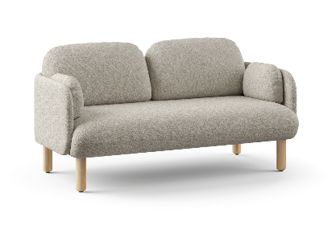
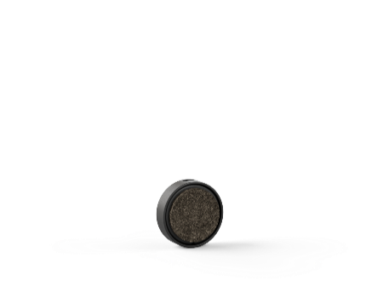
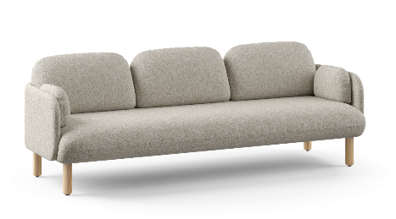
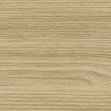
MYAMI
Soft furniture | Fabrics | Bases | Base colours | Glides
 | Berta Step & Step Melange Austea Cyber Dream Velito Synergy
Powder-coated metal legs
For hard or soft flooring (optional)
Lounge chair
Powder-coated metal sled legs
Two-seater sofa
Double-sided glides hard or soft flooring
Solid ash wood legs
Three-seater sofa
Solid ash wood frame with legs

Slide 25
narbutas.com

