Slide 1
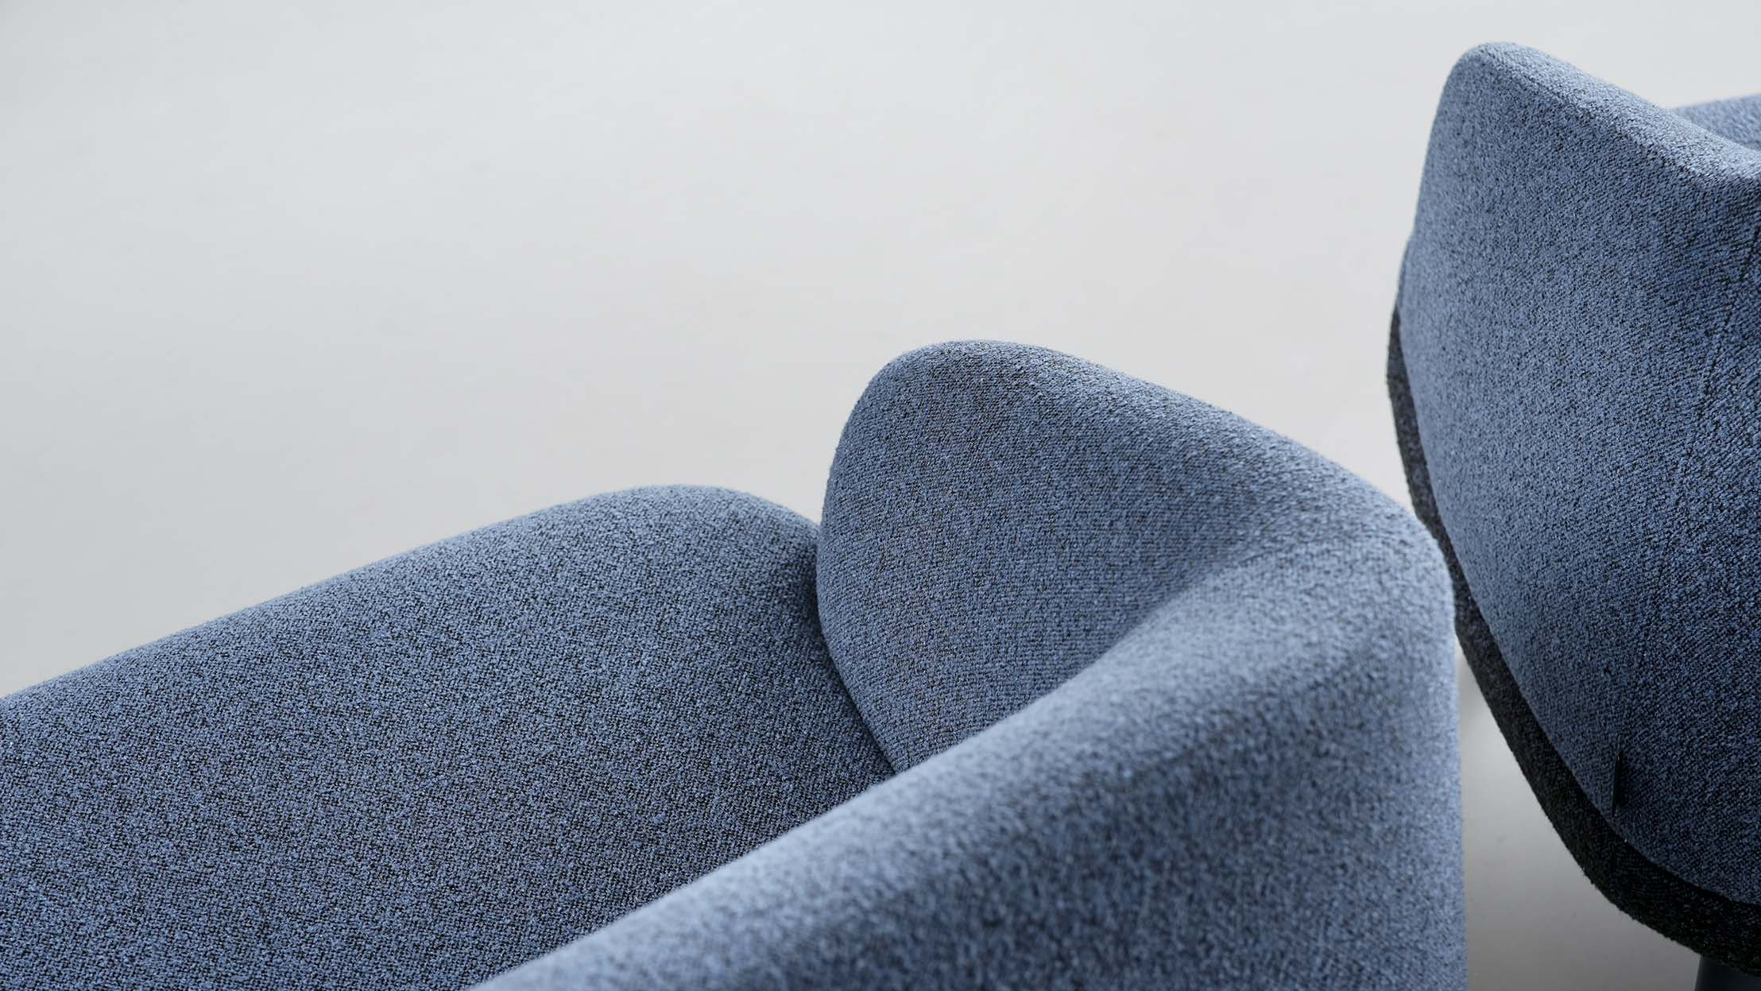
KOPA
Luxury of slowing down

Slide 2
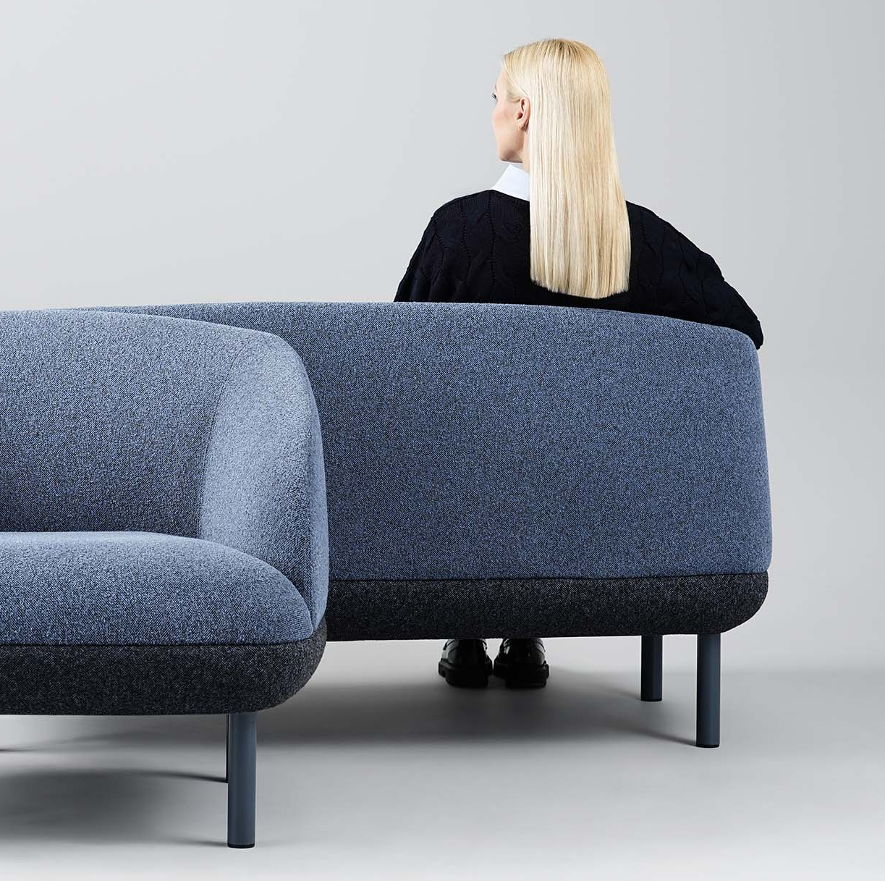
KOPA
A response to today’s pace
In a fast-paced environment, moments of calm and emotional comfort are increasingly rare. Soft furniture becomes a subtle form of everyday luxury, inviting people to pause, slow down, and feel at ease.
Notes:
In today’s environment, moments of calm and emotional comfort are becoming increasingly rare. The spaces around us are often noisy and overstimulating, leaving little room to pause, breathe, and regain a sense of balance. Comfort is sometimes understood only in functional terms — seating may be ergonomic, yet still feel uninviting, while interiors often prioritise a representative style that is not always centred on the comfort of the people within them. With this in mind, we created KOPA soft furniture. Designed to provide the right level of comfort, it becomes a subtle form of everyday luxury — inviting people to pause, slow down, and feel at ease.

Slide 3
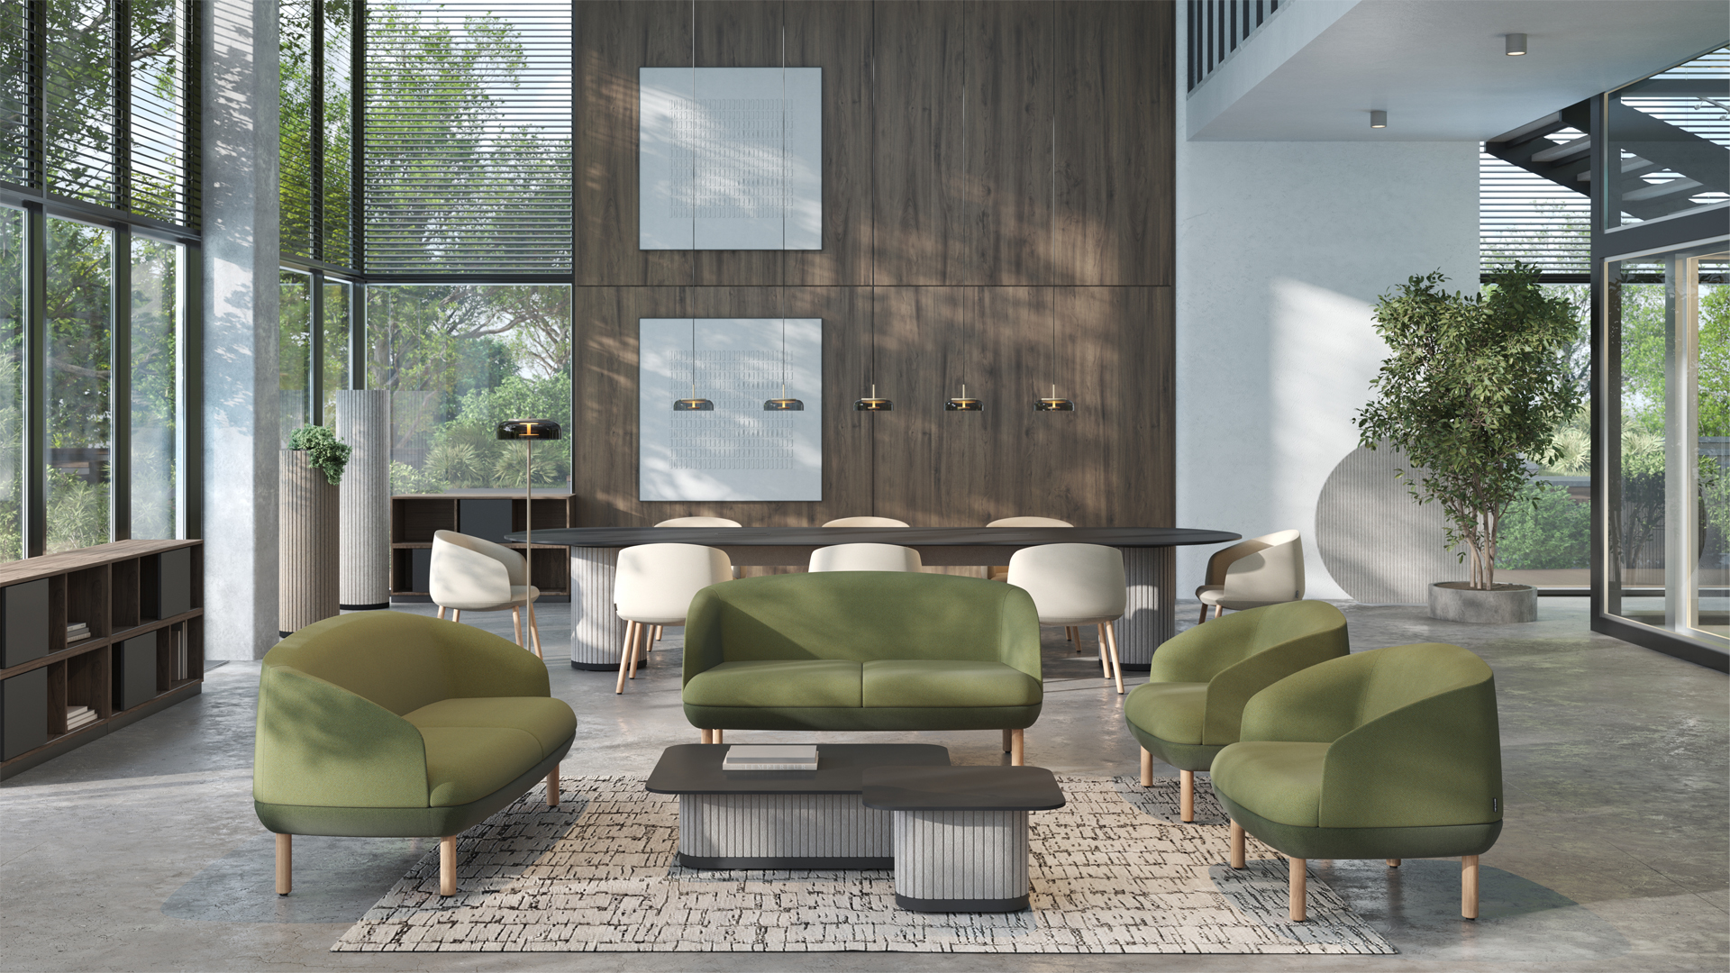
KOPA
KOPA – sophisticated design, uplifting comfort
Notes:
KOPA is a sophisticated soft seating collection, offering uplifting comfort for everyday moments — from short breaks to team or individual meetings.

Slide 4

KOPA
“
At the heart of the collection lies the concept of 360-degree comfort — not only the comfort experienced while seated, but also the one conveyed through design, shapes, upholstery, and colours, because today comfort is a small everyday luxury we should never give up — a simple yet essential form of self-care.
Orlandini Design
Notes:
KOPA was designed by the Italian studio Orlandini Design, whose approach brings together long-standing professional experience in industrial design across both residential and contract / office environments with a keen attention to new trends, materials, and technologies. The studio is known for a distinctive style defined by formal clarity and carefully considered technical solutions. At the heart of the KOPA collection lies the concept of 360-degree comfort — not only the comfort experienced in use, but also the comfort conveyed through design, shapes, upholstery, and colours. As designer Folco Orlandini says, “Comfort becomes a small everyday luxury we should not give up.”

Slide 5

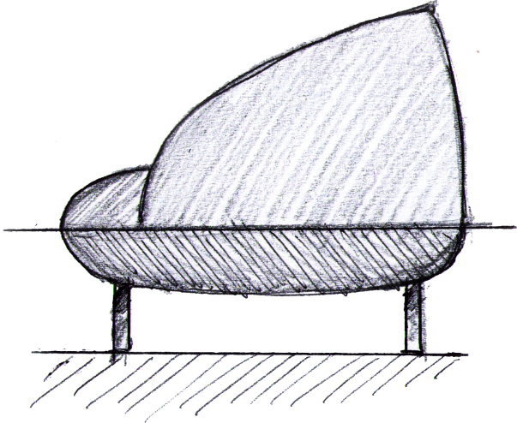
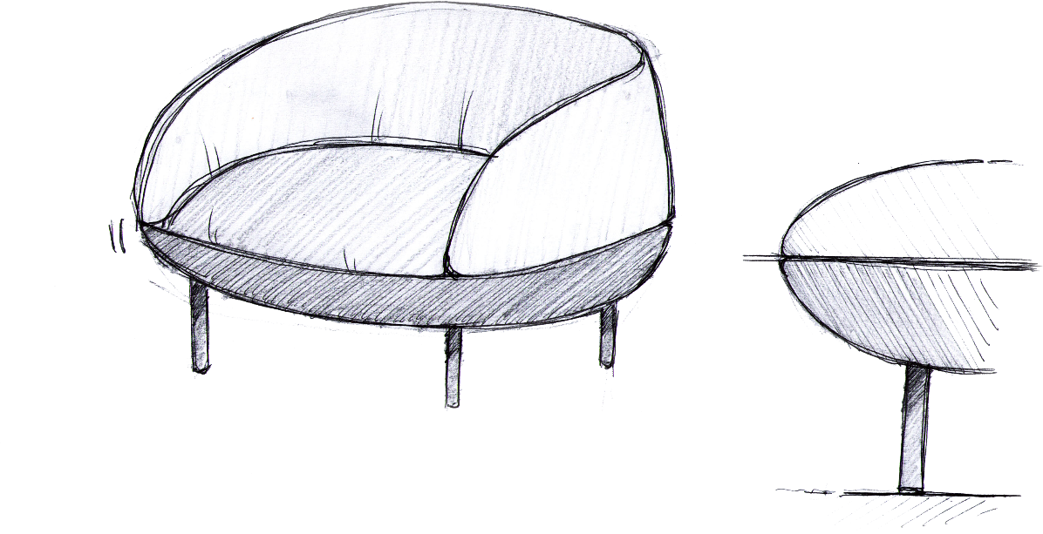
KOPA
“
Dune-inspired design language
The collection translates a sense of stillness and ease. Inspired by sand dunes, soft, gracefully contoured lines and harmonious proportions emerge from a slow, conscious design process — centred on listening to the body, movement, and the need for calm.
Orlandini Design
Notes:
KOPA takes its name from the Lithuanian word for a sand dune — a magical gift of nature. Its grace and soft, contoured lines are reflected throughout the collection, shaping its design identity.

Slide 6
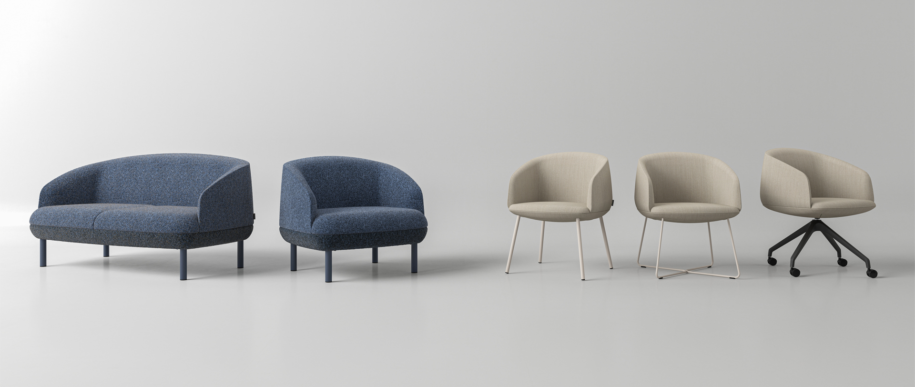
KOPA
The collection consists of three types of soft seating
Sofas
Lounge chairs
Armchairs
Notes:
The KOPA collection consists of a sofa, a lounge chair, and an armchair. This allows the soft seating to be widely used across various office environments.

Slide 7
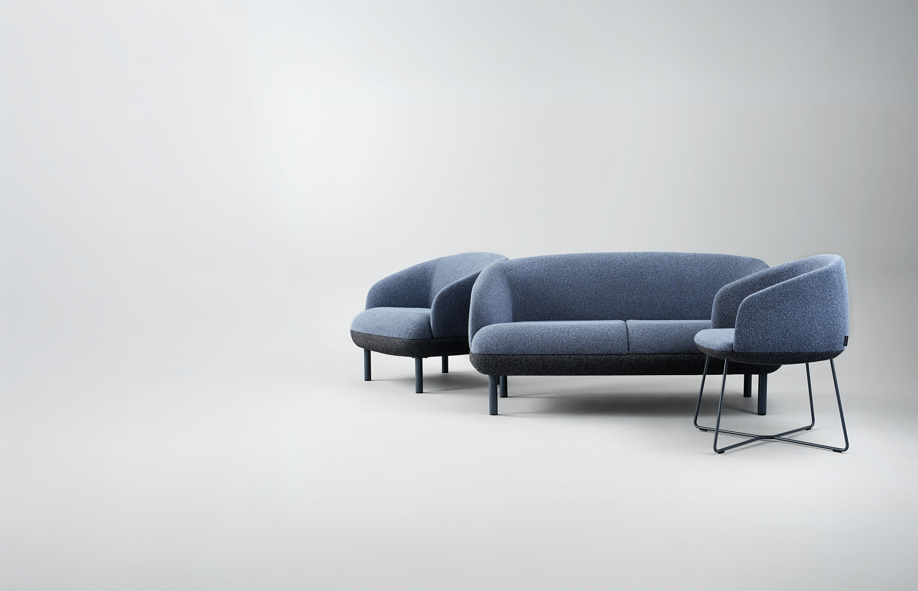
KOPA
Key features
Sophisticated design
Comfort for work–rest balance
Consistent style across different office spaces
Notes:
Let’s take a closer look at the key features of KOPA.

Slide 8
Sophisticated design
KOPA
Sophisticated design is the result of thoughtful simplicity, where form and function come together in a harmonious whole.
Notes:
Sophisticated design is the result of thoughtful simplicity, where form and function come together in a harmonious whole.

Slide 9
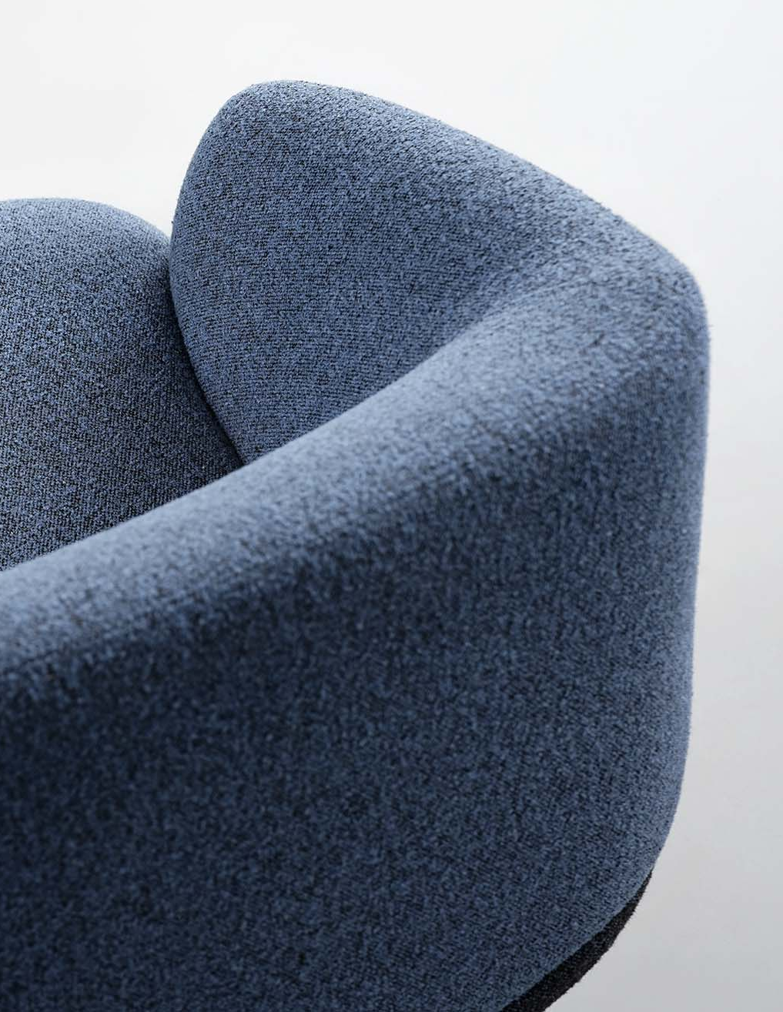
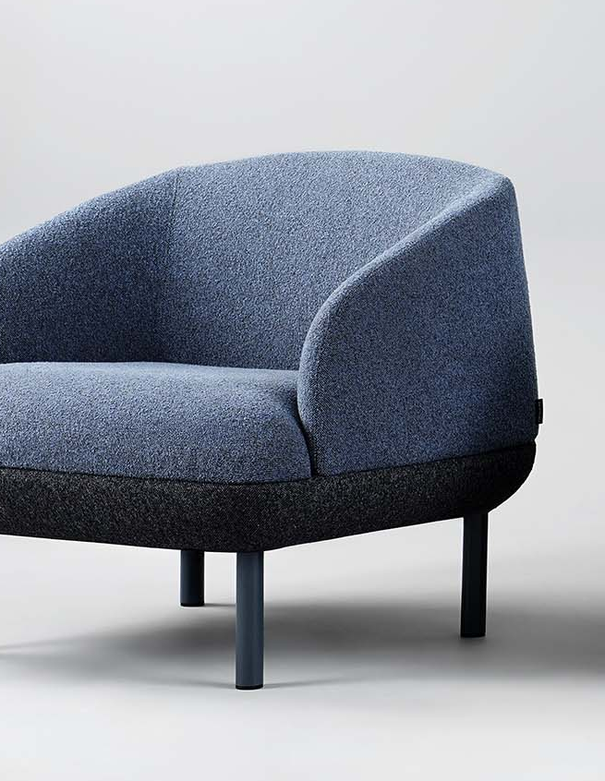
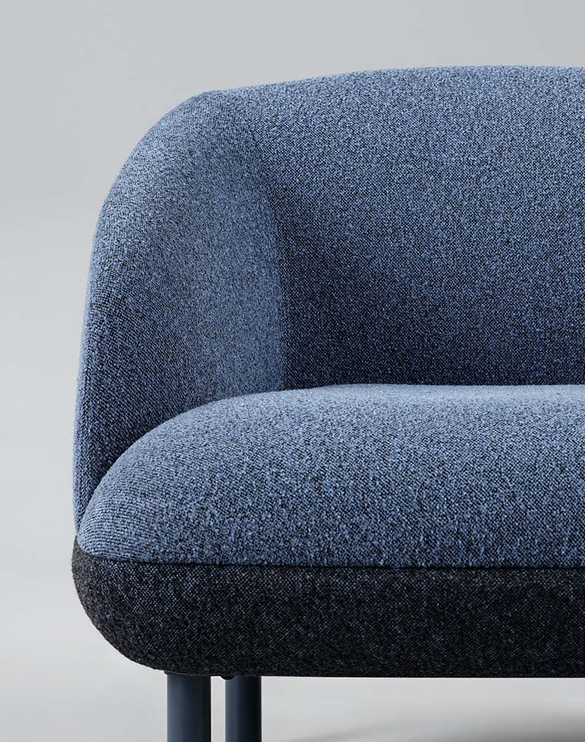
KOPA
The aesthetics of gracefully contoured forms
Notes:
Soft seating with rounded, gently voluminous forms creates a sense of warmth, subtly highlighting the office’s contemporary character and its openness to both visitors and employees, while a sophisticated design with clean lines maintains a professional and representative office image.

Slide 10
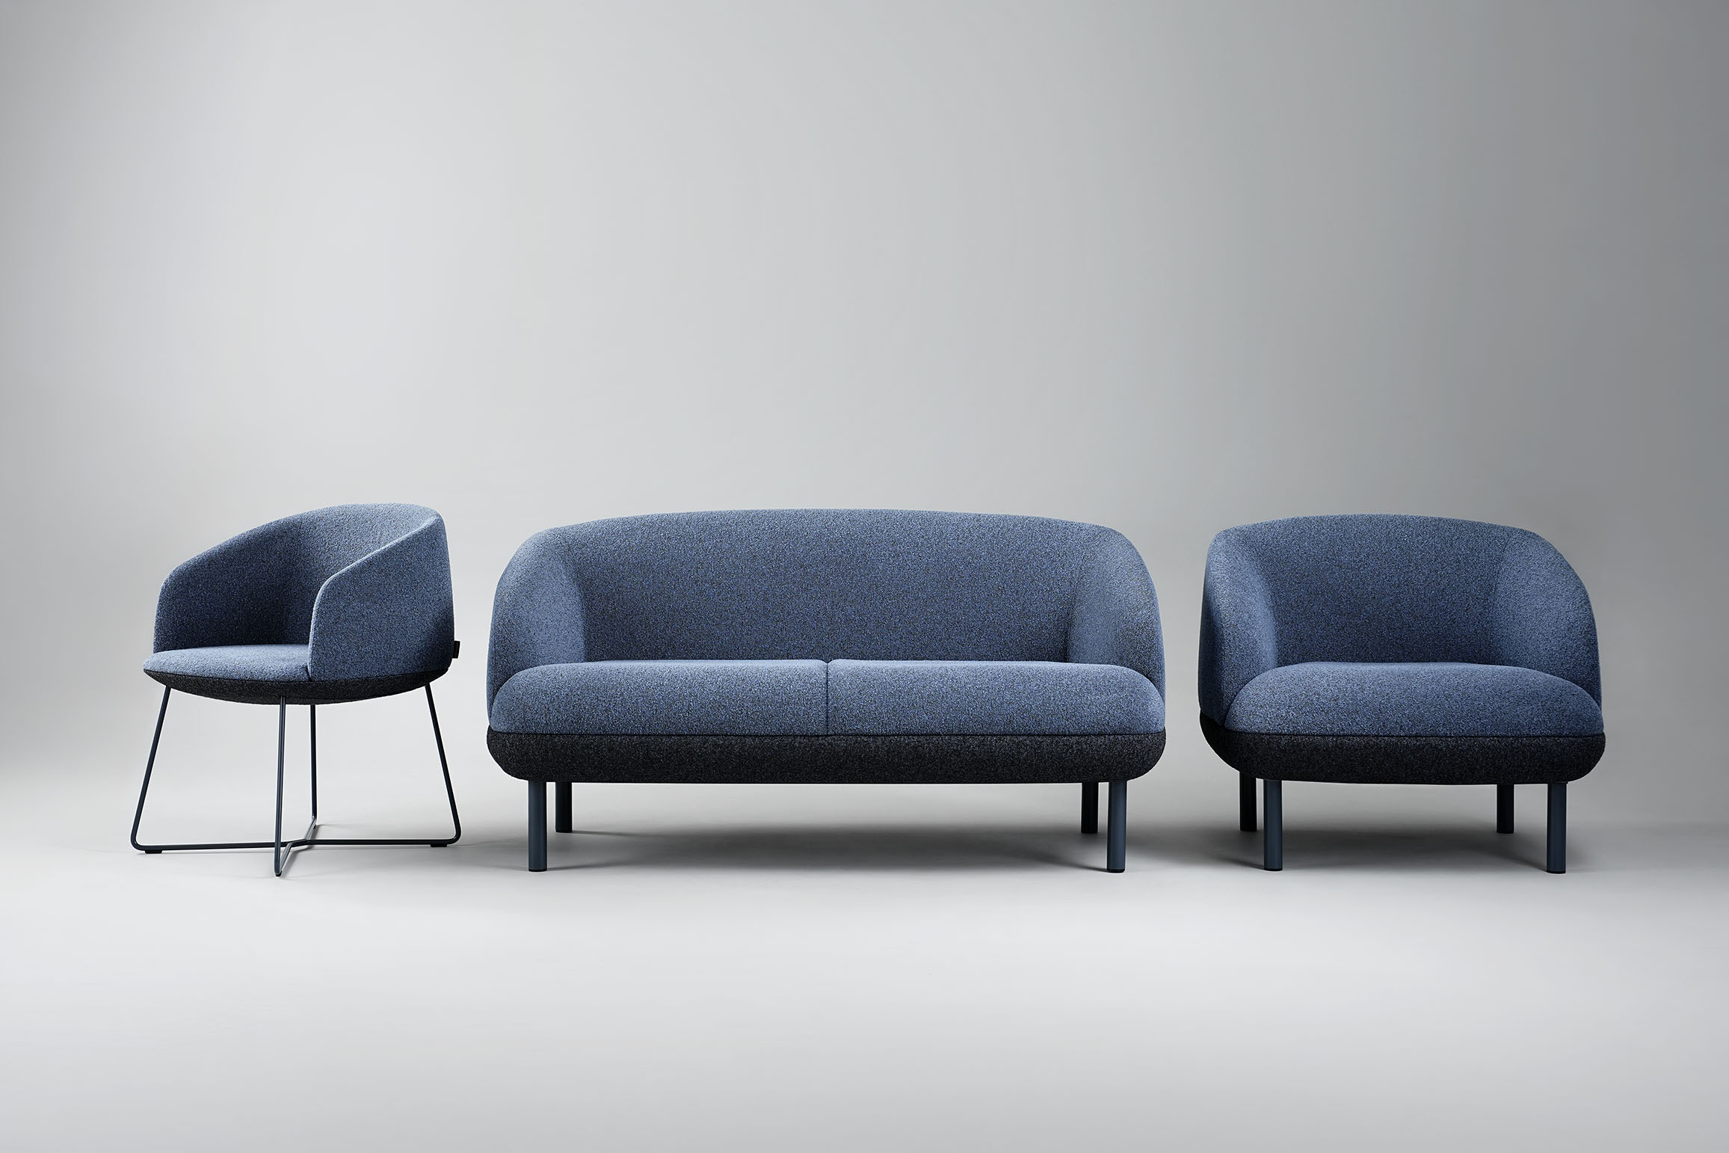
KOPA
Colour combinations for individuality
Notes:
KOPA soft seating offers the possibility to combine two colours in the upper and lower parts of the piece, creating a subtle accent and emphasising individuality. Designer Folco Orlandini recommends choosing darker shades for the lower part of the piece and lighter tones for the upper section. Please note that two-colour combinations can be created using fabrics from the same collection only.

Slide 11
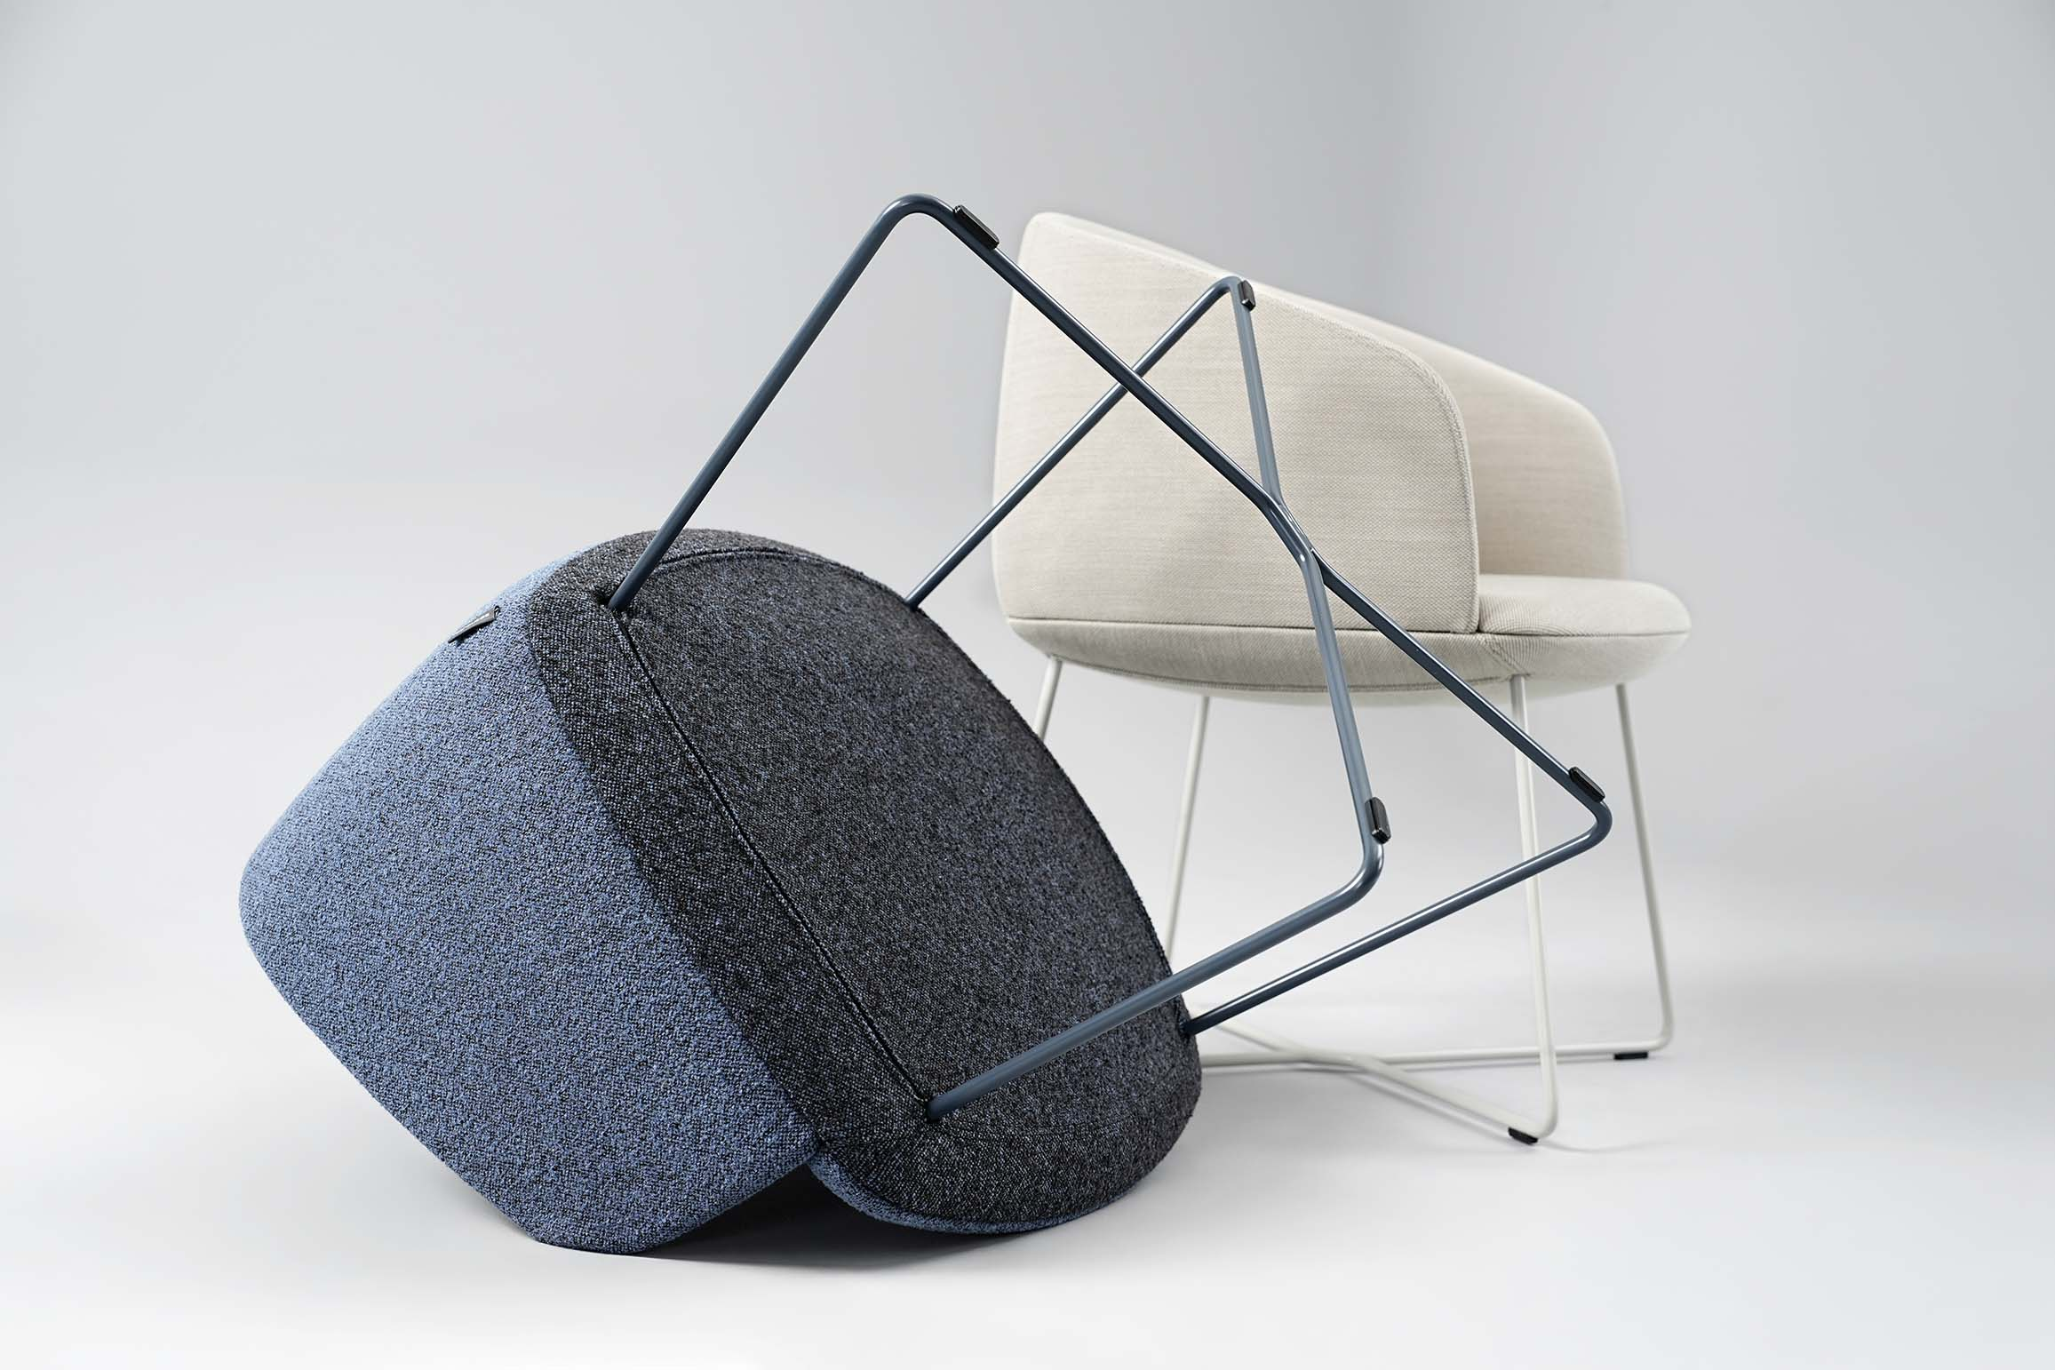
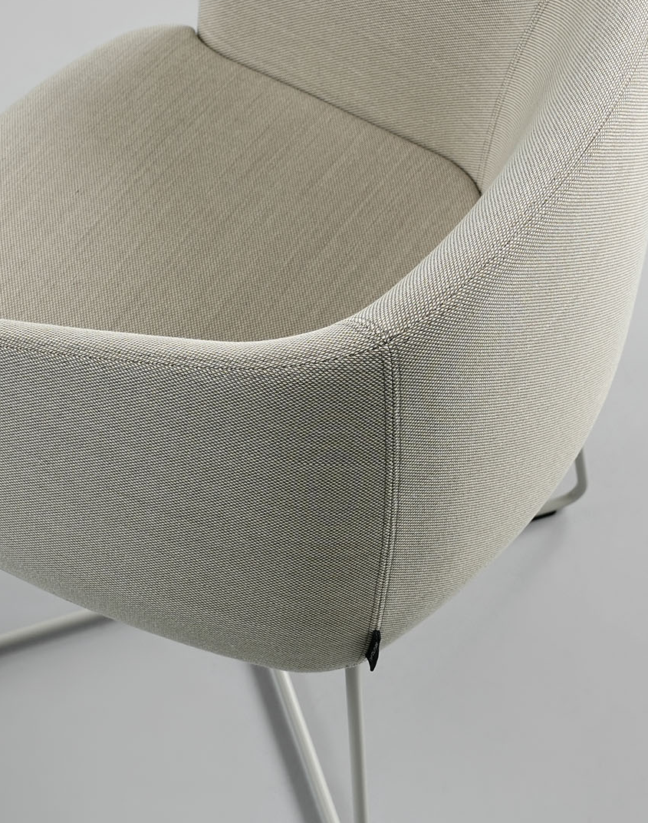
KOPA
Attention to every detail
Notes:
Carefully considered details shape the elegant KOPA design, where nothing is unnecessary. From clearly visible design solutions to those we would not normally notice due to the high quality of execution. Even when looking at the furniture from below, you can see the aesthetically concealed base structures.

Slide 12
Comfort for work–rest balance
KOPA
KOPA provides the right level of comfort, allowing users to find the ideal balance between work and relaxation.
Notes:
KOPA provides the right level of comfort, allowing users to find the ideal balance between work and relaxation.

Slide 13
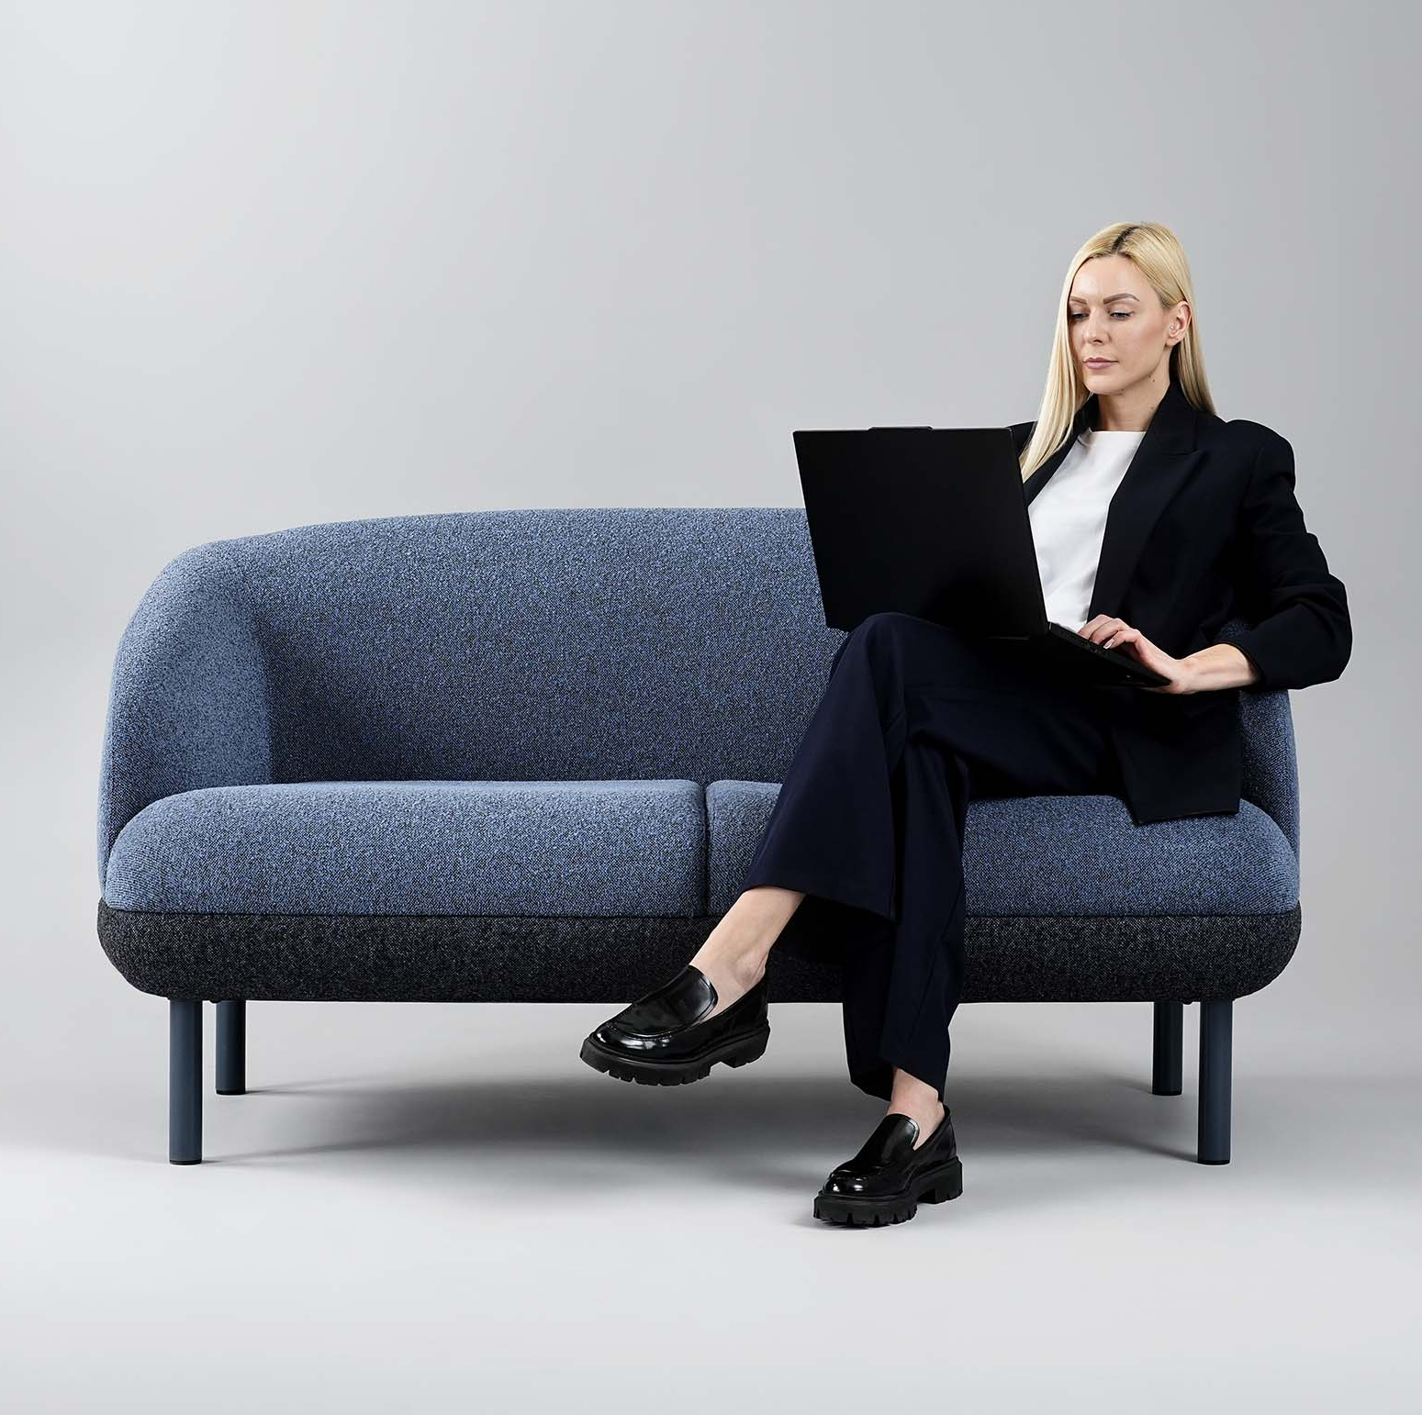
KOPA
A sofa with a pleasant sinking-in feel
Elastic webbing used inside, together with layered foam construction, ensures a high level of comfort.
Notes:
Elastic webbing inside the sofa seat ensures a high level of comfort and, together with a layered foam construction, allows for a pleasant sink-in feel.

Slide 14
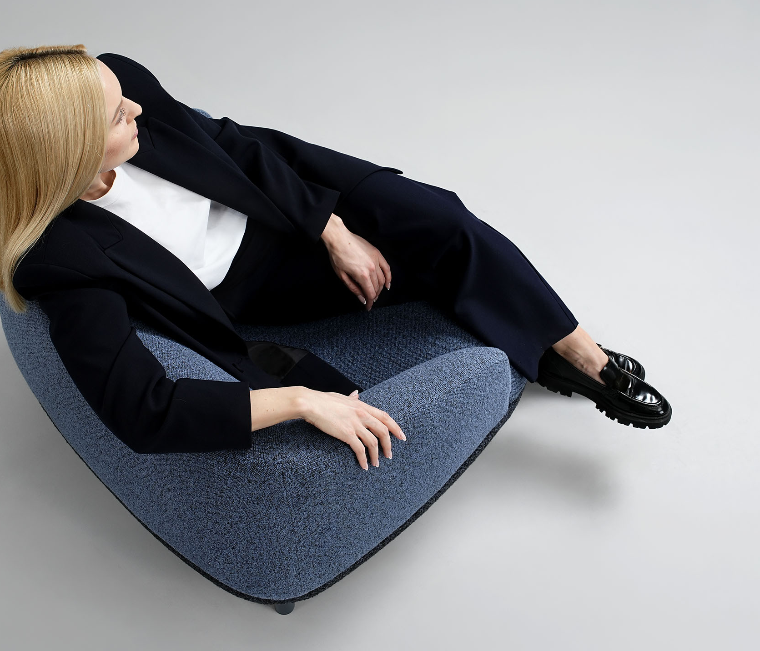
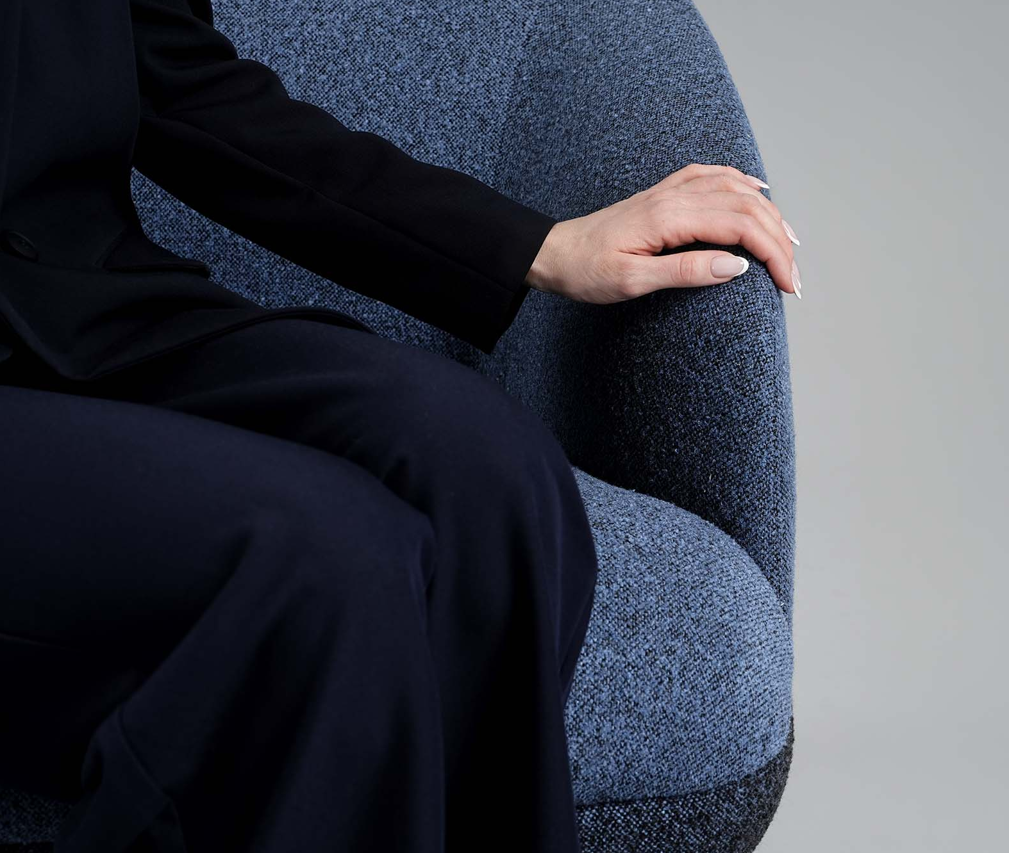
KOPA
Armrest shape supports seating freedom
Notes:
The curved shape of the armrests on sofas and lounge chairs allows comfortable seating not only in a traditional position, but also when sitting sideways.

Slide 15
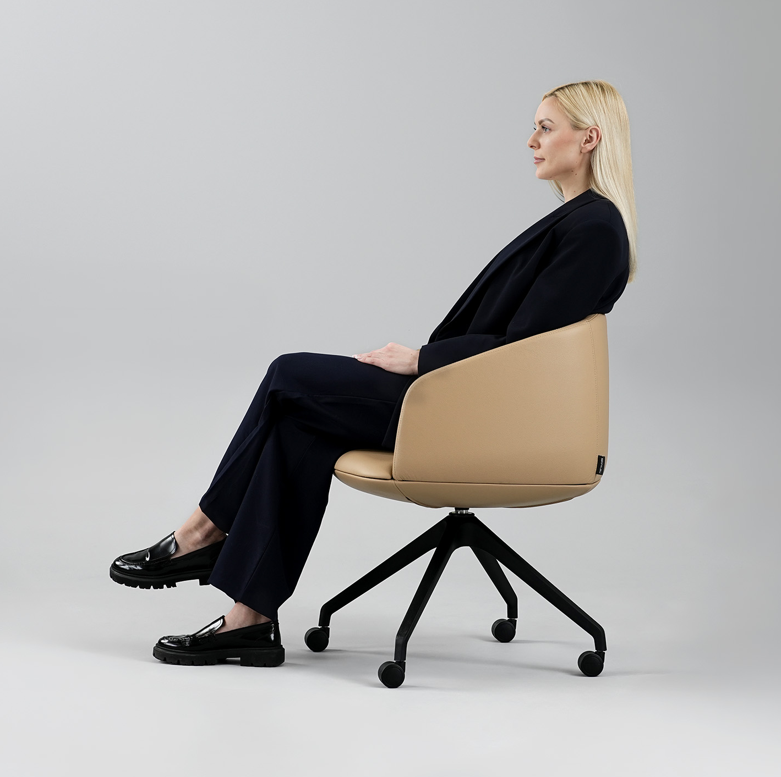
KOPA
Armchair backrest adapts to the back
Thanks to a specialised technology with a zigzag spring, the backrest adapts to the back, providing support and comfort while seated.
Notes:
The armchair backrest features a specialised technology with a zigzag spring, providing a pleasant sense of support and enhancing seating comfort.

Slide 16
Consistent style across different office spaces
KOPA
KOPA allows comfort and style to be maintained consistently across different office environments.
Notes:
KOPA allows comfort and style to be maintained consistently across different office environments.

Slide 17
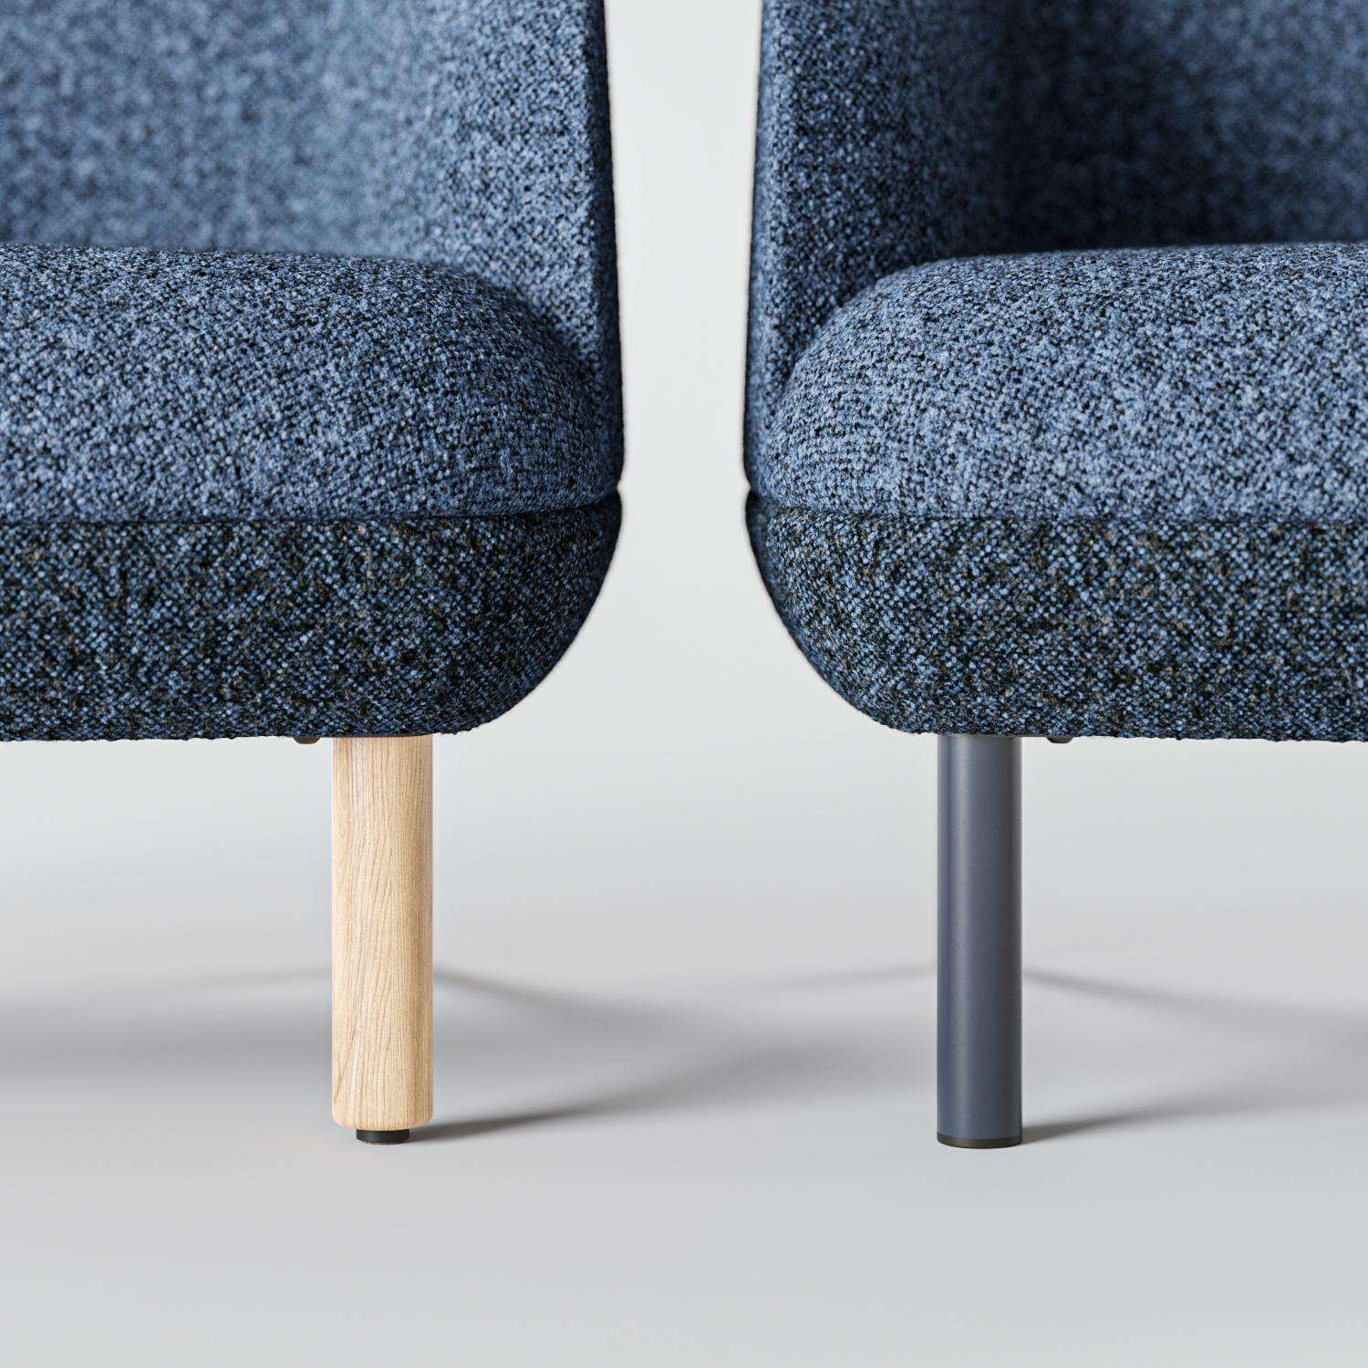
KOPA
Choice of bases for various looks
The sofa and lounge chair can be configured with two types of bases.
Notes:
In the KOPA soft seating collection, you can choose different bases — from warm wooden ones to modern metal or functional plastic options. The sofa and lounge chair can be configured with two types of bases, while armchairs are available with up to six options.

Slide 18
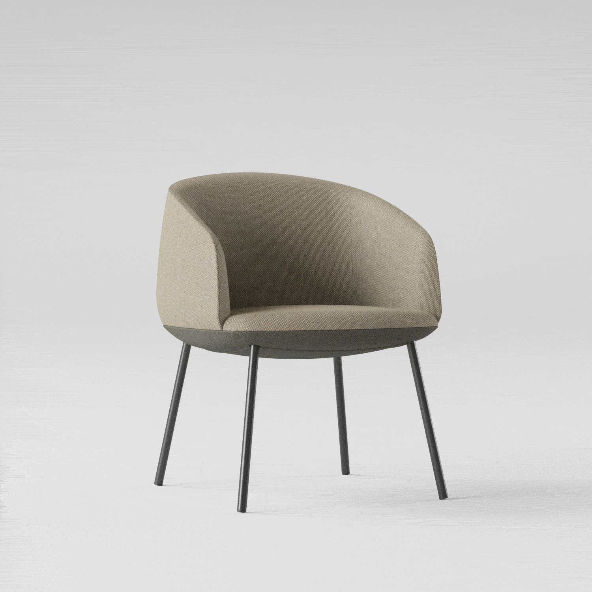
KOPA
Choice of bases for various looks
Armchairs are available with up to six options.

Slide 19
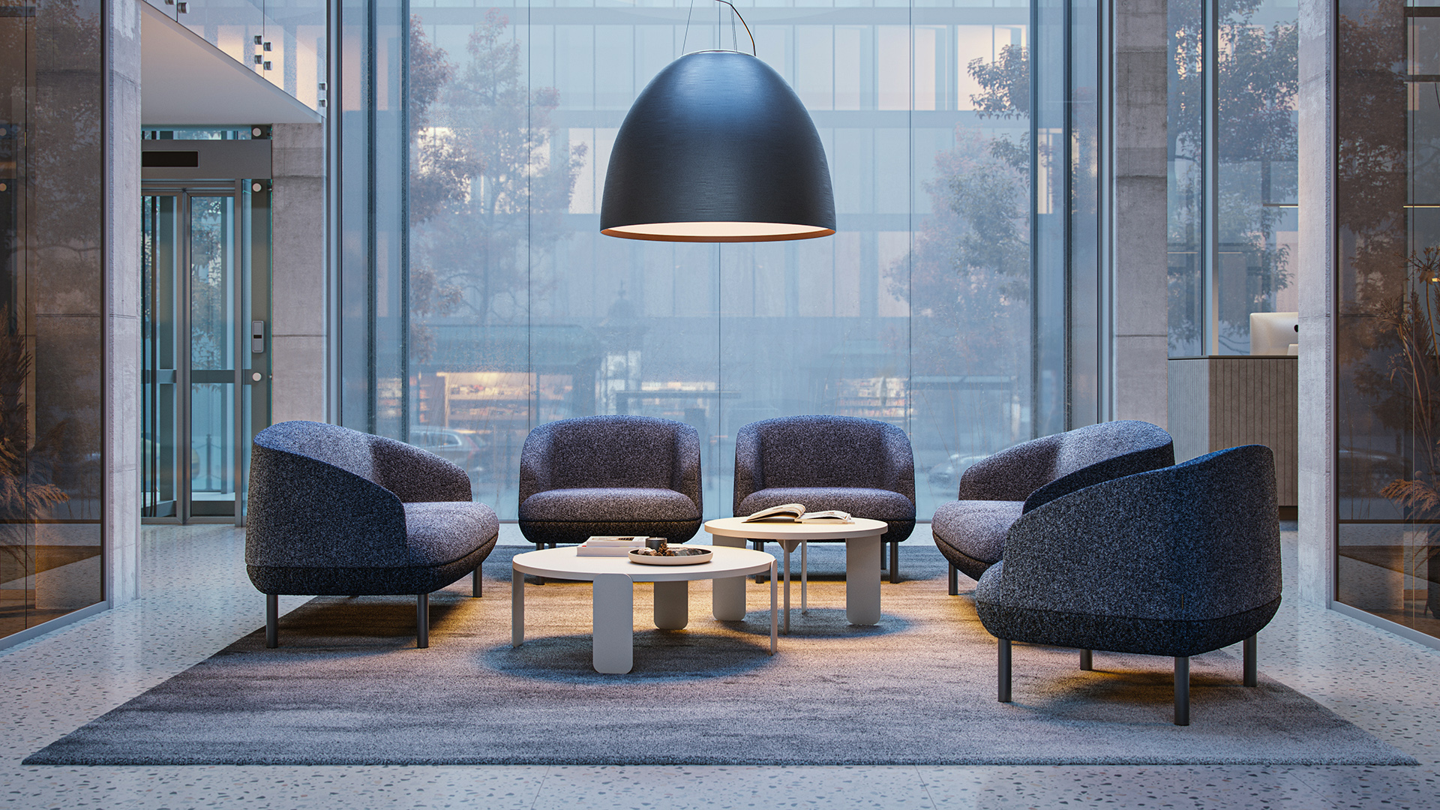
KOPA
Notes:
A wide selection of models and bases allows KOPA to be used in lobbies, lounge areas, meeting rooms, and executive workspaces. This collection pairs seamlessly with other NARBUTAS furniture — including coffee tables, meeting tables, and desks.

Slide 20
KOPA

Slide 21
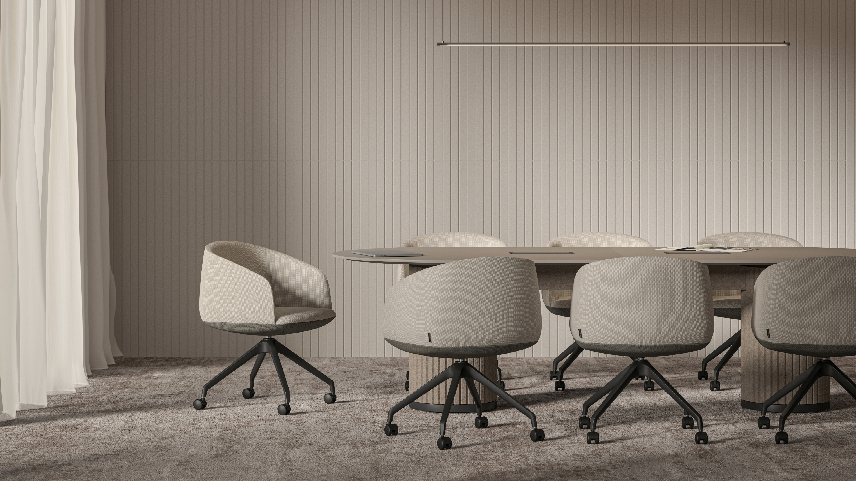
KOPA

Slide 22
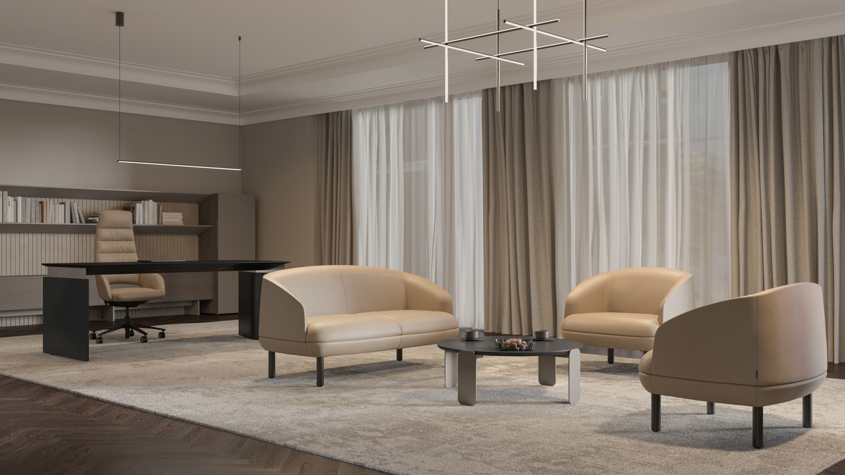
KOPA

Slide 23
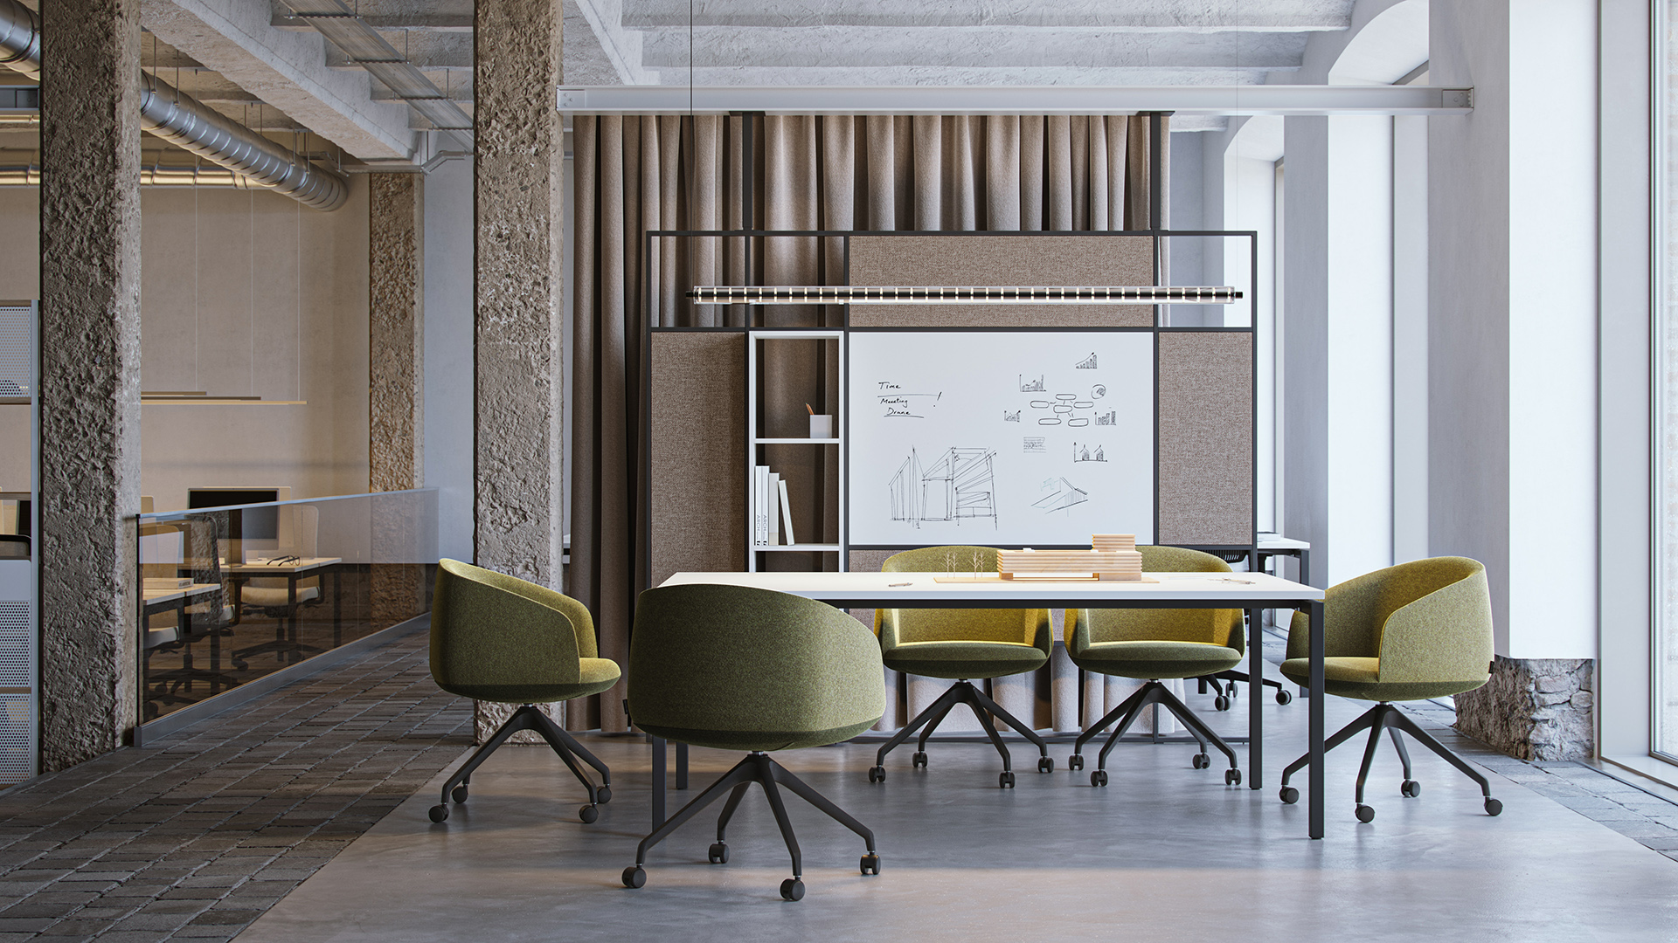
KOPA

Slide 24
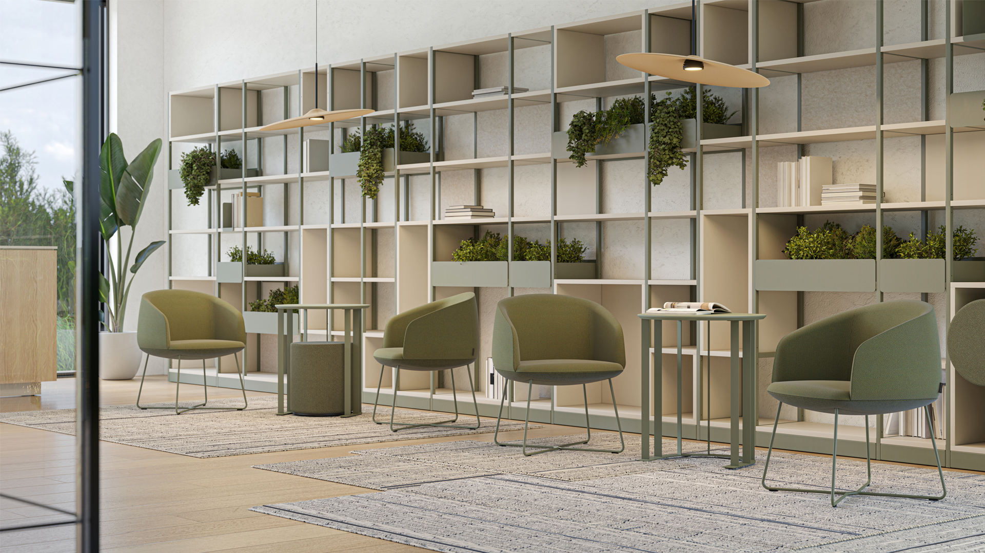
KOPA

Slide 25
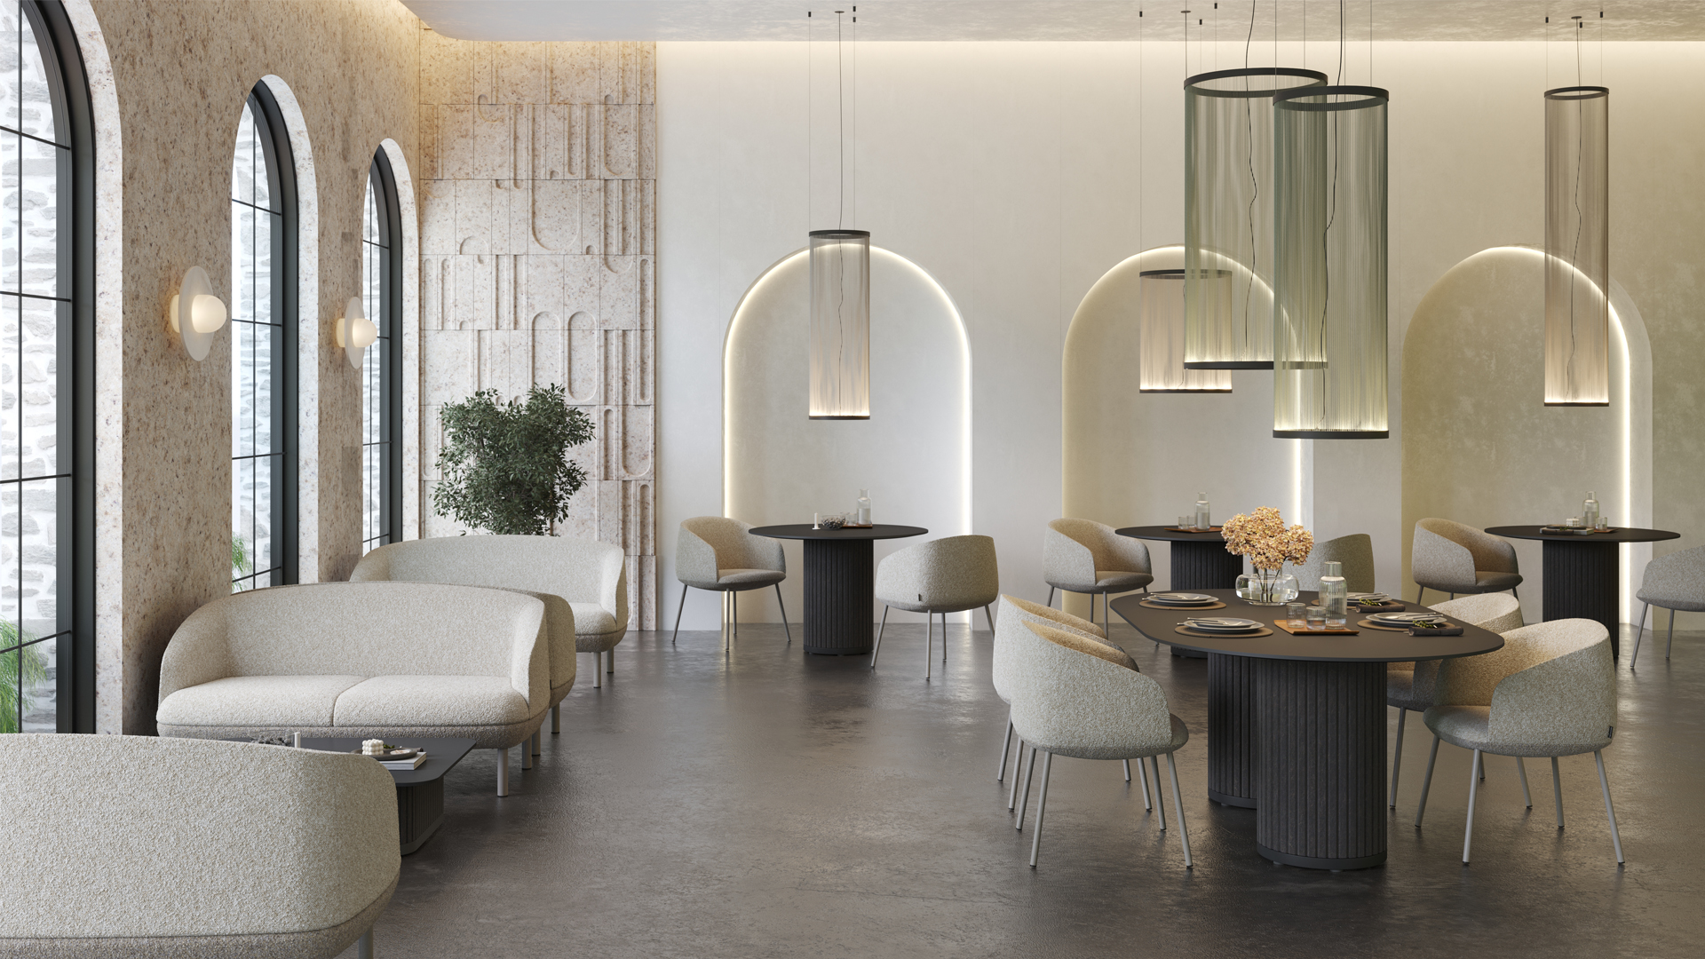
KOPA

Slide 26
Range
KOPA

Slide 27
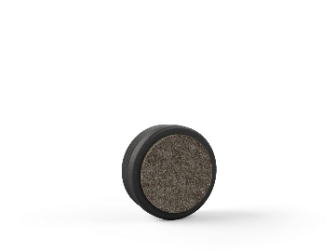
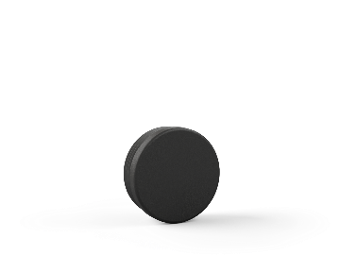
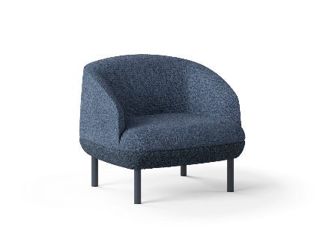
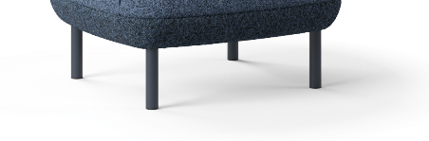










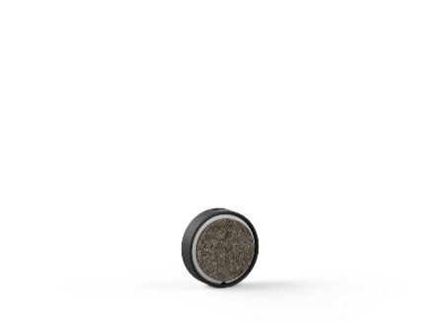

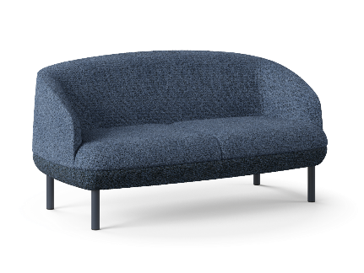
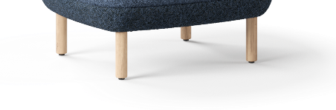


KOPA
Soft furniture | Fabrics* | Bases | Base colours | Glides
 | Berta Step Melange Austea Cyber Velito Synergy Dream Steelcut Trio 3 DNN
For hard or soft floors
Powder-coated metal legs
Lounge chair
Double-sided glides for hard or soft floors
Two-seater sofa
Solid ash wood legs
* For two-tone combinations, fabrics can only be selected from the same collection.

Slide 28
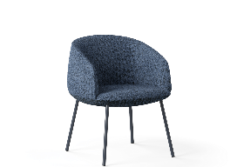
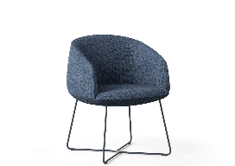
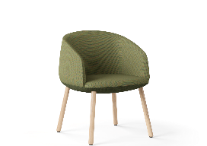
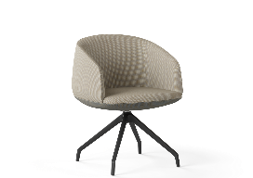

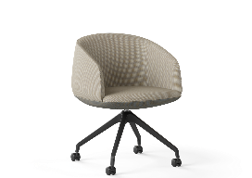
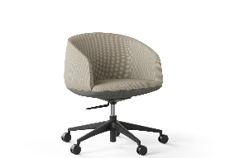
KOPA
Soft furniture | Swivel function | Height adjustment | Base colours | Glides / Castors
 | - | -
 | - | -
 | - | -
 |  | -
 |  | -
Armchairs with metal legs
Glides for hard or soft floors
Armchairs with “sled” legs
Armchairs with solid ash wood legs
Double-sided glides for hard or soft floors
Armchairs with a pyramid-type base
Glides for hard or soft floors
Armchairs with a pyramid-type base and castors
Castors for hard or soft floors, without brakes
Armchairs with a 5-star base and castors
Castors for hard or soft floors, without brakes

Slide 29
KOPA
Overview of KOPA collection
Sophisticated design by Orlandini Design
The collection includes a sofa, a lounge chair and an armchair
The sofa offers a pleasant sink-in feel — elastic webbing and layered foam construction ensure a high level of comfort
The armchair adapts to the back thanks to a specialised technology with a zigzag spring
A wide selection of base options and fabric collections
Two-colour combinations are available

Slide 30
Offer for showrooms
KOPA

Slide 31
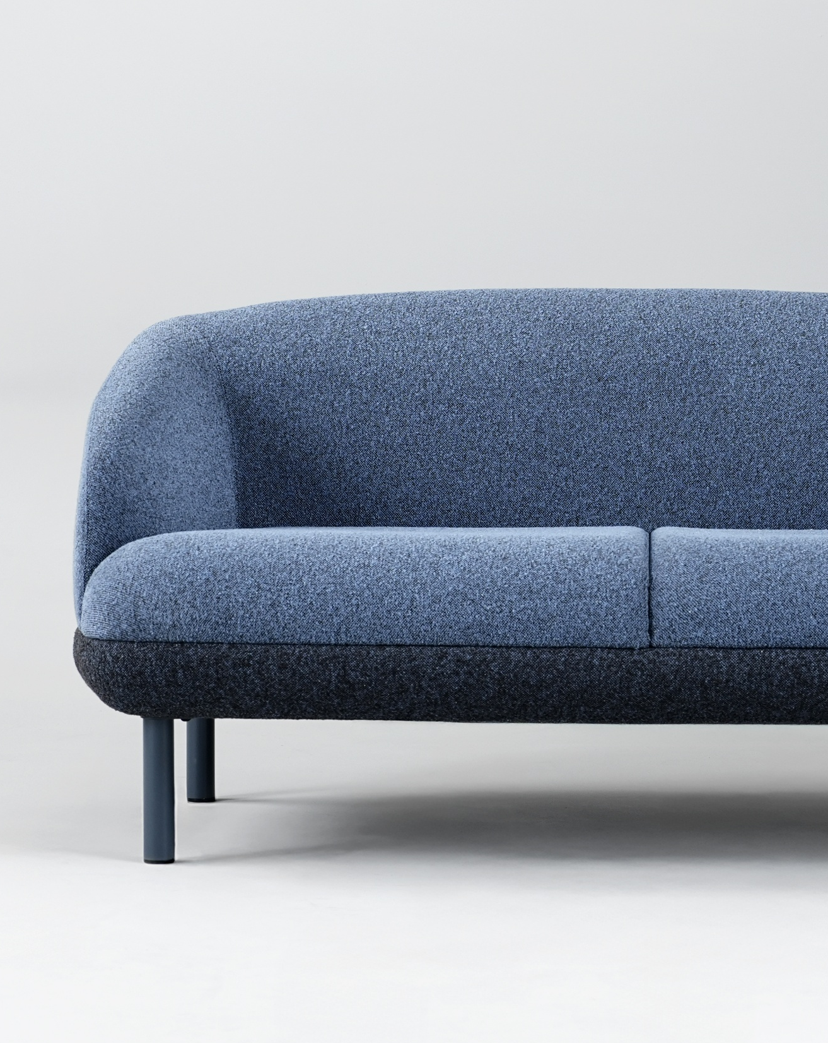
KOPA
Special KOPA combinations selected by our designers
Order KOPA for your showroom display.
Our designers have selected the best combinations of colours and features that are easy to order, implement, and showcase in your showroom.

Slide 32
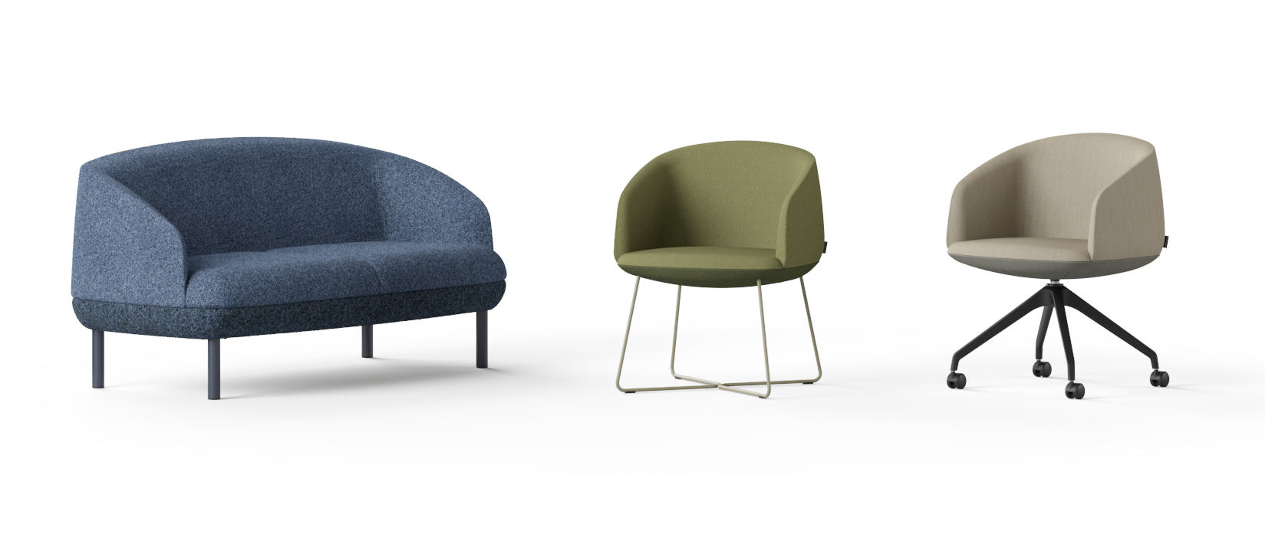
KOPA
Order KOPA for your showroom display
SDK002.GQ12.GQ13.MA14.1
G5R0032.GB17.GB10.MA11.1.0
G5R0035.GD01.GD02.TA09.1.F.0

Slide 33
KOPA
What is the process of ordering KOPA for a showroom display?
To place an order, please provide the full product code listed below the image to your customer support manager.
If you wish other material or colour combination, please order it through the nSpace platform or contact your customer support manager.
We offer special pricing for showroom orders.
Notes:
To order the selected KOPA configurations, please provide the full product code displayed below the image to your customer support manager. If you wish to choose a different colour or material combination, place your order through the nSpace platform or contact your customer support manager directly. Special pricing applies to showroom display orders.

Slide 34
KOPA

