Slide 1
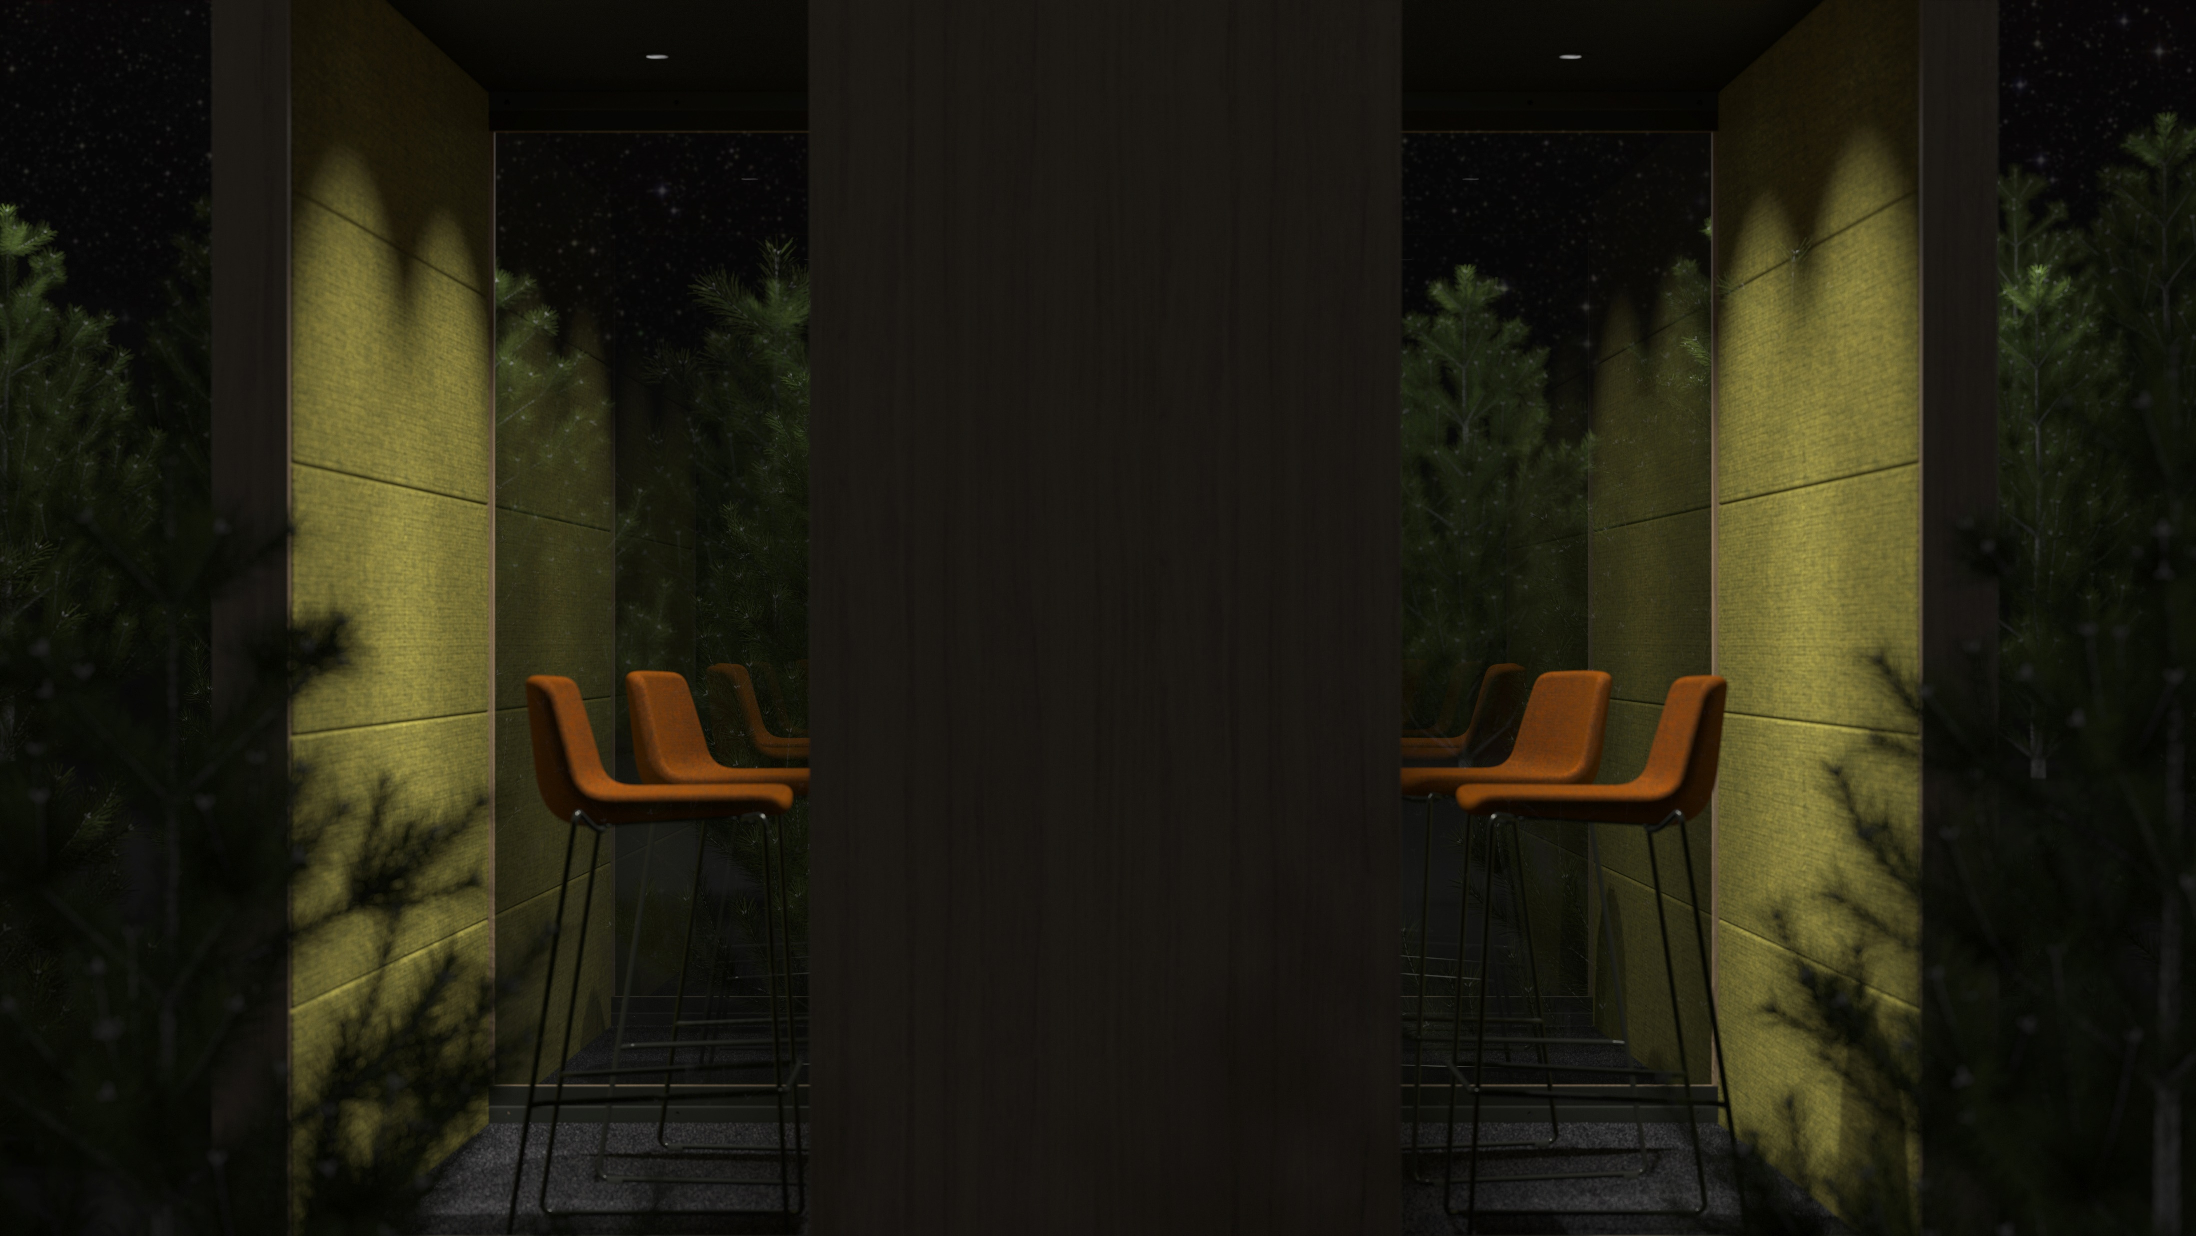
SILENT ROOM
Your comfort zone. Come in!

Slide 2
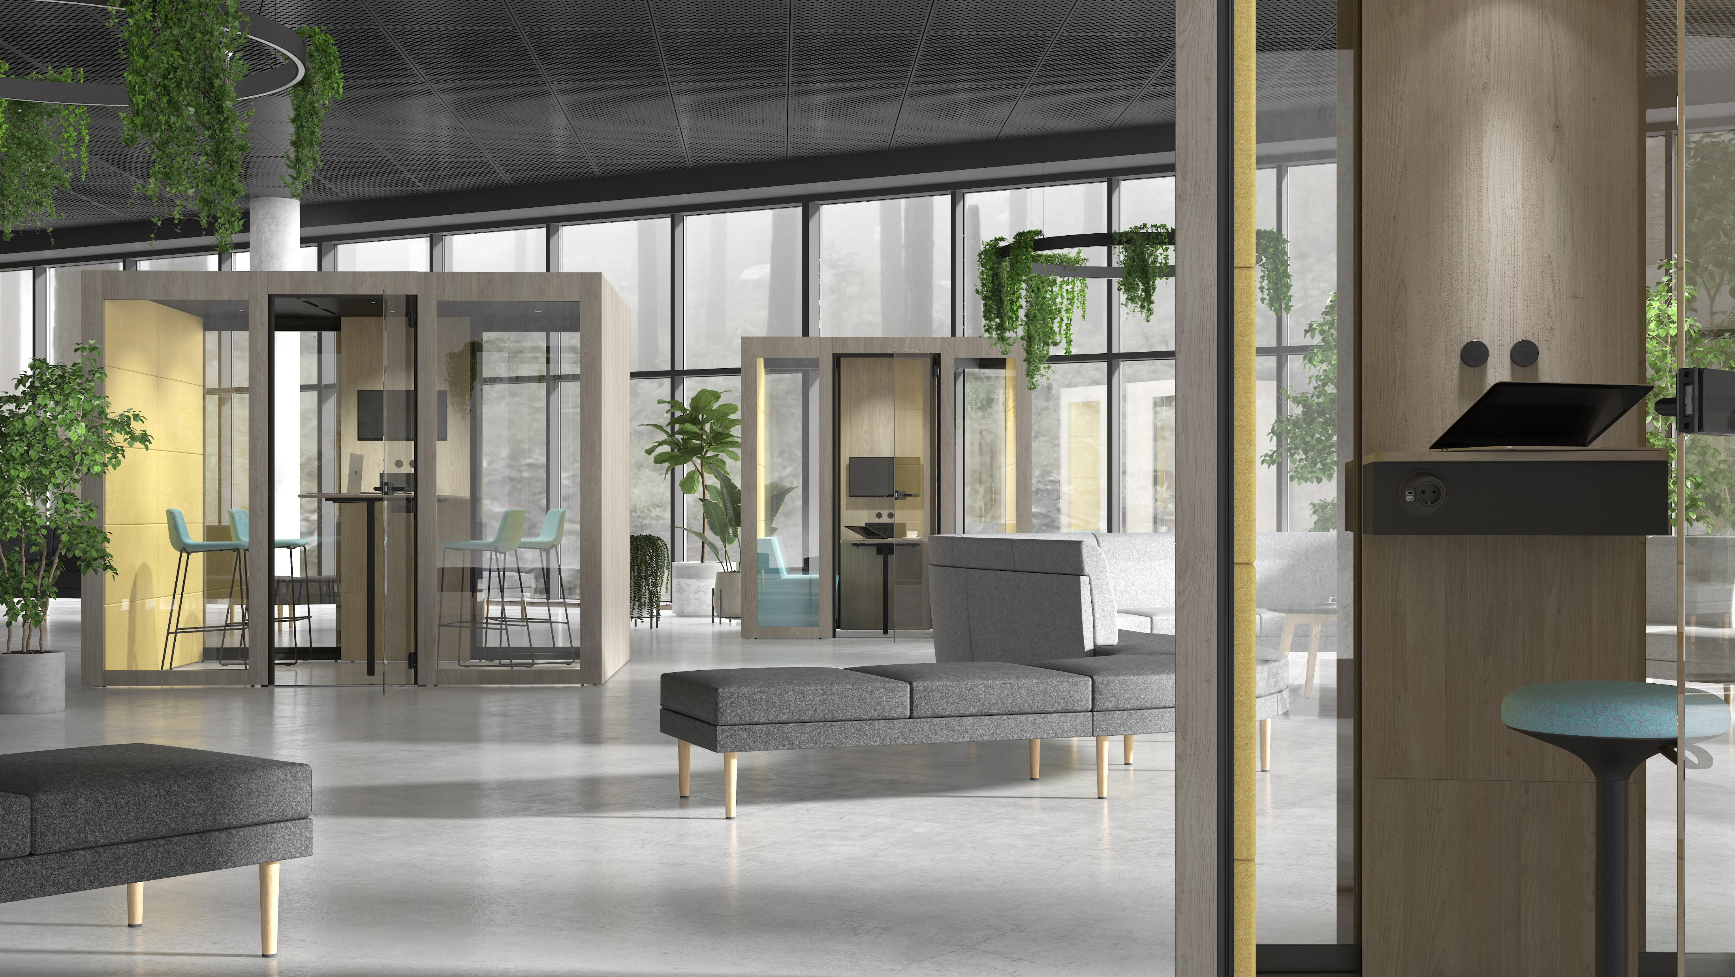
Notes:
Open-plan offices can mean more space, more light, and more freedom – but they can also lead to more noise in the work environment. Every day, employees face increasing challenges when looking for a quiet place to hold meetings, have phone conversations, or simply focus on their individual work.
Fortunately, there is a simple way to keep noise distractions at bay and ensure employee productivity - “a room within a room”.

Slide 3
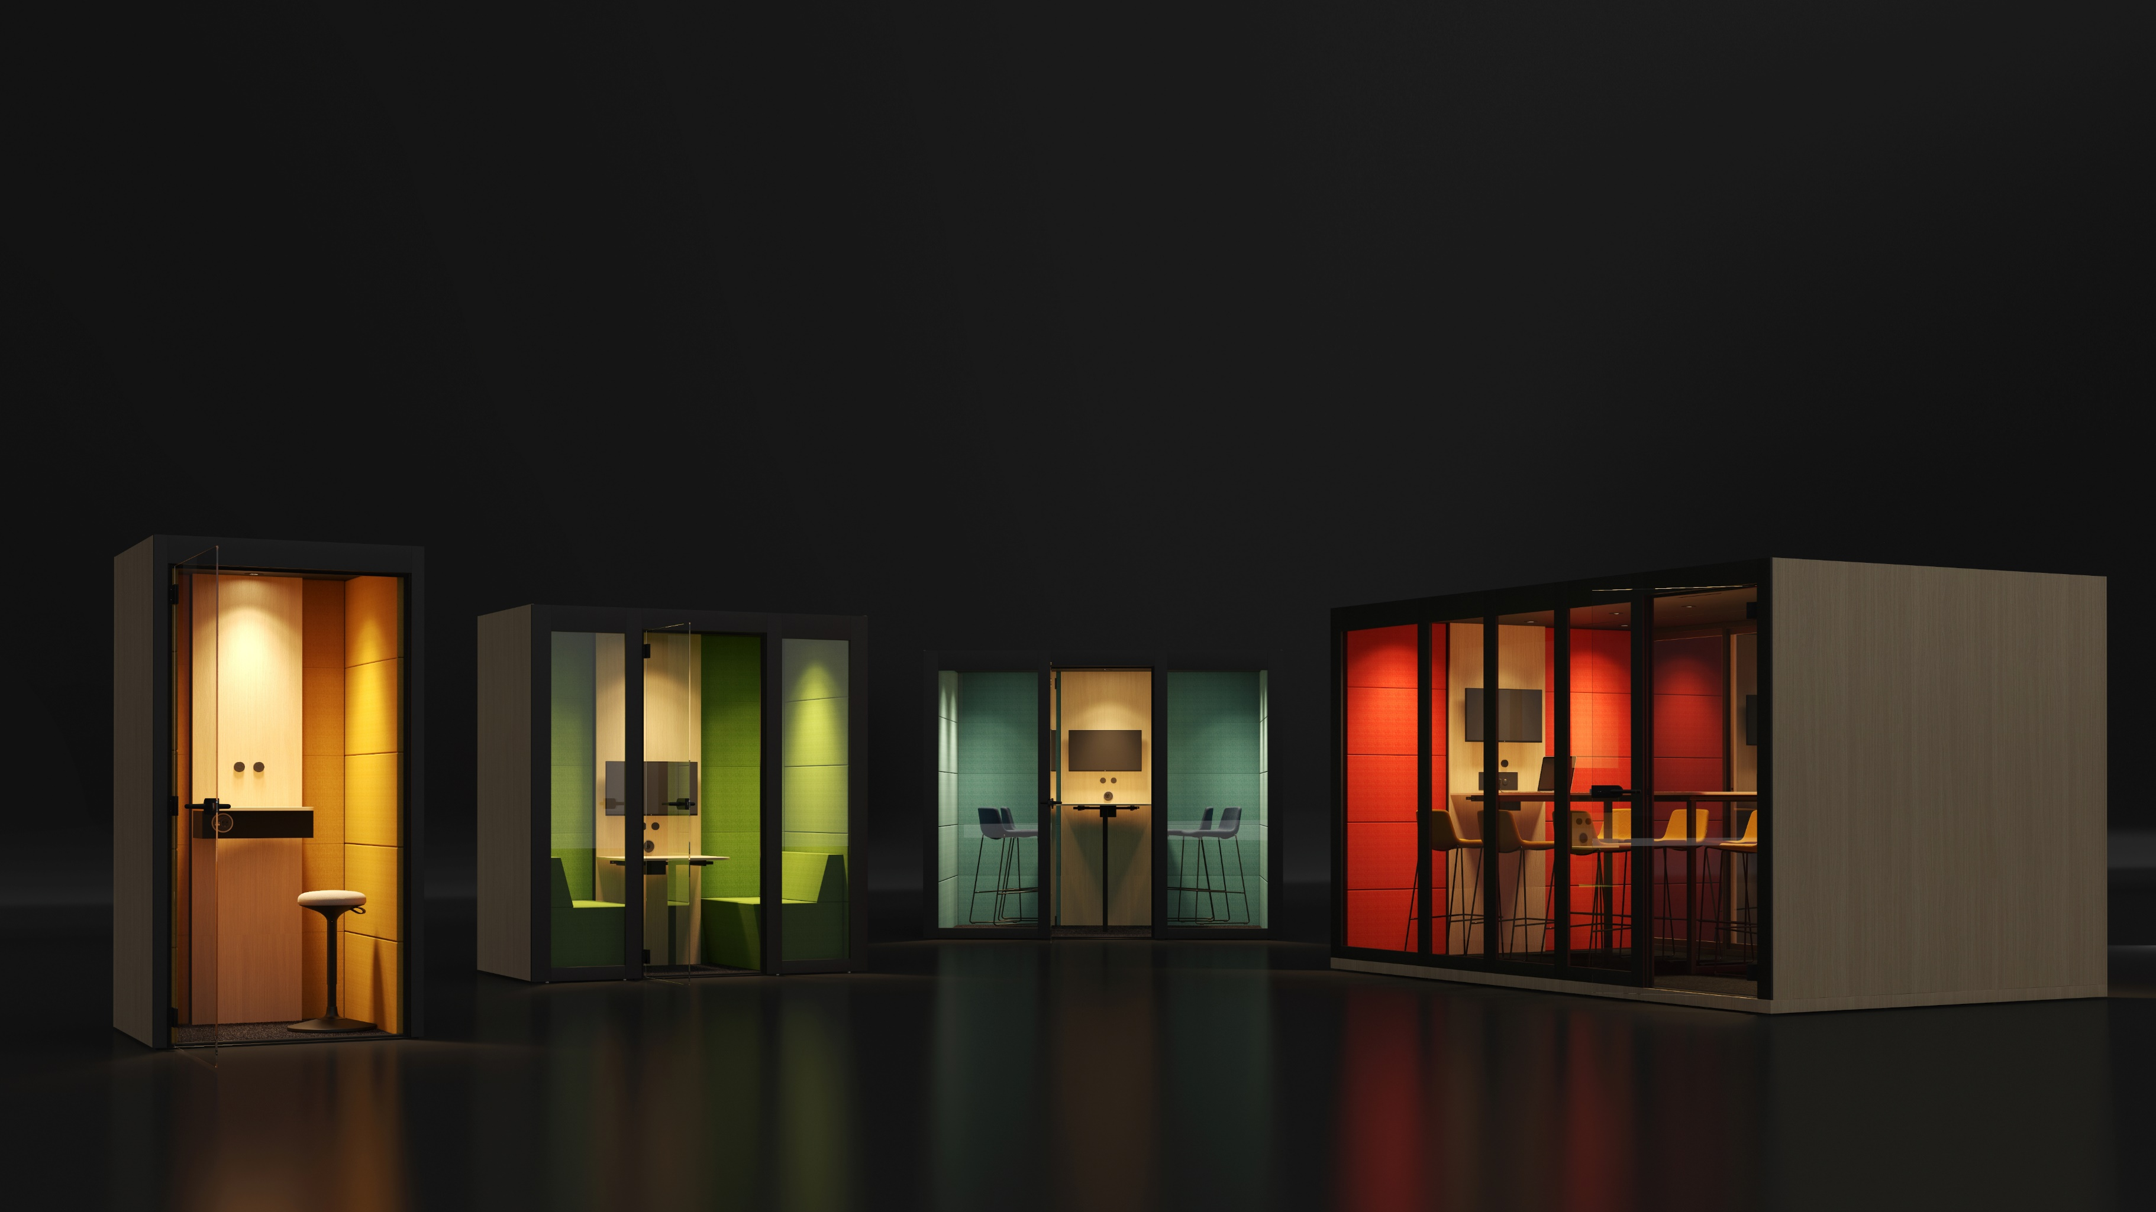
SILENT ROOM
The oasis of silence in a middle of a modern office
Notes:
We are proud to introduce NARBUTAS solution to tackle these problems – the SILENT ROOM acoustic pod series.
SILENT ROOM offers you the privacy and comfort that modern offices lack, and features easy, intuitive and energy-efficient controls. Thanks to its wide range of customisation options, a SILENT ROOM can be adapted to fit any office and any interior – whatever your needs are, there’s a SILENT ROOM for you.

Slide 4
ACOUSTIC ABSORPTION AND INSULATION

Slide 5
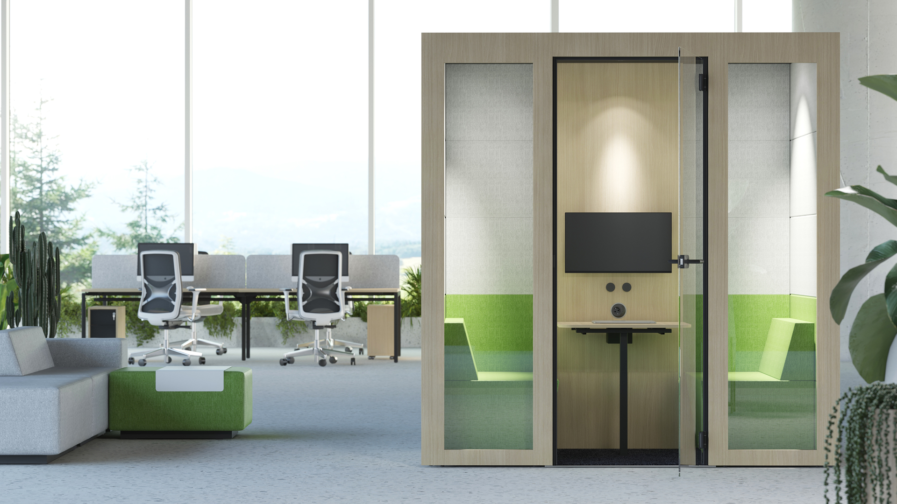
Less noise, less chaos
The acoustic pod provides the required level of sound insulation and prevents reverberation thanks to its excellent sound absorption properties.
Notes:
With its special design, the SILENT ROOM ensures the right level of sound absorption which means that it blocks both incoming and outgoing noise. The internal acoustic walls have excellent sound absorption properties which help eliminate reverberation in the room allowing the users to enjoy a cosy and pleasant atmosphere. With their low operating noise, the fans in the acoustic pod are just as quiet as the sound of leaves rustling. Thus, they will not cause any distraction to the user inside the acoustic pod and those working outside in the shared setting.

Slide 6

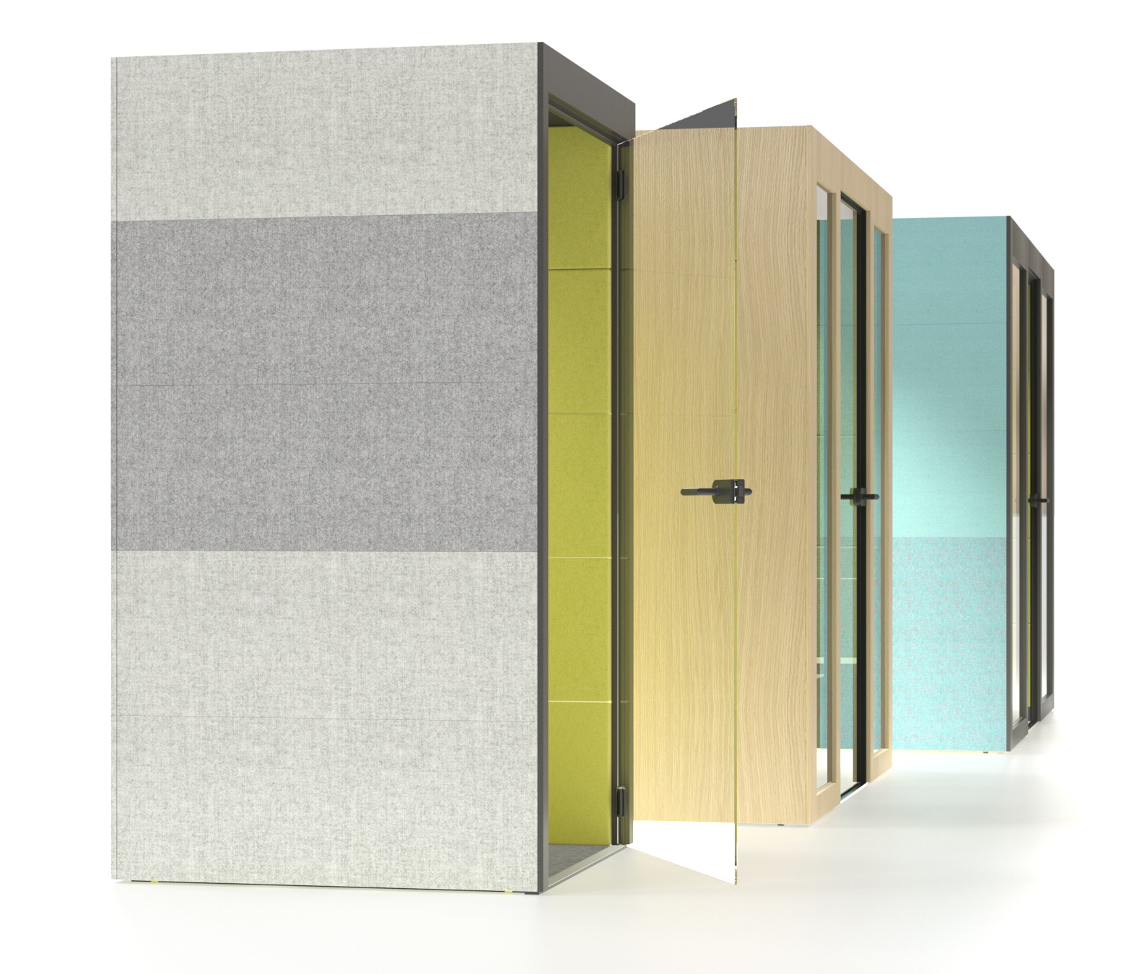
Improves overall acoustic comfort in the office
Notes:
The upholstered exterior panels are also designed to absorb noise, creating a positive effect on the general acoustics of the entire office space. By simply installing a SILENT ROOM, you can improve the acoustics of your whole office.

Slide 7
ERGONOMICS AND COMFORT

Slide 8
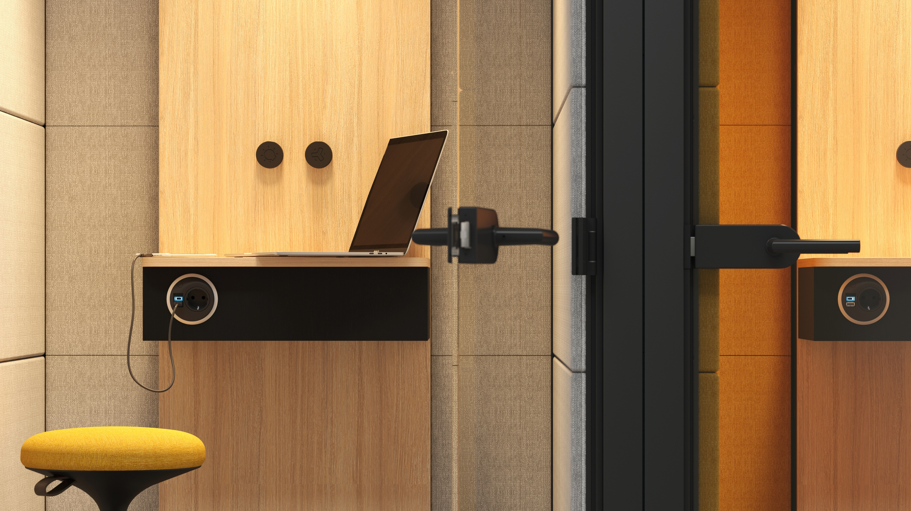
Functional interior for private conversations
Notes:
A convenient acoustic pod SILENT ROOM S designed for a single user is ideal for private phone conversations or video calls as well as for quick individual tasks that require some level of concentration. You can be sure that you will be able to continue important conversation even if your device runs out of battery power. For users’ convenience, the room is equipped with a power outlet (USB type A and C ports as an option). The acoustic pod is equipped with a small table which will provide a convenient place for your laptop or notebook so that you can keep your thoughts and ideas organized.

Slide 9
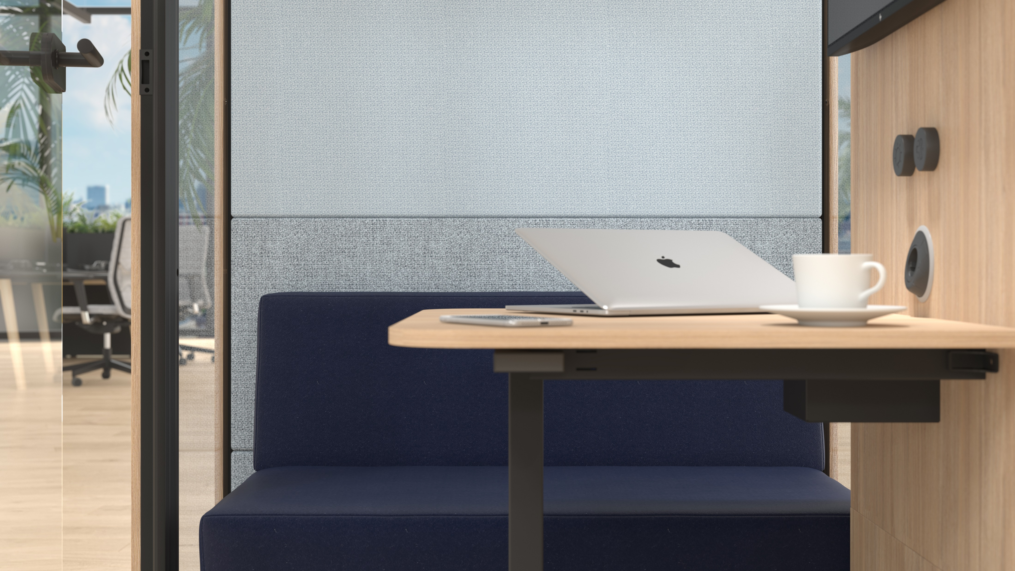
Comfortable environment and privacy
Notes:
The SILENT ROOM M can accommodate lounge seating, which features an eye-catching design and offers exceptional comfort, giving a more welcoming feel to this acoustic furniture. It will turn even the most prolonged face-to-face meetings into an enjoyable and relaxing experience.

Slide 10
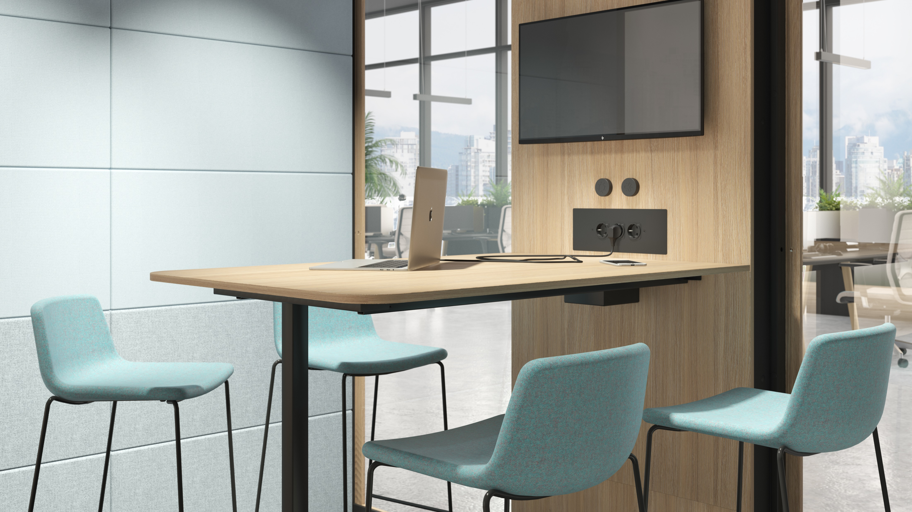
A space for efficient team meetings
Notes:
The SILENT ROOM L acoustic pod has everything that is needed to ensure a high level of comfort for efficient team meetings. A regular table or a high table will easily accommodate four persons, who will have convenient access to electricity, whereas the wall-mounted display and the wide-angle webcam will allow those who work remotely join the meeting.

Slide 11
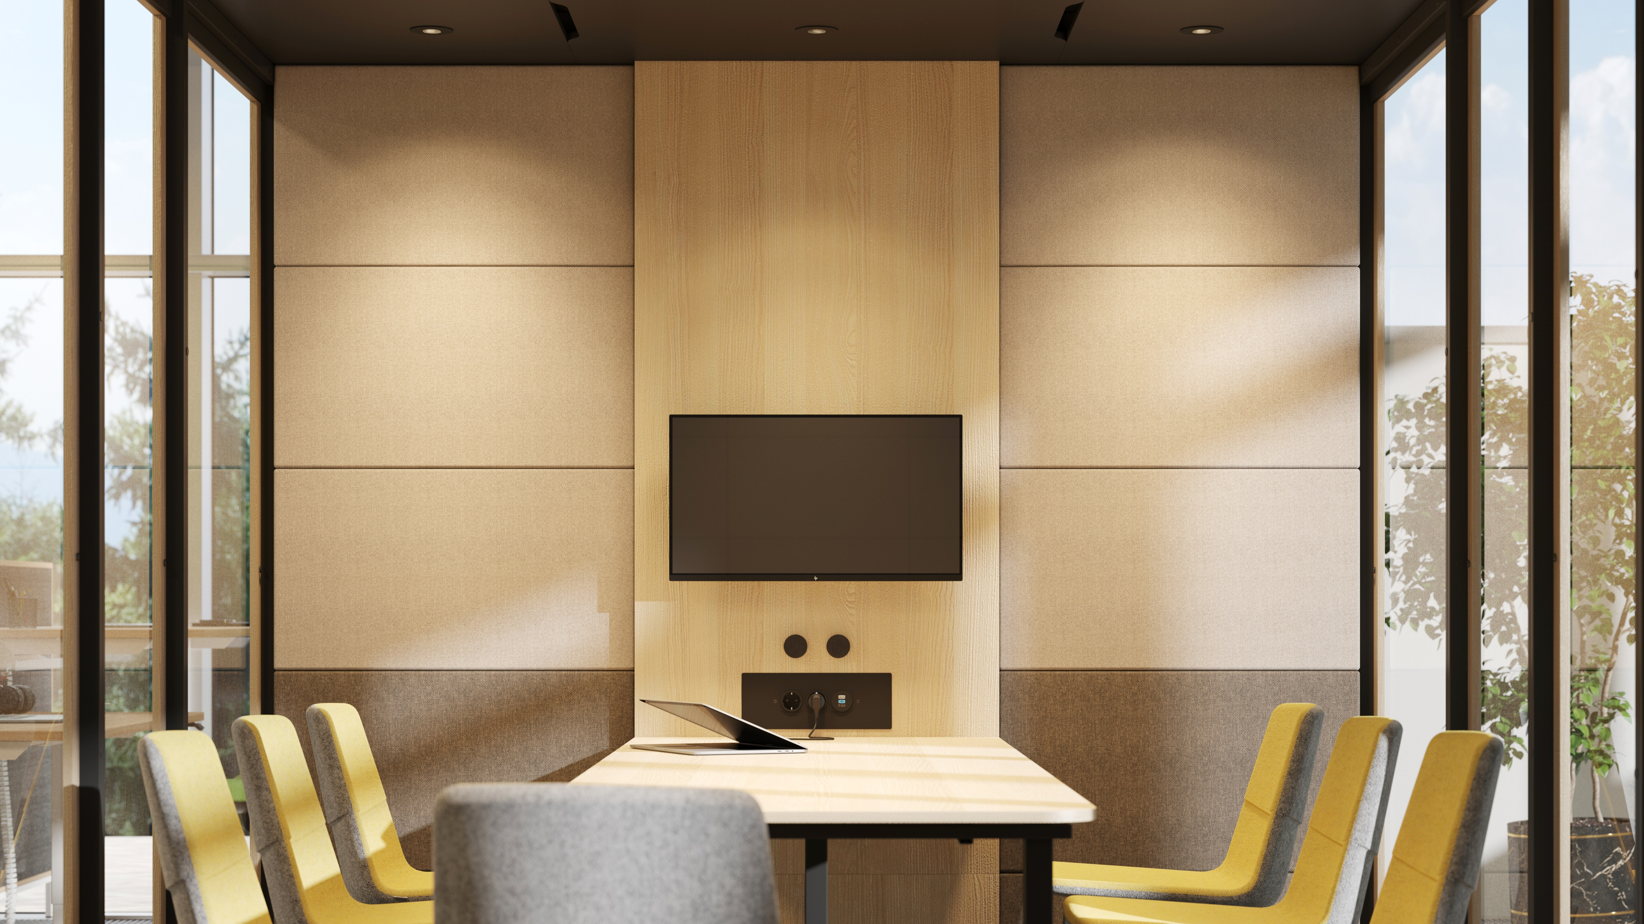
A spacious room for everyday formal and informal meetings
Notes:
This spacious acoustic pod designed for eight users ensures a high level of comfort without limiting your freedom of movement. The SILENT ROOM XL space allows you to create a personalised setting that suits your teams’ needs best. Choose a regular table or a high table with chairs for your formal team meetings or important business meetings, whereas a coffee table and comfortable visitor chairs or lounge chairs will be ideal for your casual team meetings and workshops with a more relaxing atmosphere.

Slide 12
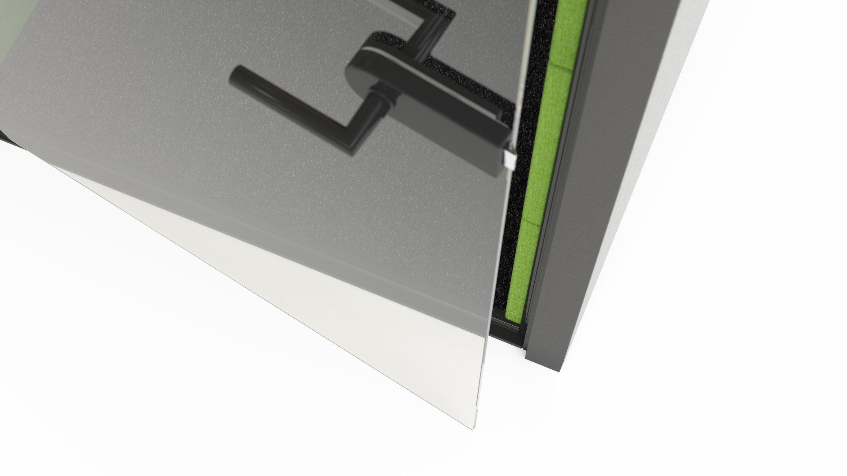
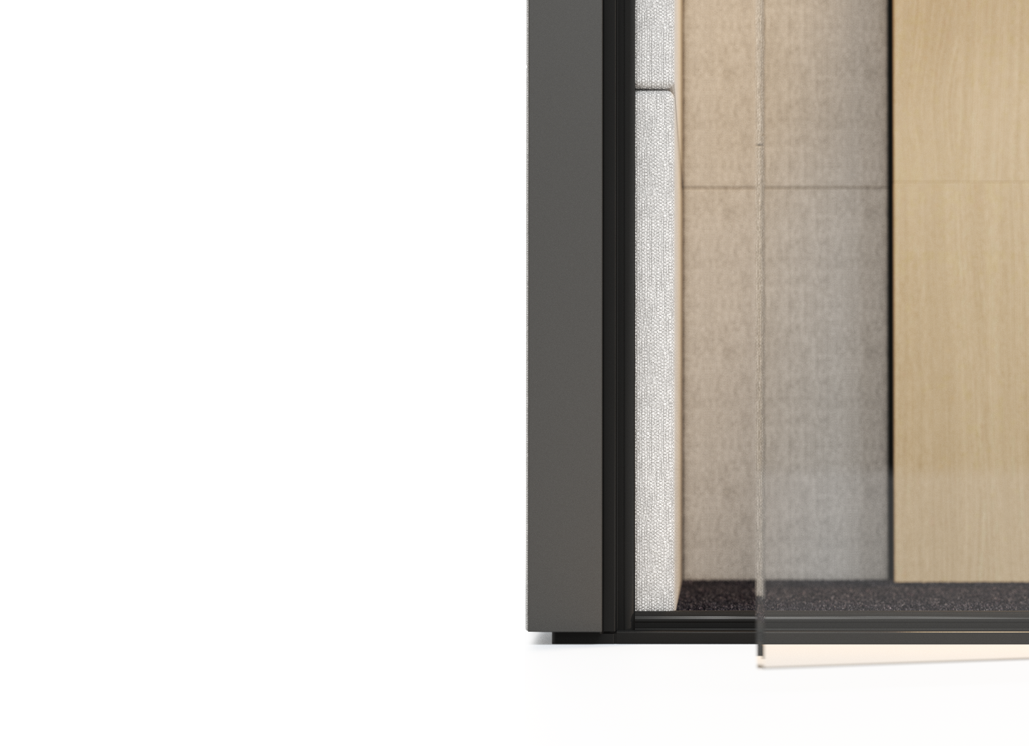
Convenient entry
Notes:
The SILENT ROOM is designed for easy access. It features a low doorstep and same-level flooring, ensuring that no caution is needed when stepping inside.

Slide 13
VENTILATION AND LIGHTING

Slide 14
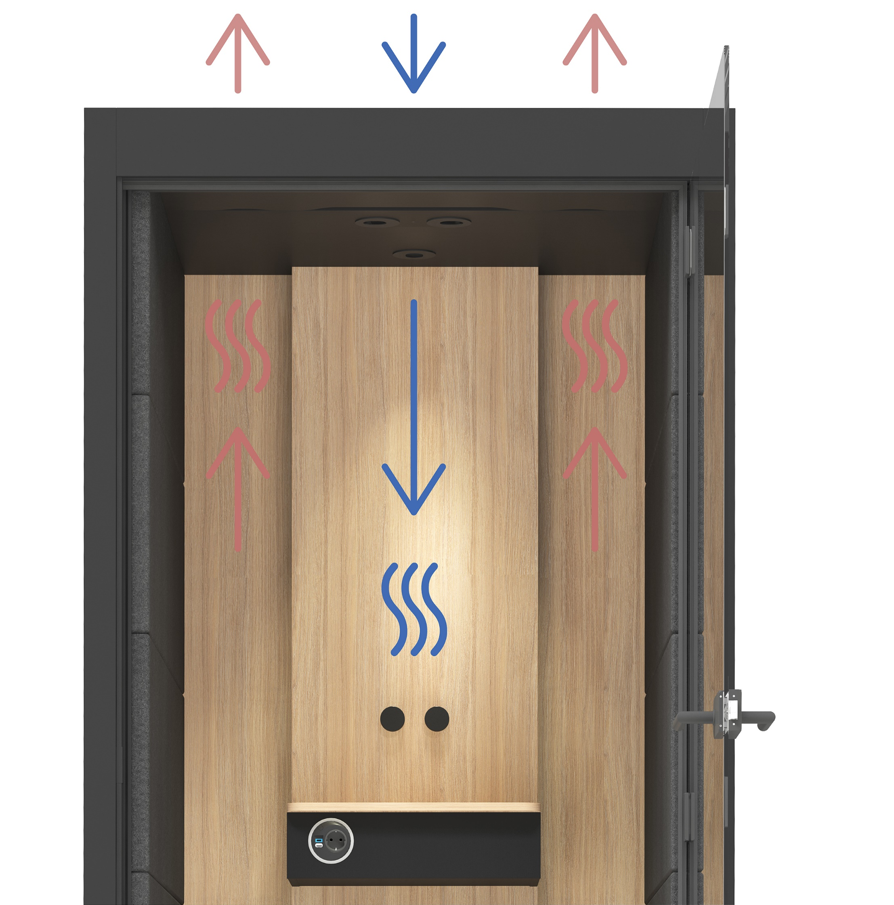
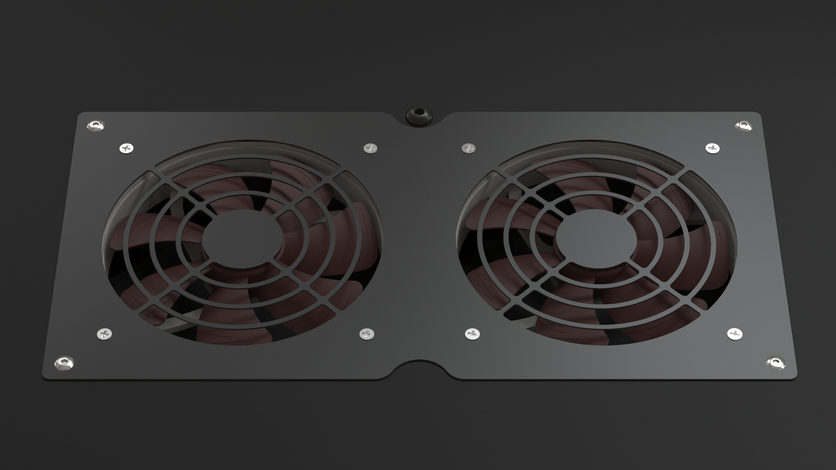

Efficient air ventilation
Air supply
Air extract
Notes:
Thanks to its air fans and lighting solutions, SILENT ROOM offers a productivity-boosting environment. Silent and powerful air fans ensure a proper airflow rate and provide an ultimate sense of comfort even during extended use. The SILENT ROOM S is equipped with 4 fans, while the SILENT ROOM M features 8 fans, SILENT ROOM L has 10 fans and the SILENT ROOM XL has many as 16 fans.

Slide 15
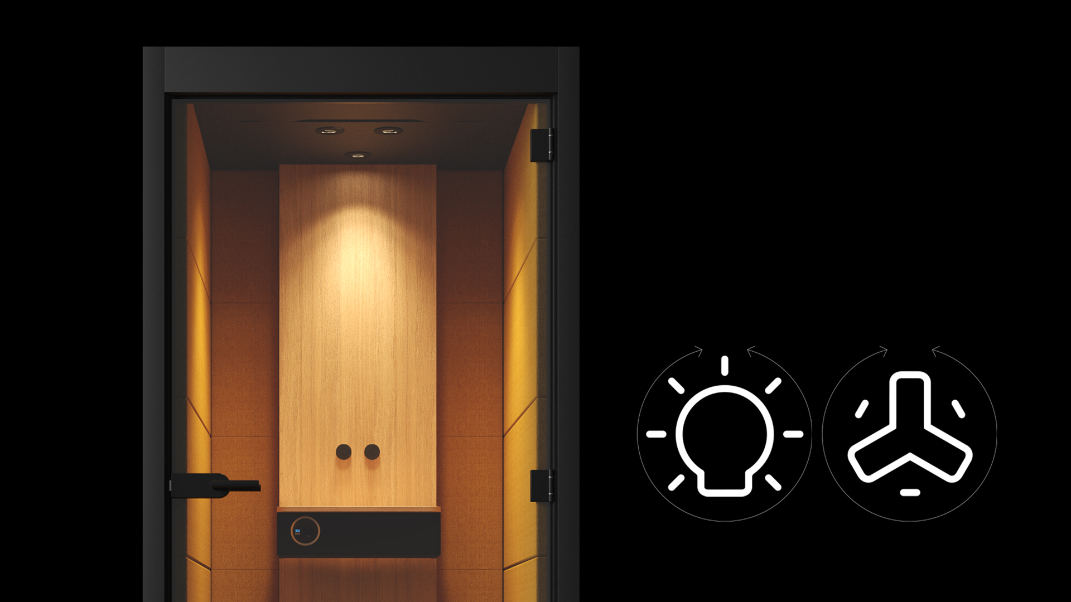
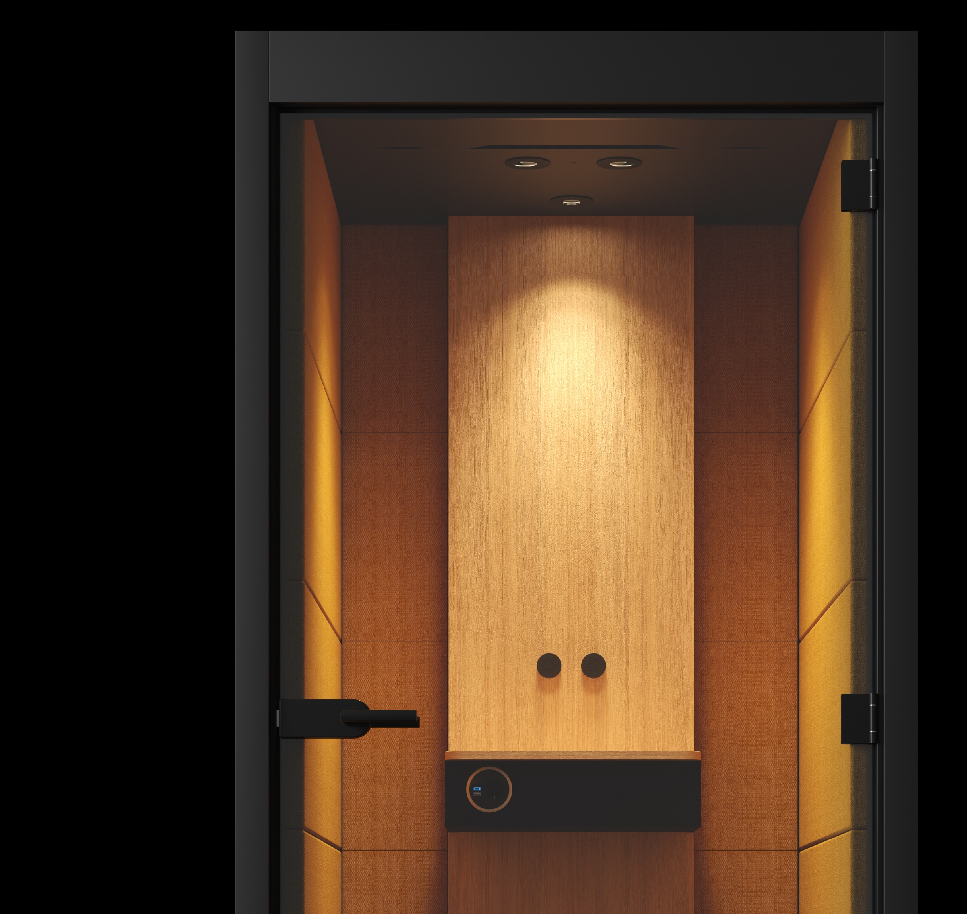
Warm
LED lighting
Notes:
The interior lighting consists of a set of ceiling-mounted warm LED lights. Some of the lights are directed sideways, casting warm and cosy light on upholstered surfaces, whereas the rest ones are directed downward ensuring efficient illumination of the working surface. The intensity of the lighting and ventilation can be easily adjusted by turning two minimalistic-looking switches.

Slide 16
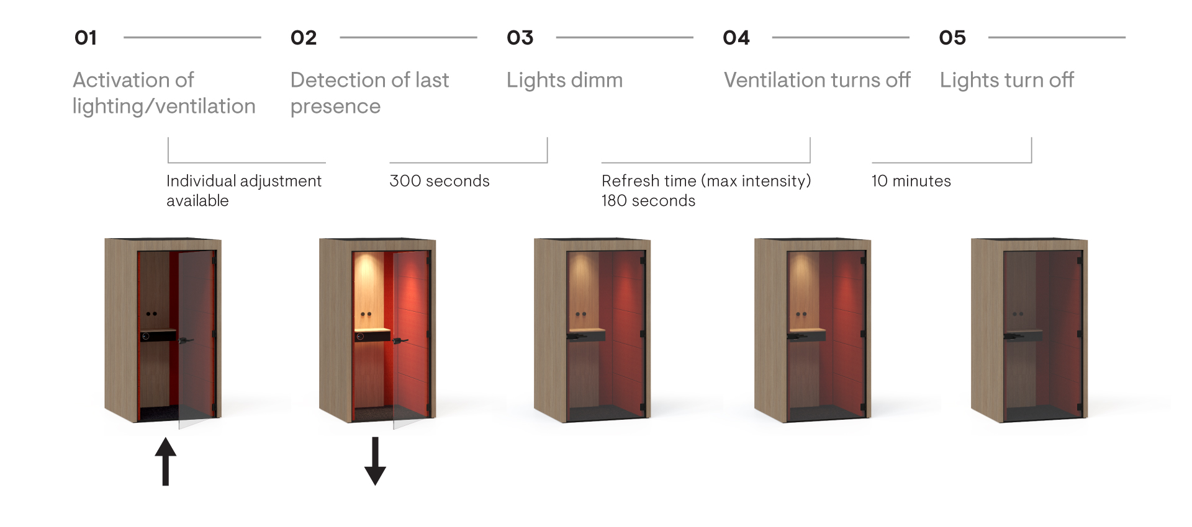
Smart energy saving
Notes:
The smart control unit is pre-set to maintain an optimal ventilation and illumination level. You will also be able to change general control unit settings according to your specific needs. Once an employee leaves the SILENT ROOM, intense ventilation is automatically activated to prepare the room for the next user. This acoustic piece of furniture also helps with energy savings as it automatically dims the lights when no one is present in the room and even turns them off after some time.

Slide 17
DESIGN AND CUSTOMISATION

Slide 18
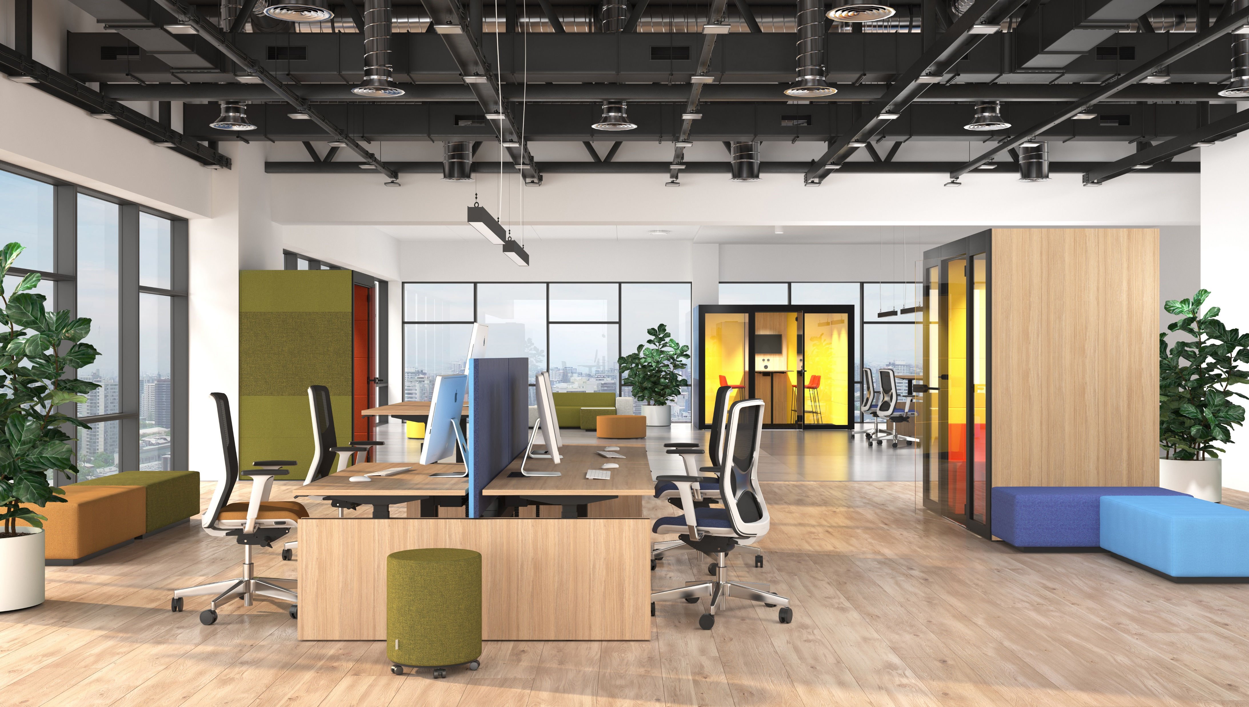
Colour combinations
Notes:
The design of your SILENT ROOM can be easily customised to match your office’s desired style and atmosphere. The interior and exterior finish can be selected separately, giving you more control over the final product. With a choice between melamine and upholstery for the exterior finish, the SILENT ROOM can blend seamlessly into any office design.

Slide 19
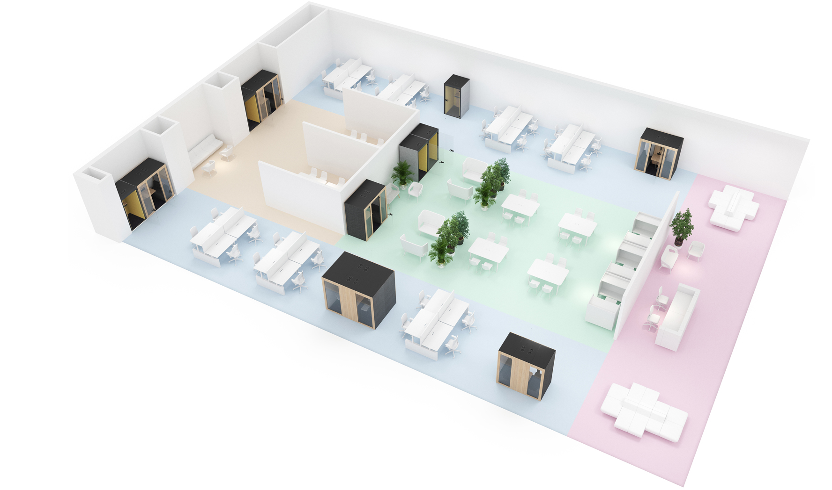
Wide range of configurations
- work space
- collaboration space
- relaxation area
- reception area
Notes:
Choose SILENT ROOM acoustic pods to create functional work areas by dividing or opening interior spaces as necessary. This piece of furniture can be set up in the middle of the office space, near the walls or partitions, or inside a wall niche, and requires a clearance of just 30cm at the top for air circulation. In this way, the SILENT ROOM will blend even more easily into your office space.

Slide 20
RANGE

Slide 21
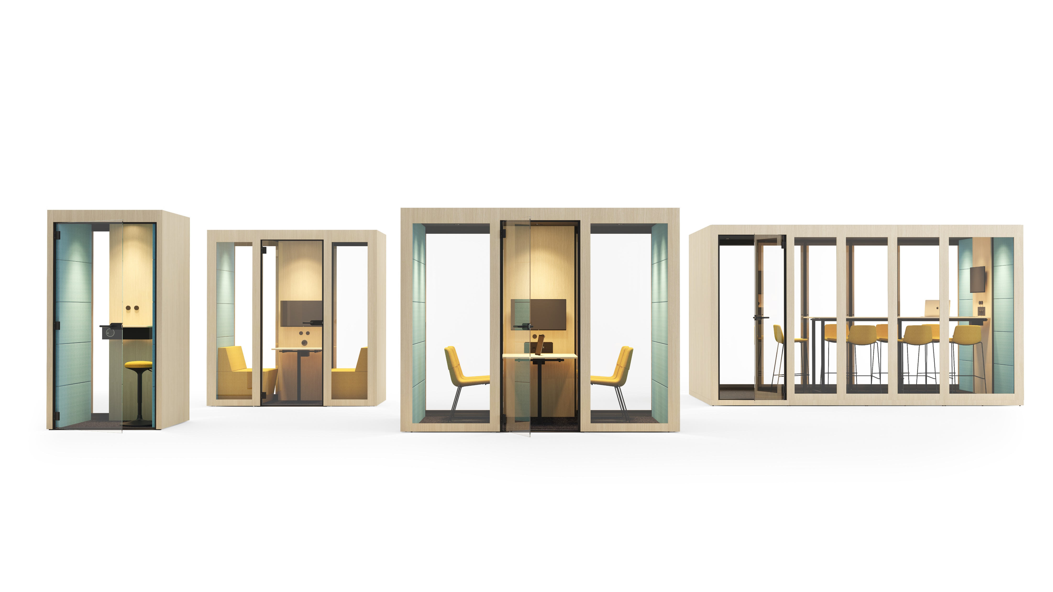
SILENT ROOM S
SILENT ROOM M
SILENT ROOM L
SILENT ROOM XL

Slide 22
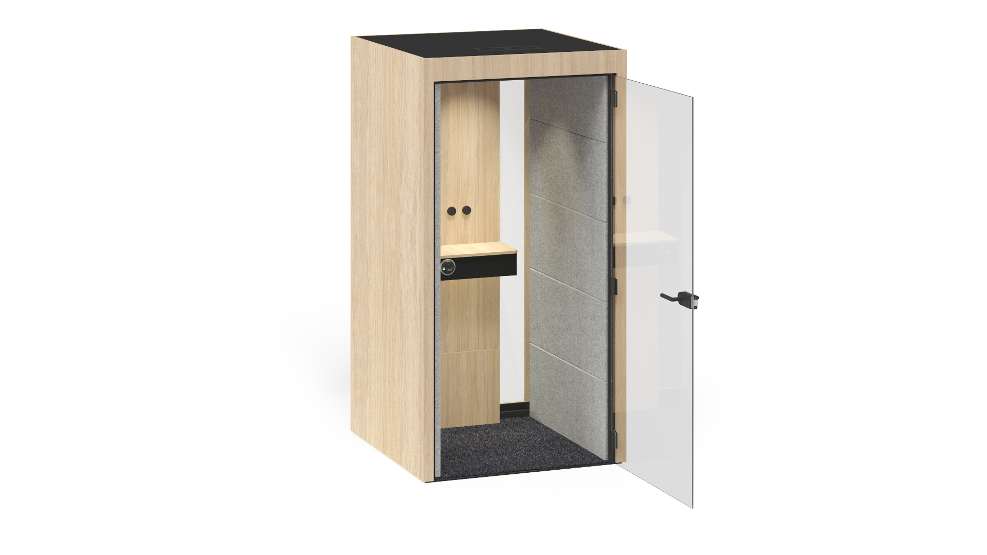
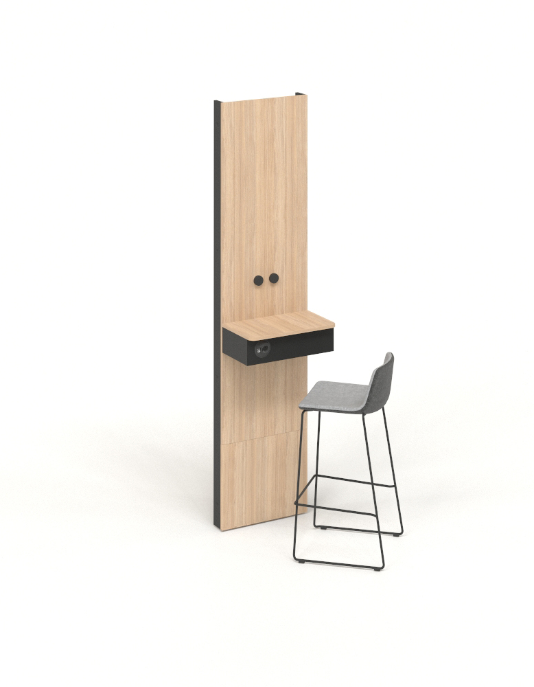
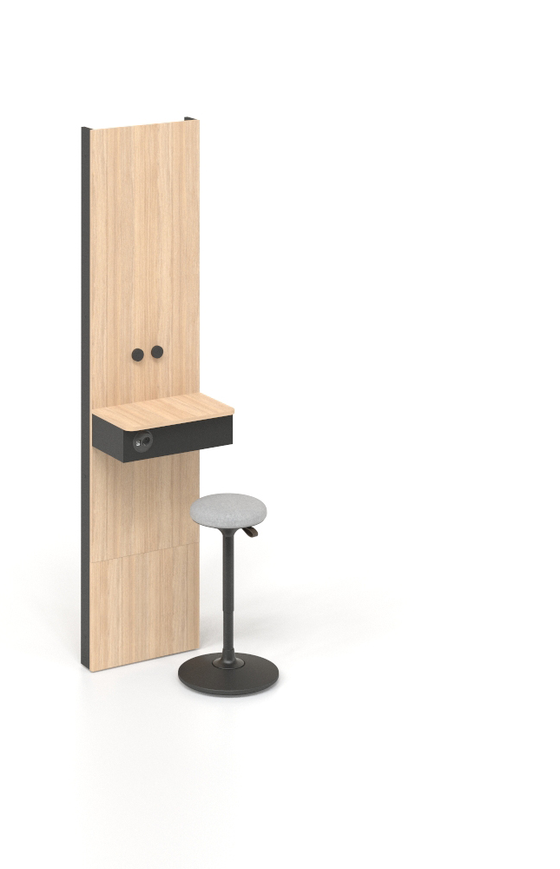
SILENT ROOM S
Notes:
For 1 person

Slide 23
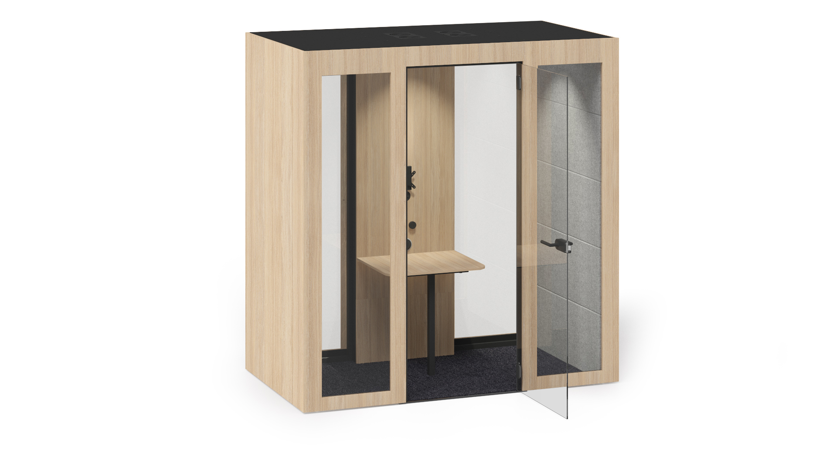
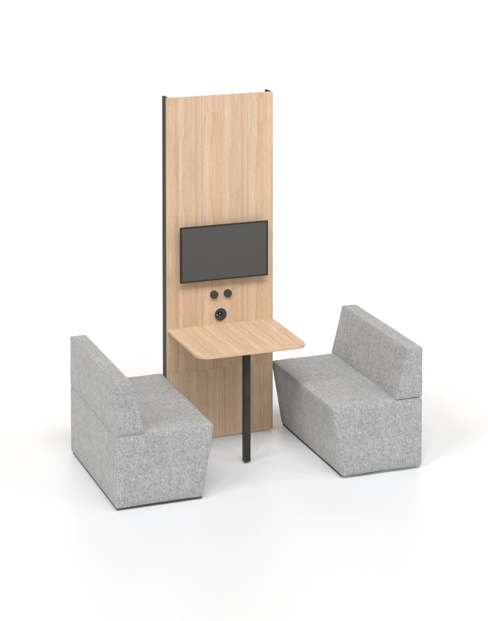
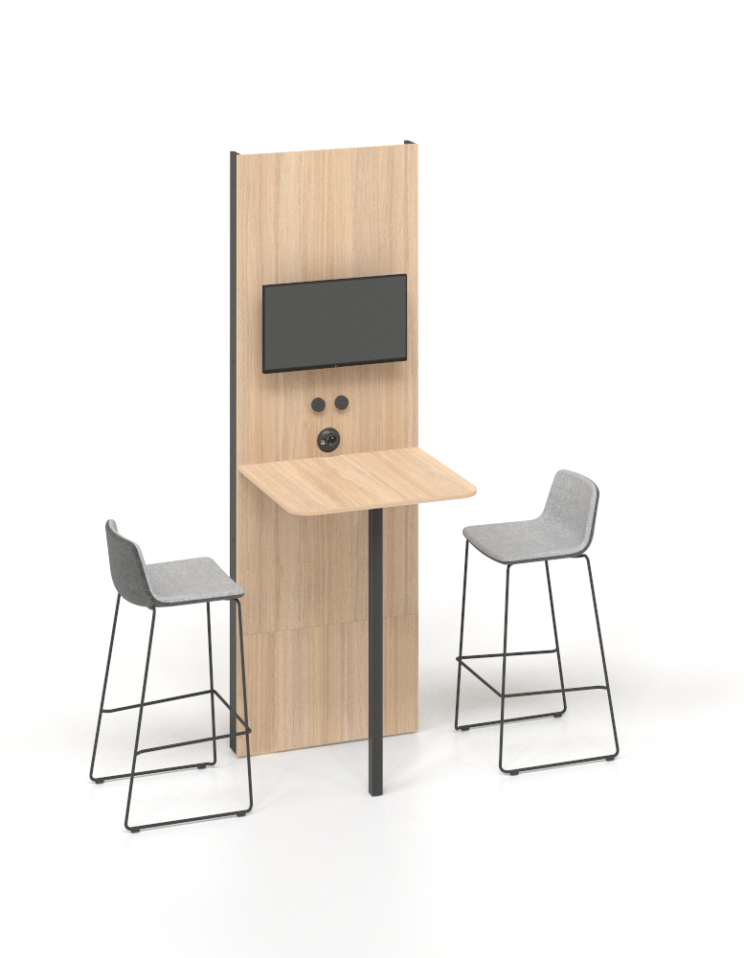
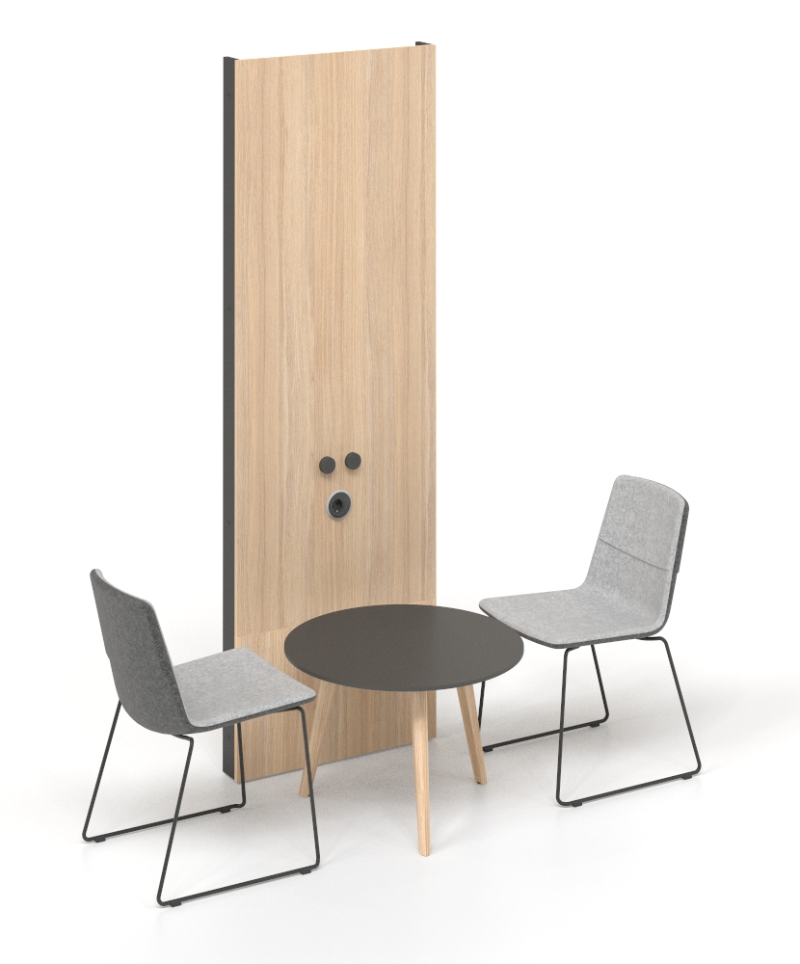
SILENT ROOM M
Notes:
For 2 persons

Slide 24
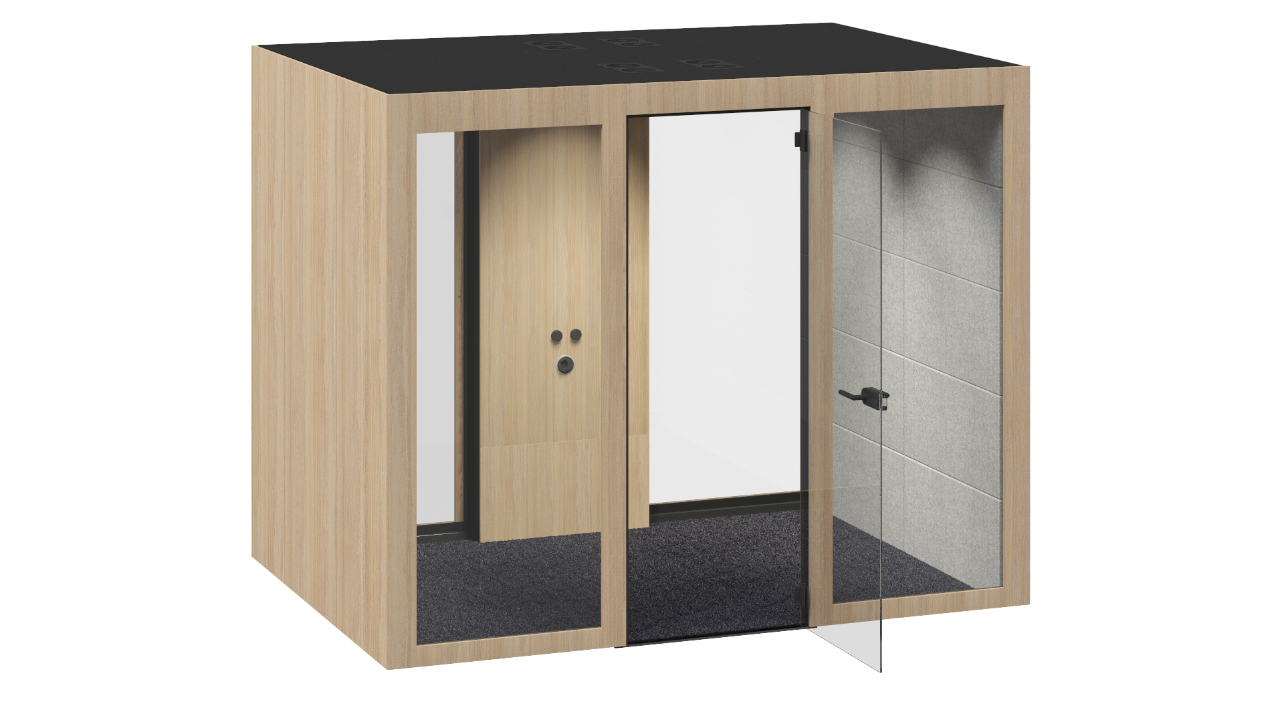
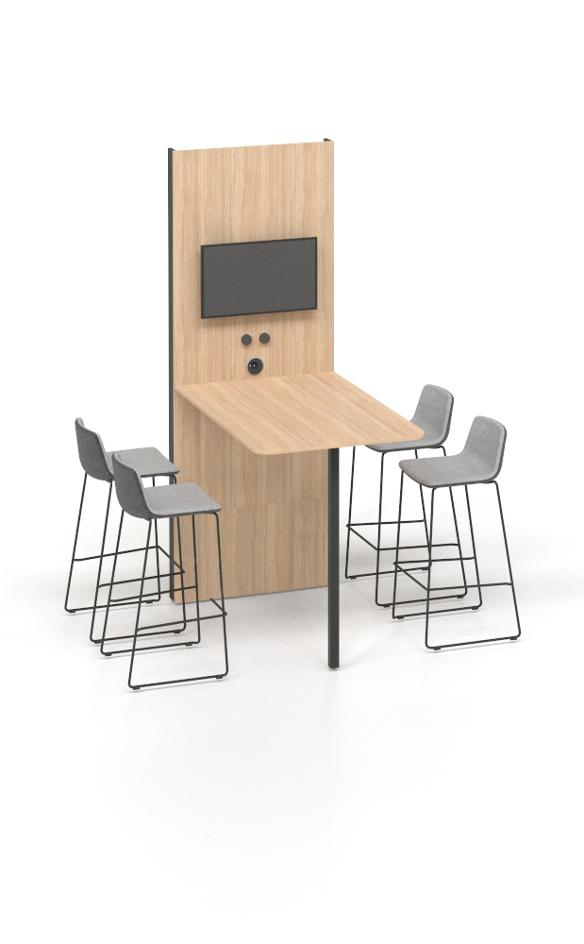
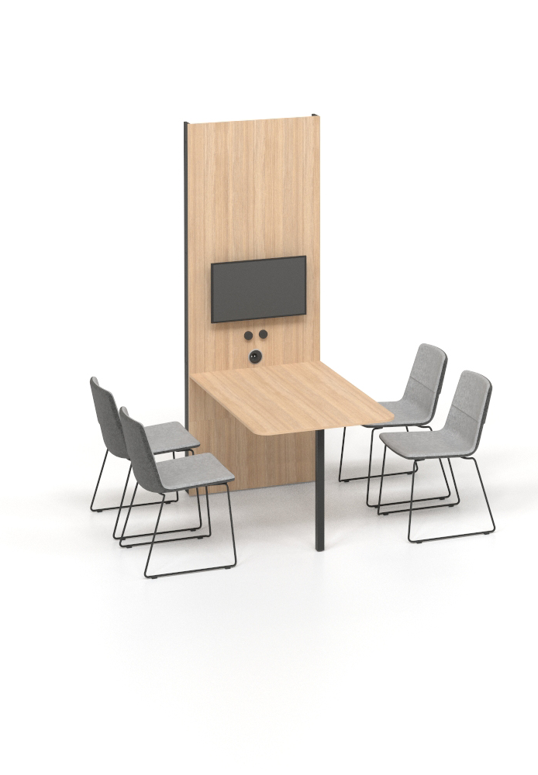
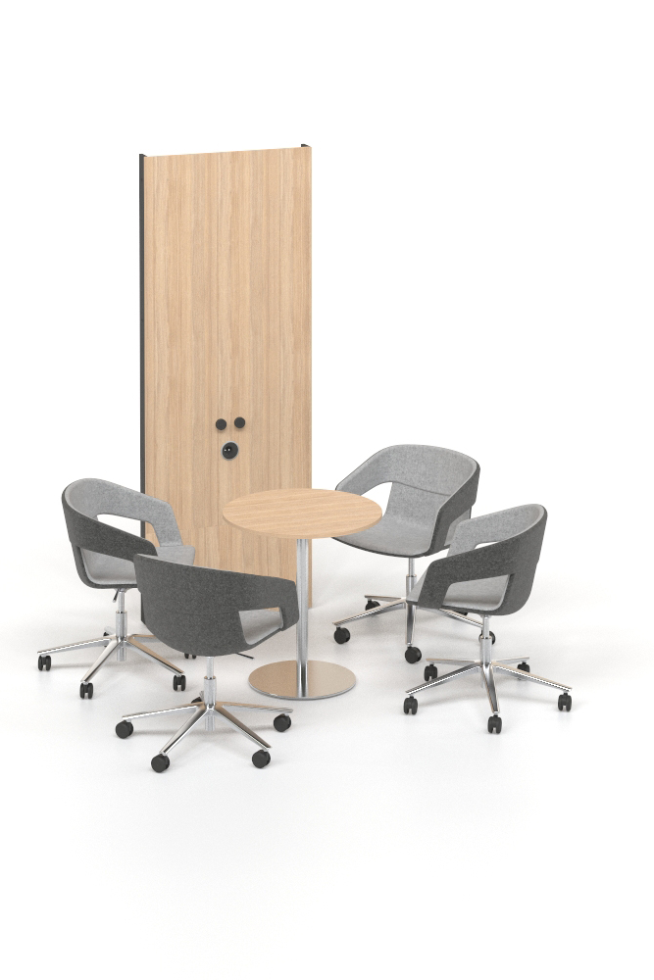
SILENT ROOM L
Notes:
For 4 persons

Slide 25
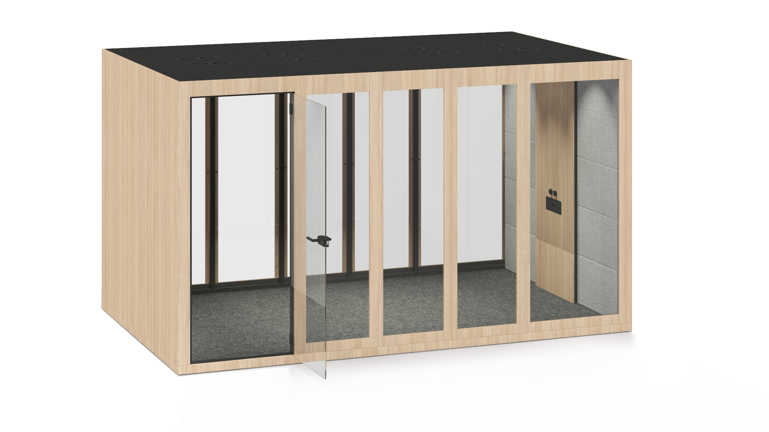
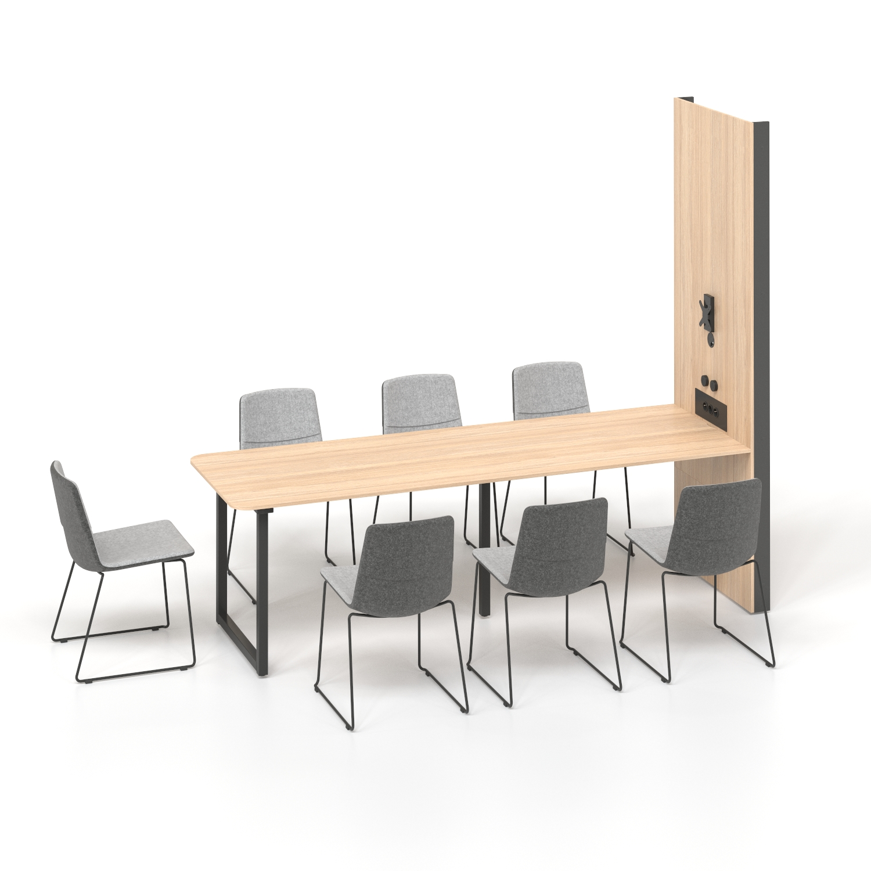
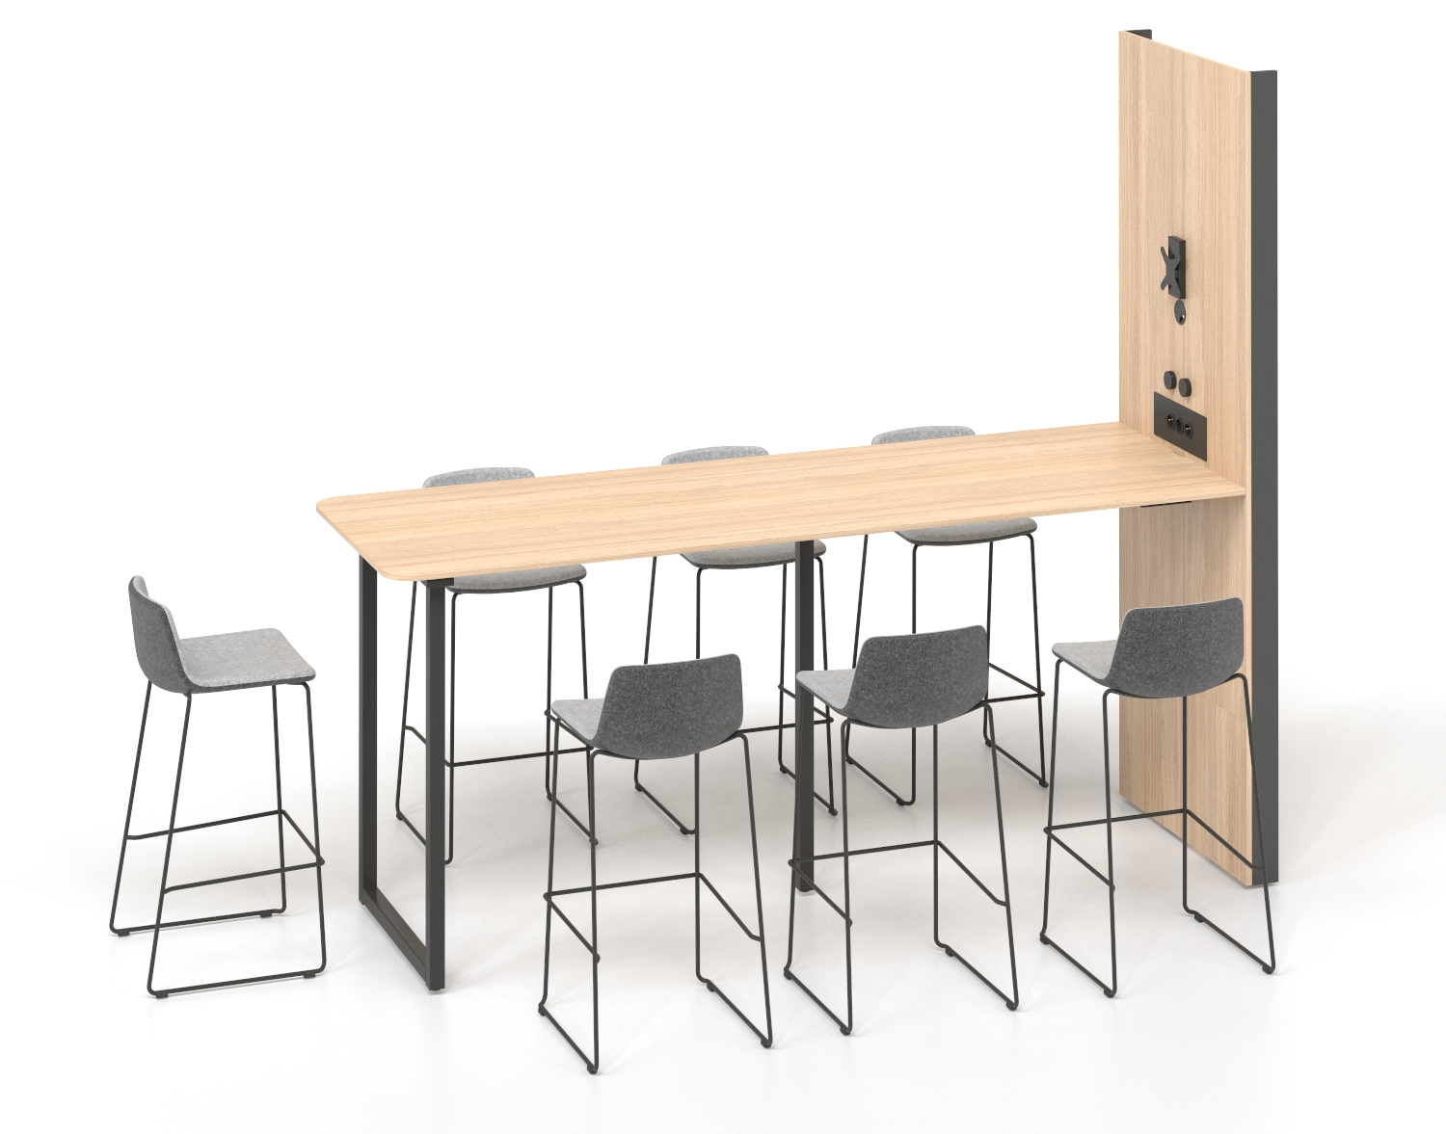
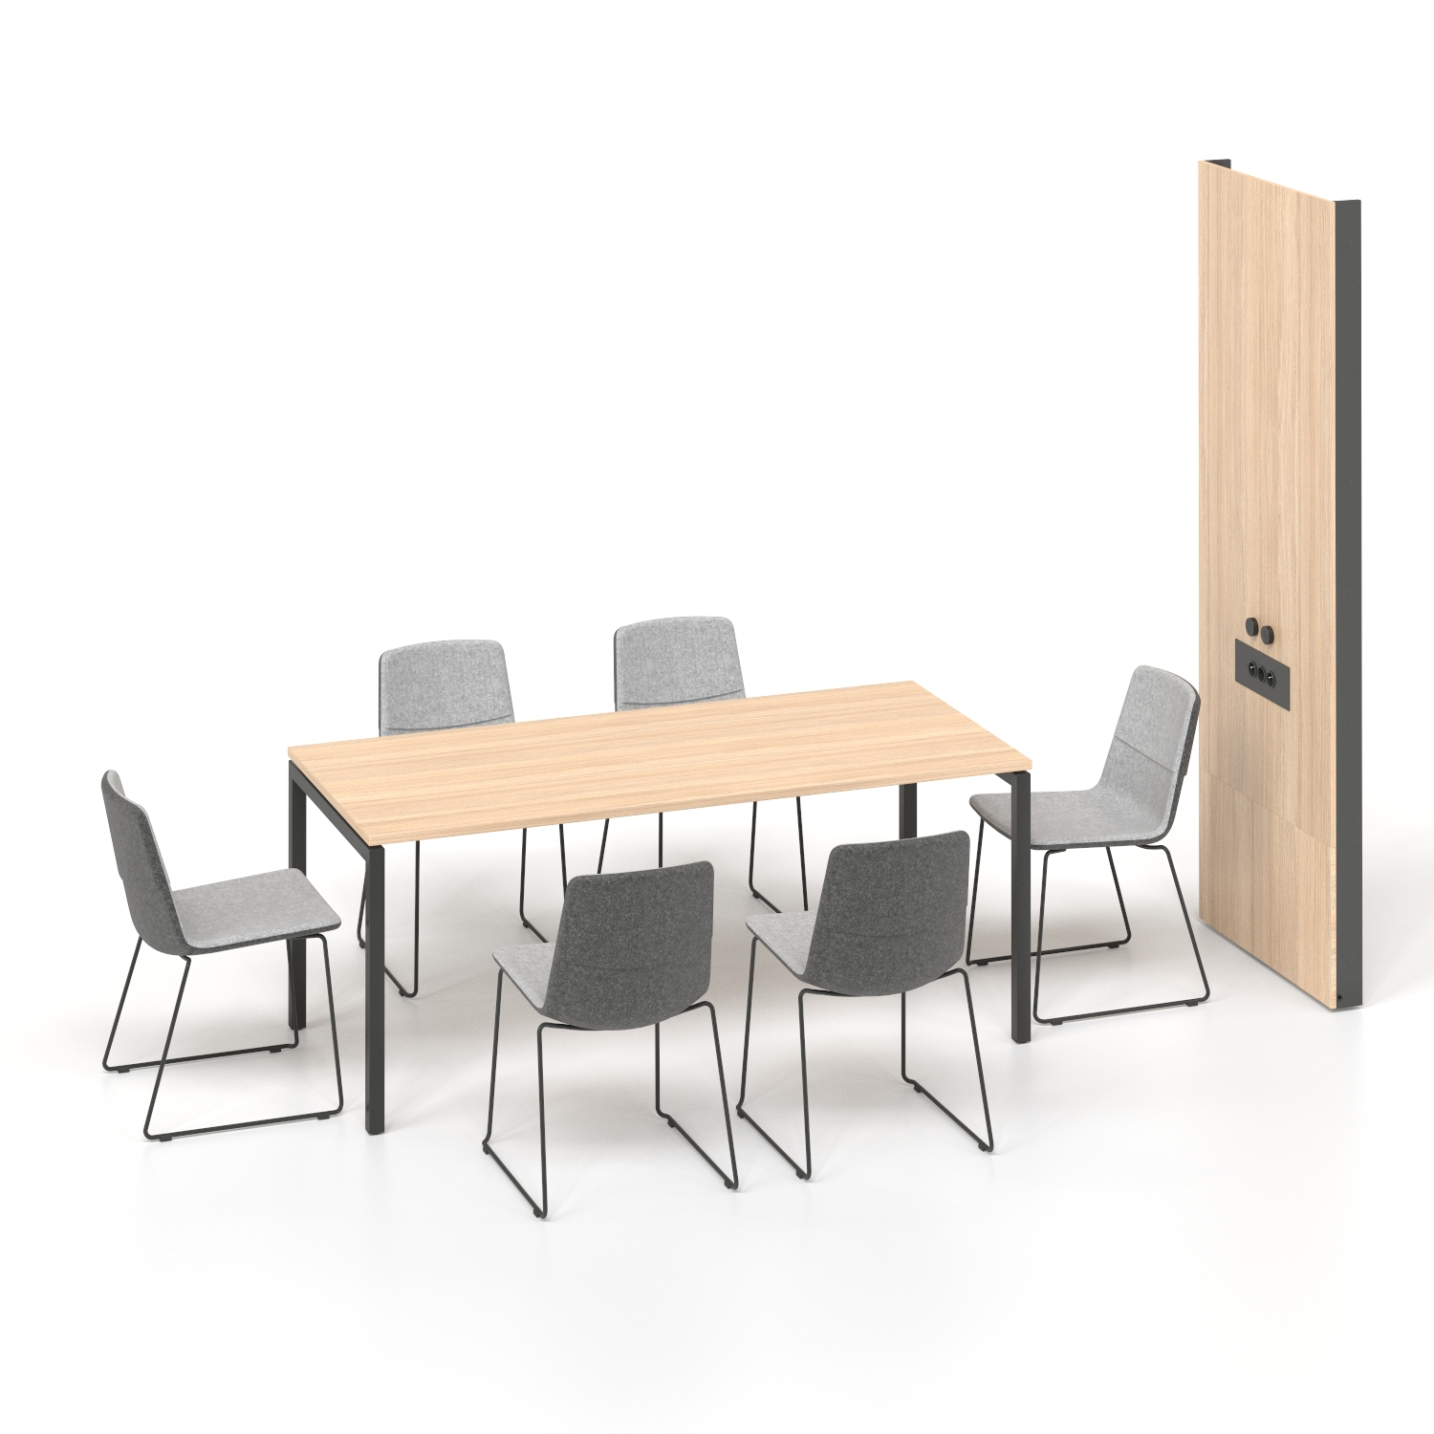
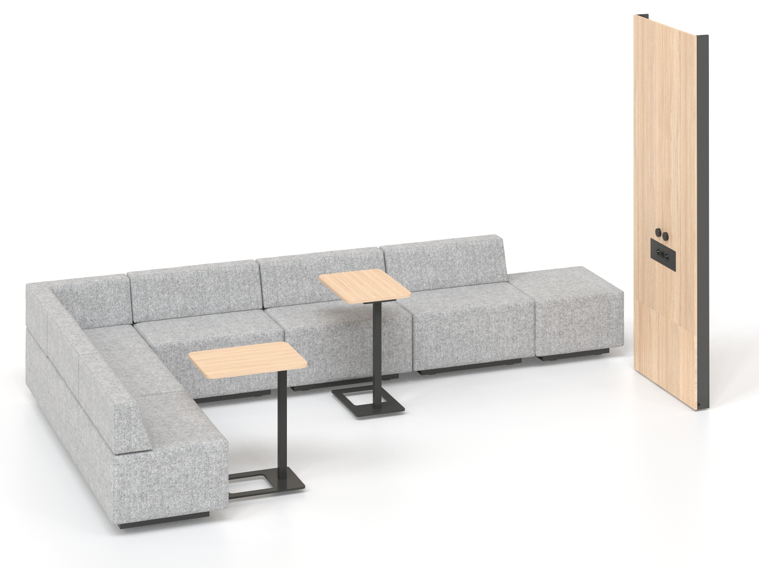
SILENT ROOM XL
Notes:
For 8 persons

Slide 26
