Slide 1
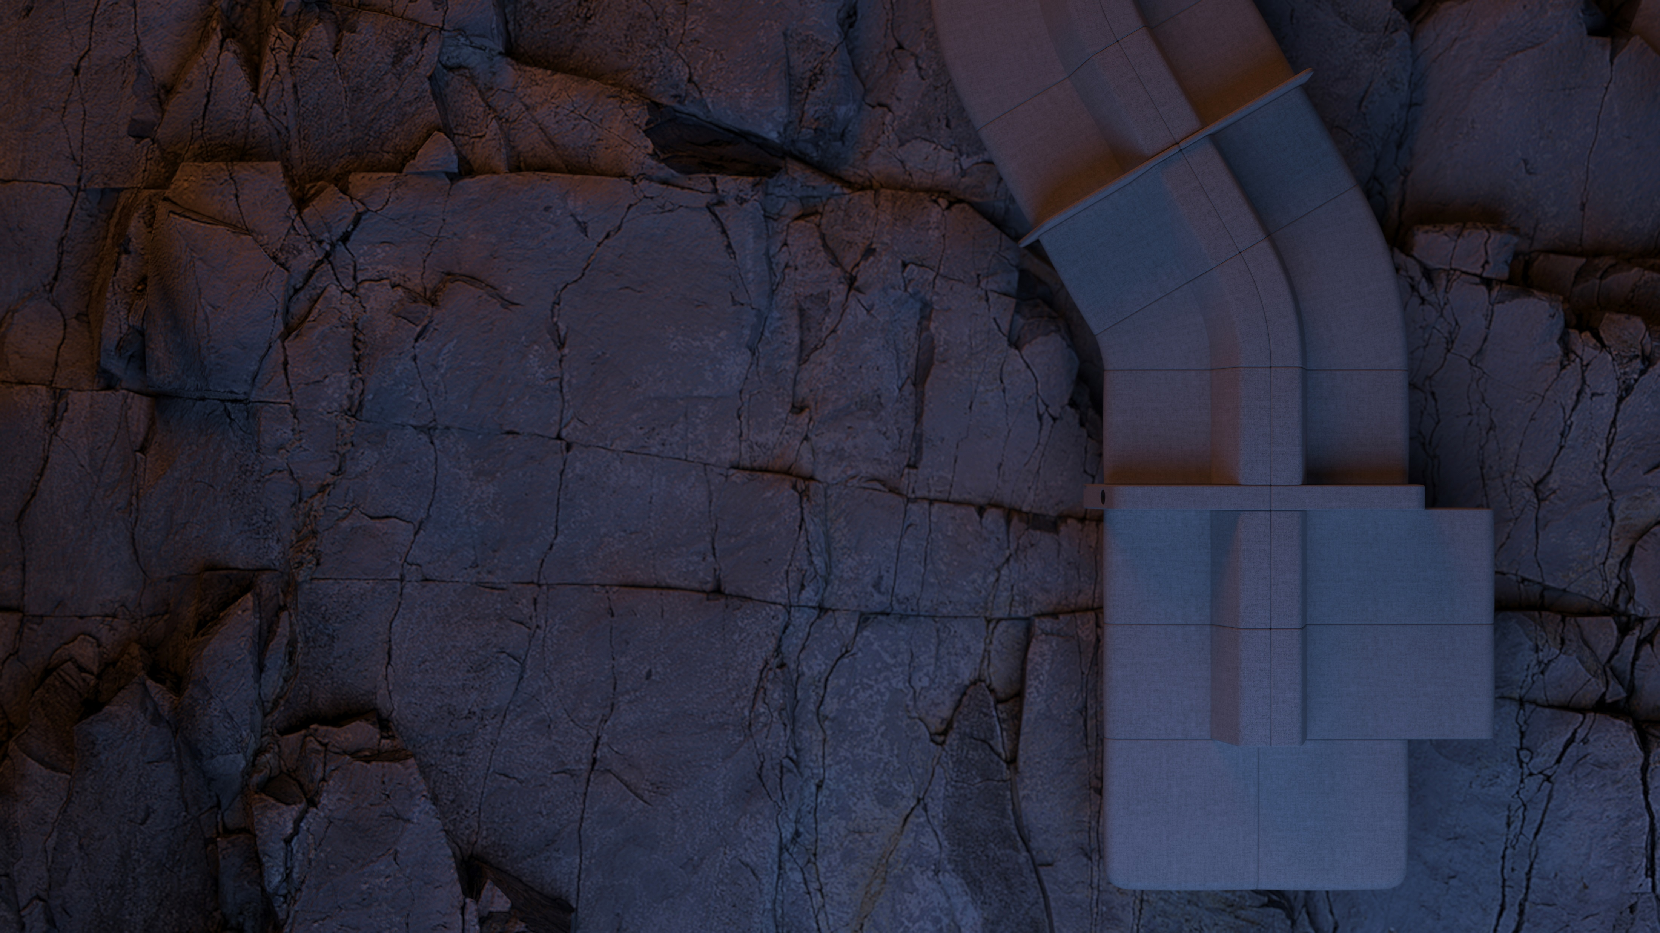
SOFT ROCK
Inspired by the new generation

Slide 2
Times change.
People do, too.
Notes:
We often hear people say: “Times change”. But have you ever tried to understand what it actually implies?
Climate, values, technology, and the spread of information – the entire world is undergoing change.
It is only natural that these changes, in one way or another, are also reflected in our work environment, from the laws on labour relations to ergonomic requirements for an individual workplace.
Changes affect materials, design, people’s attitudes and habits and... people themselves.
And this is true in a literal sense.

Slide 3
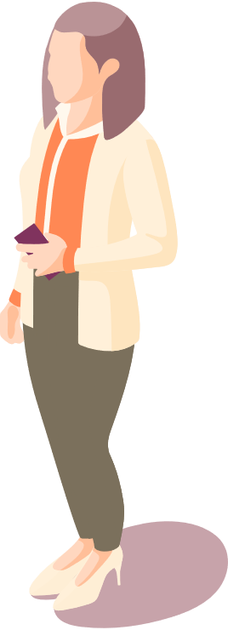
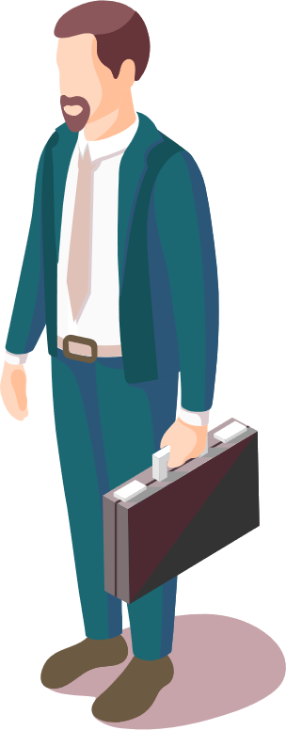
Different generations – different approaches to work
Age: 75-57
Age:
56-41
Age:
40-26
Age:
25-9
Baby Boomers
Generation X
Generation Y
Generation Z
1946
1965
1981
2012
Notes:
Over the last 20 years, an entire new generation of workers transitioned into the labour market.
Currently, there are four generations in the workforce: the Baby Boom Generation (1946–1964), the Generation X (1965–1980), the Generation Y (1980–1996), and the Generation Z (1997–2012).
Let’s take a brief look at each generation and their characteristics that also shape their workplace habits.
Baby Boomers: dedicated to work; are often called workaholics; value professionalism and stability; are great team members and mentors; loyal and reliable.
Gen Xs: highly valued by employers; independent, critical and able to create a clear separation between their professional and personal lives.
Gen Ys (alternately known as Millennials): ambitious, bold, adapt quickly, are open to new things, highly mobile and free.
Gen Zs: the most technologically savvy among all generations; have an entrepreneurial mindset and the ability to multitask.

Slide 4
New ways of working
Having grown up with new digital technology, Generation Ys have adopted a more flexible approach to a workplace which provides them with an ability to work from anywhere...
Notes:
Based on the findings of Pew Research Center, the year 2016 can be called a transitional year.
That year marked the start of a generational shift in the workforce, and Generation Y became the largest generation in the labour force bringing along change in the work environment with them.
It was this generation that shaped the approach that an office, or a formal setting, must not restrict or otherwise affect the ability to work successfully, – that any place with an internet connection and a power supply to charge a laptop can become a place of work.
Generation Ys were raised with digital technology; they take all mobile devices for granted. In other words, Millennials are completely proficient in all latest technology and incorporate it easily into their workflow.
For example, they can maintain contact via remote communication and this does not cause them any stress.
They can get tasks and all necessary information required for work and share their achievements via internet platforms, etc.

Slide 5
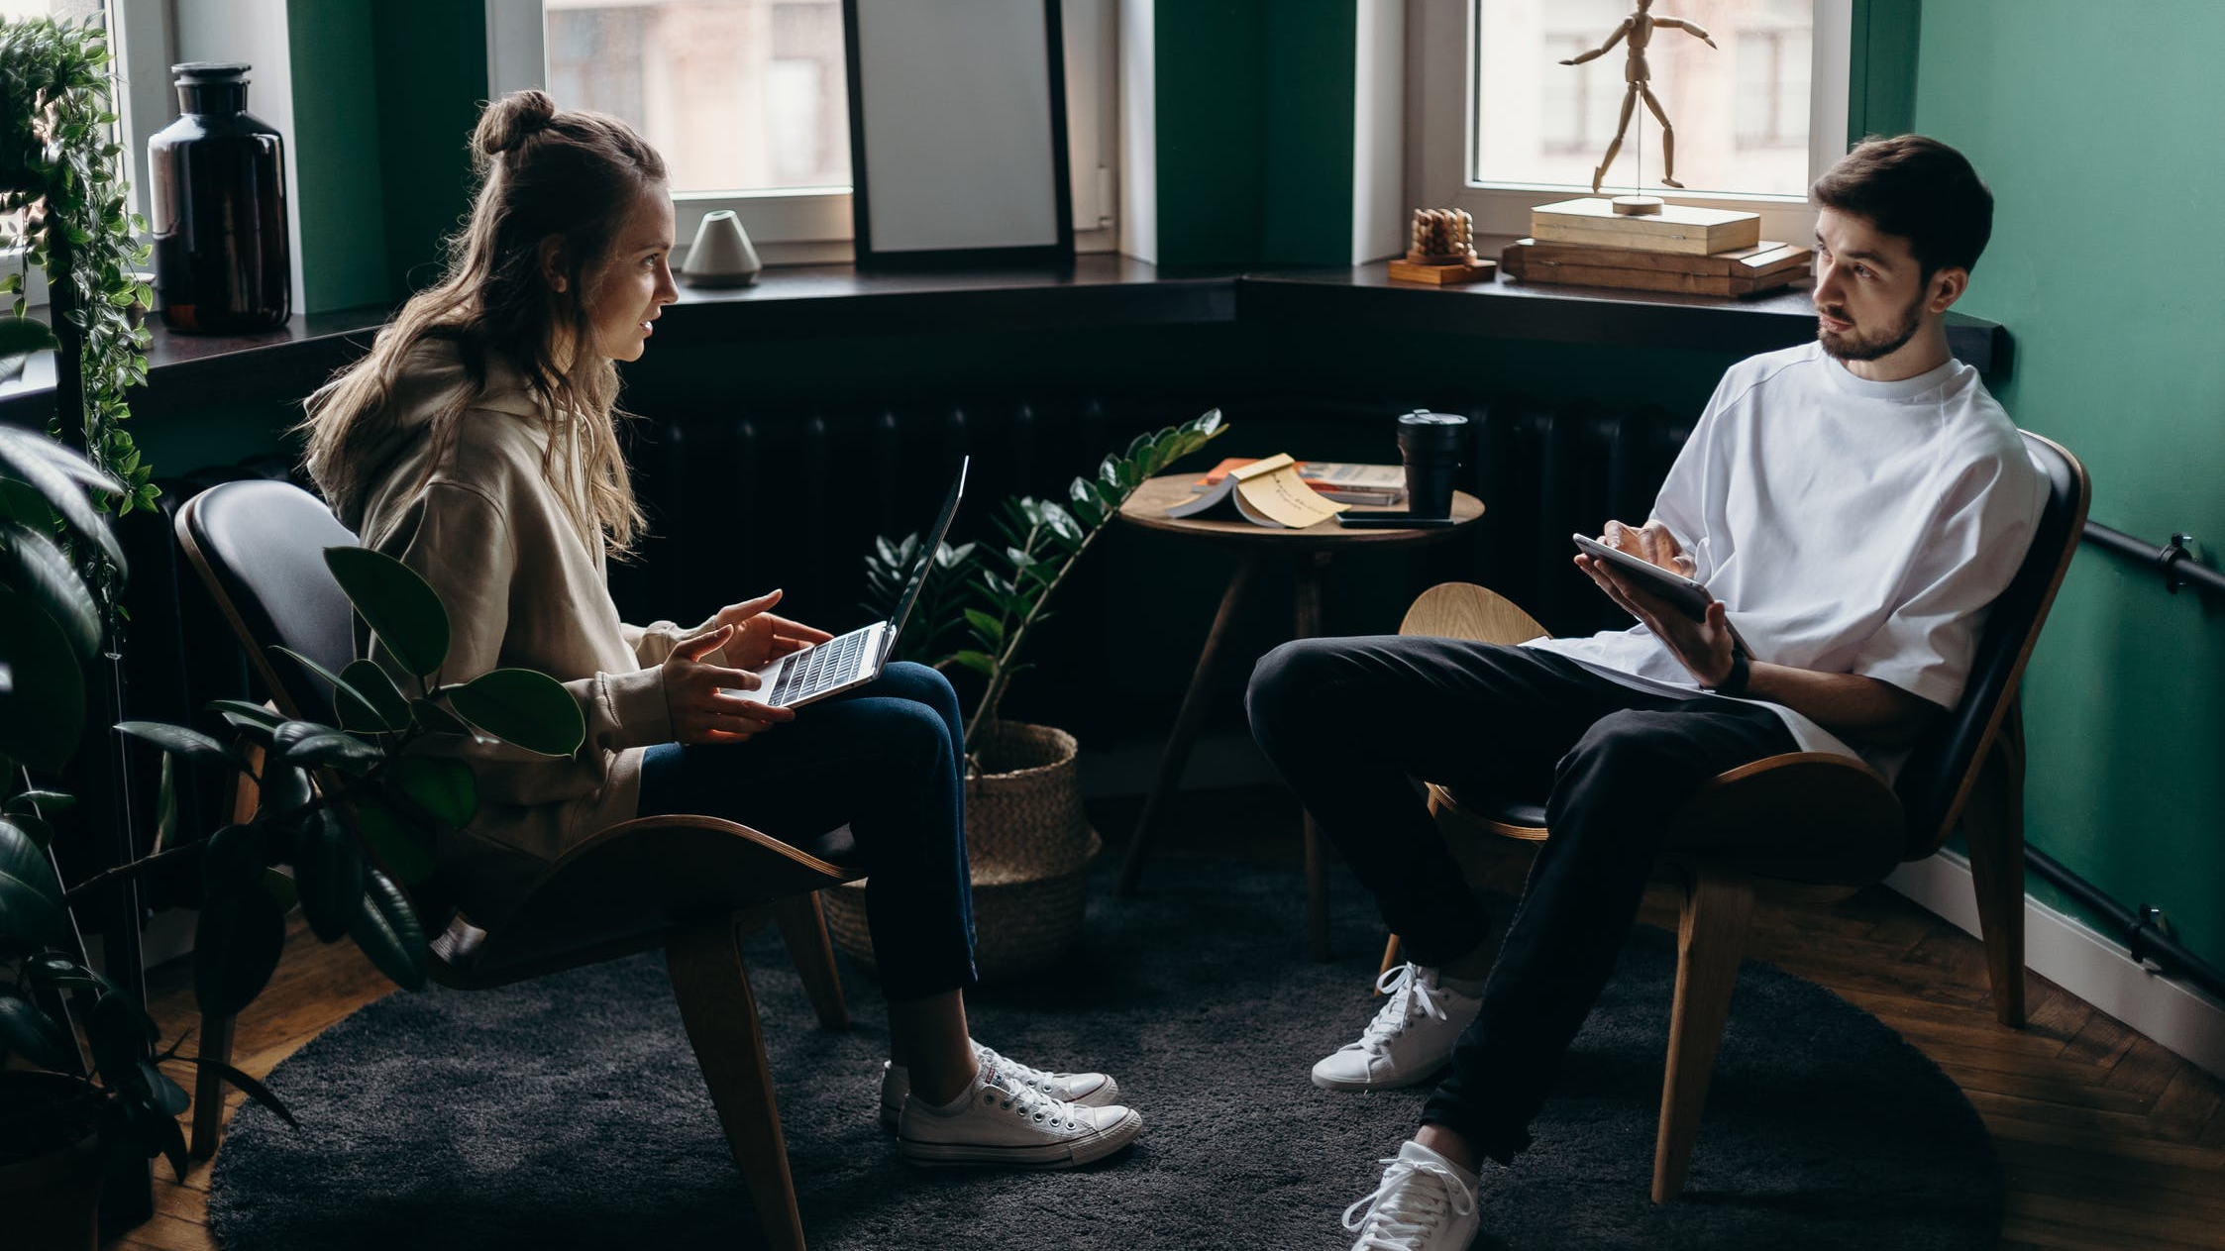
Set free by technology, people can choose where they want to work. It can be their home, a café, a hotel lobby, an airport, a park... In all those places they can feel relaxed, but at the same time focus on their work.
Notes:
You have probably noticed that trendy cafés and open modern public spaces are often occupied with young people snuggled on soft armchairs or sofas or even on the floor with their eyes glued to smart device screens.
They are not distracted by background noise and they often spend much of the day there. In this type of environment, they can feel relaxed and interact freely with each other, yet at the same time they are able to focus on their work and absorb all the information presented on the device screen.

Slide 6
Different approach to values
A casual environment creates a relaxed atmosphere, promotes more interaction and collaboration among people, boosts motivation levels encouraging them to focus more on the tasks at hand and provides inspiration for creative work.
Notes:
With a new approach to technology comes a change in values.
Millennials are known to have a stronger focus on job satisfaction compared to other generations.
For them, it is not only excellent performance and achievement of results that matter but also the sense of fulfilment in the workplace.
A formal workplace setting, clothing, and strict work processes restrict them, whereas a unique casual environment helps them relax and interact more freely, motivates them to focus more on the tasks assigned, and provides inspiration for creative work.

Slide 7
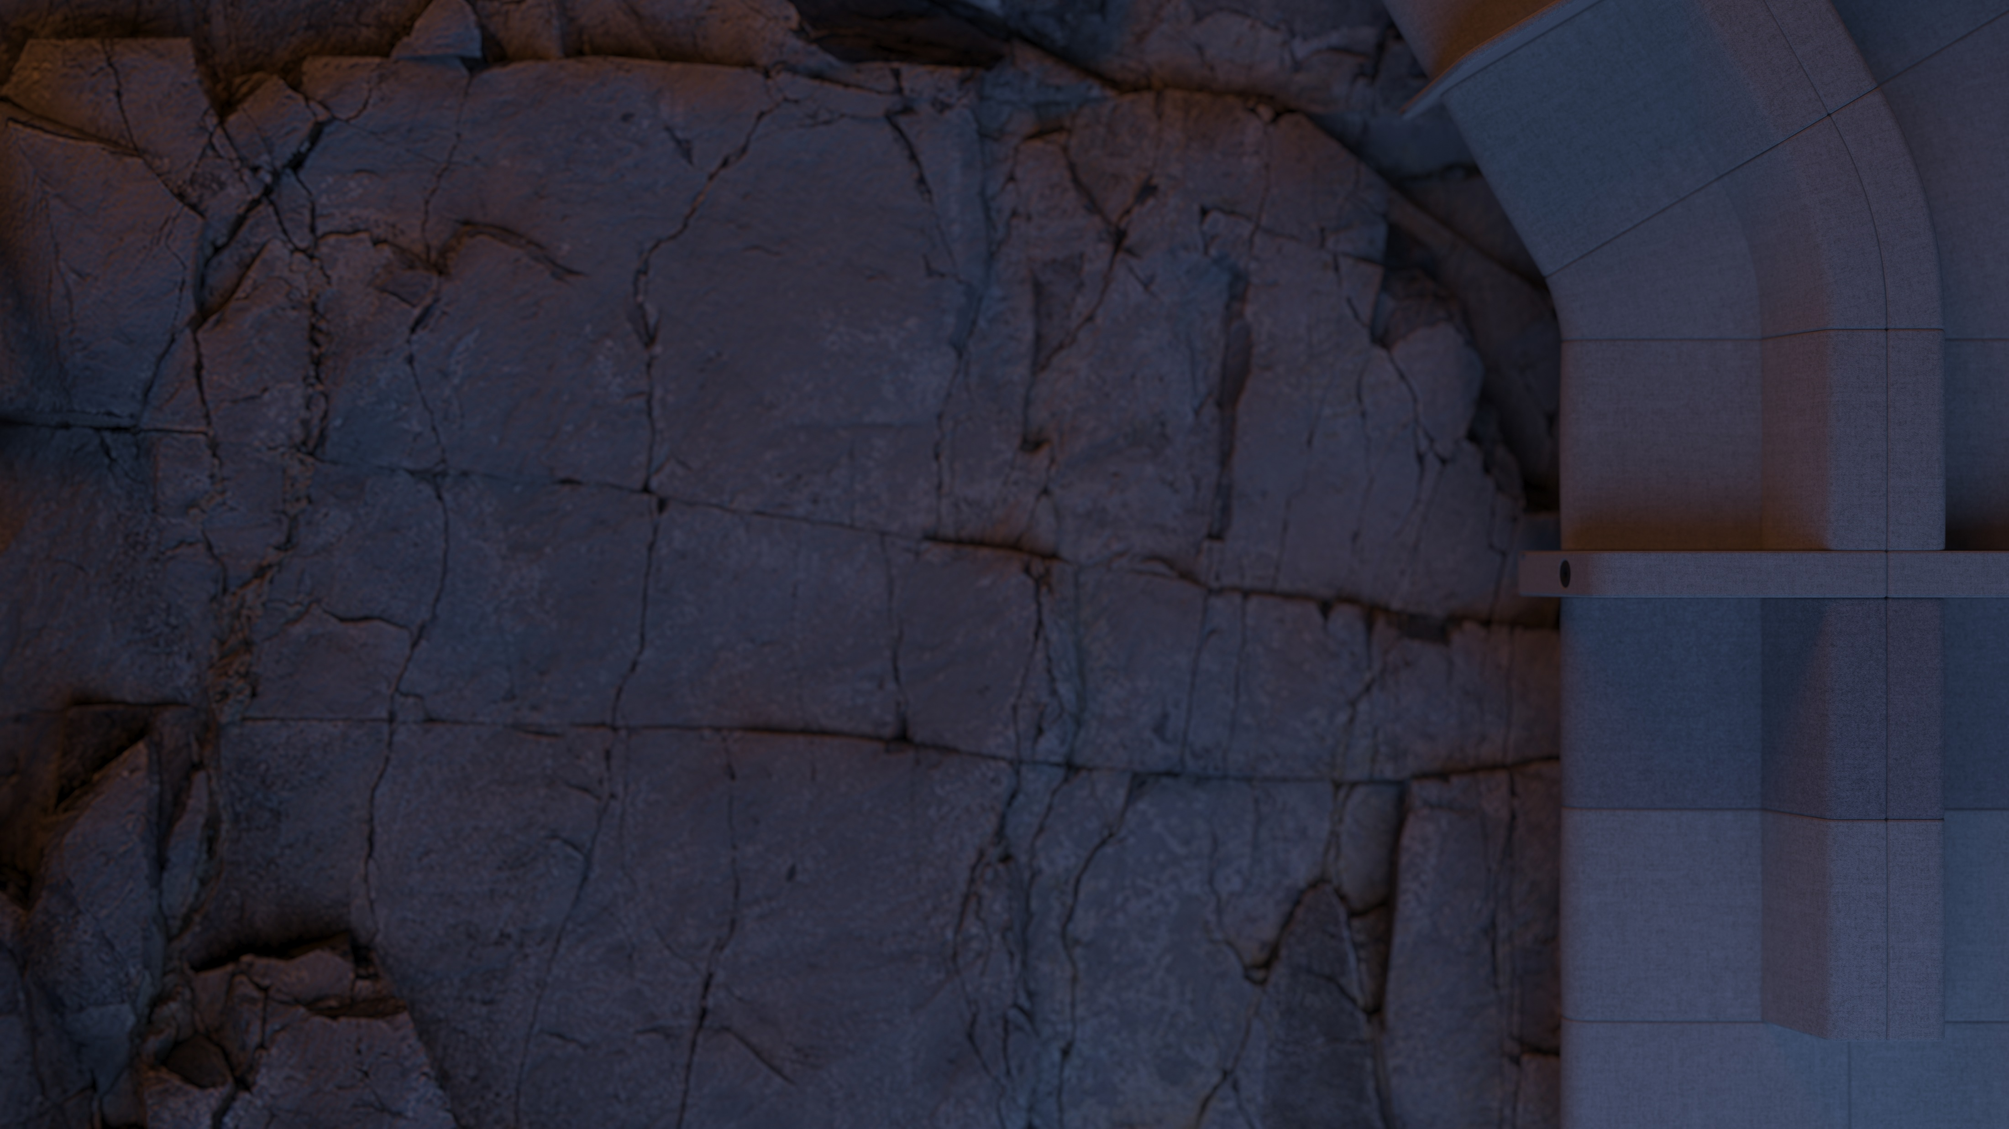
SOFT ROCK
Being open to new things, a sense of freedom, the ability to adapt quickly to changing situations – all this inspired us to create our new lounge seating collection.
Notes:
A modular lounge seating system blends subtly into all kinds of lounge or work spaces for both public and private use and helps create a welcoming, safe and calm atmosphere for relaxation, informal meetings, collaborative or individual tasks.

Slide 8
”
SOFT ROCK reflects a youthful and relaxed feel and offers numerous possibilities to set up or combine different spaces.
”
Christina Strand & Niels Hvass

Slide 9
Nature-inspired forms
Notes:
A natural setting is one of those special places where people can often find freedom and are able to relax. This is why many of us choose the seaside for our vacation, for it is there where we can listen to the calming sound of the waves.
When designing SOFT ROCK, Christina Strand and Niels Hvass drew inspiration from nature: they observed the sea’s waves washing over rock and stones on the shore, and rendering those rocks and stones’ shapes softer and smoother.

Slide 10
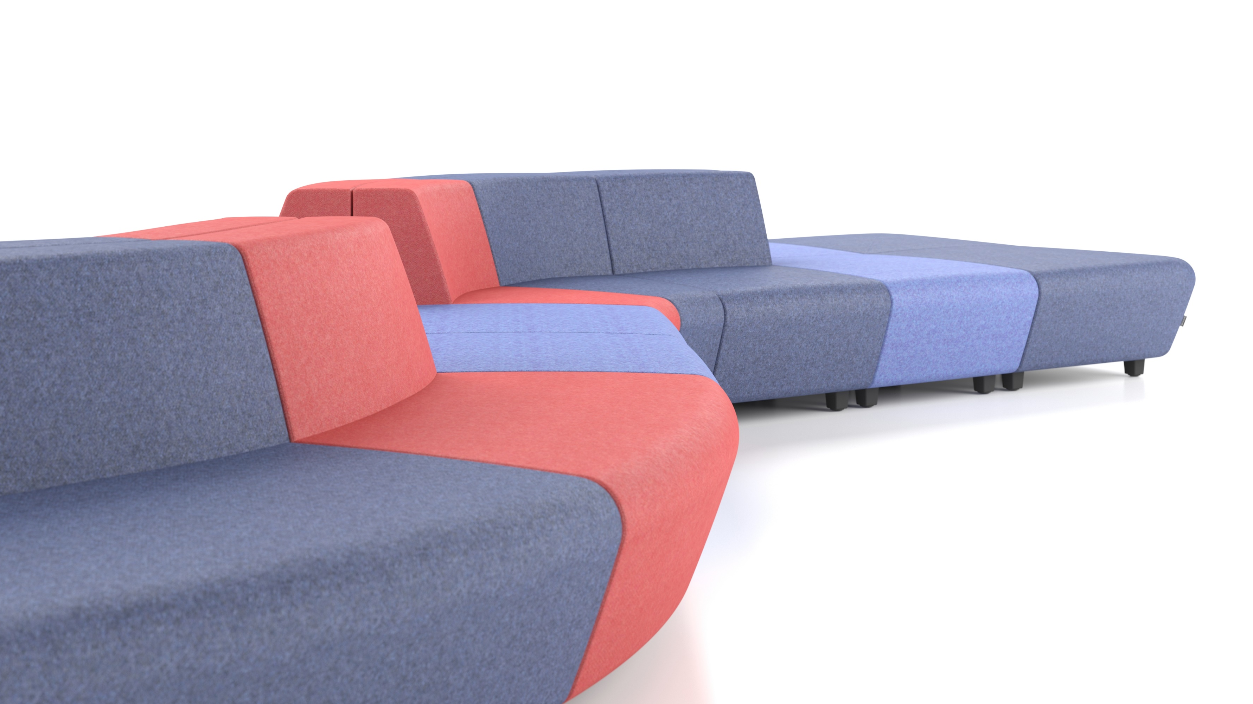
The synergy between rounded shapes and straight lines creates a unique, eye-catching yet simple design.
Notes:
Distinctive yet laconic silhouette is what makes SOFT ROCK stand out from other soft seating furniture. A clear rhythm of vertical and horizontal surfaces adds a sense of calm monumentality to this furniture, whereas the repetitive pattern of the inclined planes in the seat and backrest brings an unexpected dynamism to the office space.

Slide 11
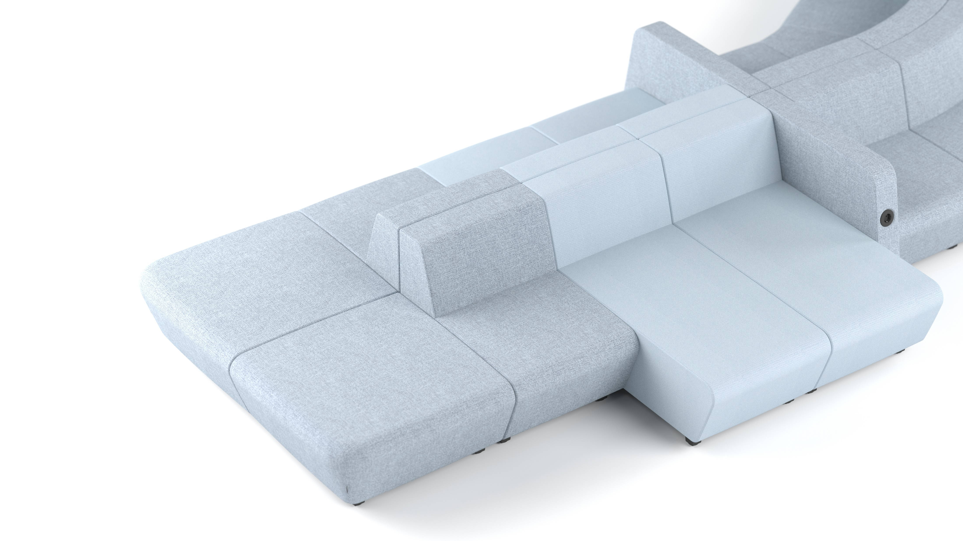
Low-frame SOFT ROCK lounge seaters with a distinctive backrest invite you to sit back in comfort or to lay down and relax.
Notes:
The visually robust and deep seat invites you to snuggle up atop this furniture in a semi-lying down position. The relaxed feel of comfort is further enhanced by its low legs, rounded edges and an extremely low backrest line.

Slide 12
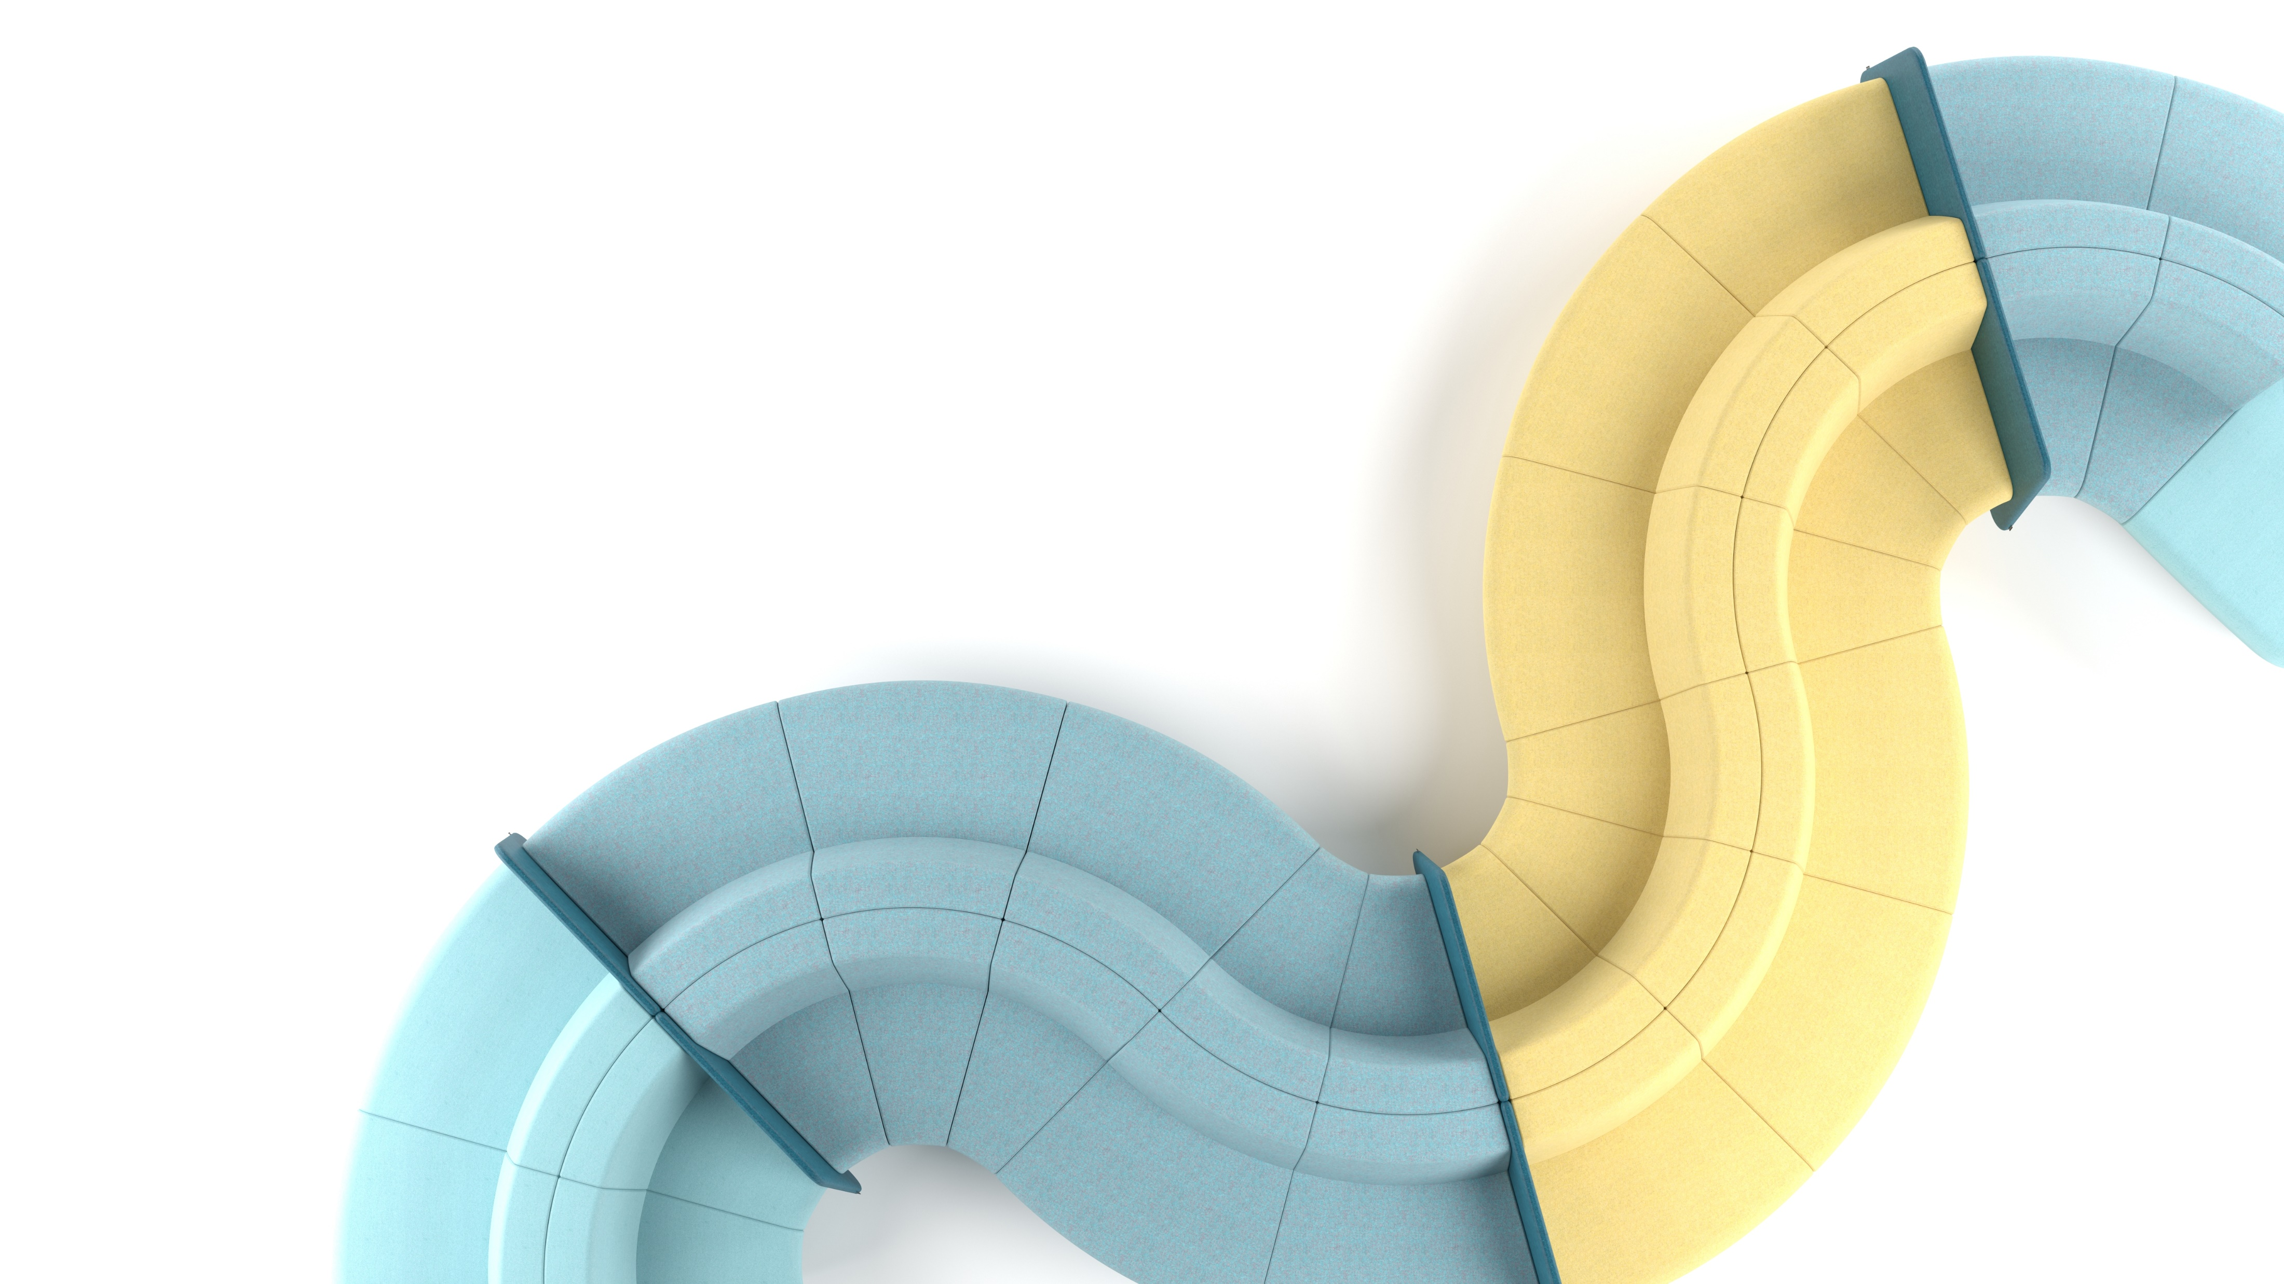
Flexible modular system
The SOFT ROCK collection consists of lounge seaters available in different sizes and forms which can be easily combined or rearranged to make efficient use of the space.
Notes:
SOFT ROCK is a flexible modular system consisting of lounge seaters available in different sizes and forms which can be easily combined or rearranged. This is why SOFT ROCK offers a simple way to make an efficient use of the space.

Slide 13
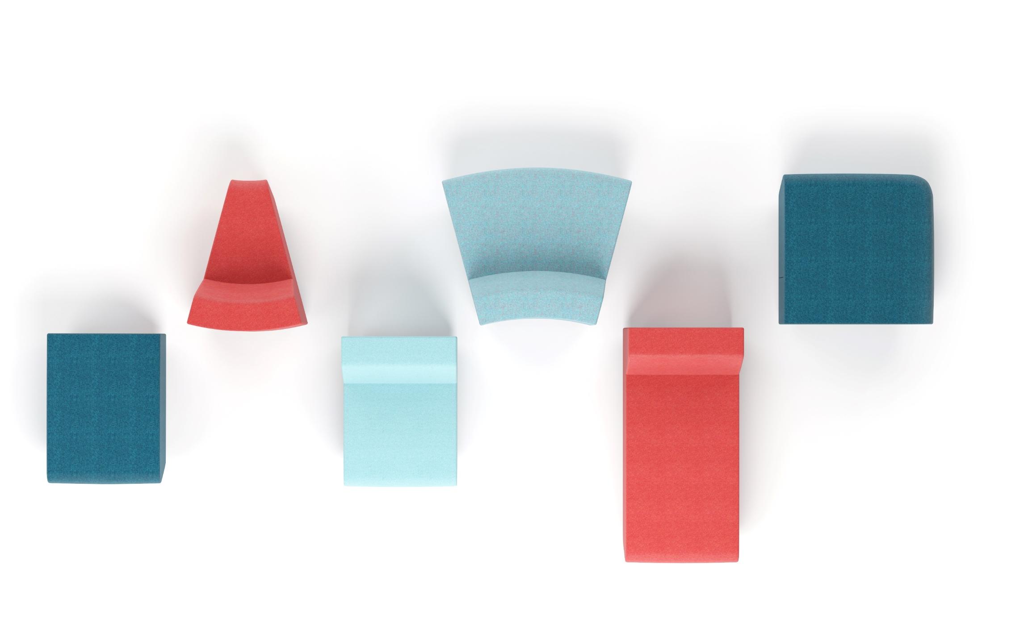
Unlimited possibilities for creative expression
6 types of lounge seaters:
come in different sizes;
feature straight or curved lines;
with or without a backrest.
Notes:
Unleash your creativity and set up desired combinations by selecting a piece of furniture of your choice from our range of six main types of lounge seaters available in different sizes, with straight or curved lines, and with or without a backrest.
A long lounge seater with a backrest offers great comfort for both relaxation and work. It is a new addition to NARBUTAS portfolio as this model was never before available in earlier NARBUTAS collections.

Slide 14
Make the most of your lounge seater composition by adding
Armrests:
low
high
with power supply modules
Screens:
low
high
high screens with a table
Notes:
Depending on your actual needs, use additional accessories – different armrests and screens to make the most of your lounge seater composition.

Slide 15
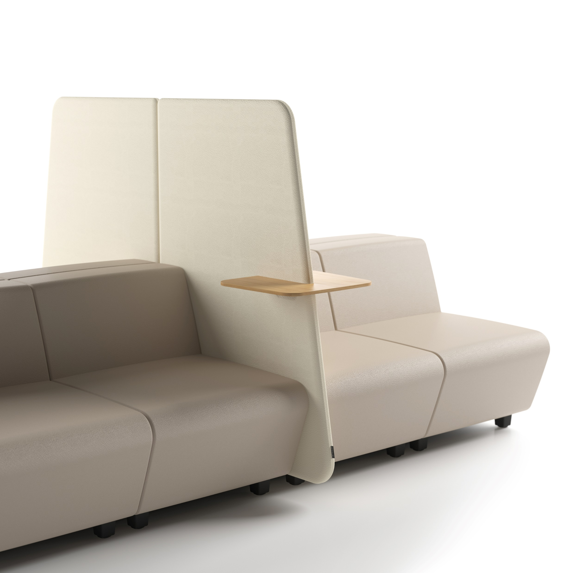
Privacy and safety
Integrated screens help to create zones for individual work that requires concentration.
An easy way to ensure a desired seating distance between users.
Leather-look lounge seaters are easy to clean and disinfect.
Notes:
The screens can be harmoniously integrated into the SOFT ROCK lounge seating combinations and can change their purpose. It is a perfect tool allowing you to create a more private area for individual work that requires concentration within an open space. Also, thanks to the screens, you can create a safe atmosphere by ensuring desired distances between people without totally isolating them. Leather look lounge seaters are extremely easy to clean and disinfect.

Slide 16
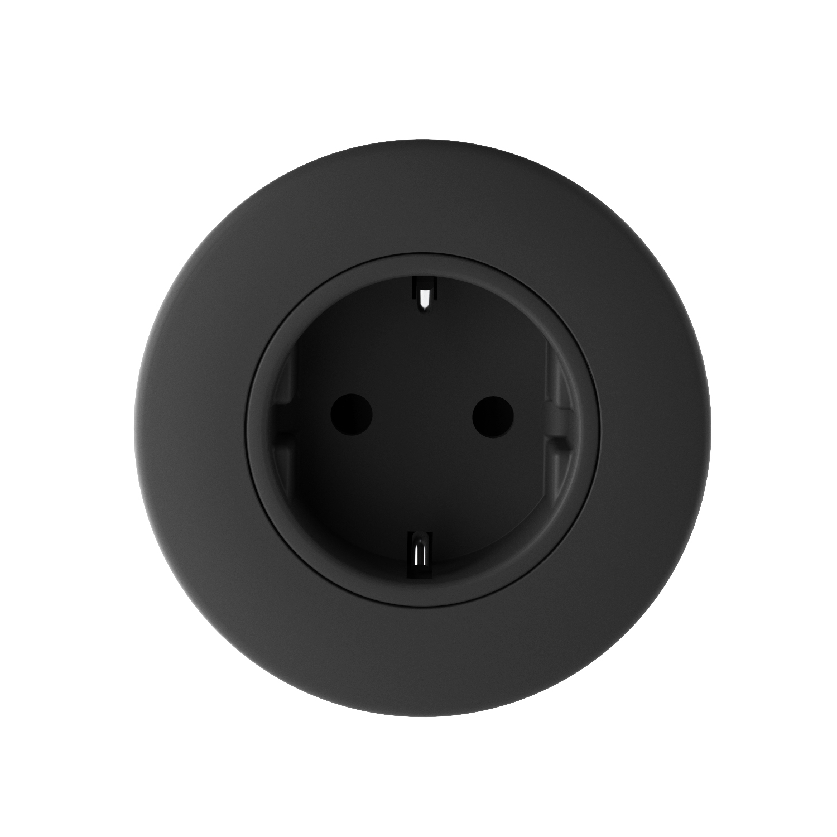
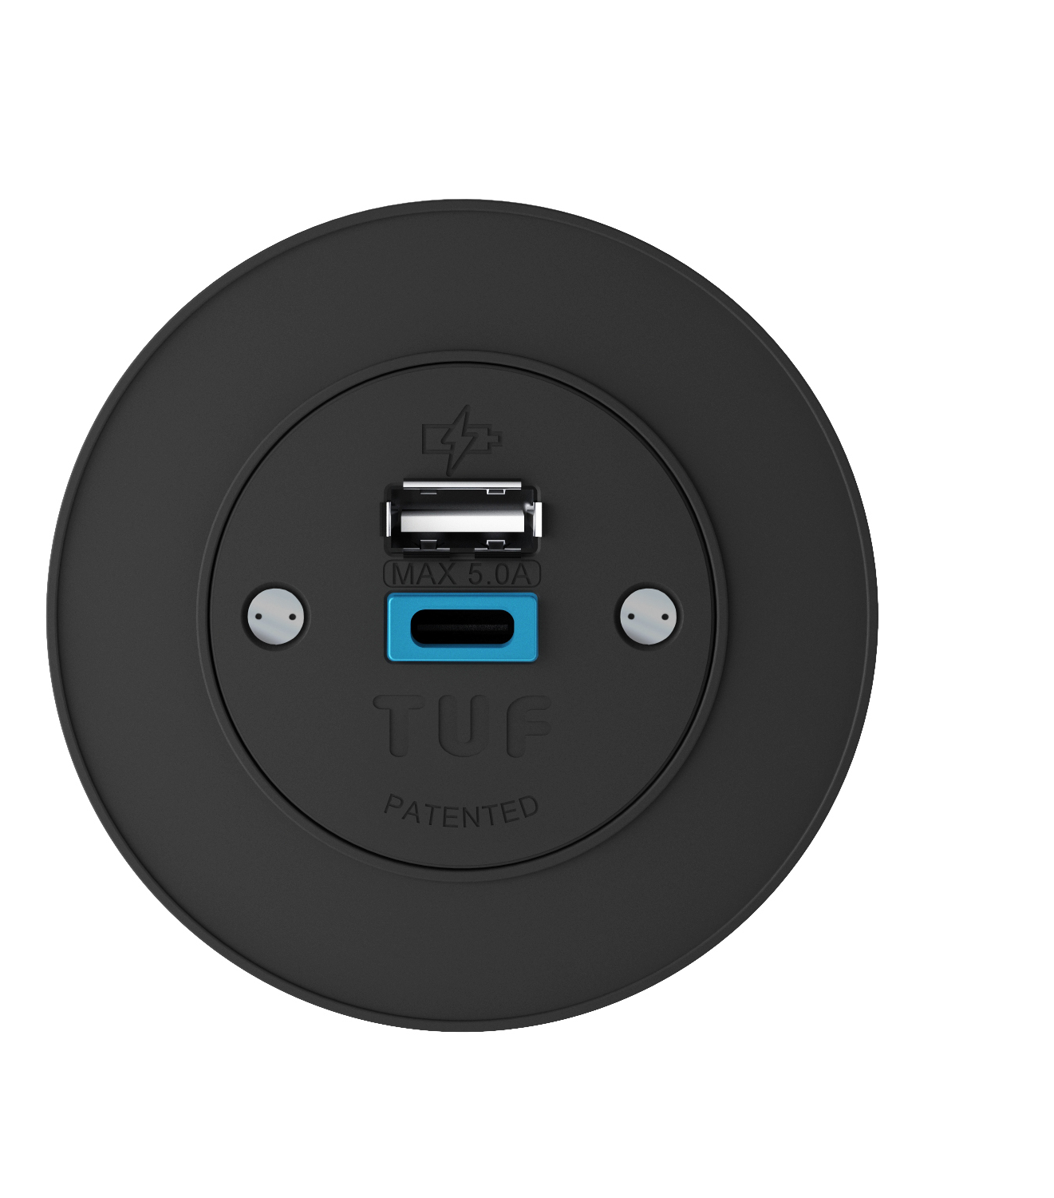
Always “connected”
To meet your need for constant connectivity, the low and high armrests offer the following in-built features:
power sockets;
fast charging USB ports.
Notes:
Technology is an integral part of modern living. In order to meet your need for constant connectivity or, in other words, your need to always remain “connected”, the armrests of the SOFT ROCK furniture have in-built power sockets or fast charging USB (Type A+C) ports. SOFT ROCK lounge seating furniture offers its users a convenient way of charging their mobile phones, laptops or other smart devices.

Slide 17
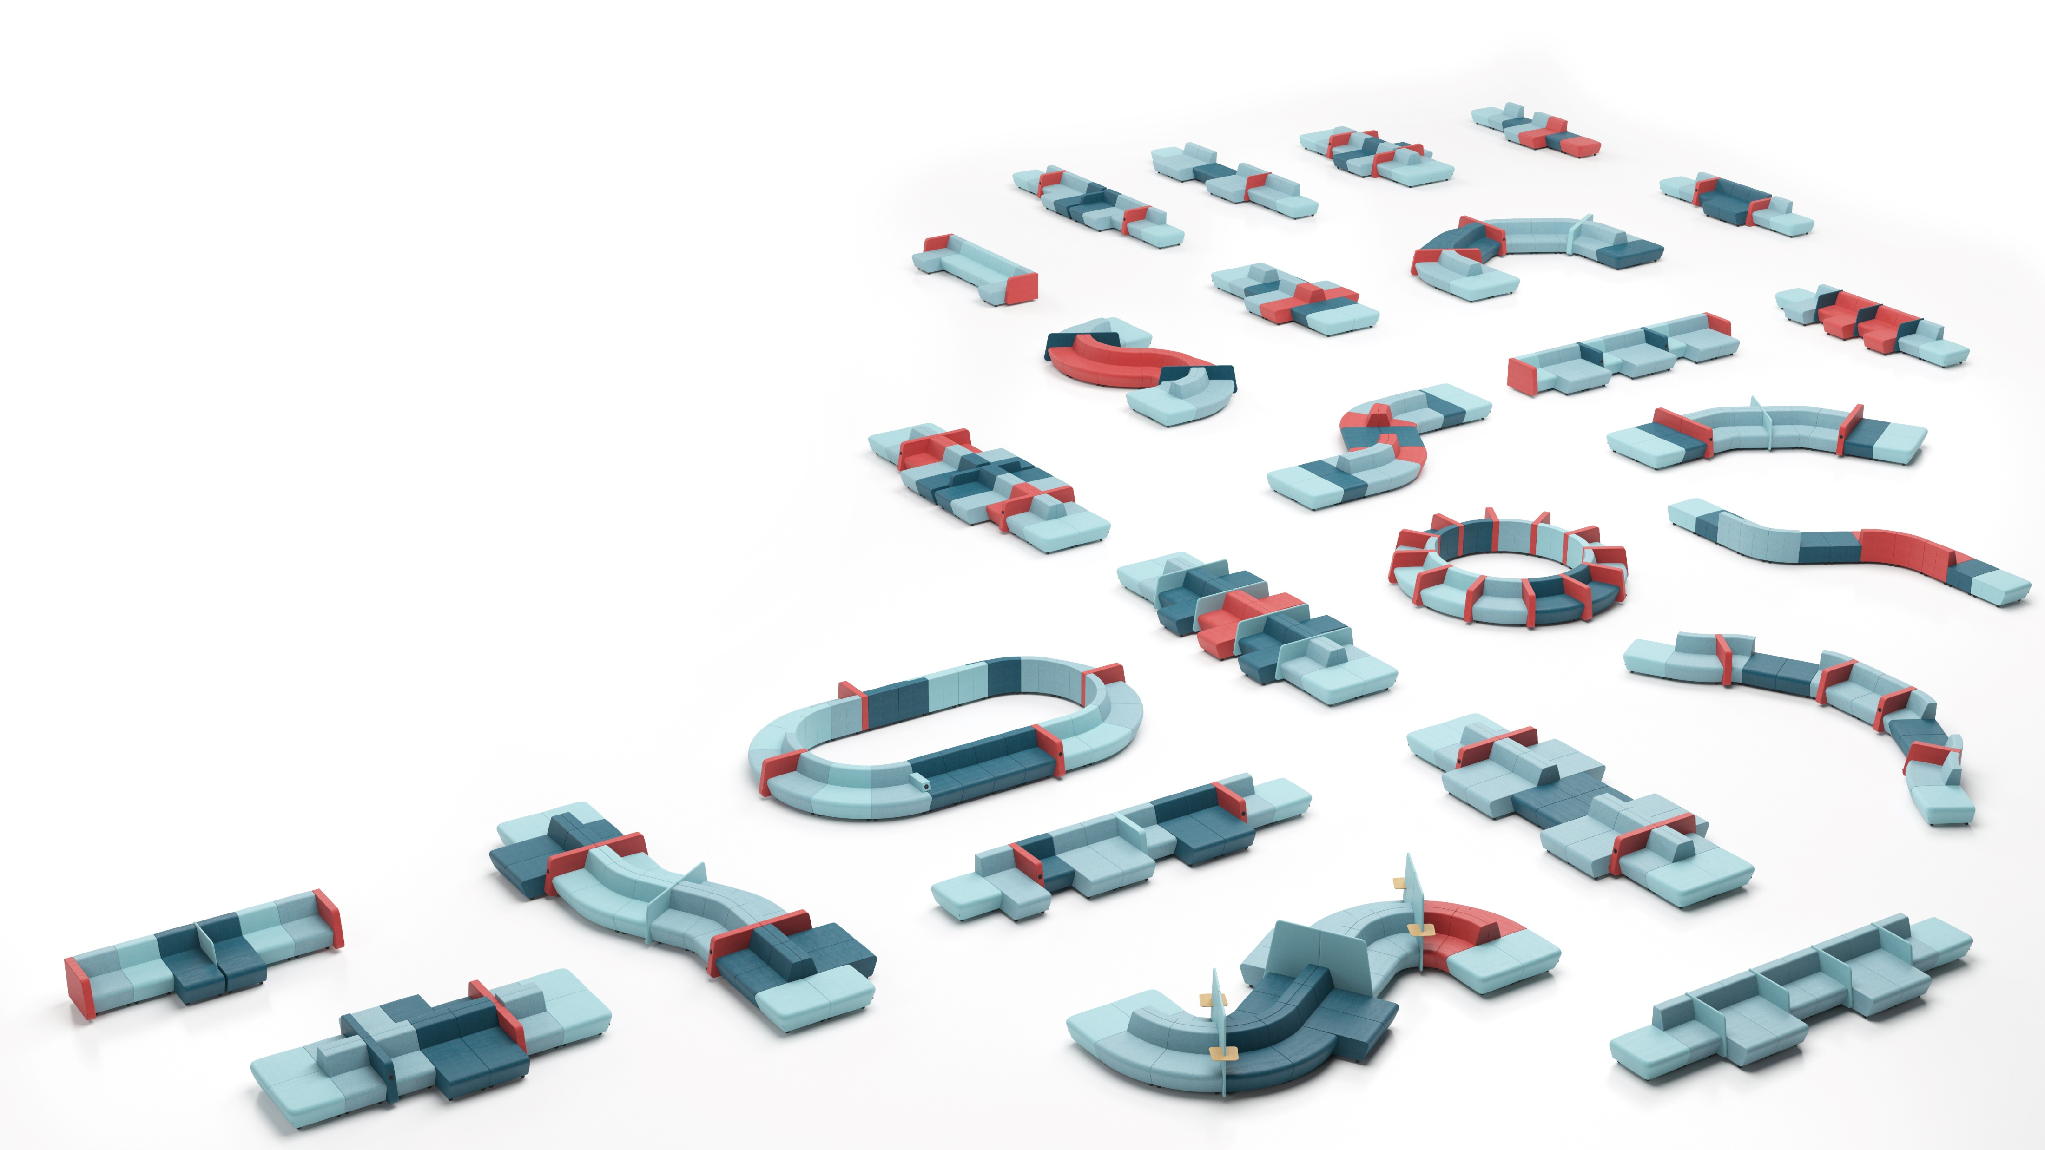
Wide range of applications
SOFT ROCK lounge seating system can be easily adapted to individual needs and building architecture. Create comfortable spaces for collaboration, meetings, face-to-face interactions, training, concentration or relaxation.
Notes:
SOFT ROCK lounge seating system has been designed so that it could be easily adapted to individual needs and building architecture. SOFT ROCK can either be a traditional sofa suitable for small spaces or a sprawling “island” which requires a larger space. This lounge seating system helps you create comfortable spaces for collaboration, meetings, face-to-face interactions, training, concentration or relaxation.
Thanks to its versatility, SOFT ROCK lounge seater can be easily adapted to the offices with Activity-Based Working arrangements. This principle allows you to better meet the different needs of employees, ensure diversity in decision making required for successful work and helps promote greater involvement of employees in workplace activities while at the same time enhancing their sense of enjoyment at work.

Slide 18
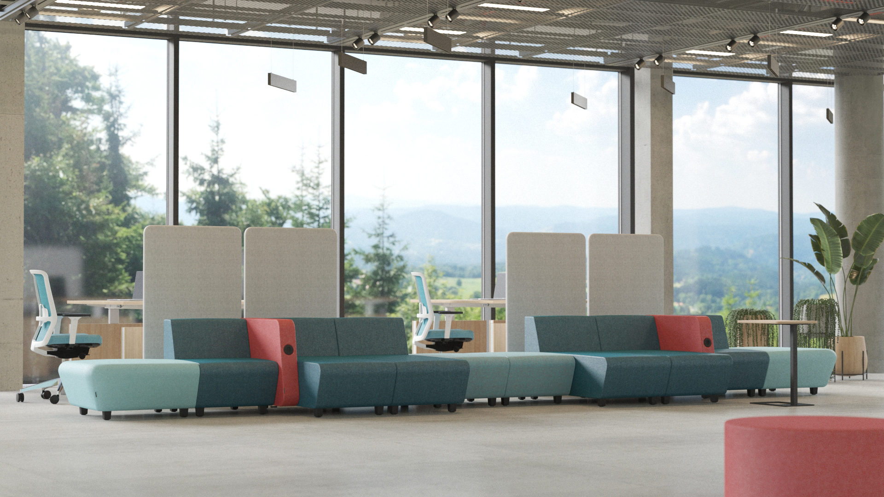
A collaboration space
Notes:
A collaboration space. Ideal for all active collaborative activities. Open formations arranged in spaces of varying sizes ensuring uninterrupted communication. The seating formations offer a convenient place for employees to sit down, even if just for a short period of time, while simultaneously allowing them to connect presentation equipment or charge their laptops. This type of space is often used for creative workshops involving the use of display screens, magnetic boards or whiteboards.

Slide 19
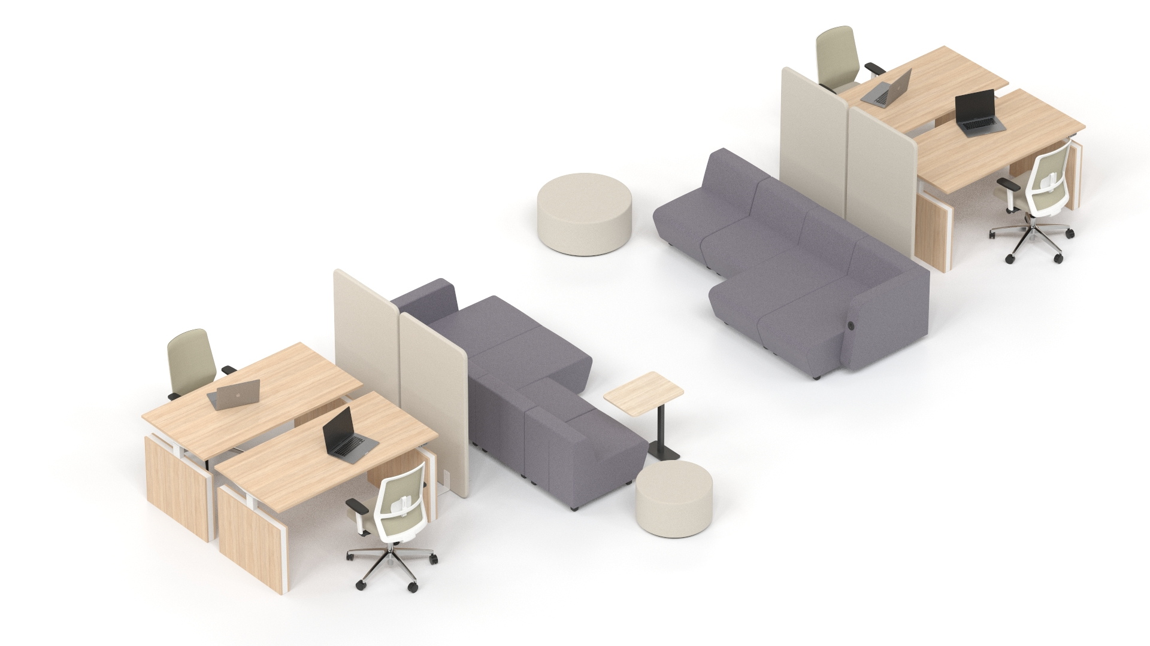
A collaboration space
Notes:
A small, low, open-plan lounge island arranged in the passage ways between the workstations is perfect for the face-to-face interactions of colleagues working in close proximity. The lounge seating can come with a small table (or tables) or can be easily combined with other lounge systems of a matching height, e. g. GIRO.
A single-sided composition with a standard seat depth or an extra deep seat version with the backrests placed against the cabinets close to the workstations helps to create a small and cosy lounge perimeter visually separated from the work area. You can also choose low coffee tables or individual seating lounge units to complement your seating arrangement.
The composition designed for creative workshops has an axial arrangement of a free-standing display screen or magnetic board / whiteboard. The seating is arranged in a spacious semi-circle with its backrests placed against high tables and high chairs to form a provisional platform, or a second seating level. The area close to the display screen can feature additional low lounge furniture and coffee tables.

Slide 20
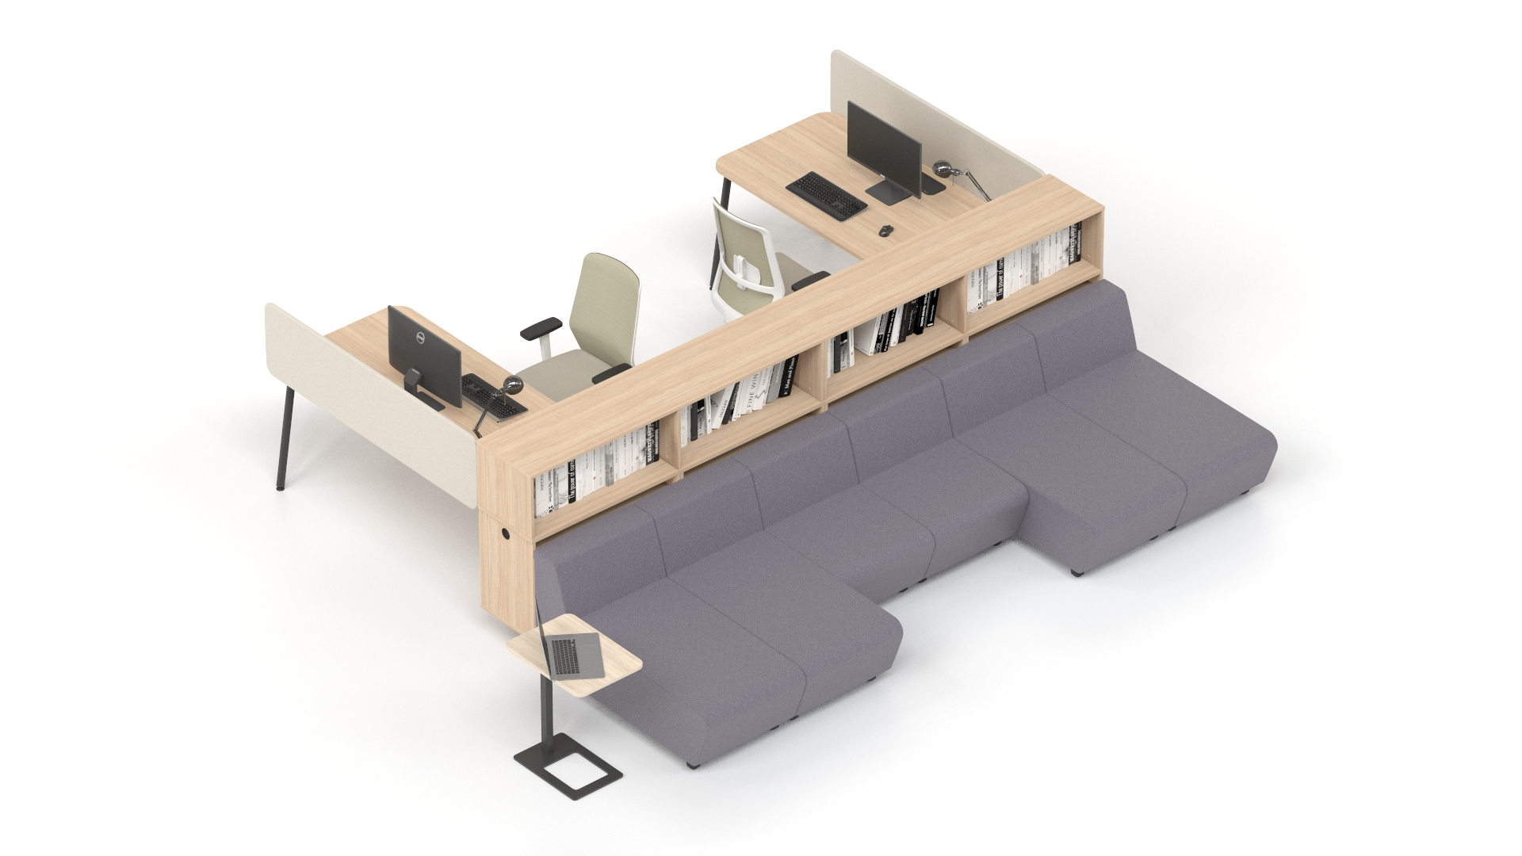
A collaboration space
Notes:
A small, low, open-plan lounge island arranged in the passage ways between the workstations is perfect for the face-to-face interactions of colleagues working in close proximity. The lounge seating can come with a small table (or tables) or can be easily combined with other lounge systems of a matching height, e. g. GIRO.
A single-sided composition with a standard seat depth or an extra deep seat version with the backrests placed against the cabinets close to the workstations helps to create a small and cosy lounge perimeter visually separated from the work area. You can also choose low coffee tables or individual seating lounge units to complement your seating arrangement.
The composition designed for creative workshops has an axial arrangement of a free-standing display screen or magnetic board / whiteboard. The seating is arranged in a spacious semi-circle with its backrests placed against high tables and high chairs to form a provisional platform, or a second seating level. The area close to the display screen can feature additional low lounge furniture and coffee tables.

Slide 21
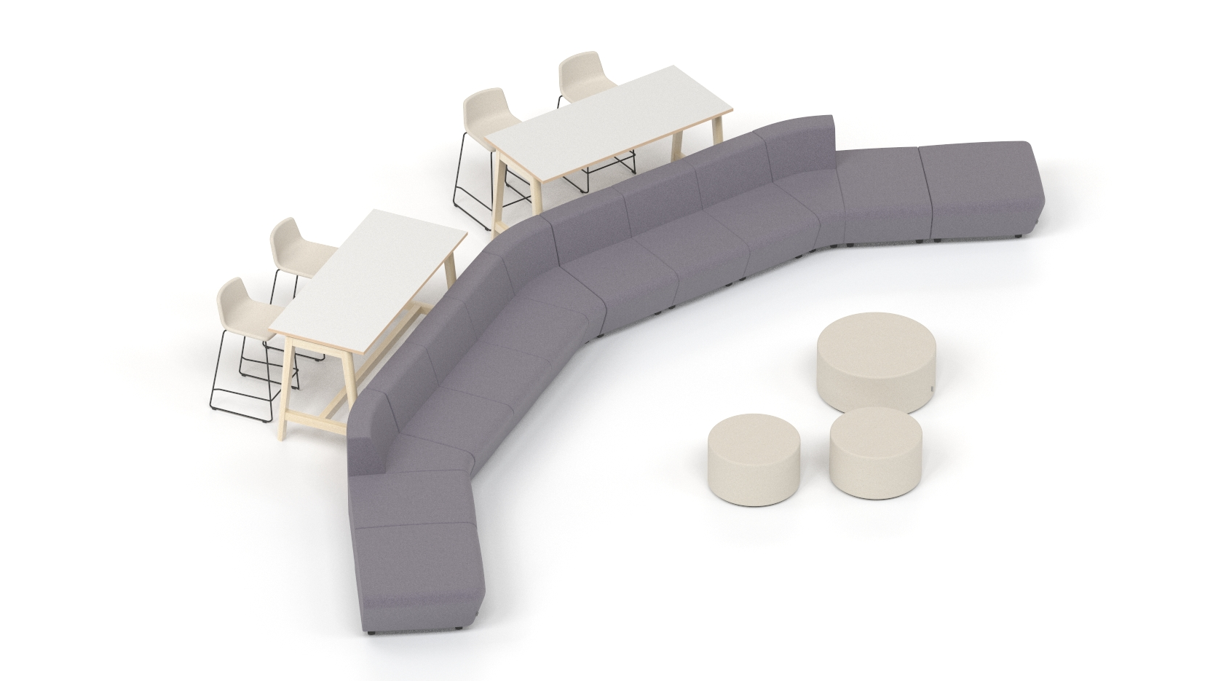
A collaboration space
Notes:
A small, low, open-plan lounge island arranged in the passage ways between the workstations is perfect for the face-to-face interactions of colleagues working in close proximity. The lounge seating can come with a small table (or tables) or can be easily combined with other lounge systems of a matching height, e. g. GIRO.
A single-sided composition with a standard seat depth or an extra deep seat version with the backrests placed against the cabinets close to the workstations helps to create a small and cosy lounge perimeter visually separated from the work area. You can also choose low coffee tables or individual seating lounge units to complement your seating arrangement.
The composition designed for creative workshops has an axial arrangement of a free-standing display screen or magnetic board / whiteboard. The seating is arranged in a spacious semi-circle with its backrests placed against high tables and high chairs to form a provisional platform, or a second seating level. The area close to the display screen can feature additional low lounge furniture and coffee tables.

Slide 22
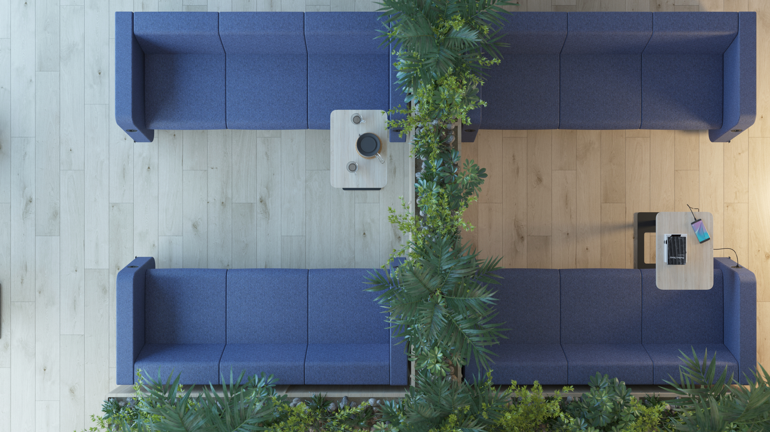
A meeting space
Notes:
A meeting space. Traditional meeting spaces are ideal both for one-on-one interactions between two people or for meeting up with a large team for discussions. Large or small, open or private, formal or relaxing, with round or rectangular tables, with upholstered armchairs or minimalist visitor chairs.

Slide 23
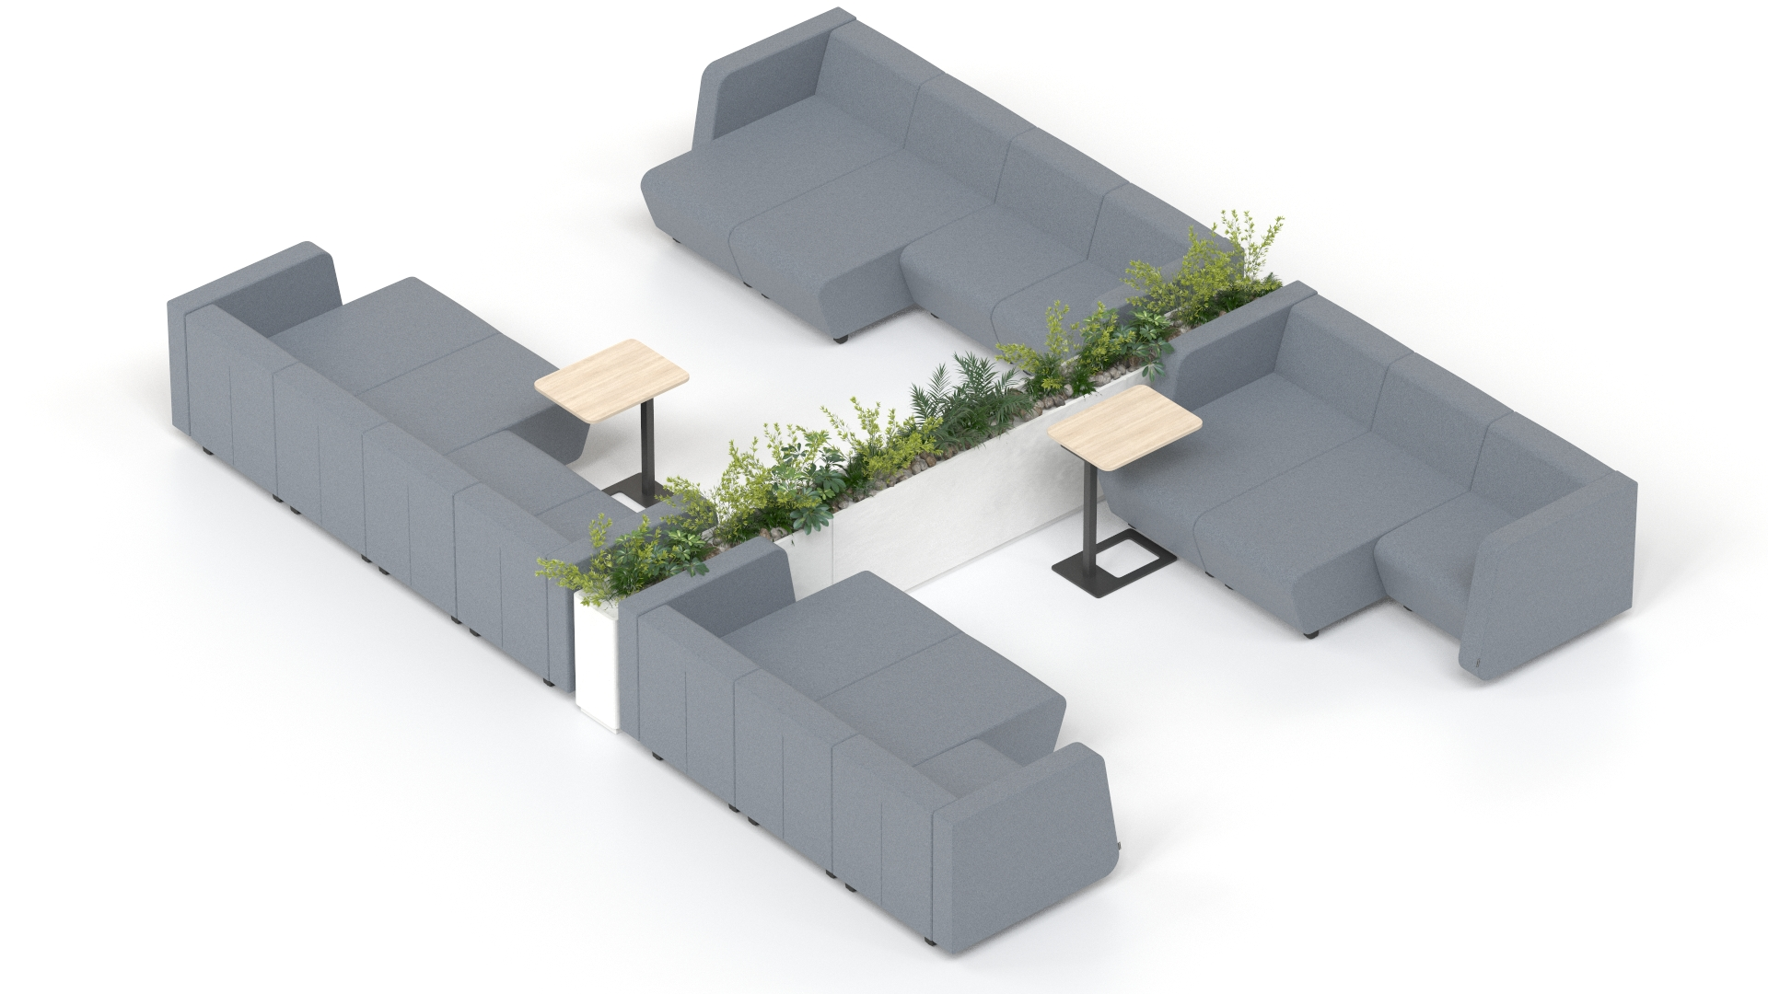
A meeting space
Notes:
The compositions with standard seat depth and high screens are oriented so as to face one another to form an enclosed small meeting space visually separated from the surrounding environment and accommodating 2 to 4 people. Increase the number of seats, combine a standard seat depth modules with extra deep versions, insert additional tables and use plants or other compositions in between the gaps to create additional meeting space configurations providing a different level of privacy and relaxing atmosphere and a capacity suited for 2 to 4 or 4 to 6 people.
A spacious C-shaped arch-type arrangement accommodating a large low table (or several smaller tables) in the centre. Free-standing screens in the back of the arch arrangement ensure a greater level of privacy and adds a sense of warmth. Additional pieces of lounge furniture can be added to the open-ended arch configuration.

Slide 24
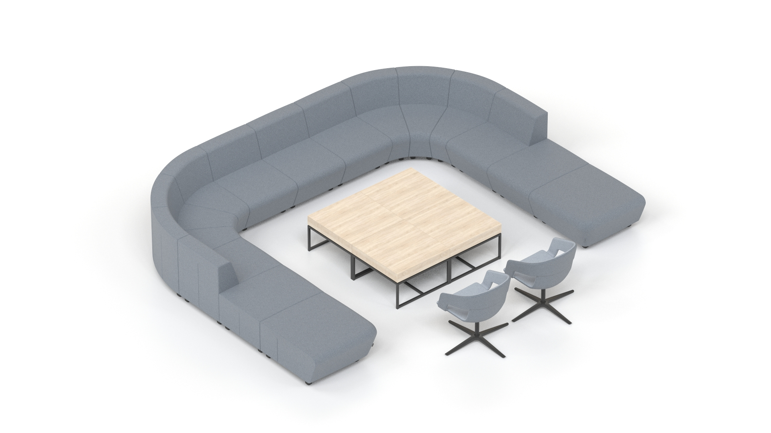
A meeting space
Notes:
The compositions with standard seat depth and high screens are oriented so as to face one another to form an enclosed small meeting space visually separated from the surrounding environment and accommodating 2 to 4 people. Increase the number of seats, combine a standard seat depth modules with extra deep versions, insert additional tables and use plants or other compositions in between the gaps to create additional meeting space configurations providing a different level of privacy and relaxing atmosphere and a capacity suited for 2 to 4 or 4 to 6 people.
A spacious C-shaped arch-type arrangement accommodating a large low table (or several smaller tables) in the centre. Free-standing screens in the back of the arch arrangement ensure a greater level of privacy and adds a sense of warmth. Additional pieces of lounge furniture can be added to the open-ended arch configuration.

Slide 25
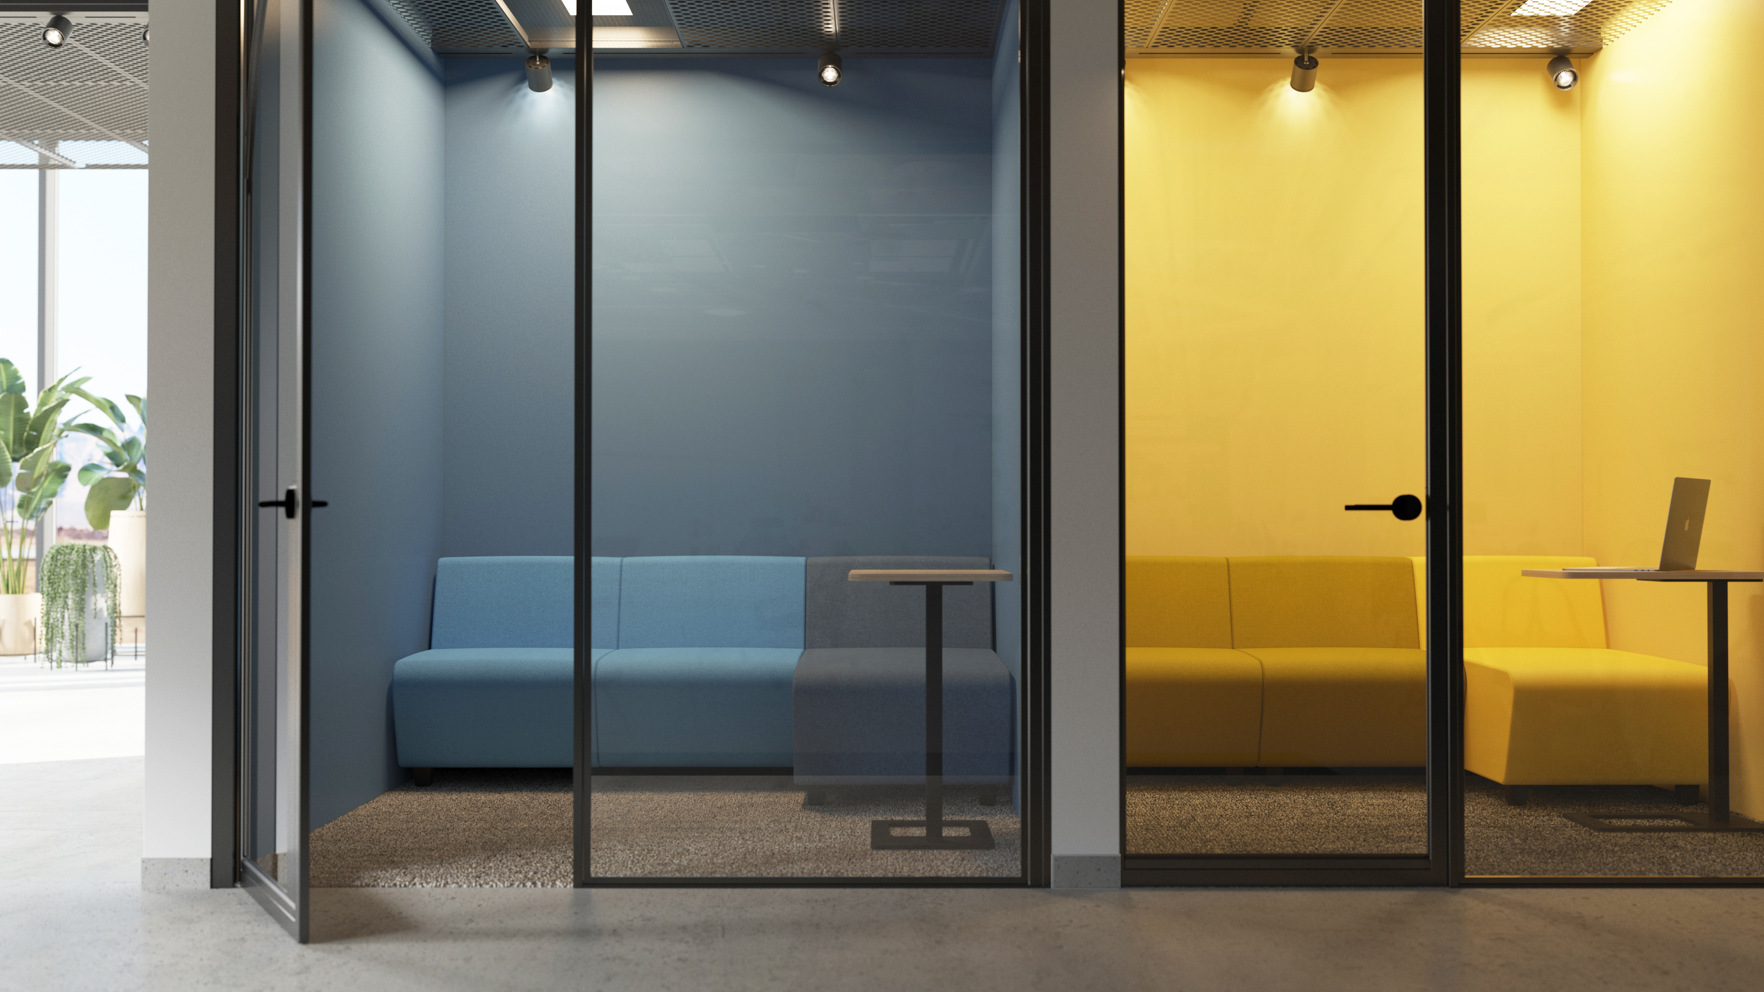
A quiet space for concentration and individual relaxation
Notes:
A quiet space for focused work. Designed for all kinds of individual activities: working on your computer, having phone conversations in isolated booths, enjoying an oasis of silence in cosy quiet zones with comfortable soft seating for a nice coffee break, unassigned workplaces for temporary work.

Slide 26
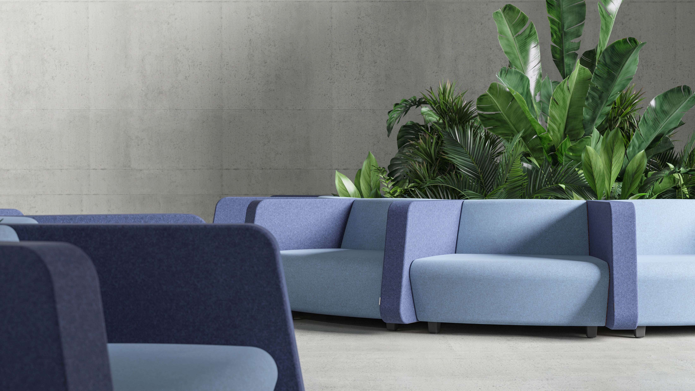
A quiet space for concentration and individual relaxation
Notes:
The arrangement consisting of a closed outward circle is ideal for short-term sitting or for carrying out small individual tasks that required a semi-enclosed work space. One seat uses two modules and the seats are separated by high screens. The central part accommodates a plant composition or other sort of composition for space decoration.
Closed box-type niches enclosed with a glass structure guarantee full protection of the work or relaxation area against background noise. Standard seat depth can be combined with extra deep seat version. Also, they can be complemented with a small table. To further enhance the relaxing atmosphere of the space, optional acoustic wall/ceiling panels and lighting of a desired colour temperature and intensity can be used.

Slide 27
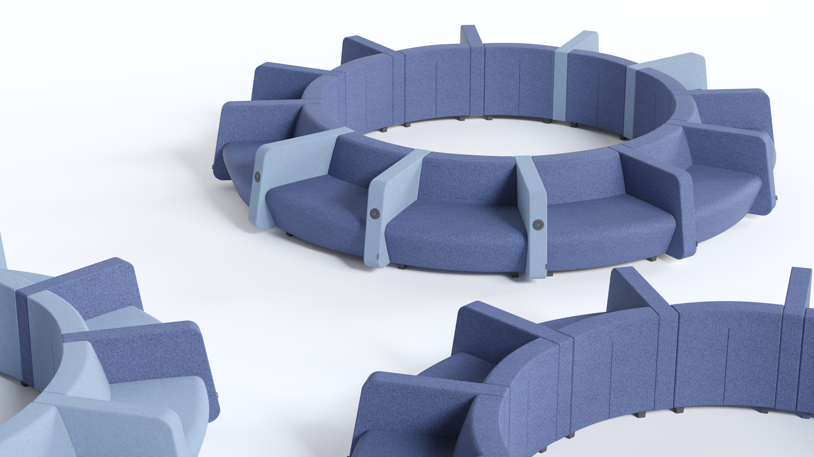
A quiet space for concentration and individual relaxation
Notes:
The arrangement consisting of a closed outward circle is ideal for short-term sitting or for carrying out small individual tasks that required a semi-enclosed work space. One seat uses two modules and the seats are separated by high screens. The central part accommodates a plant composition or other sort of composition for space decoration.
Closed box-type niches enclosed with a glass structure guarantee full protection of the work or relaxation area against background noise. Standard seat depth can be combined with extra deep seat version. Also, they can be complemented with a small table. To further enhance the relaxing atmosphere of the space, optional acoustic wall/ceiling panels and lighting of a desired colour temperature and intensity can be used.

Slide 28
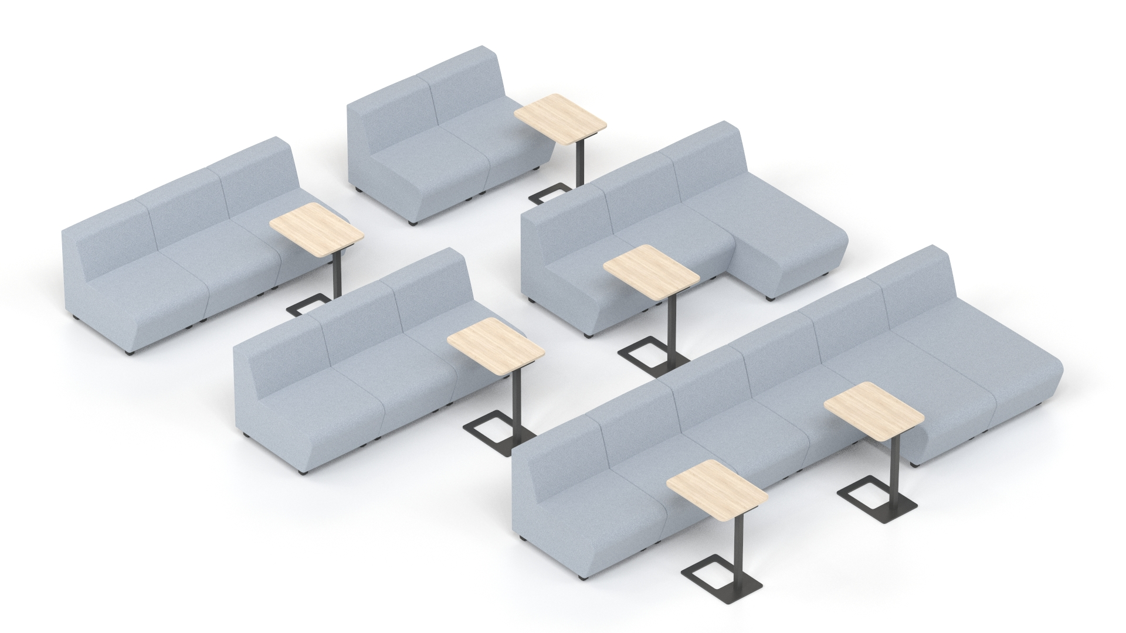
A training space
Notes:
A training space. Auditorium, amphitheatre or other space types suitable for public seminars, conferences or internal training sessions as well as corporate events. Large, open and convertible spaces, for example, an amphitheatre can at the same time serve as an auditorium and a large lounge area.
A large, open space within the office is primarily designed for face-to-face interactions or relaxation but can also be used for internal corporate events, training sessions, presentations, etc. Wide, stepped terraces have sufficient space to accommodate small lounge perimeters along with other low furnishings to create individual zones for separate groups of people, at the same time orienting them in the same direction so that they face the presenter or a display screen.

Slide 29
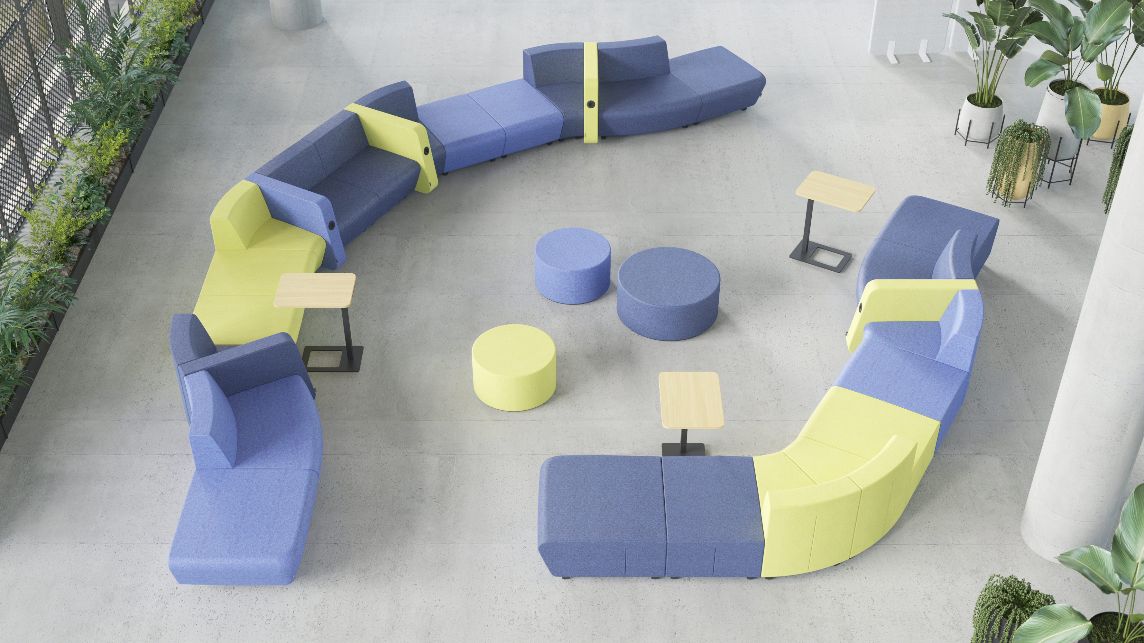
A relaxation space
Notes:
A relaxation space. Lounge areas, relaxation and play areas, cafés, small spaces within niches that can serve as coffee-points, open lounge islands and cosy one-person sheltered seating. All kinds of activities involves non-formal interactions or relaxation.

Slide 30
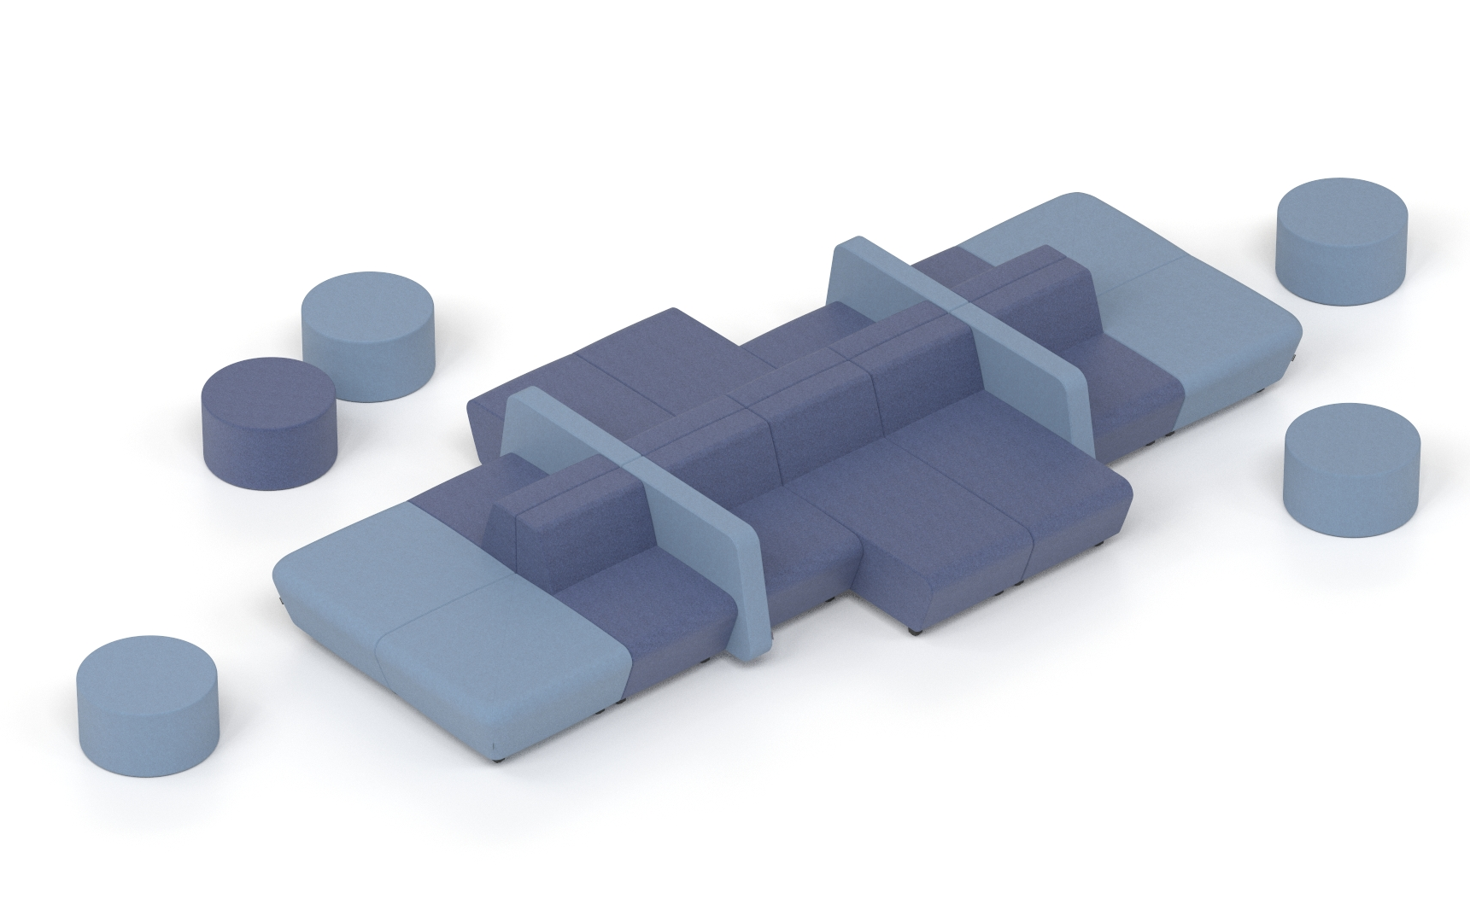
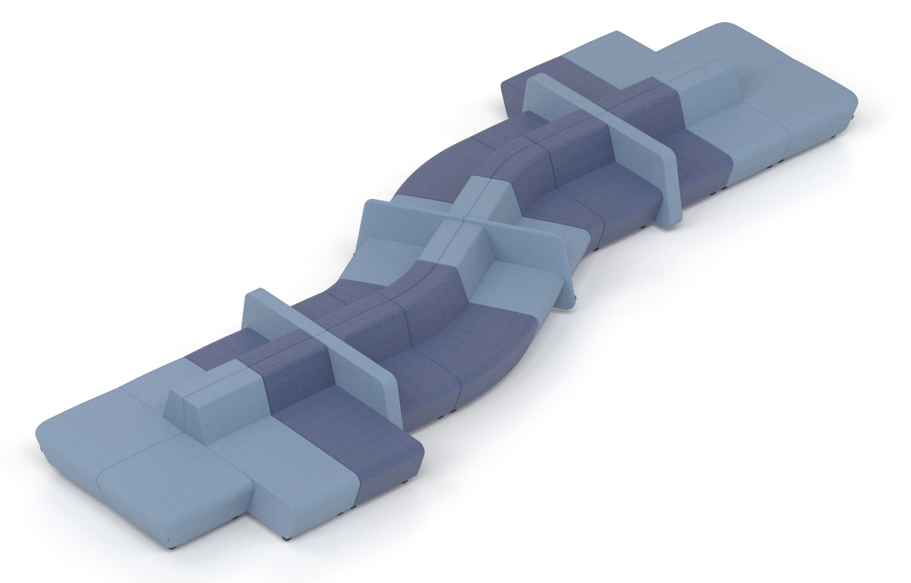
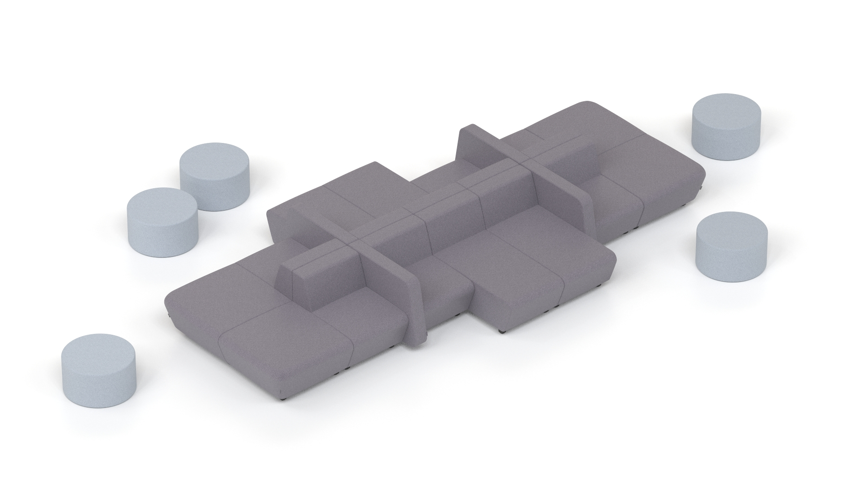
A relaxation space – islands
Notes:
The largest and broadest category of spaces is very conducive to making the most of countless combination options of the SOFT ROCK furniture. Large and expressive compositions accommodating the whole range of possible configurations within office lounge areas, lobbies, anterooms, atriums or other types of public spaces are ideal for short-term seating, temporary work, relaxation or face-to-face interactions. Single-sided, double-sided, symmetrical or completely irregular compositions can be additionally combined with other lounge systems or coffee tables.

Slide 31
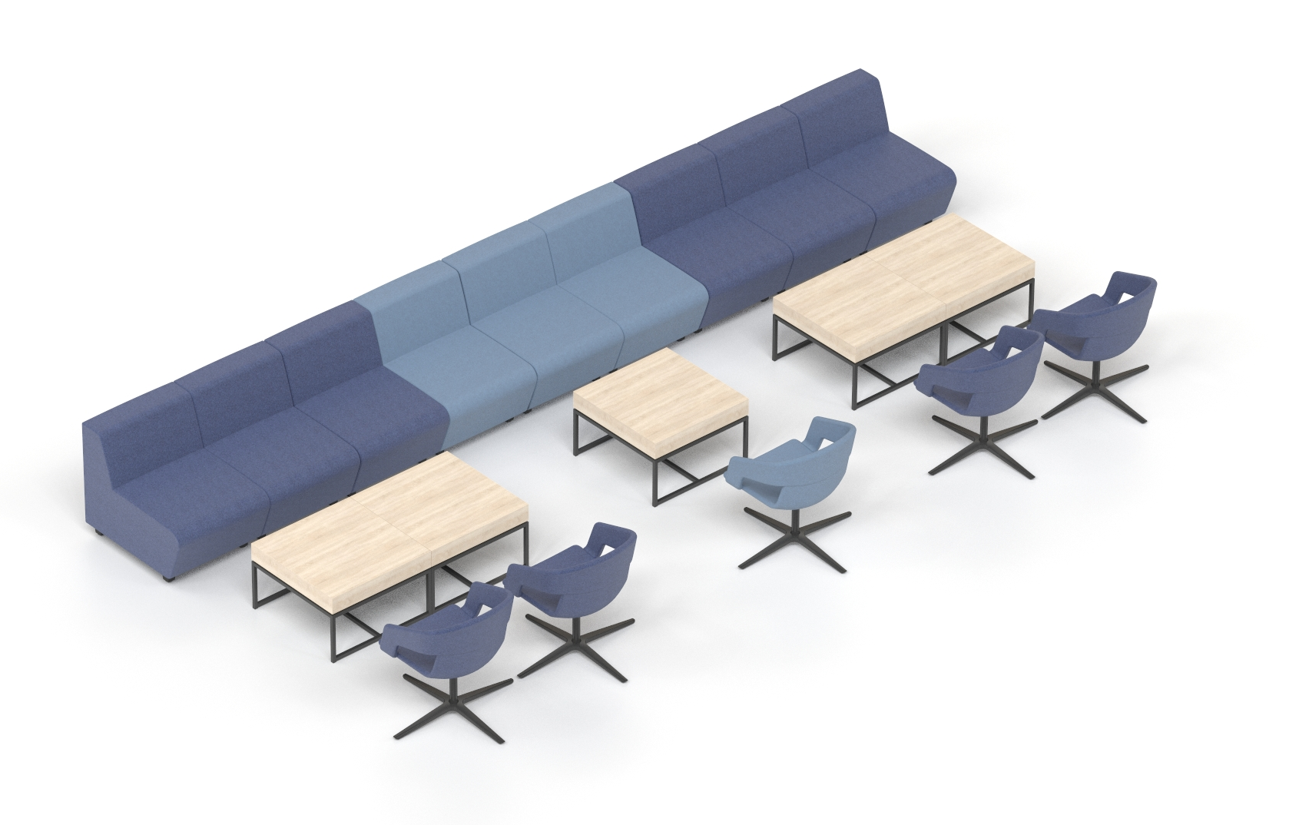
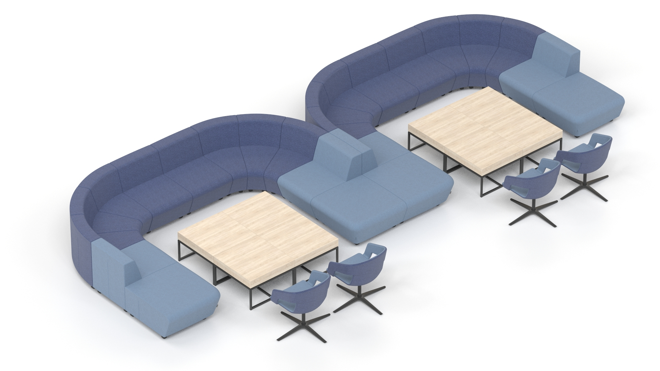
A relaxation space – cafés
Notes:
Lounge compositions ideally suited for café spaces. The common characteristic of these compositions is the possibility to extend the sitting perimeter and to adapt it to the room configuration. Curved seats of standard depth are combined to form straight, curved and semi-enclosed seating which is complemented with tables of varying heights and sizes as well other individual seating lounge furniture from other systems.

Slide 32
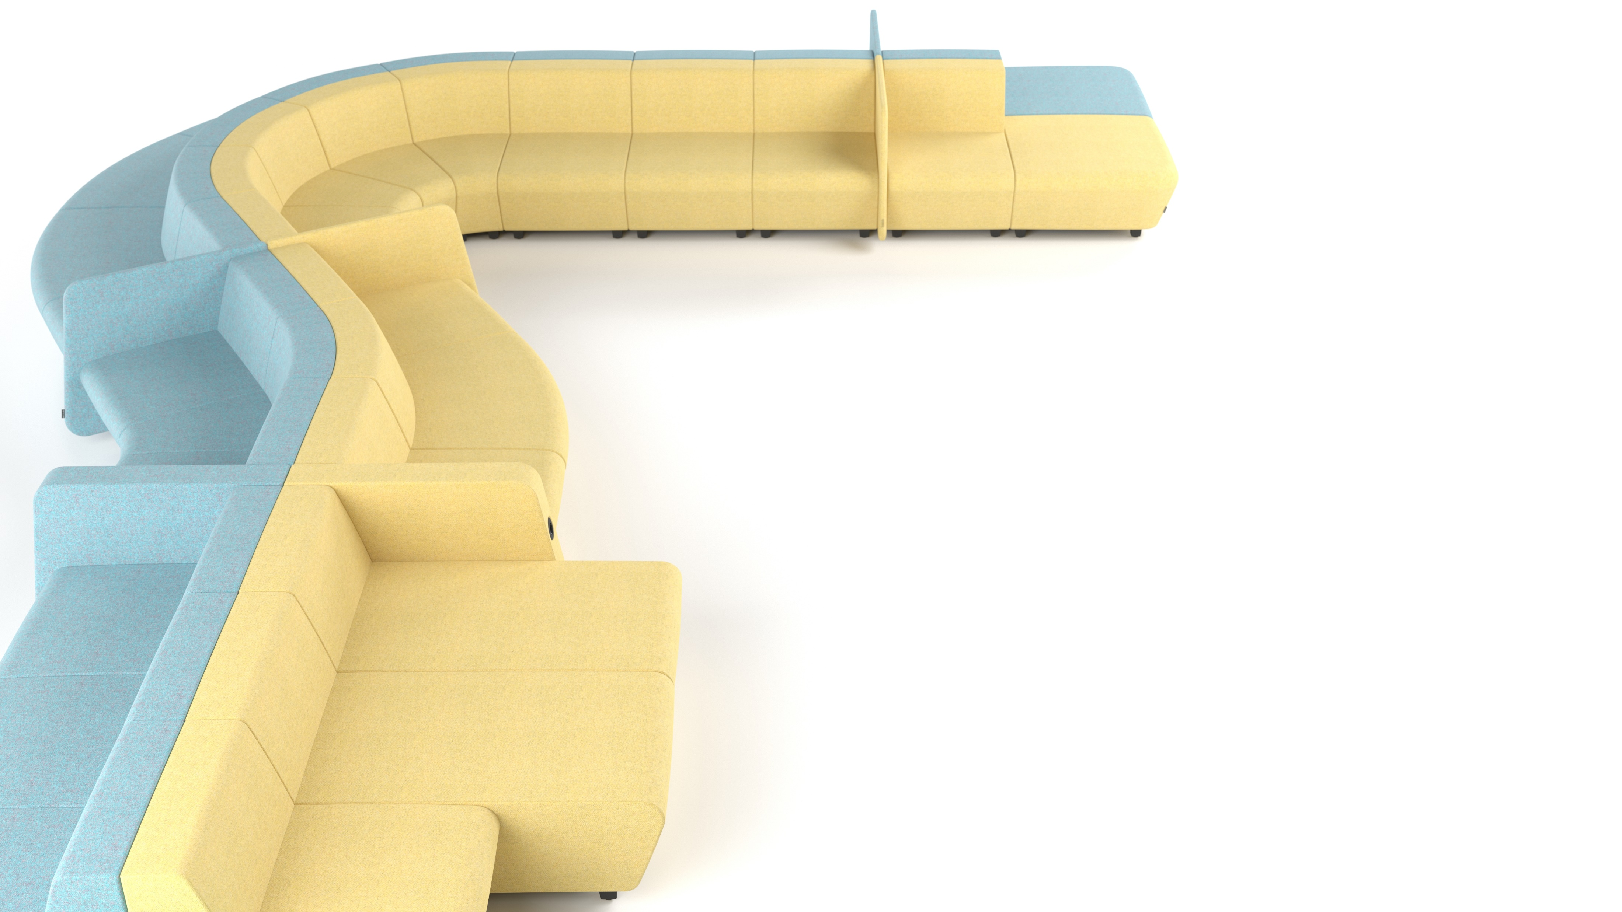
Colours with function
Different module colours not only offer great options to create unique combinations, but also allow you to visually define and separate spaces within the boundaries of the lounger seater.
Notes:
Each module of the lounge seating unit can have a different colour. This not only offers great options to create unique combinations suitable for a variety of different interiors but also enables you to visually define and separate spaces within the boundaries of the lounger seater.

Slide 33
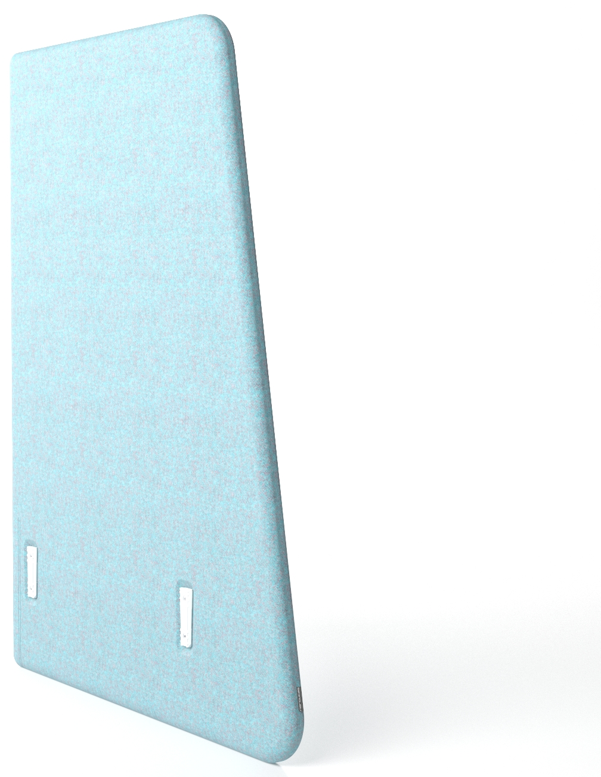
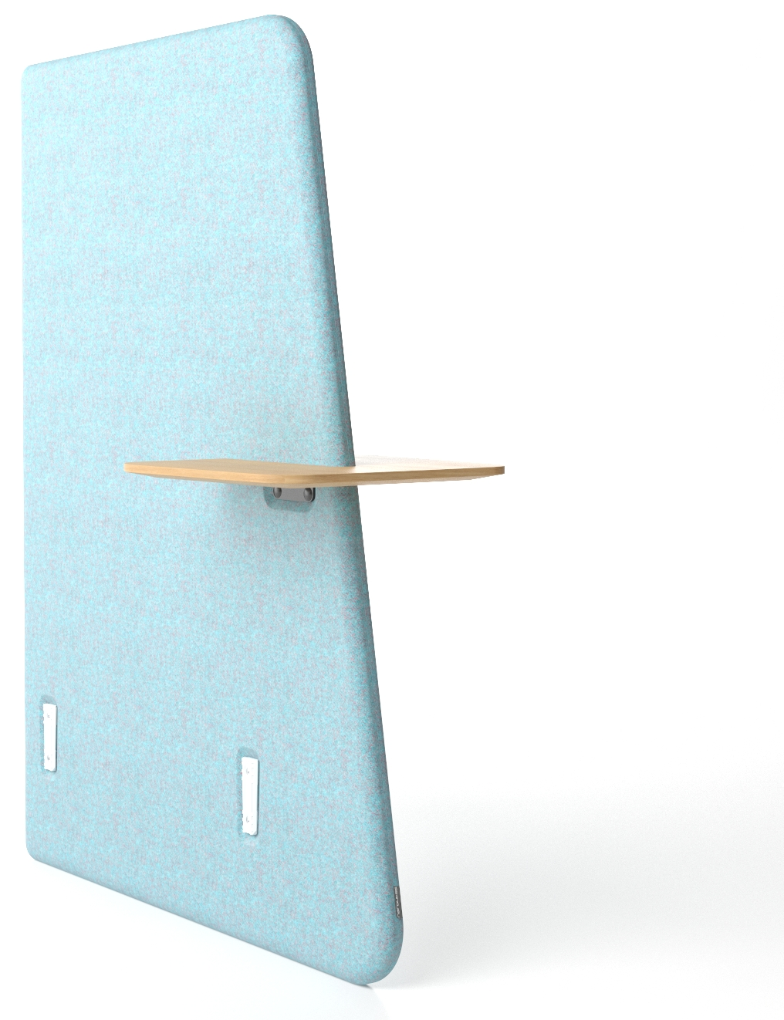
Range
Main modules
Lounge seater
Lounge seater with a backrest
Long lounge seater with a backrest
Corner lounge seater (90°)
Curved lounge seater with a backrest (+30°)
Curved lounge seater with a backrest (-30°)
Armrests
Armrest with metal base
Armrest with metal base and 1 USB fast charger (type A+C) or a power socket
Side armrest (R/H, L/H, centred)
Side armrest (R/H, L/H, centred) with 1 USB fast charger (type A+C) or a power socket
Screens
Low screen (R/H, L/H, centred)
High screen (R/H, L/H, centred)
Central screen with a plywood table

Slide 34
